Slide 1
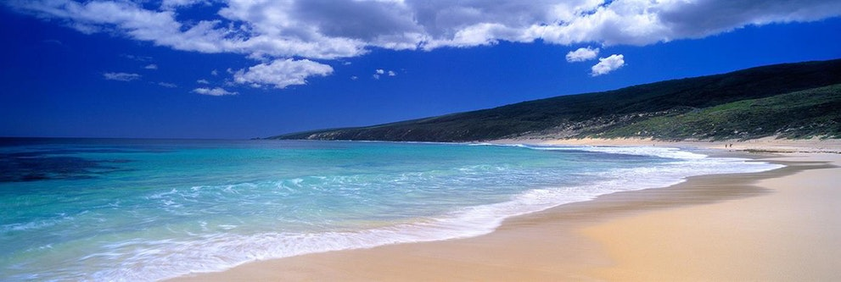
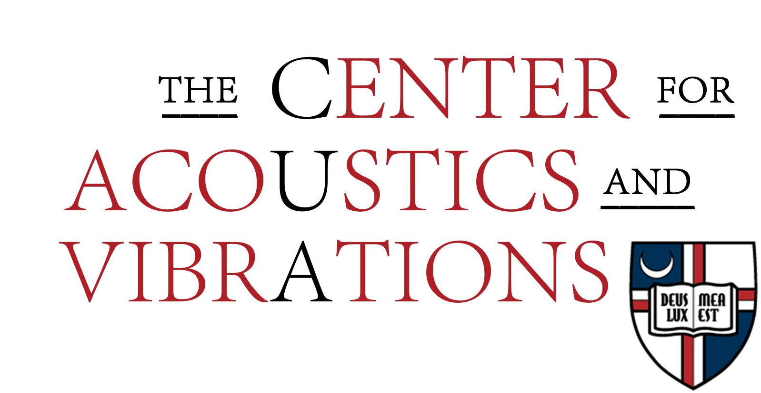
Long Range Acoustic Transmission Loss Under Varying Atmospheric and Terrain Conditions
Teresa Ryan
Work Supported by
ONR Award N00014-15-1-2512(2015-2016) ECU $14k
ONR Award N00014-17-1-2213 (2017-2022) ECU $141k
ONR Award N00014-20-1-2034 (2020-2022) $370k
ONR DURIP N00014-21-1-2930 (2021-2022) $339k
ONR Award N00014-xx-1-xxxx (CUA) (2021-2024)
ONR Award N00014-22-1-2492 (2022-2025) $334k
Cumulative Total via ONR $1.2M

Slide 2
Long Range Acoustic Transmission Loss Under Varying Atmospheric and Terrain Conditions
Teresa Ryan

Slide 3
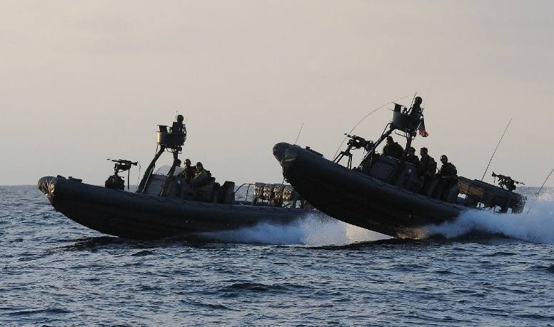
Long Range Acoustic Transmission Loss Under Varying Atmospheric and Terrain Conditions
Teresa Ryan

Slide 4
Long Range Acoustic Transmission Loss Under Varying Atmospheric and Terrain Conditions
Teresa Ryan

Slide 5
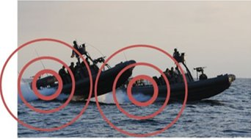
What matters?
Parameters influencing atmospheric acoustic propagation:
Wind speed and direction
Humidity
Temperature profile
Sea state
Shore topography
Acoustic surface impedance

Slide 6
SPL at receiver
Source level
Atmospheric absorption
SPL relative to free field propagation
Spherical
spreading
Notes:
SPL relative to free field propagation , also called excess attenuation

Slide 7
SPL re: FF (excess attenuation)
$$∆L=f\left(refraction,sea, shore, turbulence\right)$$
Due to the wind and temperature profile: function of meteorological data
Due to the shore type and length: function of geological data
Due to the geometry of the sea surface: function of meteorological data
Notes:
And turbolence

Slide 8
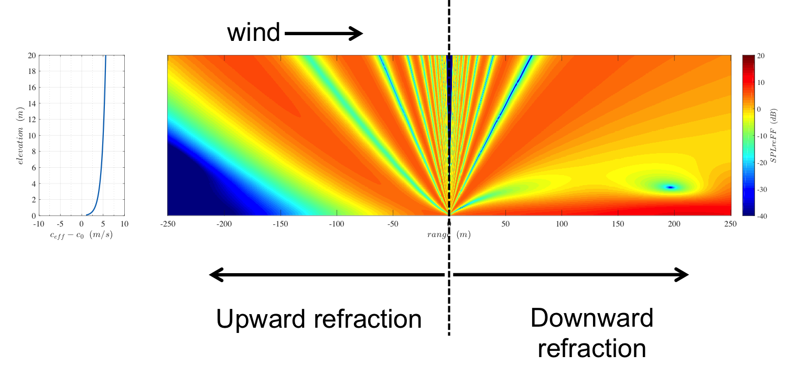

Slide 18
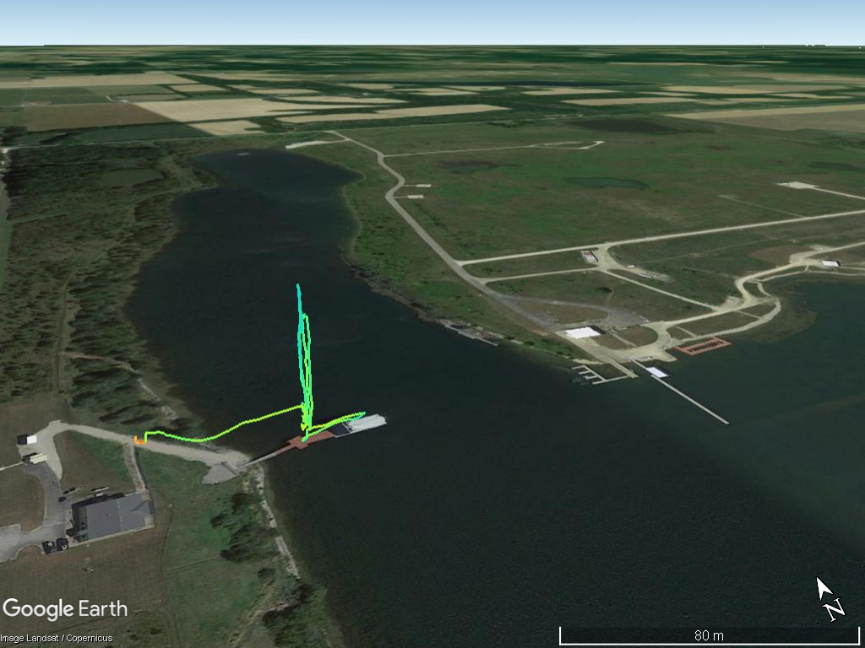
UAV-Temperature Profiles

Slide 19
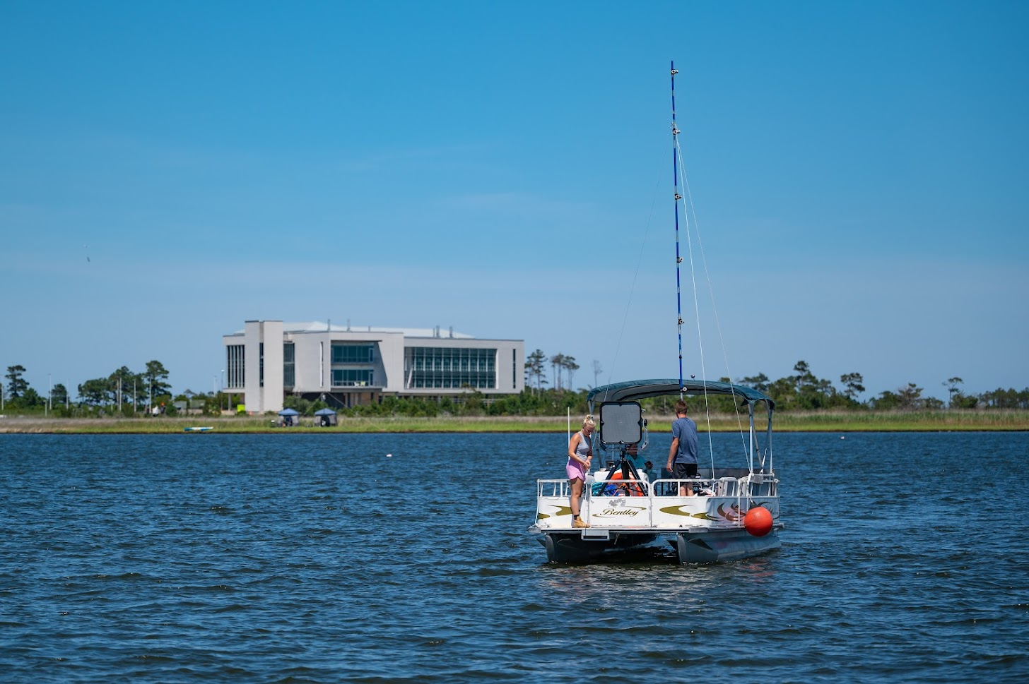

Slide 20
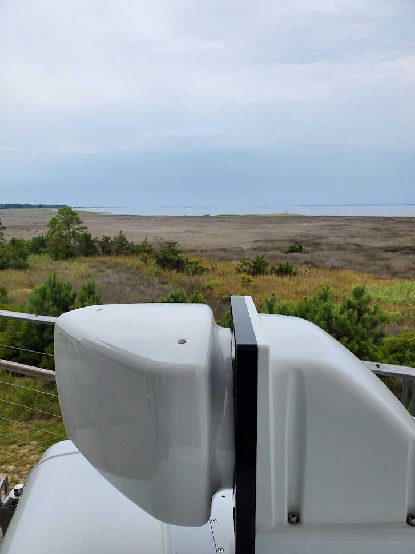

Slide 21
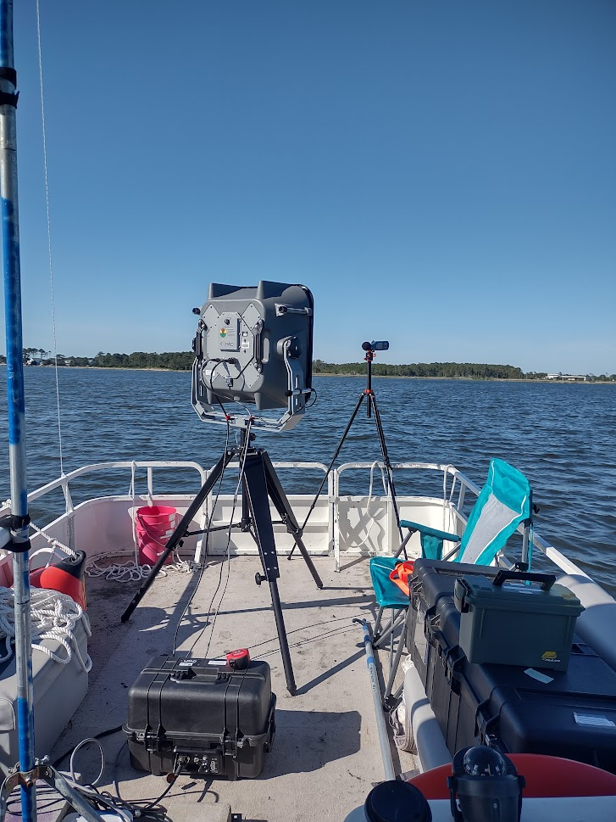
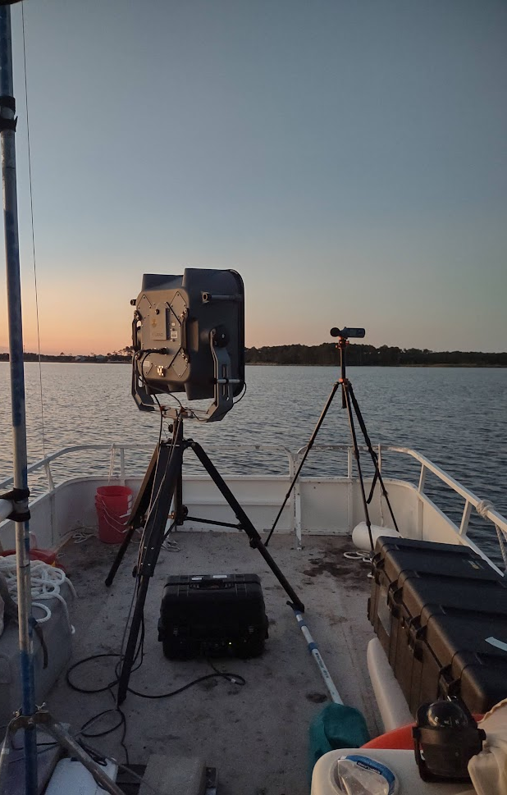

Slide 22
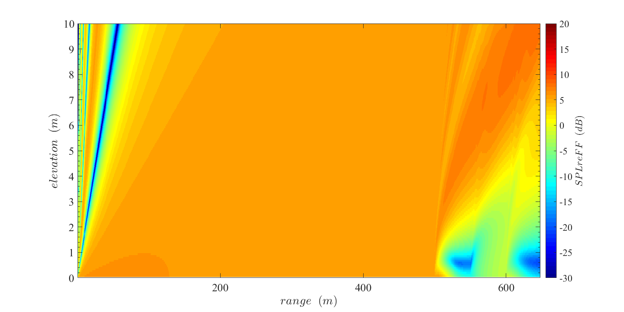
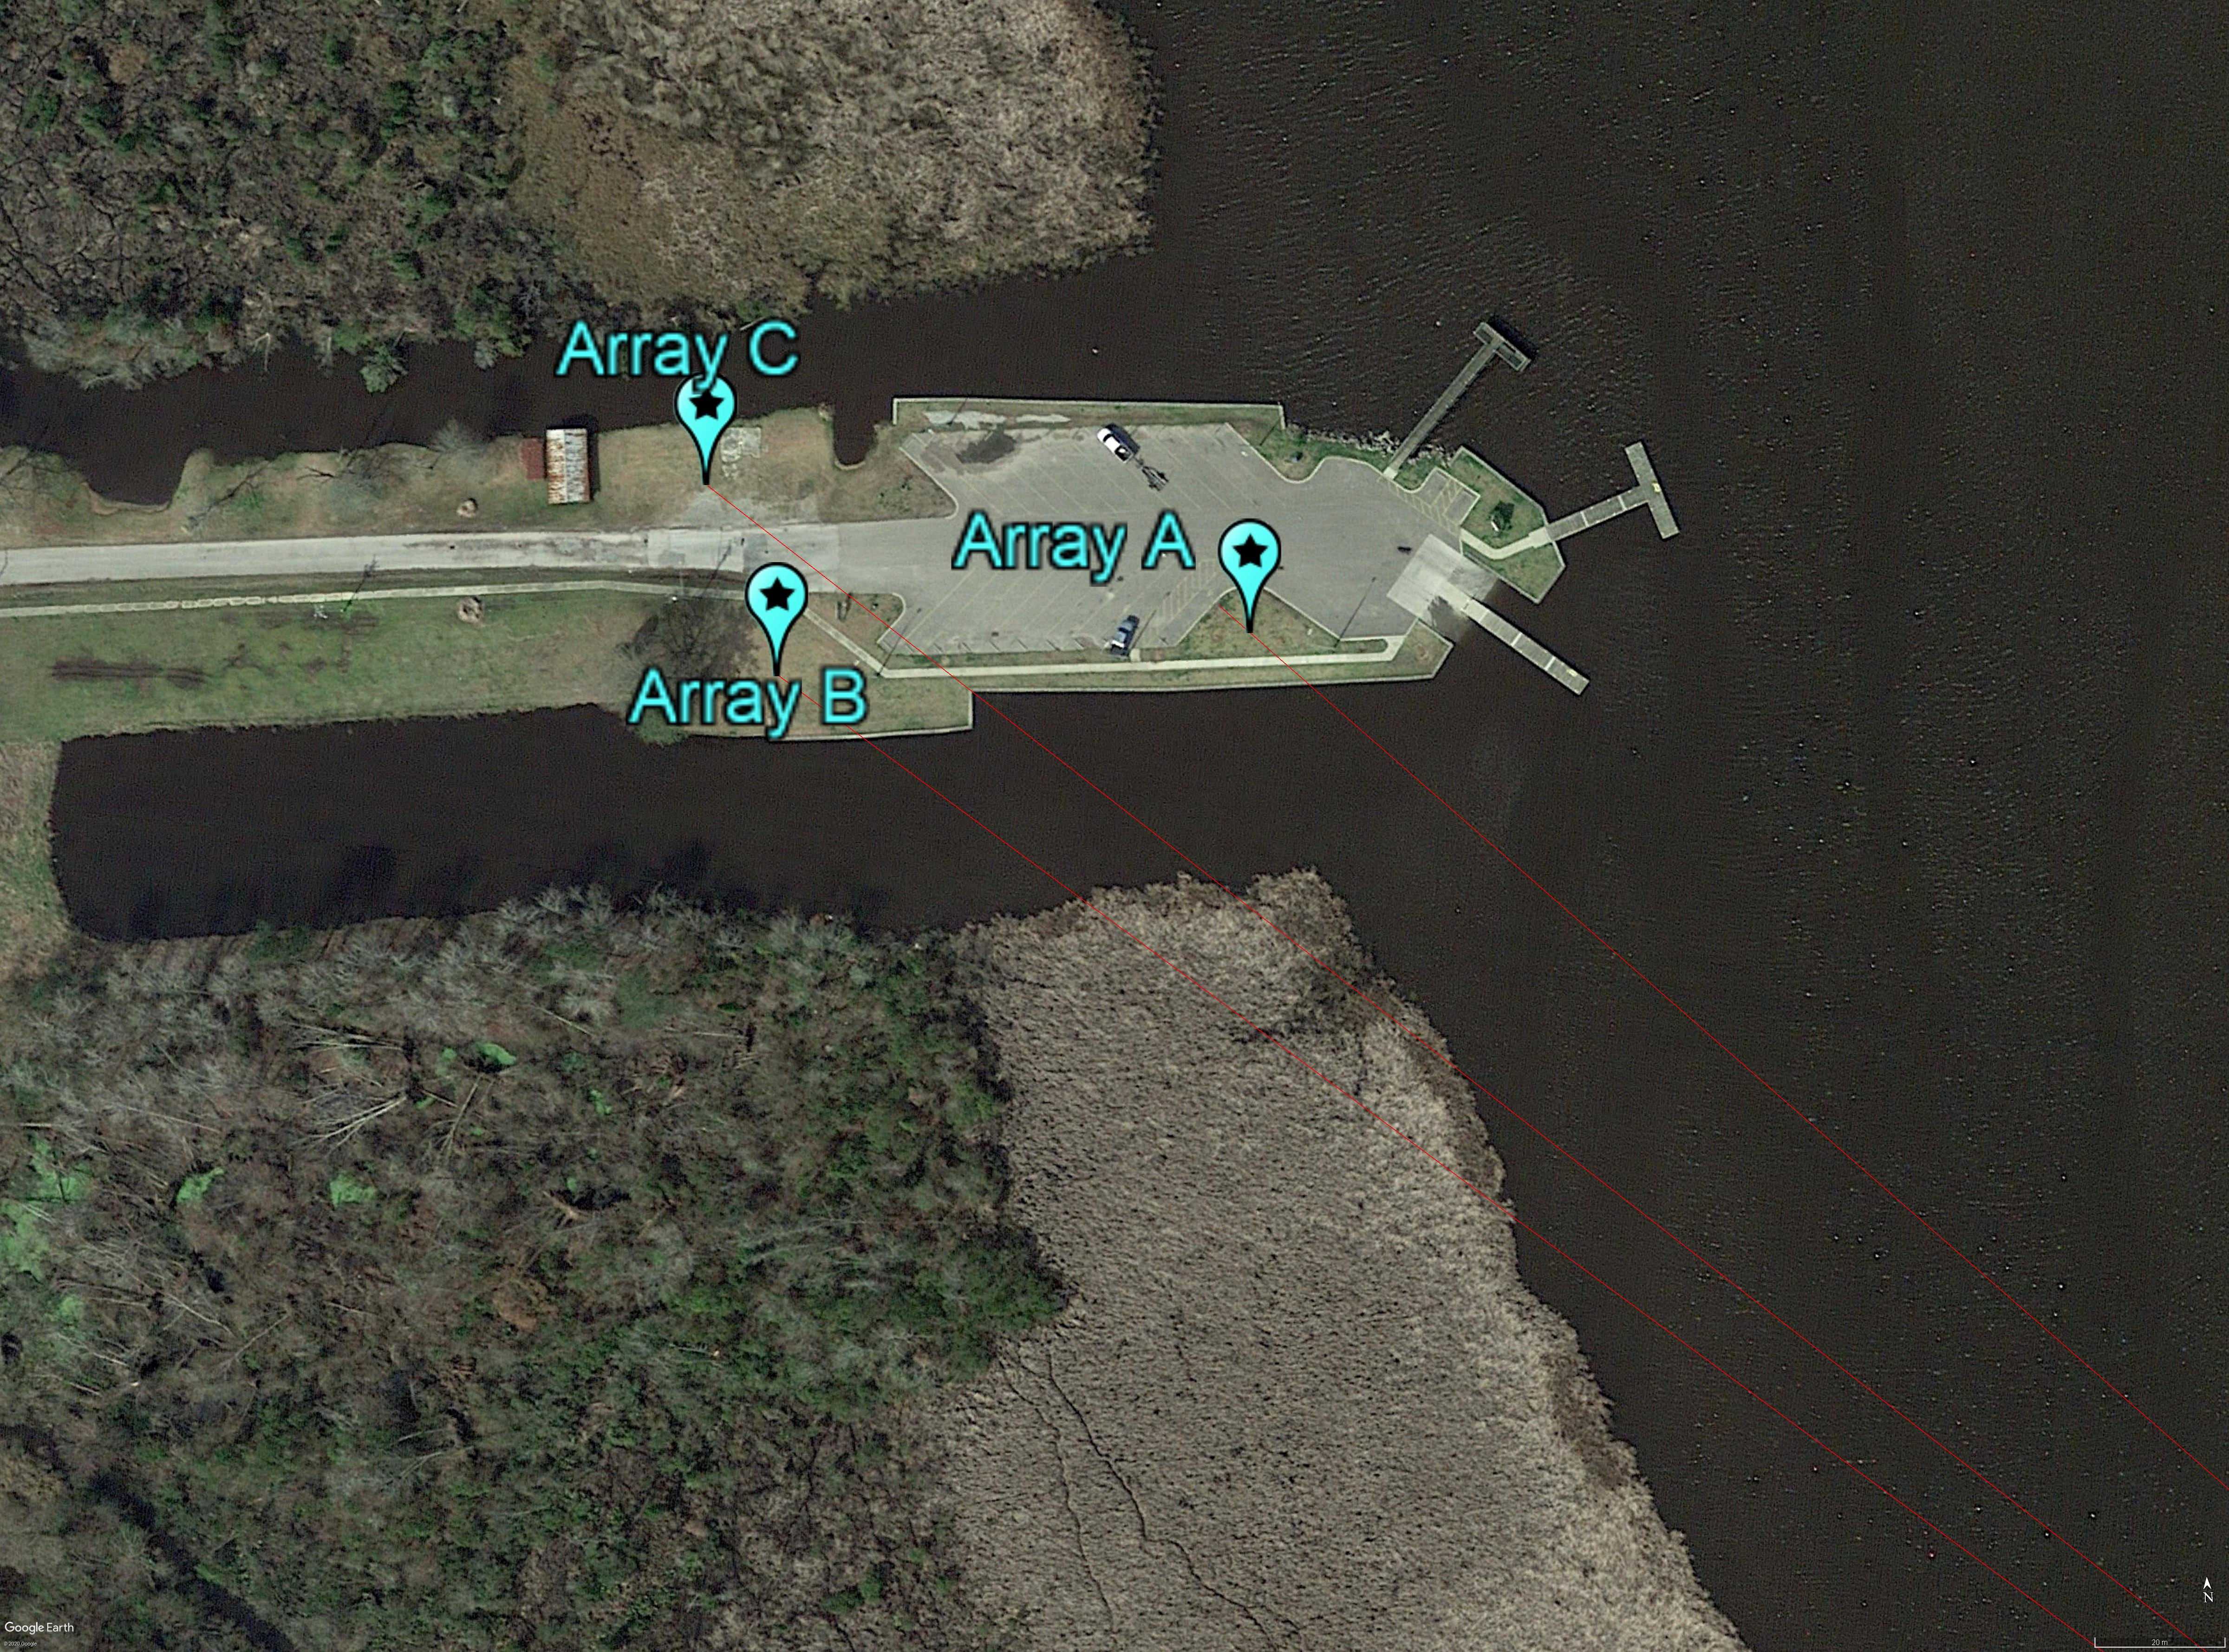
Comparing model to measurements
C
B
A
Source
Long grass
WATER
LONG GRASS
WATER
LAWN

Slide 23
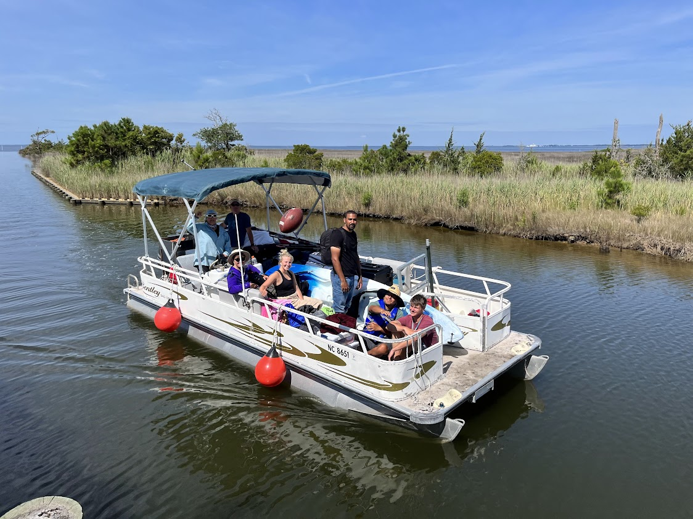
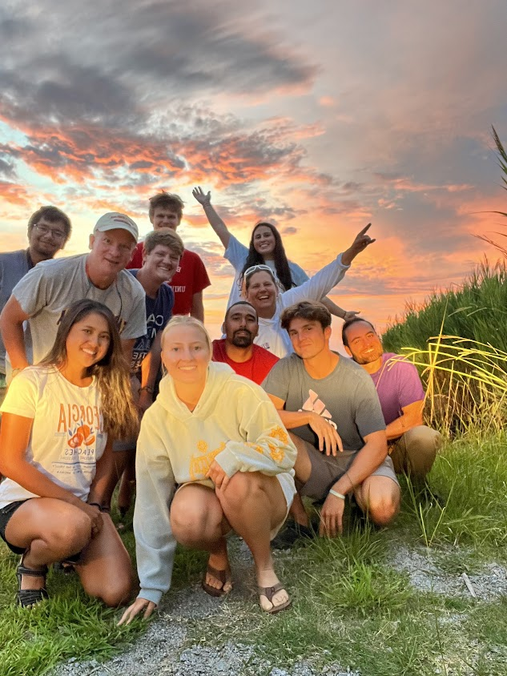
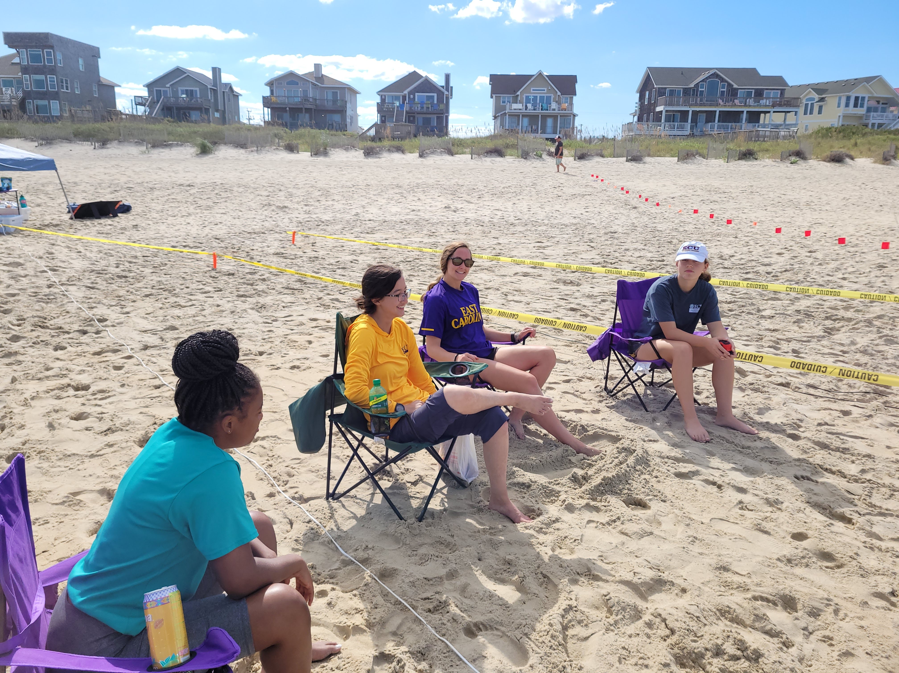
Acknowledgements
Jamie Bonfiglio
Caleb Anderson
Hannah Blackburn
Alex Ferro
Kyle Kirian
Chris Pietryck
Rolando Rosado
Erica Stark
Matthew Stengrim
Jeff Foeller
Andrea Vecchiotti
Rachel Beavans
Nia Wilson
Erica Walker
Emma Cole

Slide 24
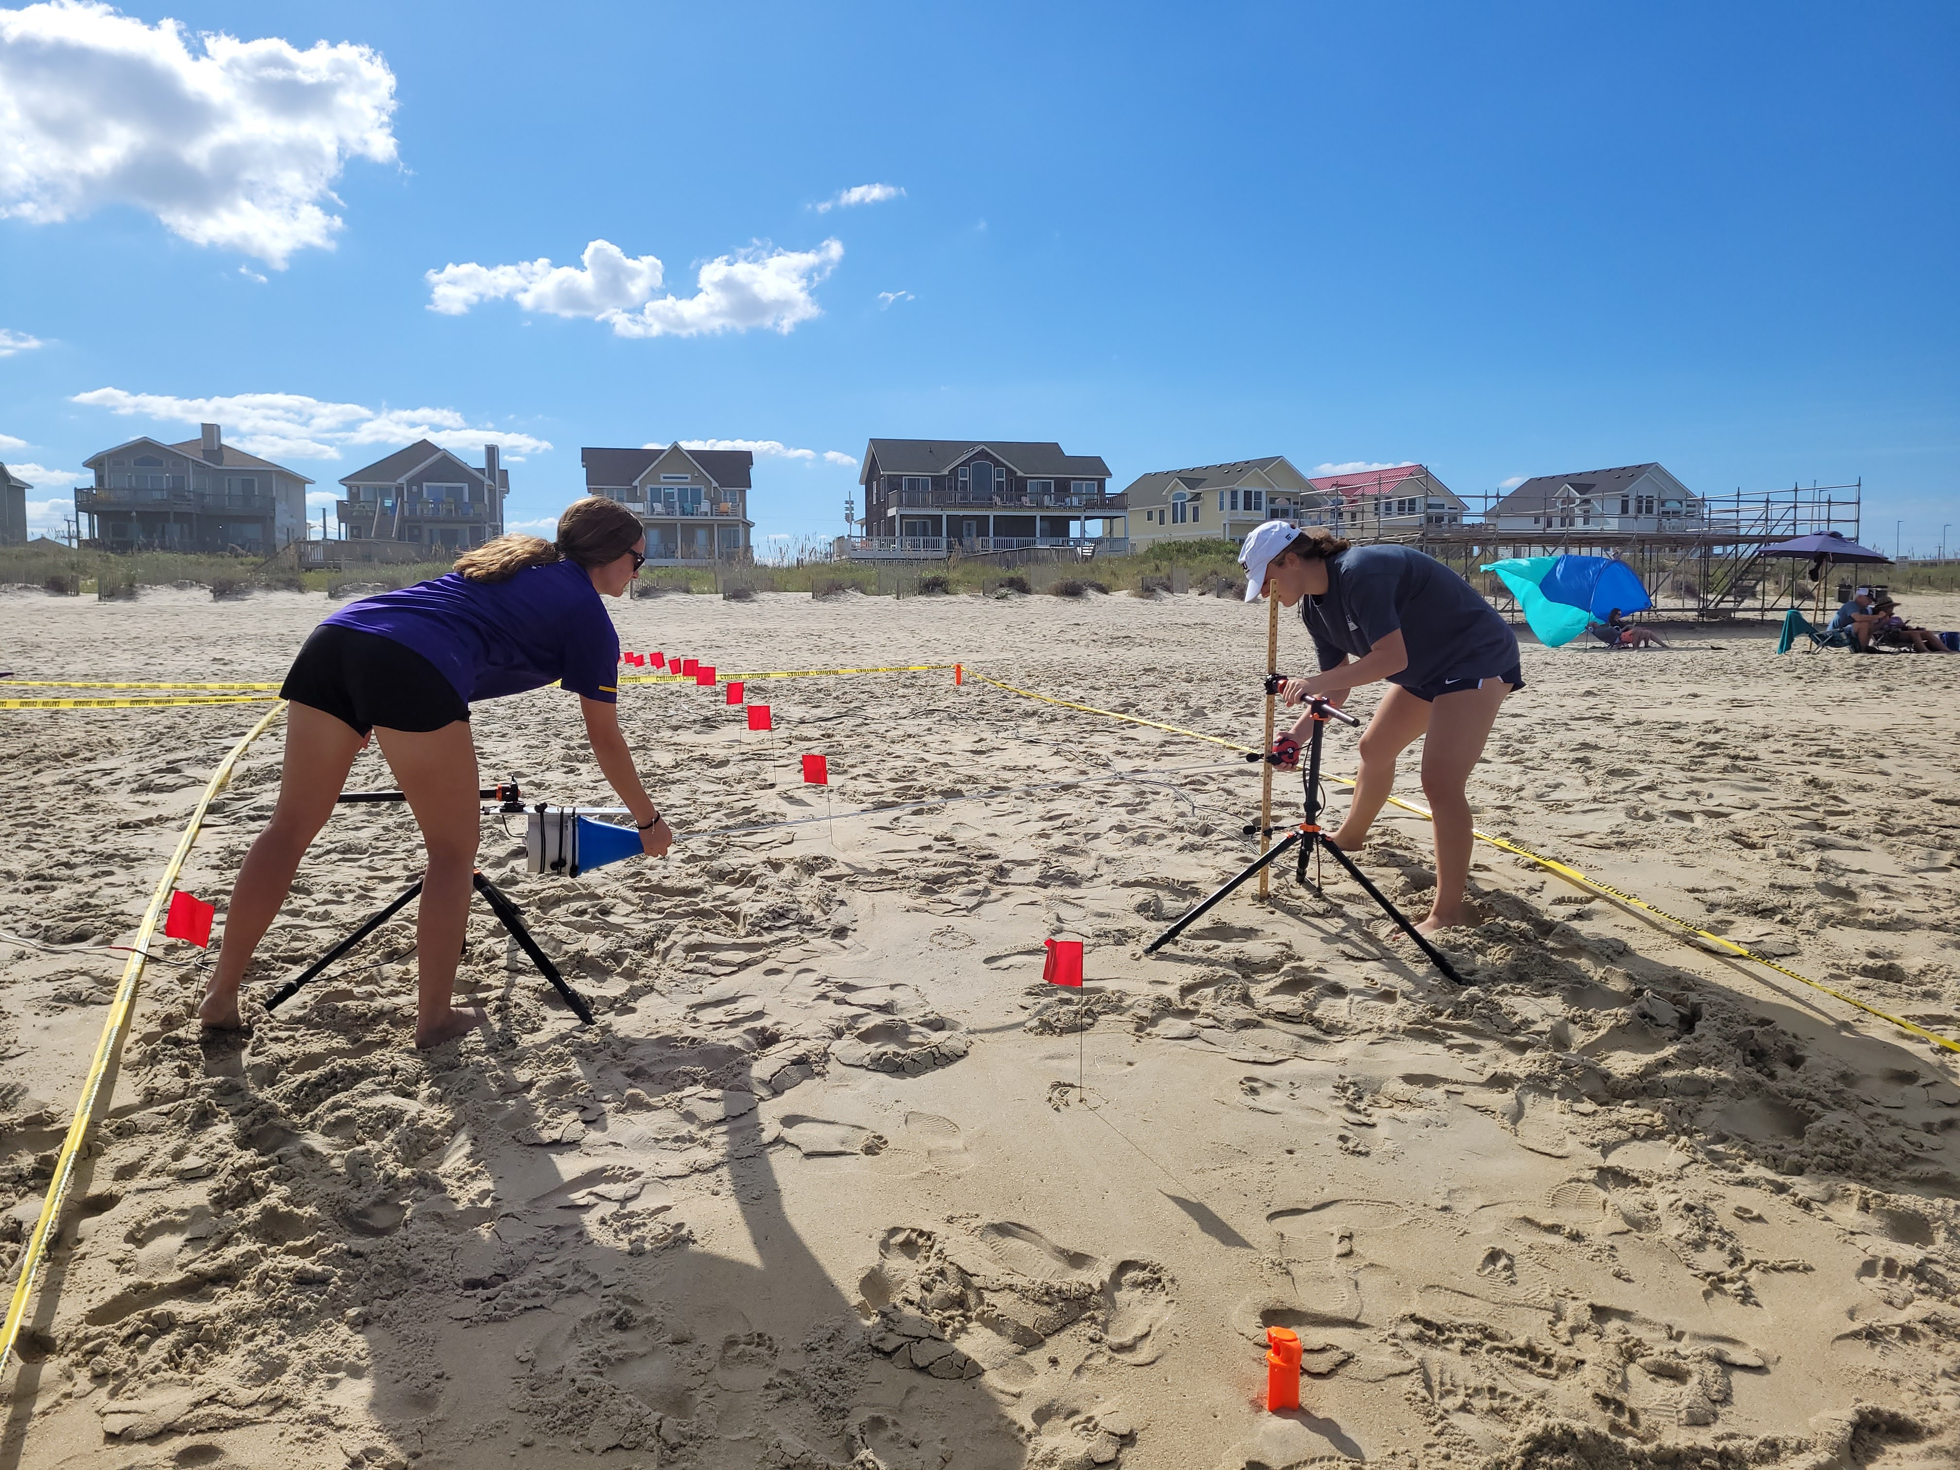
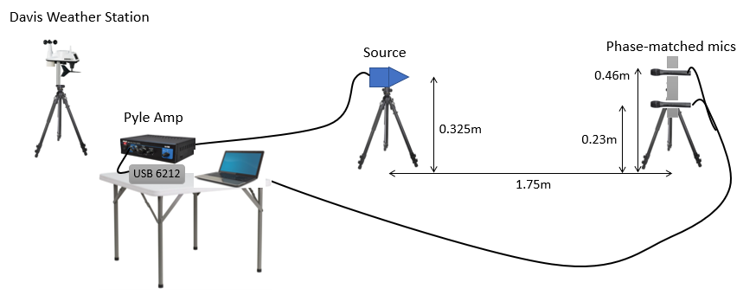
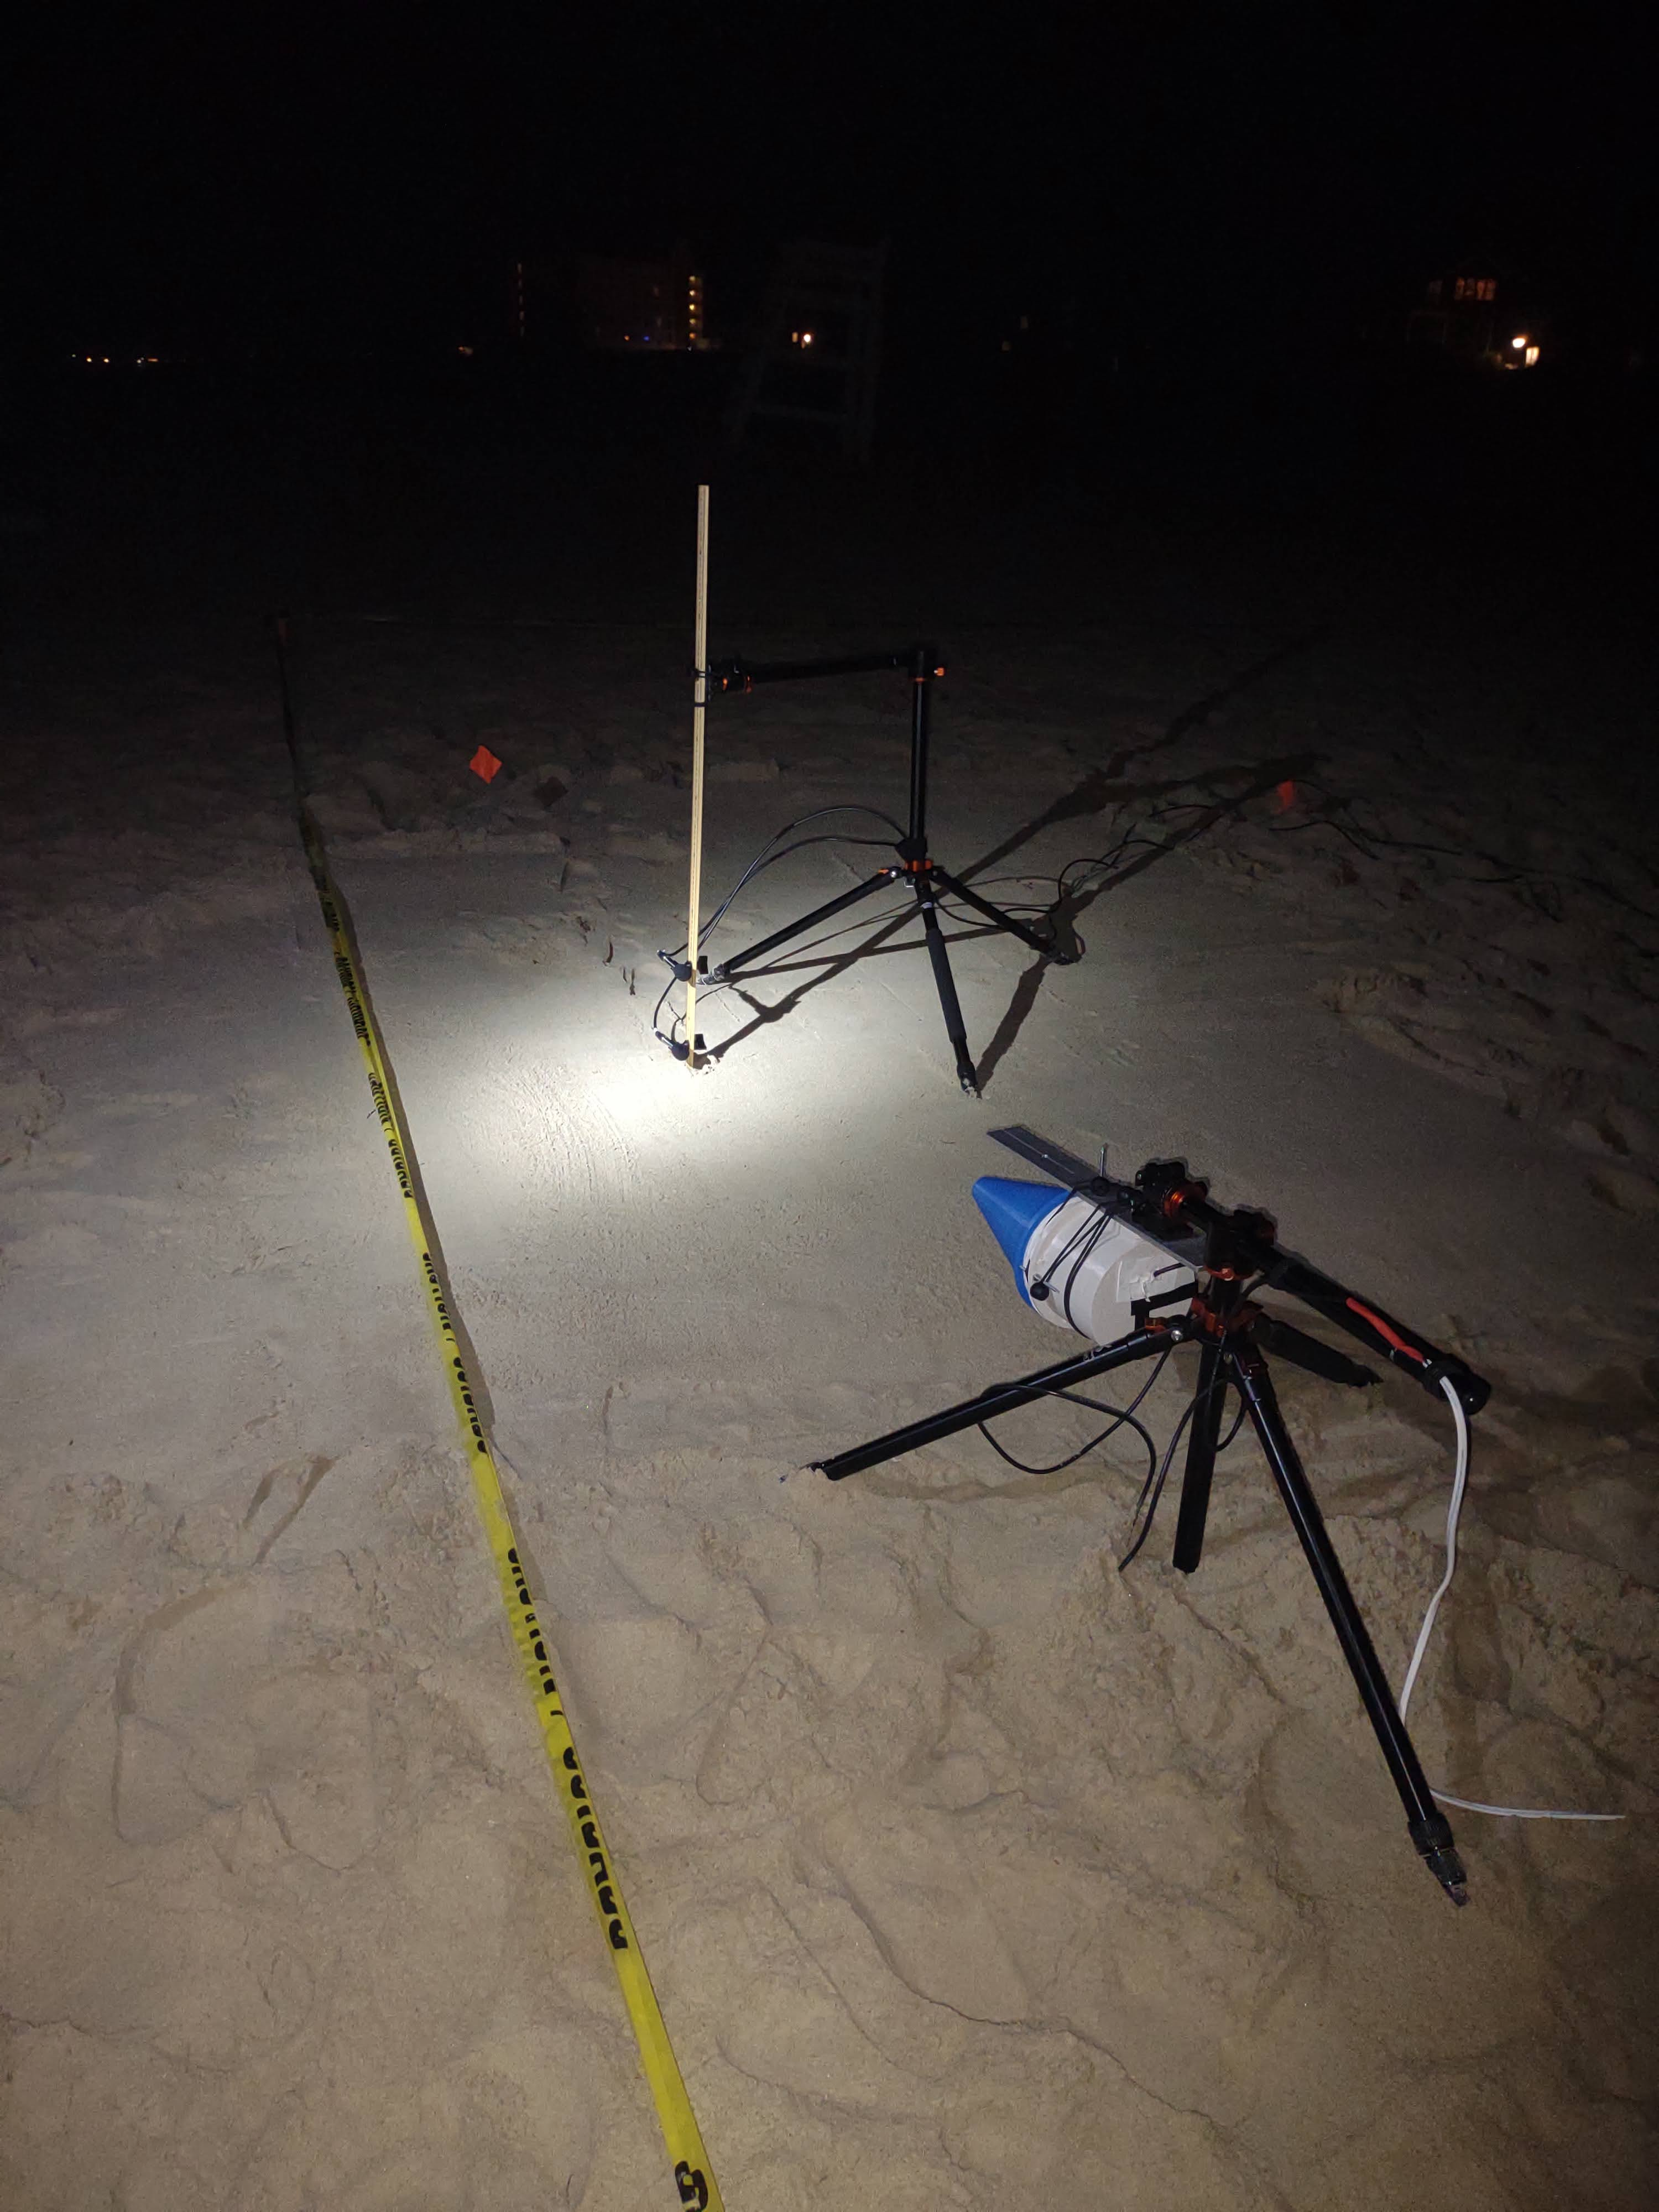
ANSI/ASA S1.18
A
B
0.2m
0.2m
0.05m
1.0m
Notes:
Config A and B, make stuff bigger
Mic model numbers
Don’t spell out the name
Fixing wednesday

Slide 25
ANSI/ASA S1.18
A
B
0.2m
0.2m
0.05m
1.0m
Notes:
Config A and B, make stuff bigger
Mic model numbers
Don’t spell out the name
Fixing wednesday

Slide 26
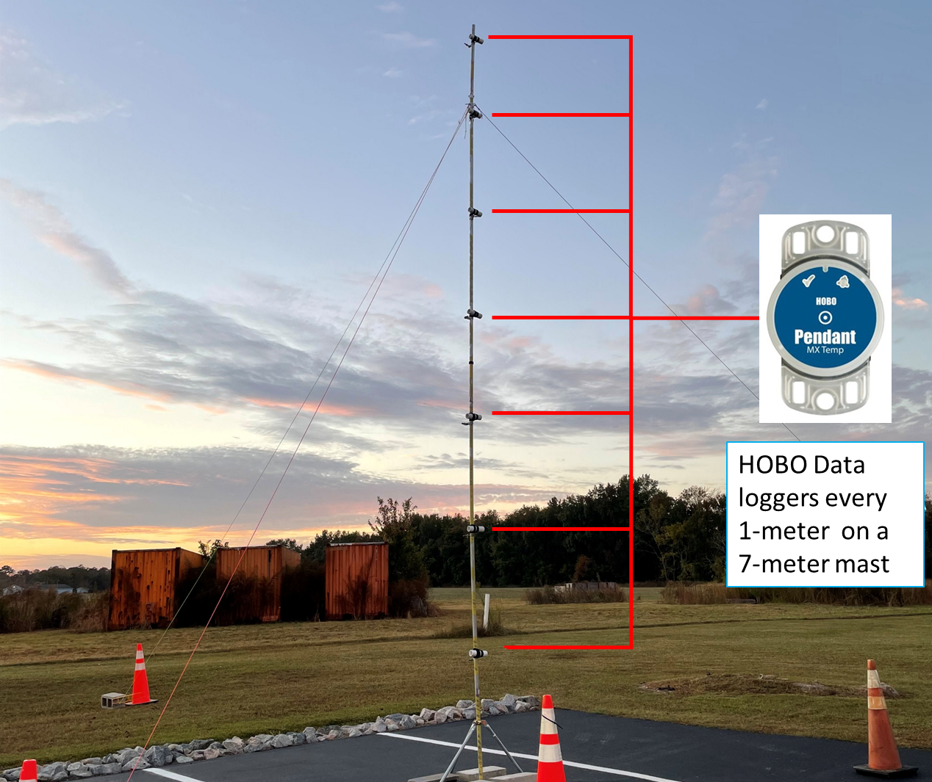
Temperature Profiles: Surface Matters

Slide 27
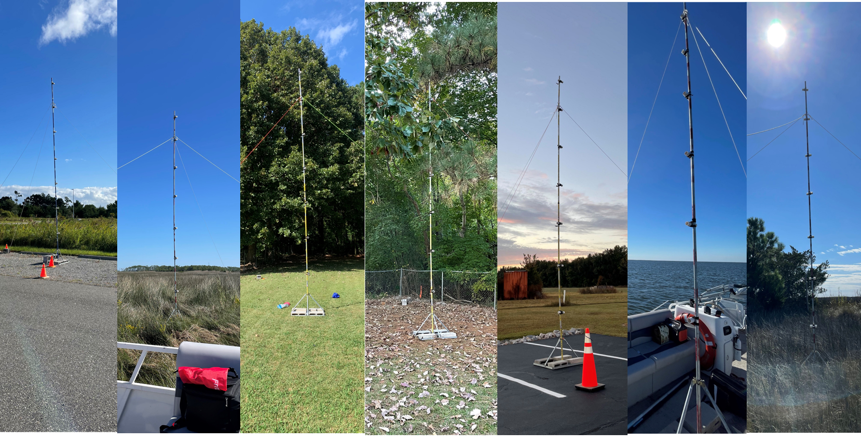
Temperature Profiles: Surface Matters

Slide 28
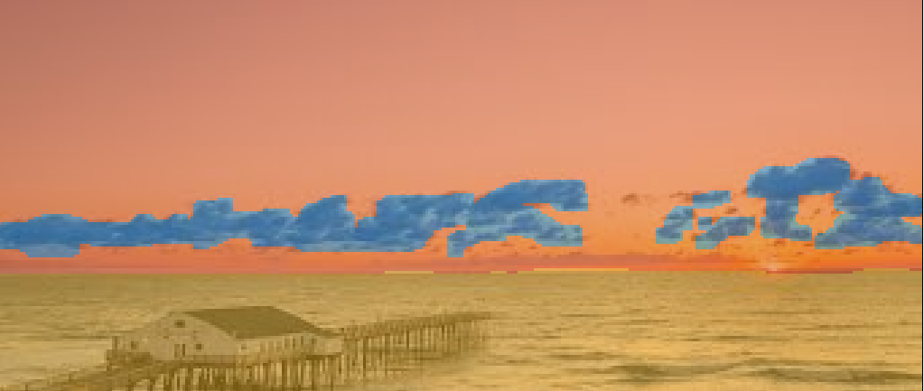
Machine Learning for Cloud Cover Determination
Wind speed profile:

Slide 29
Academic Products 2020-present
Conference Presentations
F. A. Cobb, A. Vecchiotti, J. Vignola, D. Turo, and T. J. Ryan , “Acoustic surface impedance measurements in coastal environments” accepted for 182nd meeting of the Acoustical Society of America, 23-27 May 2022, Denver, CO
A. Vecchiotti, F. A. Cobb, T. J. Ryan ,J. Vignola, and D. Turo .Sea state induced sound transmission loss of atmospheric broadband sources 182nd meeting of the Acoustical Society of America, 23-27 May 2022, Denver, CO https://doi.org/10.1121/10.0011102
F. A. Cobb, A. Vecchiotti, J. Vignola, D. Turo, and T. J. Ryan “Experimental investigation of the variance of ground impedance measurements in coastal environments” accepted for inter.noise 2022 Glasgow, Scotland.
A. Vecchiotti, T. J. Ryan, F. A. Cobb, J. Vignola, and D. Turo, “Atmospheric sound transmission loss uncertainties induced by sea roughness,” The Journal of the Acoustical Society of America, vol. 150, no. 4, pp. A132–A132, Oct. 2021, doi: 10.1121/10.0007874.
F. A. Cobb, A. Vecchiotti, J. Vignola, D. Turo, and T. J. Ryan, “Acoustic surface impedance of sandy shores,” The Journal of the Acoustical Society of America, vol. 150, no. 4, pp. A198–A198, Oct. 2021, doi: 10.1121/10.0008116.
F. A. Cobb, N. Wilson, A. Vecchiotti, D. Turo, J. Vignola, and T. J. Ryan, “Characterization of sand moisture profiles for improved atmospheric acoustic modeling,” The Journal of the Acoustical Society of America, vol. 148, no. 4, pp. 2698–2698, Oct. 2020, doi: 10.1121/1.5147475.
A. Vecchiotti, T. J. Ryan, F. A. Cobb, N. Wilson, J. Vignola, and D. Turo, “Excess attenuation at the beach: A model validation,” The Journal of the Acoustical Society of America, vol. 148, no. 4, pp. 2740–2740, Oct. 2020, doi: 10.1121/1.5147612.
N. Wilson, F. A. Cobb, D. Turo, J. Vignola, and T. J. Ryan, “Comparison of existing and experimental weather models of the near surface atmospheric boundary layer,” The Journal of the Acoustical Society of America, vol. 148, no. 4, pp. 2699–2699, Oct. 2020, doi: 10.1121/1.5147476.
A. Vecchiotti, T. J. Ryan, F. A. Cobb, Vignola, Joseph F., and D. Turo, “Modeling excess sound attenuation of a sandy shore: a case study,” presented at the 18th Symposium on Long Range Sound Propagation LRSP-18, Washington, DC, USA, Aug. 03, 2020. [Online]. Available: https://olemiss.app.box.com/s/6qbkgdwn8ptn3xcd097rxn64umtkd6of
F. A. Cobb, D. Turo, A. Vecchiotti, Vignola, Joseph F., and T. J. Ryan, “Measurement of near-shore acoustic transmission loss: a case study,” presented at the 18th Symposium on Long Range Sound Propagation LRSP-18, Washington, DC, USA, Aug. 03, 2020. [Online]. Available: https://olemiss.app.box.com/s/6qbkgdwn8ptn3xcd097rxn64umtkd6of
Conference Papers
T. Ryan, F. Cobb, A. Vecchiotti, J. Vignola, and D. Turo, “Near-shore acoustic transmission loss: a measurement approach,” Proc. Mtgs. Acoust., vol. 41, no. 1, p. 045001, Aug. 2020, doi: 10.1121/2.0001350.
F. Cobb, N. Wilson, A. Vecchiotti, D. Turo, J. Vignola, and T. Ryan, “Characterization of acoustic properties of swash-zone sand for improved atmospheric acoustic modeling,” in Proceedings of Meetings on Acoustics, Virtual, Dec. 2020, vol. 42, p. 025001. doi: 10.1121/2.0001390.
A. Vecchiotti, T. J. Ryan, F. Cobb, N. Wilson, J. F. Vignola, and D. Turo, “Acoustic modeling of a sandy beach for atmospheric sound propagation in a near-shore environment,” Proc. Mtgs. Acoust., vol. 41, no. 1, p. 022002, Aug. 2020, doi: 10.1121/2.0001356.
N. Wilson, F. Cobb, D. Turo, and T. Ryan, “Acoustic transmission loss models using experimental temperature profiles of the near surface atmospheric boundary layer,” in Proceedings of Meetings on Acoustics, Dec. 2020, vol. 42, p. 025002. doi: 10.1121/2.0001406.
A. Vecchiotti, T. J. Ryan, F. Cobb, N. Wilson, J. F. Vignola, and D. Turo, “Acoustic modeling of a sandy beach for atmospheric sound propagation in a near-shore environment,” Proc. Mtgs. Acoust., vol. 41, no. 1, p. 022002, Aug. 2020, doi: 10.1121/2.0001356.
Journal Paper
A. Vecchiotti, T. J. Ryan, F. Cobb, J. F. Vignola, and D. Turo. Investigation of engineering models for sound propagation in a near-shore environment. Applied Acoustics 2022, https://doi.org/10.1016/j.apacoust.2022.108991
Ryan, Teresa, Vecchiotti, Andrea, Foeller, Jeffry, Cobb, Faith, Vignola, Joseph and Turo, Diego. "Synchronized acoustic and atmospheric measurement system for characterization of atmospheric sound propagation" Noise Mapping, vol. 9, no. 1, 2022, pp. 109-112. https://doi.org/10.1515/noise-2022-0008

Slide 30
Acknowledgements
Jamie Bonfiglio
Caleb Anderson
Hannah Blackburn
Alex Ferro
Kyle Kirian
Chris Pietryck
Rolando Rosado
Erica Stark
Jeff Foeller
Andrea Vecchiotti
Rachel Beavans
Nia Wilson
Erica Walker
Emma Cole

Slide 31
Long Range Acoustic Transmission Loss Under Varying Atmospheric and Terrain Conditions
Teresa Ryan
Industry partner: Anybody that makes atmospheric/acoustic measurement tools?
DoD partner: Expand collaboration to AFRL/ARL/??
New ideas: Have ideas in energy harvesting; vibration/signature suppression; ultrasensitive mass detection;…

