Slide 1
Eradicating bacterial biofilms
We have developed a new class of compounds that overcome bacterial resistance traits, including biofilm formation. These compounds work with existing antibiotics to treat resistant bacterial infections and also by themselves as biofilm eradicators.

Slide 2
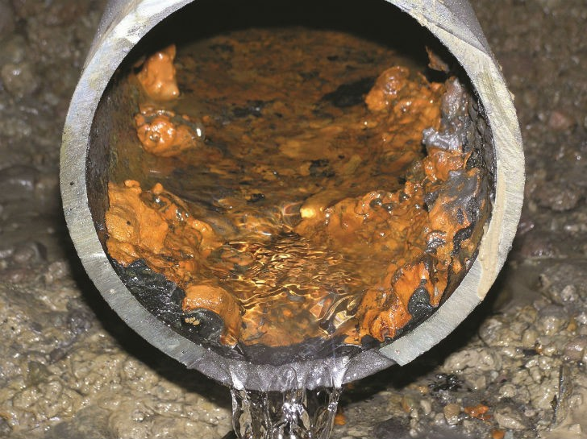
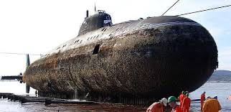
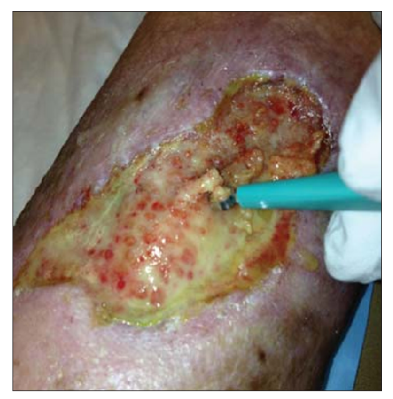
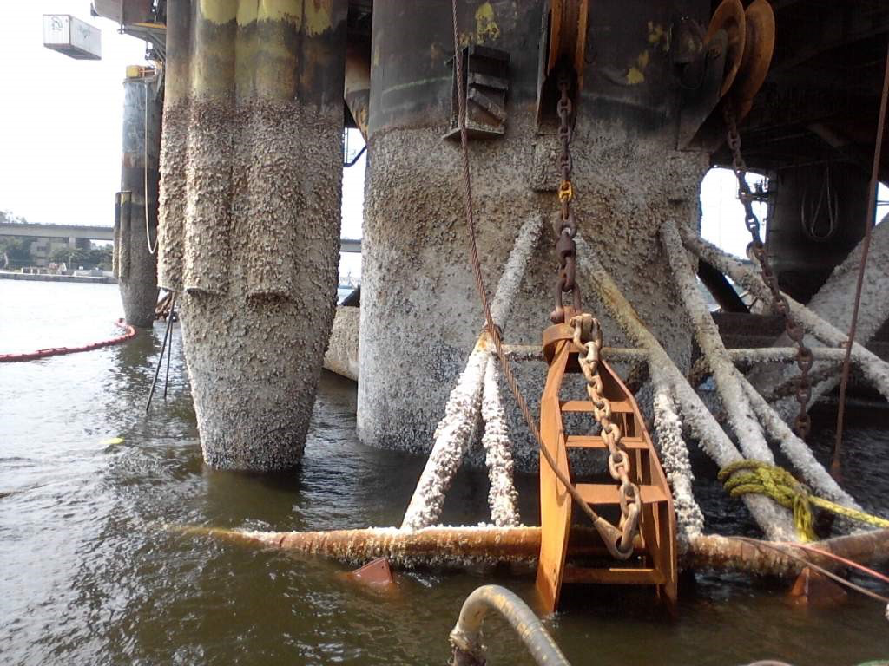
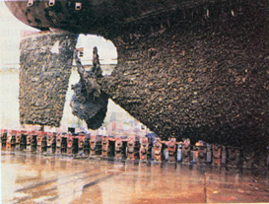
Biofilms

Slide 3
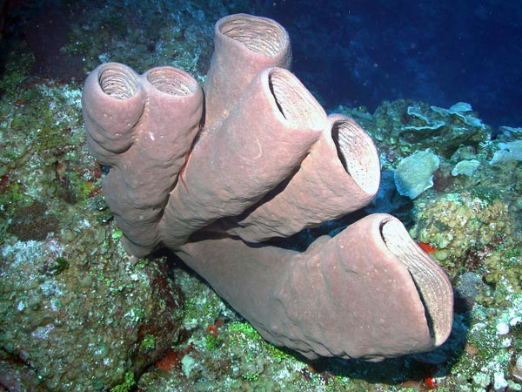
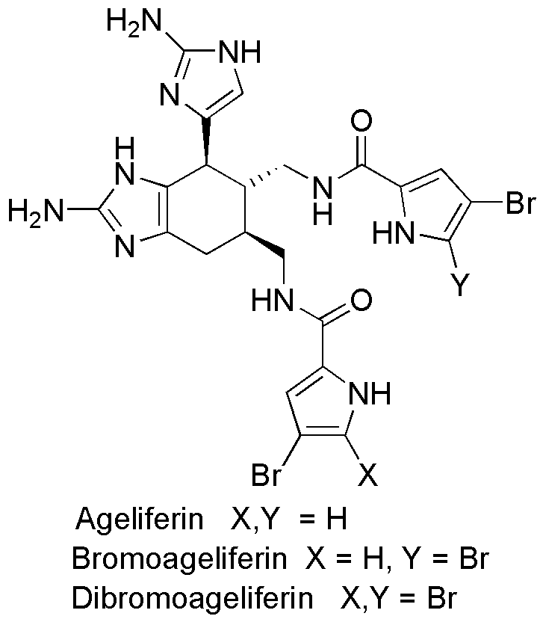
Our Technology
Agelas Conifera
Sponges filter bacteria laden sea water continually but to protect themselves against biofouling by exuding natural products.
Biofouling (on coral) is the result of biofilm formation.
How does it do this?
Which are the good bits? Can we make those better?
Which are the bad bits? Can we get rid of them?

Slide 4
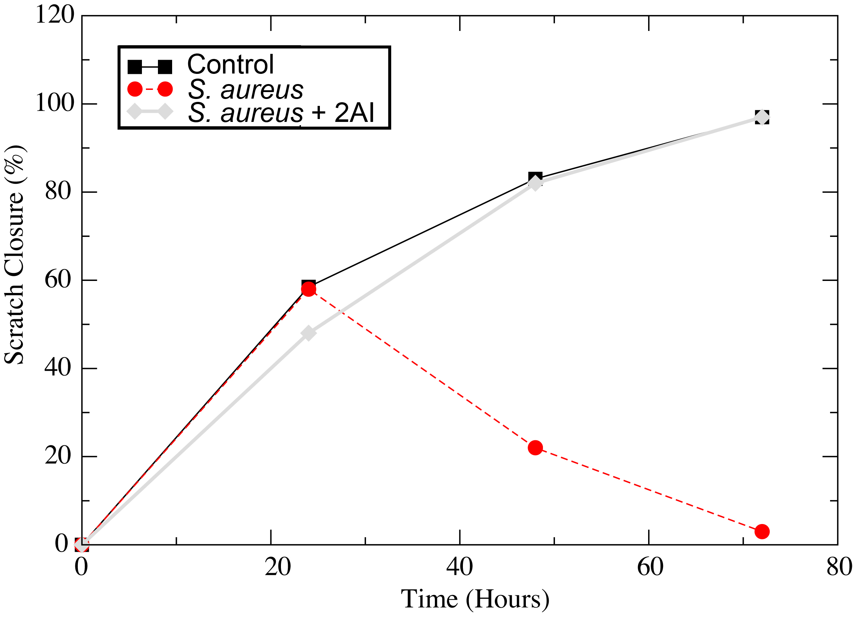
Wounds
1 Day Exposure
7 Day Exposure
40-50 lb Weanling Pigs
Lead 2AI Skin/wound Compound H10
Four doses over 1 week
No visible irritation
Scratch closure (%) vs. Time.
Control – scratch and follow closure
RED – infected with S. aureus biofilm
GREY – infected with S. aureus biofilm plus 2AI.
2AI-H10 did not cause any gross abnormalities in the porcine skin-model, nor did it stimulate any significant immune reaction
With 2AI scratch closes like no infection

Slide 5
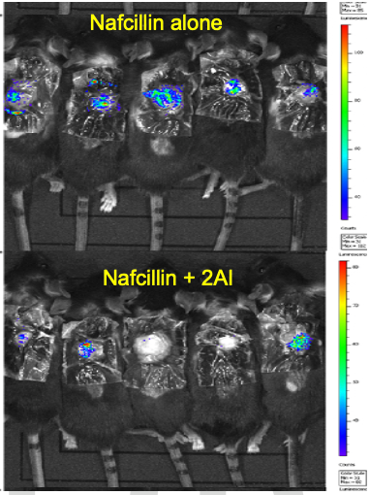
Effect of 2AIs in combination with wound dressings
Tegaderm hydrogel wound filler is a sterile, non-preserved, formulation of complex hydrophilic polymers designed to hydrate wounds. Unfortunately, Tegaderm is difficult to use in combination with antibiotics as it promotes virulence/biofilm formation and delays bacterial clearance from the wound.
MRSA biofilm mouse wound
Wound infected with MRSA (biofilm)
Tegaderm dressing applied
2AI dissolved in gel
Day 1, 2, 6 : 2AI gel placed on wound under Tegaderm
Overall, there is a 50% reduction in MRSA

Slide 6
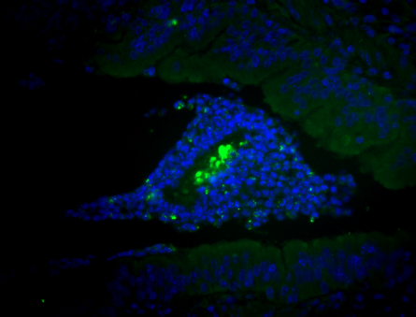
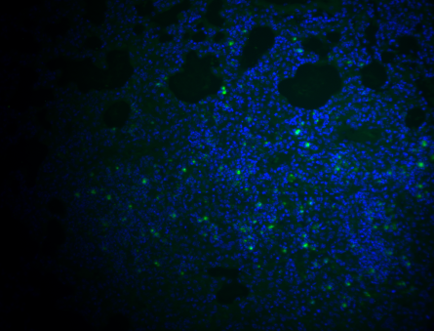
Chronic lung infection model (cystic fibrosis)
Study design:
Intratracheal instillation of 10⁵ CFU of MDR P. aeruginosa (cystic fibrosis)
Treatments given IP (intraperitoneal) started 2 days post-infection and continued 3 days
Animals analyzed 5 days post-infection and lungs were processed for bacterial counts and histology
MDR P. aeruginosa biofilm - GFP tagged
Treated with 2AI

