Slide 1
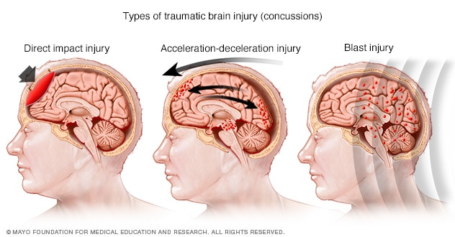
Long-lasting oculomotor impairment and injury prevalence in mTBI subjects
mTBI:
Short-lived to long-lasting neurological functional impairment
Often long-term impairment is undetectable by standard protocols
Can persist for several months or longer post-trauma
224,000 hospitalizations and 61,000 deaths in 2017.
75% are mild traumatic brain injuries (mTBI).
38-45% increased lower extremity injury rate 2-yr post-concussion

Slide 2
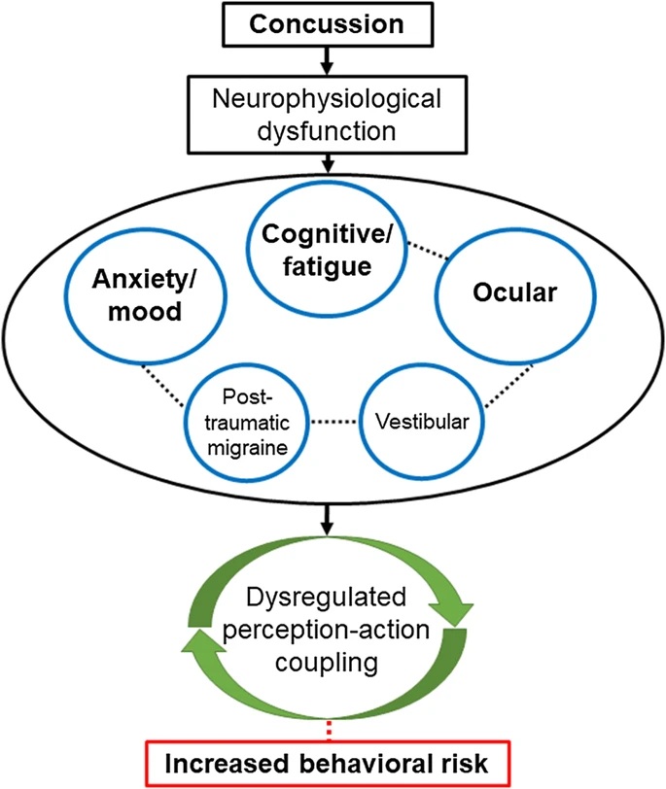
Long-lasting oculomotor impairment and injury prevalence in mTBI subjects
mTBI

Slide 3
Long-lasting oculomotor impairment and injury prevalence in mTBI subjects
Our approach is to measure central and peripheral changes through:
Vision
Using eye-tracking as a marker of injury state
Saccadic activity, smooth pursuit, pupillometry
Brain activity changes
Electroencephalography (EEG) detects
High temporal resolution
Assess the electromagnetic field created when neurons in the brain are active
Functional near-infrared spectroscopy (fNIR)
High spatial resolution
Assess the hemodynamic response, or the relative change in oxygenated/deoxygenated hemoglobin in the blood
Balance/Postural control: ultimate integration of sensory and motor pathways
Typical approaches often resolve after 2-3 weeks post injury
Need to challenge the sensory system
Eye-tracking + Virtual Reality (VR) → powerful assessment tool of short- and long-term concussed individuals
Complete stimulus control
Highly reproducible
Deployable

Slide 4
Smooth Pursuit Eye Movements as an indicator of mTBI
No mTBI
mTBI
*Hunfalvay, Murray, Mani, & Carrick, 2021

Slide 5
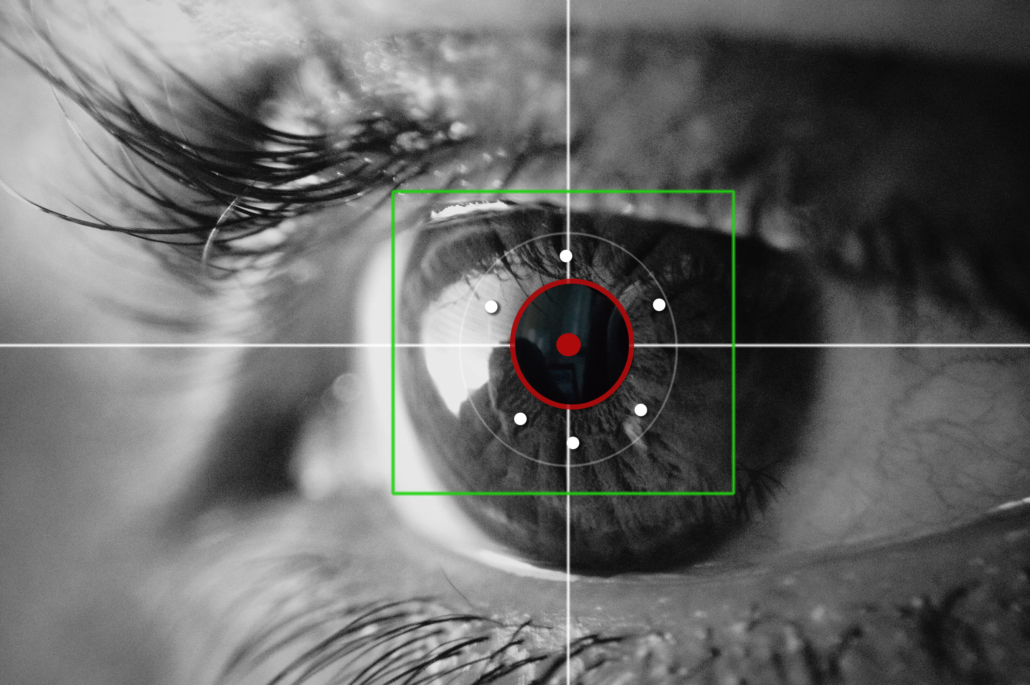
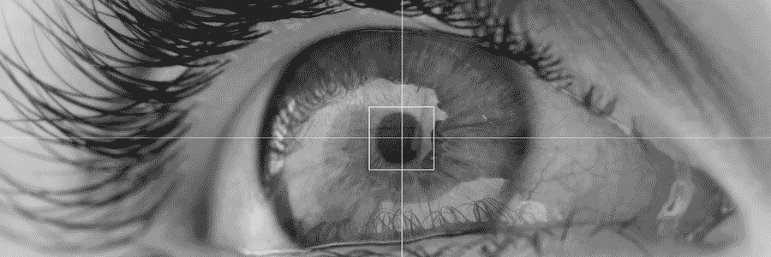
Smooth Pursuit Eye Movements as an indicator of mTBI
Five conditions (visual tasks): CSP, HSP, VSP, HSA, and VSA
Order was randomized and counterbalanced
Three trials per task
30 seconds per trial
Brief period of rest between trials
Eye-tracker: 5-point calibration
Sampling frequency of 120 Hz.
Data reduced to 20 seconds
Removed first and last 5 seconds

Slide 6
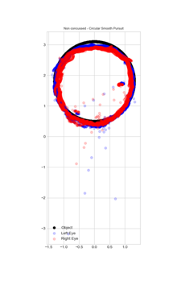
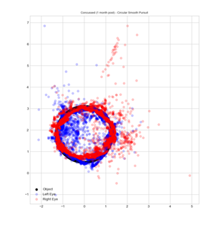
Smooth Pursuit Eye Movements as an indicator of mTBI
Meters/Deg.
No mTBI
mTBI

Slide 7
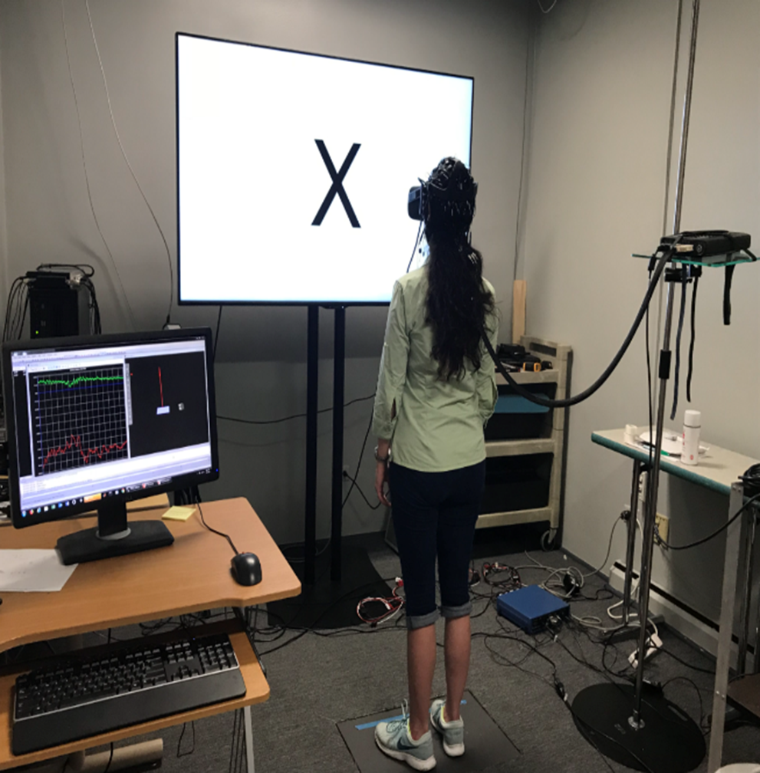
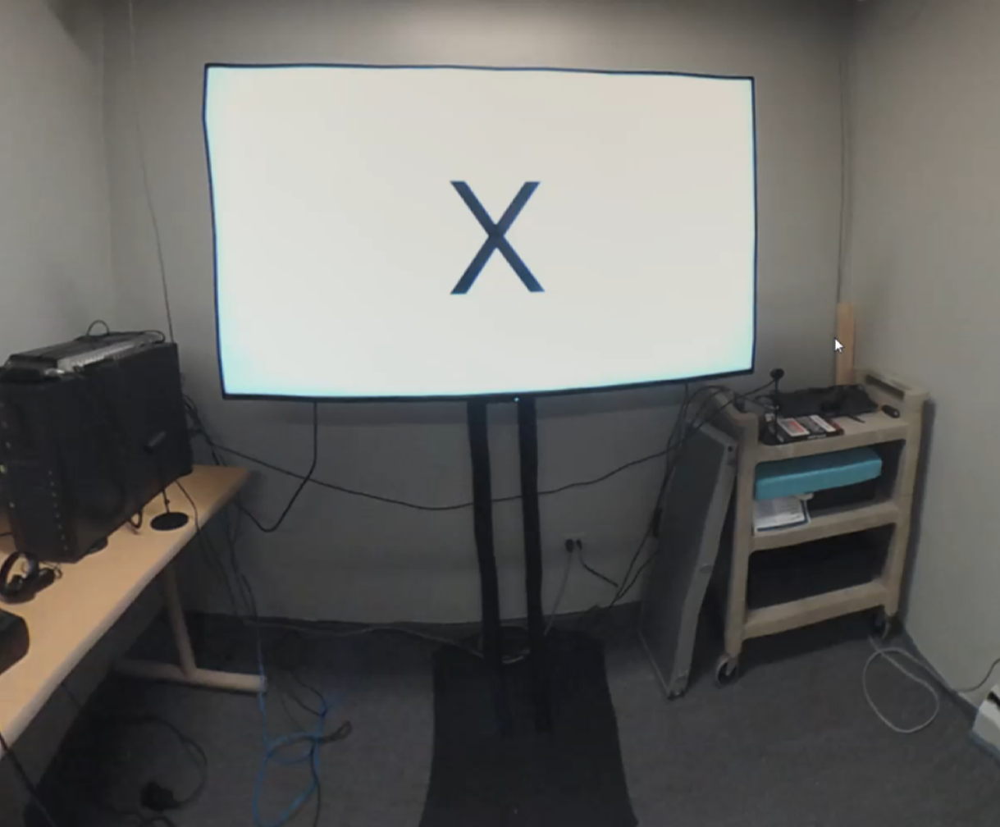
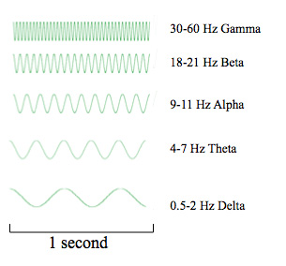
mTBI Neural Signature is Substantially Different Than Fatigue Neural Signature in Non-mTBI Controls
Fatigue protocol: 30-min walk on an inclined treadmill (1.9 m/s)
Weighed backpack (27 kg)
Borg’s RPE scale (12-14)
Talk test
HR: 50-70% of max
Conditions:
Eyes-closed (EC)
Eyes-open (EO)
Single leg (SL)
Mental distraction (SS)
Unstable surface (US)
Virtual reality-induced optical flow (VR)
Virtual reality baseline (VB)
VR: replica of the lab
Fore and aft sway (0.2m, 0.5 Hz)
*Sandri Heidner, G., O’Connell, C., Domire, Z.J., Rider, P., Mizelle, J.C., Murray, N.P. (in review)

Slide 8
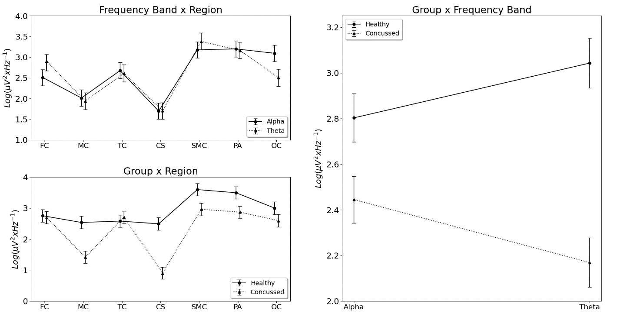
mTBI Neural Signature is Substantially Different Than Fatigue Neural Signature in Non-mTBI Controls
mTBIs cause a significant increases in cognitive workload during simple and discrimination reaction task

Slide 9
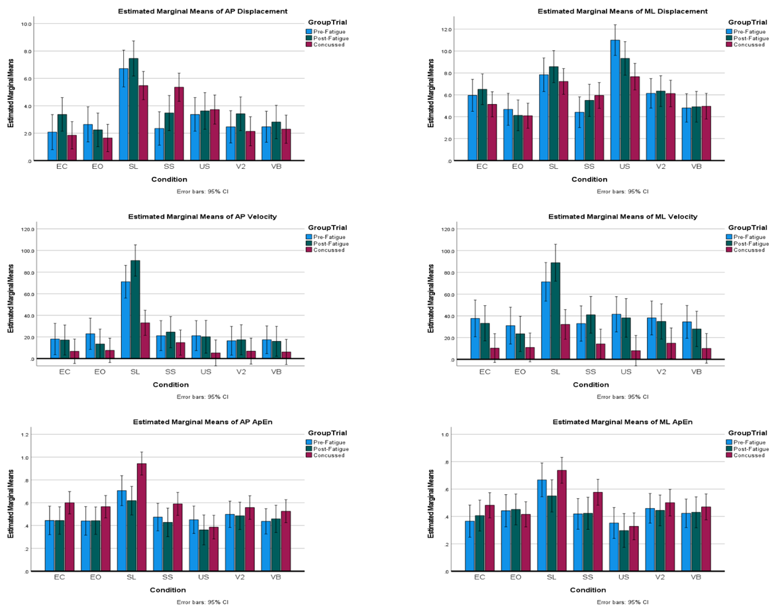
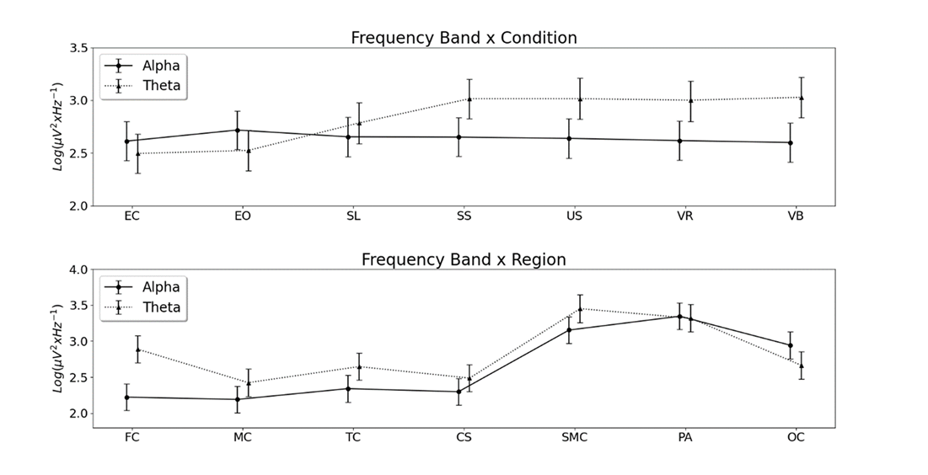
mTBI Neural Signature is Substantially Different Than Fatigue Neural Signature in Non-mTBI Controls
Approximate Entropy changes with balance perturbations and following mTBI.

Slide 10
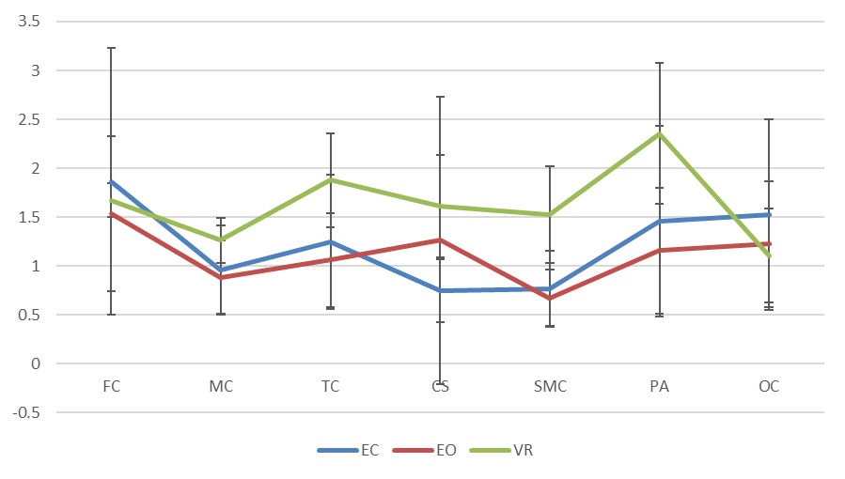
mTBI Neural Signature is Substantially Different Than Fatigue Neural Signature in Non-mTBI Controls
FEC demonstrated increase neuronal activation across adjacent networks. Greater activation occurred within the VR environment and represents a compensatory mechanism in fatigue and impaired conditions (p < .05) comparing the eyes open, eyes closed and the moving VR environment conditions.

Slide 11
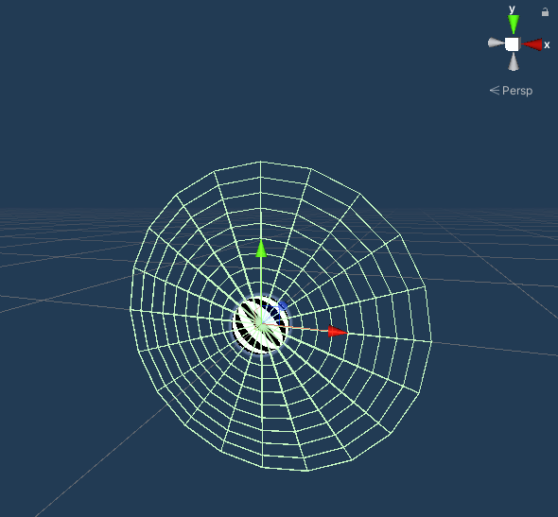
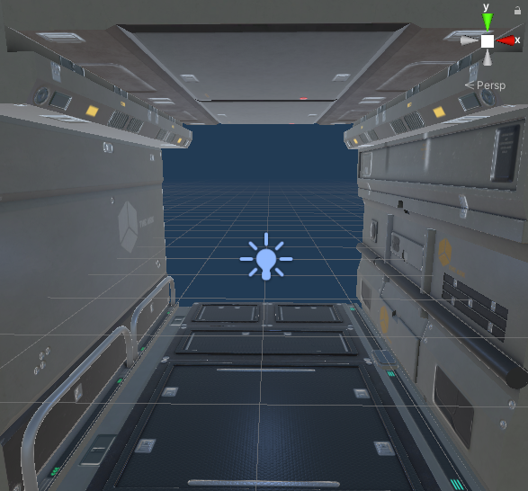
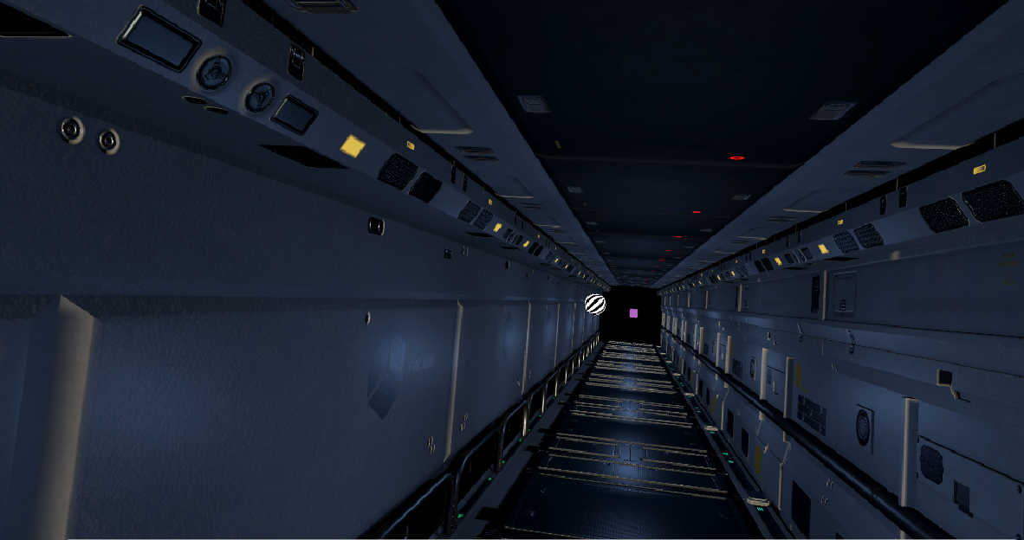
Challenging the central and peripheral systems through Virtual Reality
g.Tec Nautilus 32-chan EEG (wireless, dry)
Sampling Rate: 500 Hz
Biopac MP35 4-chan EMG
Bipolar Ag/AgCl electrodes
Tibiales anterior (L/R)
Soleus (L/R)
Sampling rate: 1000 Hz
HTC Vive VR Headset + Tobii eye tracking
Bertec forceplate

Slide 12
Corticomuscular coherence (EEG-EMG) metrics

Slide 13
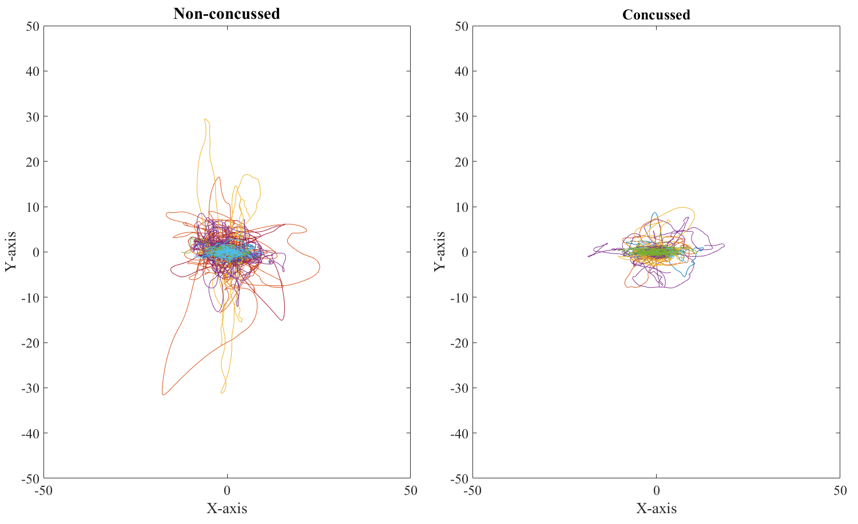
Challenging the central and peripheral systems through Virtual Reality

Slide 14
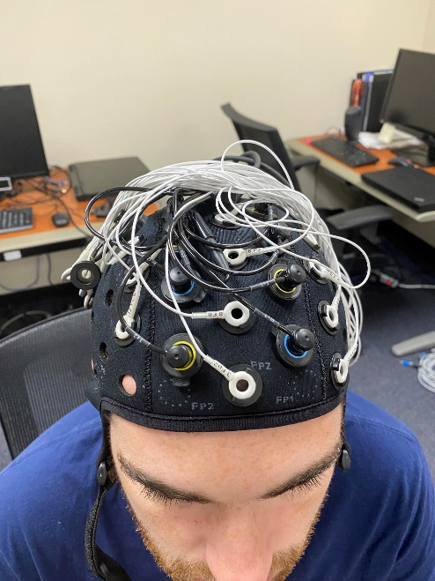
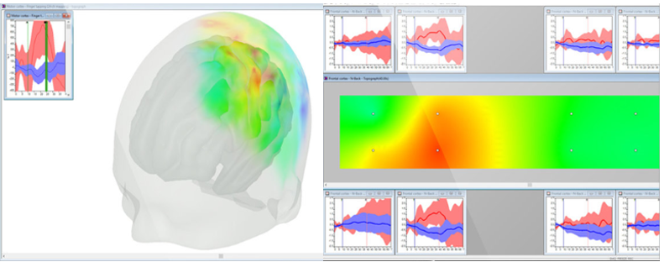
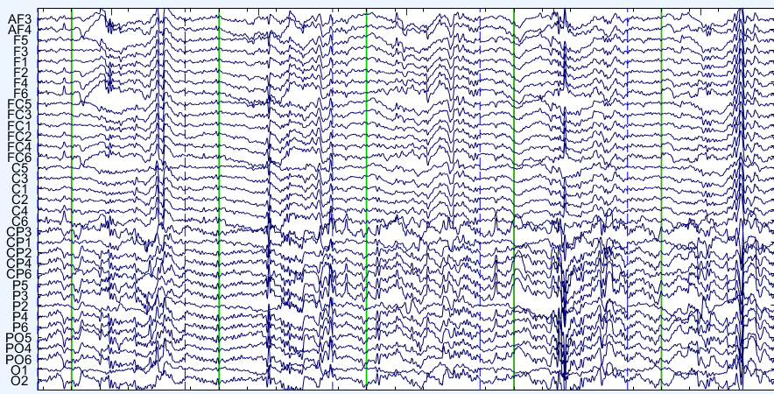
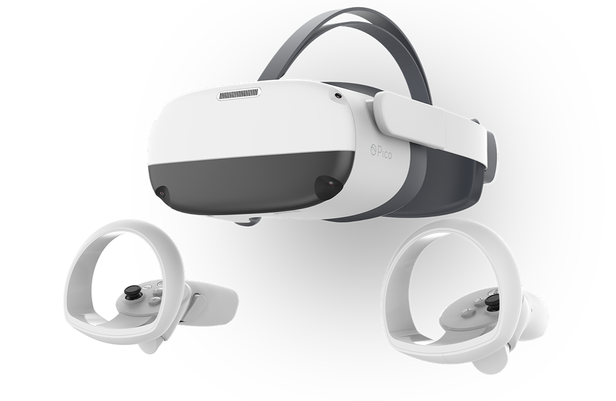
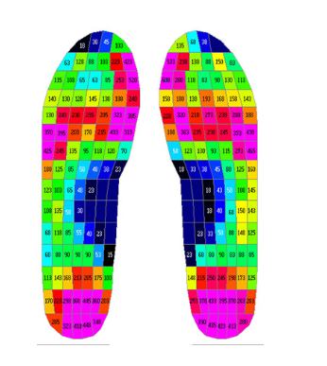
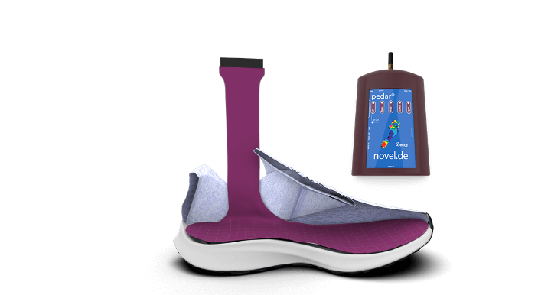
Current capacity in brain function and mobile testing lab
EEG and fNIRS combined:
57 fNIRS channels and 64 EEG channels
Wireless VR
Pedar Pressure insoles

Slide 15
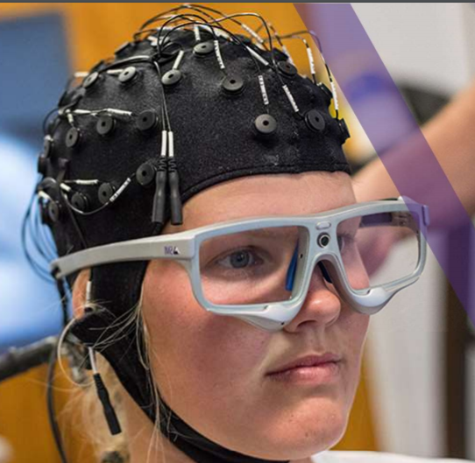
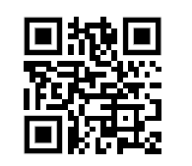
Funding Sources
Visual Motor Laboratory
Special thanks to the students and faculty who work in the Visual Motor Laboratory and on these projects:
Faculty:
Zac Domire and Chris Mizelle
PhD and MS students
Gustavo Sandri Heidner
Brittany Trotter
Josh Lawton
Callie Herman
Plus, several undergraduate students
https://sites.ecu.edu/vml/

