Slide 1
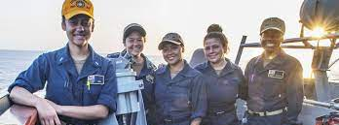

Modeling Bone Stress Injury Risk in At Risk Populations – Implications for the Female Servicemember
Stacey Meardon, PT, PhD
Department of Physical Therapy
Human Movement Analysis Labs (HMAL)
https://sites.ecu.edu/hmal/
Image credit: navy.com
Notes:
First, I’d like to thank the research day organizers for the opportunity to present our work examining musculoskeletal injury from a modeling perspective.
The work we do is very collaborative and would not be possible without collaborators, institutional support and students. While I collaborate with many researchers both within and outside of ECU, I would like to specifically acknowledge John Willson, Rich Willy, Hanna Rice, James Lin, Ali Vahdati and Tim Derrick whose contribution were critical to the work discussed today.
Image credit: https://www.navy.com/who-we-are/women-in-the-navy

Slide 2

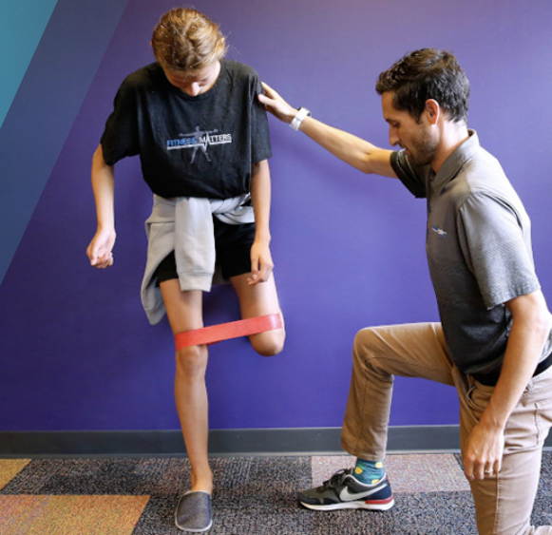
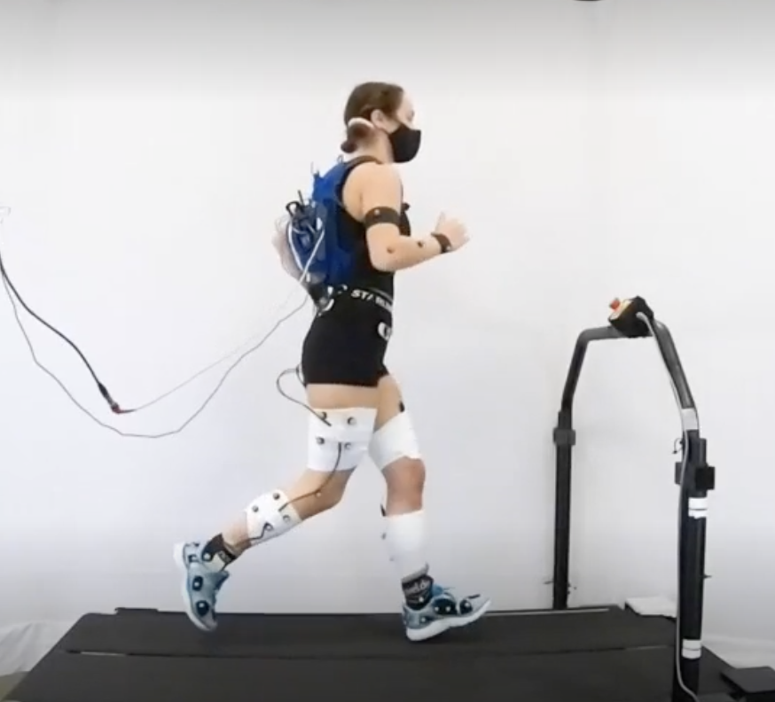
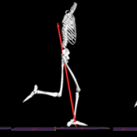
Primary Focus Area: Musculoskeletal (MSK) injury risk factors and interventions, especially bone stress injury (BSI)
College of Allied Health Sciences
Department of Physical Therapy
MOBIL & STAR Labs
Human Movement Analysis Lab
Current Funding
  NIH Academic Research Enhancement Award (R15); NIA-1R15AG058228-01A1 (3 year); $430,845
  NSF REU Site; EEC-1950507 (3 year); $413,186
Past Funding
  HJF Foundation for the Advancement of Military Medicine (1 year); $458,361
  NSF REU Site; EEC-1659796 (3 year); $356,199
  NSF REU Site, EEC-1359183 (3 year)
Disclaimers: The opinions and assertions herein are the private views of the authors and are not to be construed as official or as reflecting the views of the U.S. Army, the U.S. Department of Defense, or The HJF Foundation for the Advancement of Military Medicine, Inc.
Any opinions, findings and conclusions or recommendations expressed in this material are those of the author(s) and do not necessarily reflect the views of the National Science Foundation.
This content is solely the responsibility of the authors and does not necessarily represent the official views of the NIH’s NIA.
Notes:
The content presented here does not necessarily reflect those my funding agencies.

Slide 3
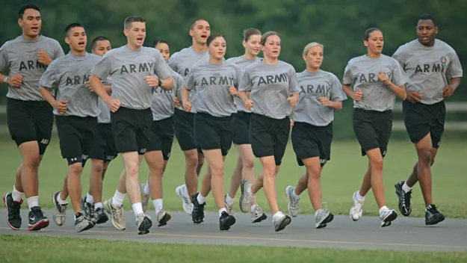
50%
Molloy JM, et al. Mil Med. 2020;185(9-10):e1461-e1471.
Image credit: kencombsrunningstore.com
Notes:
In 2017 it was reported that more than 50% of active component soldiers in the Army sustained at least 1 injury (MSKI or non-MSKI)
According to U.S. Army Public Health Center. Health of the Force Report. Health Outcomes-Injury, 2017

Slide 4
70% Overuse
Molloy JM, et al. Mil Med. 2020;185(9-10):e1461-e1471.
Image credit: kencombsrunningstore.com
Notes:
70% of these injuries were considered OVERUSE MSKI (eg, tendinopathies and stress fractures) which are defined as typically having a gradual onset resulting from repetitive overload during recurrent physical activity.
While this percentage is high, it does suggest that a large portion of MSKI occurrence may be modifiable.

Slide 5
~60-65% of limited duty days and non-deployment
Common overuse injury sites: lumbar spine, lower leg, knee
Common traumatic injury sites: foot/ankle, head/neck and arm/shoulder
Molloy JM, et al. Mil Med. 2020;185(9-10):e1461-e1471.
Image credit: kencombsrunningstore.com
Notes:
These high rates of injury negatively affect military readiness.
Noncombat musculoskeletal injuries (“MSKIs”) are reported to account for [CLICK]
nearly 60% of soldiers limited duty days and
65% of soldiers who cannot deploy for medical reasons.
Common overuse injury [CLICK] sites include lumbar spine, lower leg, knee and common traumatic injury sites [CLICK}: foot/ankle, head/neck and arm/shoulder.
Of these, my colleagues and I are particularly interested in the lower leg, knee, foot/ankle

Slide 6
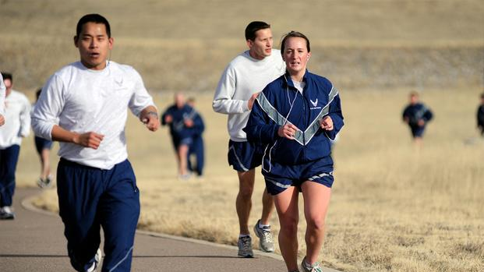
Limited duty days and non-deployment
Medical separation
Medical costs and disability
Chronic pain
2° health deficits
Image credit: military.com
Notes:
In addition to limited duty days and non-deployment, MSKI is associated with
higher medical separation rates.
significant medical costs, including service-connected disability compensation.
chronic pain
Secondary health deficits due to pain or long-term disability
A significant subset of soldiers develops chronic pain or long-term disability after injury; this may increase their risk for chronic disease or secondary health deficits potentially associated with MSKI.
Image: https://www.military.com/daily-news/2019/03/21/air-force-testing-buy-gender-neutral-fitness-test-overhaul.html

Slide 7
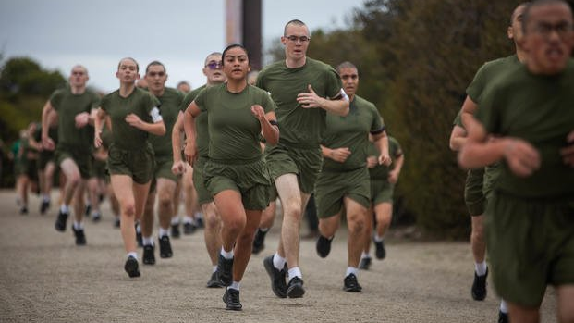
Female servicemembers have a 1.3 to 2-fold increased MSK injury risk compared to males and a 3-fold greater bone stress injury (BSI) risk.
Wentz L, et al. Mil Med. 2011;176(4):420-430; Molloy JM, et al. Mil Med. 2020;185(9-10):e1461-e1471.
Image credit: military.com
Image credit: military.com
Notes:
One subpopulation at notable risk is females. Depending on the injury site, female servicemembers have up to a 3-fold injury risk compared to males, (1.3x in active components and 2x in trainees)

Slide 8
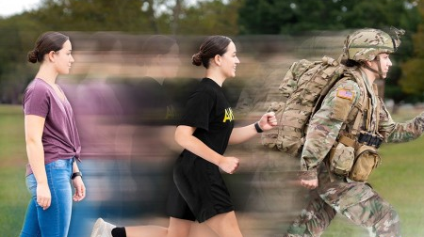
Better identification. Better rehabilitation. Better training.
Image credit: www.army.mil
Notes:
Our lab’s research interest parallel military needs in this area. We seek to identify screening tools to
better identify those at risk,
design better rehabilitation approaches to optimize recovery MSK injury and prevent re-injury
Provide empirical evidence to inform safe training decisions
In order to do that, we seek to better understand:
mechanisms of MSK injury
factors influencing MSK injury development and recovery
The DoD has responded to medical threat to readiness by standardizing injury definitions and implementing a medical surveillance systems that include tools to monitor MSK injury. Divisions also actively seek to find solutions through both research and implementation of holistic solutions, like the Army’s H2F holistic health and fitness system.
The army specifically tracks MSK injury in training populations (“training related injuries”)
MSKIs affect muscles, bones, joints, tendons, ligaments, cartilage, and other connective tissues.
Non-MSKIs include, but are not limited to, nerve injuries, contusions, blisters, open wounds, and environmental (eg, heat, cold, altitude) injuries
Overuse injuries (eg, tendinopathies and stress fractures) are defined as typically having a gradual onset resulting from repetitive overload during recurrent physical activity
Traumatic injuries (eg, joint sprains, ligamentous tears, or fractures) are defined as having sudden onset, resulting from high intensity forces sustained at one point in time.

Slide 9
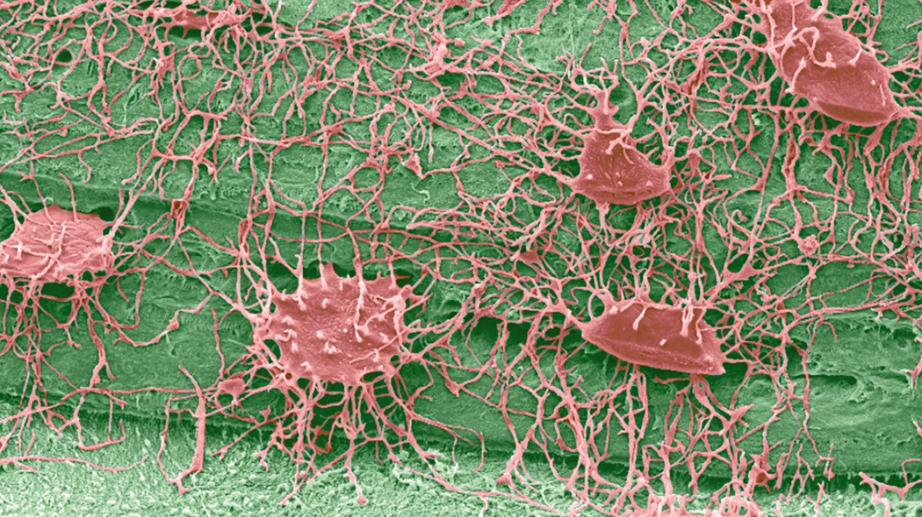
Mechanobiology of Injury
Biomechanics
Motor Control
Physiology
Structure
Footwear
Surface
Hormone status
Activity history
Energy intake
Health history
Nutrition
Genetics
Biomechanical load
Bone strength
Bone Strain
Workload
Rest/recovery
Bone Stress Injury
Normal
re/modeling
Damage related remodeling
Accelerated
remodeling
Stress
Reaction
Stress
Fracture
Complete
Fracture
Modified from ²Brukner et al. Blackwell Science Asia. 1999.
Notes:
From a mechanistic perspective, injury is a biomechanical event at the tissue level – tissue stress/strain is in the causal pathway.
If we can estimate the load that tissue is experiencing during training related tasks, we will be better poised to identify the key biomechanical load and bone strength factors that that interact to predispose servicemembers to injury.
Further, we will be able to evaluate the consequences of repetitive high magnitude bone strain within the context of training relevant workloads and recovery periods.
Physiology/Health history – sleep, stress, personality type, psychosocial factor

Slide 10
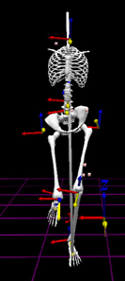
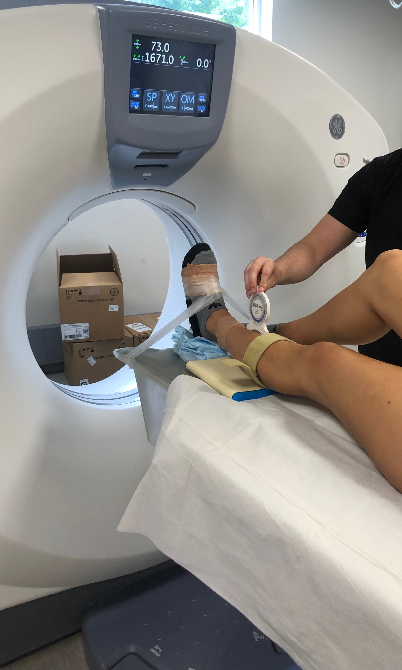
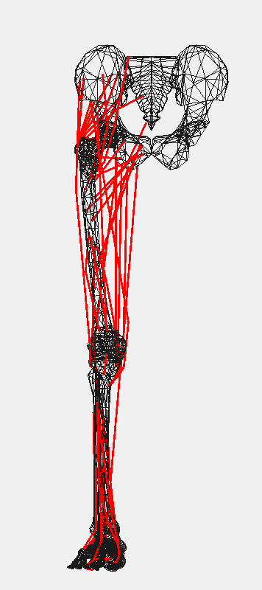
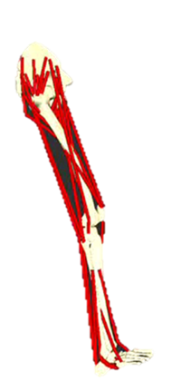
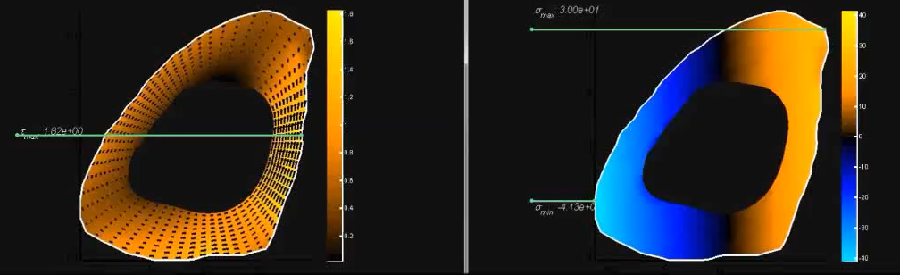

Estimating Tissue Load
In-lab activity
Medical imaging
Motion capture data
Image segmentation
Musculoskeletal model
Bone or joint
model
Lab-based biomechanical load
Tissue load
Notes:
The way in which our lab derives tissue loads uses a combination in-lab activity and medical imaging.
We capture both motion and force data [CLICK] during a relevant tasks and input that data into a musculoskeletal model [click] to estimate biomechanical load [CLICK] acting at the tissue of interest.
If we have access to medical imaging like MRI or CT, we can segment those images [click] to extract the tissue geometry and material properties to create a bone or joint model [CLICK].
Integrating both lab based biomechanical load and tissue load [CLICK], we can then estimate tissue specific load - distal tibia stress during running is illustrated here.

Slide 11
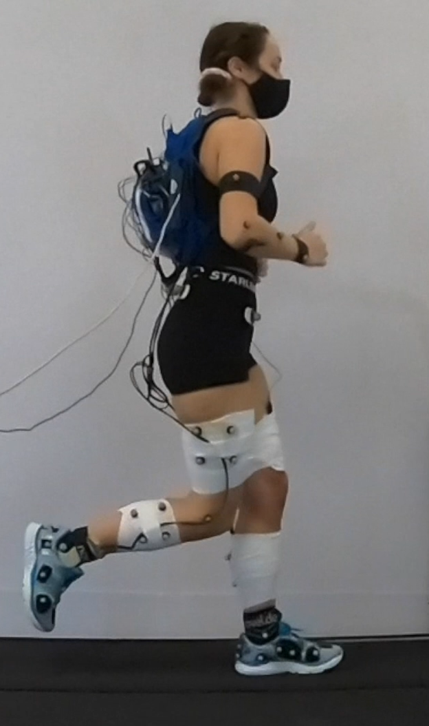
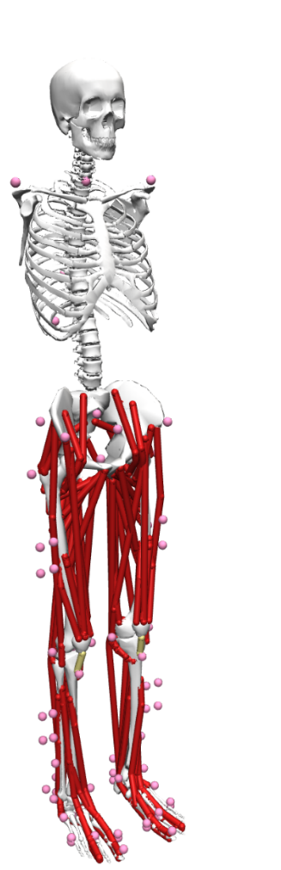
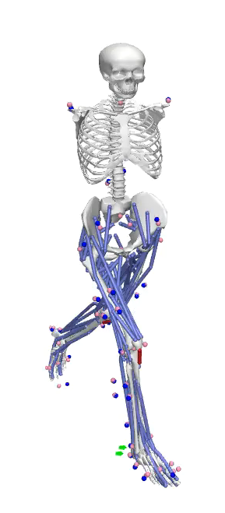
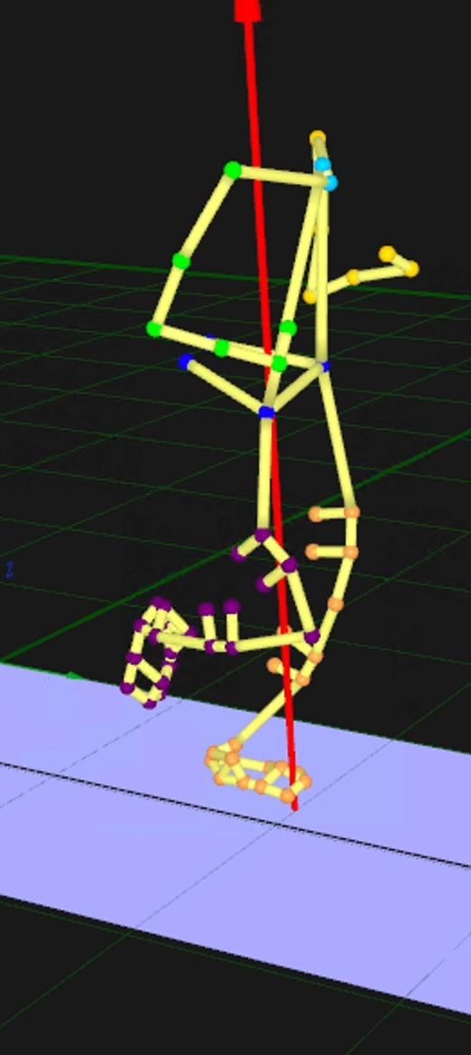
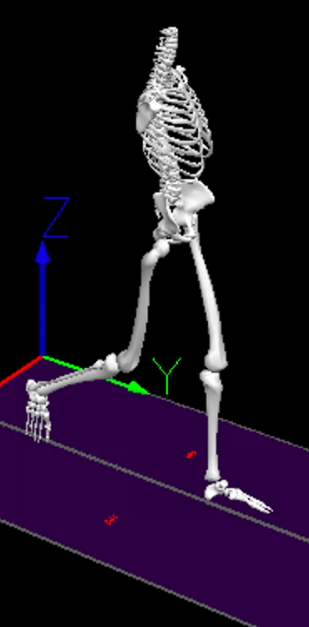
In-lab Activity
In Lab Activity
Marker Tracking
Rigid Body Model
Musculoskeletal Model
Digital
“Twin”

Slide 12
Lower Extremity Biomechanical loads
Notes:
Using these techniques, our lab has been able to estimate loads throughout the lower extremity to inform rehabilitation and prevention efforts.

Slide 13
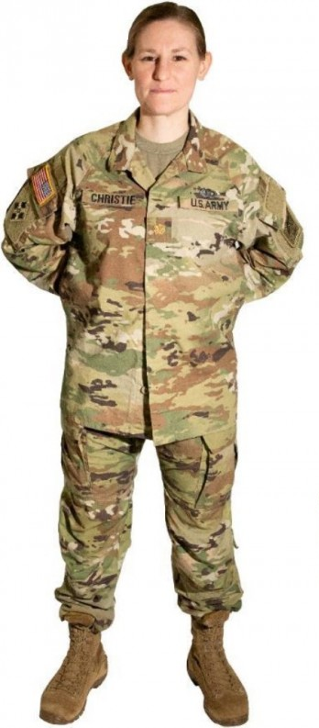
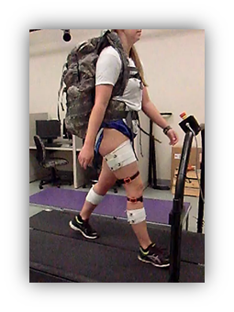

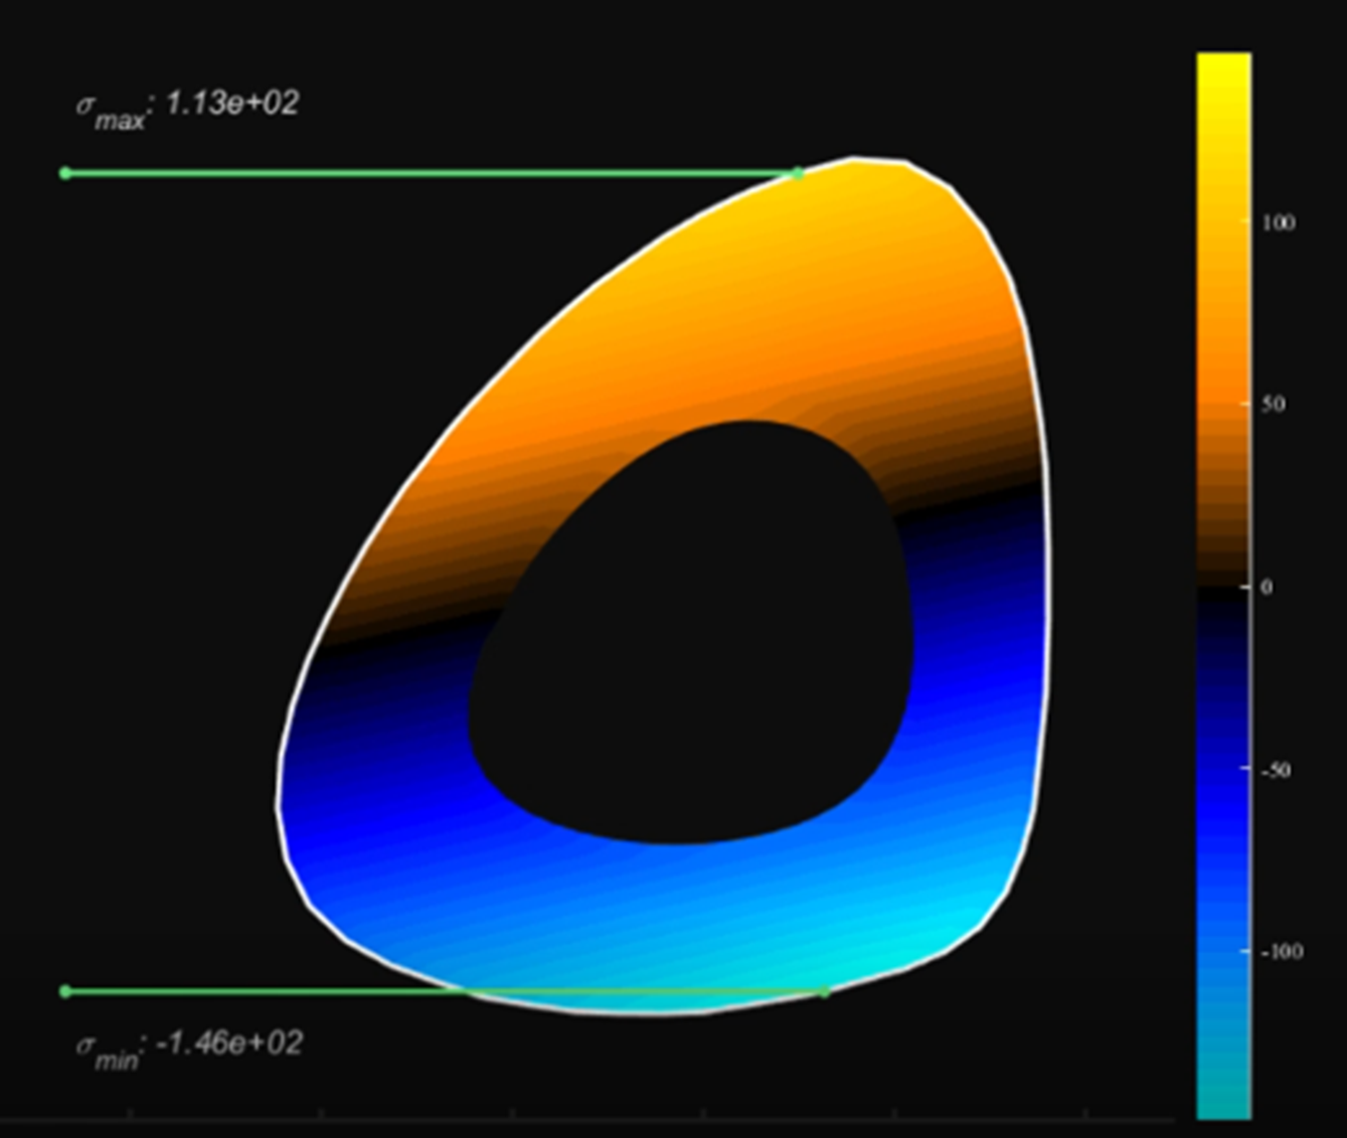
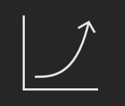
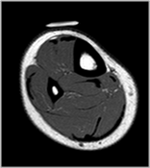


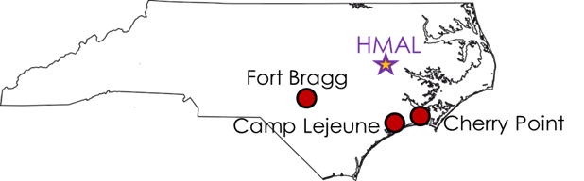
Data-driven multi-scale models of tissue loads during human movement
Concussion
Gait modification with real-time feedback
Physical training protocols
Exertion & fatigue effects
Sex disparities
Load carriage
Footwear
Post-traumatic OA
ITBS
Amputation
PFP
ACL
Bone stress injury
CAI, Ankle fx
Achilles injury
Observed dynamics
Innovative solutions
Musculoskeletal modeling
Probabilistic injury
prediction
Subject-specific models
sites.ecu.edu/hmal
Tissue loads
Notes:
Some examples of what we have studied include:
Gait modification with real-time feedback
Physical training protocols
Exertion & fatigue effects
Sex disparities
Load carriage
Footwear
These data driven models can and have been able to identify solutions for a variety of military relevant injuries by researchers in our lab

Slide 14



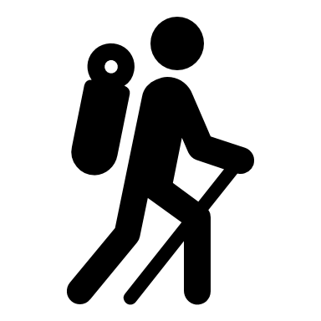

Military relevant outcomes from our lab
Tissue loads can be estimated during training activities using efficient computational models of the musculoskeletal system^{4,5,6,7,8, 15, 17,18}
Tibial stress may be higher in females across a variety of gait speeds⁶
Tissue loads are mediated by activity type and speed^{6,8,16}
Tissue loads are influenced by running technique^{4,7,9,10}, exertion^{11,12,13}, footwear¹⁴, and load carriage¹⁸
Tissue loads can be input to damage formation indices and probabilistic models of failure that account for adaptation¹⁹ to identify military relevant solutions
Notes:
1.In collaboration with John Willson, we have shown that tissue loads in the LE can be estimated during training activities using efficient computational models of the musculoskeletal system
2. Sex differences in mechanics have translated to higher loads in females - we found higher peak stress in women during running and walking which may predispose them to injury
3. We have also shown that LE loads, and tibia stress vary with activity and gait speed
4. In collaboration Hanna Rice, and Rich Willy, we have also demonstrated that LE loads are influenced by running form, fatigue, footwear and load carriage.
5. Finally, in collaboration with Ali Vahdati, we have seen that the differences in tissue loads detected by our models can be input to models of failure which could be used to identify military relevant solutions

Slide 15
Current projects
Real time feedback on running form (females and males)*
Load progression (females and males)
Effect of exercise protocol on tissue load and damage formation (females and males)
Relationship between musculoskeletal injury and postural control (females and males) †
Effect of simulated bone strengthening on tibial stress (females and males)*
Wearable sensors to predict tissue loads outside of the lab (females and males) ‡
Effect of fitness and exertion on musculoskeletal loads in females at risk of bone stress injury§
Field measures of bone structure to inform screening algorithms §
  * partially supported by by NSF EEC-1659796 and EEC-1359183
  † in collaboration with Dr. Chia-Cheng Lin and supported by NIH NIA-1R15AG058228-01A1
  ‡ in collaboration with Jon Davis (IU) and Dr. Allison Gruber (IU) and supported by ASB and ACSM grants
  § in collaboration with Dr. John Willson (ECU) and Junfei Tong (BHSAI) and supported by HJF.
Notes:
All our current project include females to either examine or at least screen for potential sex disparities.
We are wrapping up a study examining RT feedback on peak tibial stress [CLICK]
We have found that peak stress (y-axis) can be lowered by shortening your step length and widening your step width (x-axis) while a FFS pattern increases compression, tension and shear

Slide 16
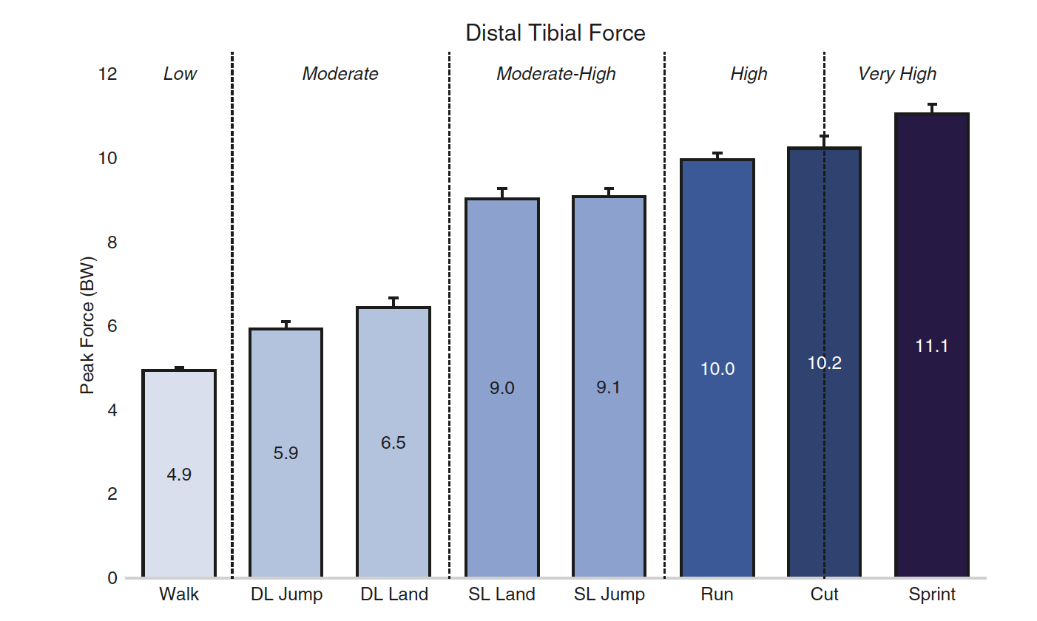
Current projects
Real time feedback on running form (females and males)*
Load progression (females and males)
Effect of exercise protocol on tissue load and damage formation (females and males)
Relationship between musculoskeletal injury and postural control (females and males) †
Effect of simulated bone strengthening on tibial stress (females and males)*
Wearable sensors to predict tissue loads outside of the lab (females and males) ‡
Effect of fitness and exertion on musculoskeletal loads in females at risk of bone stress injury§
Field measures of bone structure to inform screening algorithms §
  * partially supported by by NSF EEC-1659796 and EEC-1359183
  † in collaboration with Dr. Chia-Cheng Lin and supported by NIH NIA-1R15AG058228-01A1
  ‡ in collaboration with Jon Davis (IU) and Dr. Allison Gruber (IU) and supported by ASB and ACSM grants
  § in collaboration with Dr. John Willson (ECU) and Junfei Tong (BHSAI) and supported by HJF.
Notes:
A study on load progression has shown a predictable increase in peak distal tibia forces (y-axis) across double and single leg tasks (x-axis).
These results can be used to guide exercise progression following injury or when initiating an training protocol.

Slide 17
Current projects
Real time feedback on running form (females and males)*
Load progression (females and males)
Effect of exercise protocols on tissue load and damage formation (females and males)
Relationship between musculoskeletal injury and postural control (females and males) †
Effect of simulated bone strengthening on tibial stress (females and males)*
Wearable sensors to predict tissue loads outside of the lab (females and males) ‡
Effect of fitness and exertion on musculoskeletal loads in females at risk of bone stress injury§
Field measures of bone structure to inform screening algorithms §
  2:3 HIIT vs Prolonged Run
  35% less cumulative peak stress
  30-32% lower damage formation rate
  57% fewer “high impact” load cycles
  Less increase in bone stress with exertion
  * partially supported by by NSF EEC-1659796 and EEC-1359183
  † in collaboration with Jon Davis (IU) and Dr. Allison Gruber (IU) and supported by ASB and ACSM grants
  ‡ in collaboration with Dr. Chia-Cheng Lin and supported by NIH NIA-1R15AG058228-01A1
  § in collaboration with Dr. John Willson (ECU) and Junfei Tong (BHSAI) and supported by HJF.
  * partially supported by by NSF EEC-1659796 and EEC-1359183
  † in collaboration with Dr. Chia-Cheng Lin and supported by NIH NIA-1R15AG058228-01A1
  ‡ in collaboration with Jon Davis (IU) and Dr. Allison Gruber (IU) and supported by ASB and ACSM grants
  § in collaboration with Dr. John Willson (ECU) and Junfei Tong (BHSAI) and supported by HJF.
Notes:
In a comparison of HII running to prolonged running, we found 35% less cumulative load (y-axis) with HII running compared to prolonged time-matched running (x-axis) and 30-32% lower damage formation rates (y-axis).
This was most likely due to fewer high impact load cycles and less stress increase with fatigue.

Slide 18
Current projects
Real time feedback on running form (females and males)*
Load progression (females and males)
Effect of exercise protocols on tissue load and damage formation (females and males)
Relationship between musculoskeletal injury and postural control (females and males) †
Effect of simulated bone strengthening on tibial stress (females and males)*
Wearable sensors to predict tissue loads outside of the lab (females and males) ‡
Effect of fitness and exertion on musculoskeletal loads in females at risk of bone stress injury§
Field measures of bone structure to inform screening algorithms §
  * partially supported by by NSF EEC-1659796 and EEC-1359183
  † in collaboration with Dr. Chia-Cheng Lin and supported by NIH NIA-1R15AG058228-01A1
  ‡ in collaboration with Jon Davis (IU) and Dr. Allison Gruber (IU) and supported by ASB and ACSM grants
  § in collaboration with Dr. John Willson (ECU) and Junfei Tong (BHSAI) and supported by HJF.
  * partially supported by by NSF EEC-1659796 and EEC-1359183
  † in collaboration with Dr. Chia-Cheng Lin and supported by NIH NIA-1R15AG058228-01A1
  ‡ in collaboration with Jon Davis (IU) and Dr. Allison Gruber (IU) and supported by ASB and ACSM grants
  § in collaboration with Dr. John Willson (ECU) and Junfei Tong (BHSAI) and supported by HJF.
Notes:
Shifting gears, a bit, Dr. Lin and I are examining the relationship between musculoskeletal injury and postural control.
Preliminary results suggest lower equilibrium scores (y-axis) in test conditions in which vision is manipulated.

Slide 19
Current projects
Real time feedback on running form (females and males)*
Load progression (females and males)
Effect of exercise protocols on tissue load and damage formation (females and males)
Relationship between musculoskeletal injury and postural control (females and males) †
Effect of simulated bone strengthening on tibial stress (females and males)*
Wearable sensors to predict tissue loads outside of the lab (females and males) ‡
Effect of fitness and exertion on musculoskeletal loads in females at risk of bone stress injury§
Field measures of bone structure to inform screening algorithms §
  * partially supported by by NSF EEC-1659796 and EEC-1359183
  † in collaboration with Dr. Chia-Cheng Lin and supported by NIH NIA-1R15AG058228-01A1
  ‡ in collaboration with Jon Davis (IU) and Dr. Allison Gruber (IU) and supported by ASB and ACSM grants
  § in collaboration with Dr. John Willson (ECU) and Junfei Tong (BHSAI) and supported by HJF.
Notes:
I also have a students examining bone strengthening effects on tibial stress, [CLICK] and wearable sensors to predict tibia stress outside the lab.
And through a recent subaward with the Biotechnology High Performance Computing Software Applications Institute (BHSAI), we are examining the effect of fitness and exertion on MSK loads in females.
[CLICK] And as part of the project, my students are working on identifying field measures of bones structure to inform screening algorithms.

Slide 20
Ideal industry research partner
A company interested in:
  Novel screening tools for musculoskeletal injury risk factors
  Interventions to mitigate high tissue loads over prolonged activity
  because
    Current algorithms for musculoskeletal injury do not include a measure of tissue quality which is a critical component of load tolerance
    Prolonged moderate to high intensity loads are inevitable necessitating the development of effective load management strategies
Notes:
My ideal industry partner will be interested in novel screening tools and interventions to mitigate high tissue loads over prolonged activity because
today’s tools are lacking good measures of tissue quality and
for some populations, prolonged high intensity load are inevitable. These populations will require effective load management strategies to minimize injury risk

Slide 21
Ideal DoD/Federal research sponsor
A sponsor with:
  Shared appreciation of the impact of musculoskeletal injury on health outcomes, participation and quality of life
  Desire to support impactful work examining the mechanisms underlying injury
  because
    The burden of musculoskeletal injury, especially overuse injury, is often overlooked despite documented activity cessation, job separation, psychological stress, and financial burden.
    Understanding the mechanisms of injury allow for the development of novel and effective screening tools and interventions.
Notes:
I am also looking for research sponsor with a shared appreciation for the burden of MSK injury and a desire to support work examining mechanisms underlying injury.
Understanding the mechanisms of injury will allow for novel, effective screening tools and interventions to be developed.

Slide 22
Next big research focus areas
Over the next few years, our lab will:
  Investigate and develop screening tools for bone strength (load tolerance) to be used in musculoskeletal injury risk assessments, including return to duty decision making
  Examine the effects of training protocols on bone strength (load tolerance), tissue loads and injury risk.
  Study the effect of sensorimotor function and neurocognition on tissue loads physical training tasks.
Notes:
I plan on continuing down the path I have started. Thus, I will continue to investigate
Screening tools and return to duty decision making and
Training protocols to improve load tolerance
I would also like to examine the effects of sensorimotor function and neurocognition on tissue loads during training tasks.

Slide 23


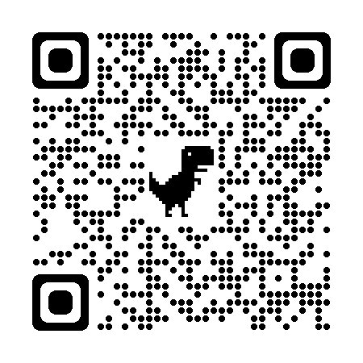
Thank you.
Acknowledgments.
Questions.
Human Movement Analysis Labs
Stacey Meardon, John Willson, Ryan Wedge and Chia Cheng Lin
https://sites.ecu.edu/hmal/
Notes:
Thank you for the opportunity to share my work as well as your attention.
If you'd like to visit our lab and my colleagues, details can be found on this website.
I will now take any questions.

Slide 24
References
Molloy JM, Pendergrass TL, Lee IE, Chervak MC, Hauret KG, Rhon DI. Musculoskeletal Injuries and United States Army Readiness Part I: Overview of Injuries and their Strategic Impact. Mil Med. 2020 Sep 18;185(9-10):e1461-e1471. doi: 10.1093/milmed/usaa027. PMID: 32175566.
Brukner, P., Bennell, K., & Matheson, G. (1999). Stress fractures. Blackwell Science Incorporated.
Wentz, L., Liu, P. Y., Haymes, E., & Ilich, J. Z. (2011). Females have a greater incidence of stress fractures than males in both military and athletic populations: a systemic review. Military medicine, 176(4), 420-430.
Meardon, Stacey A., and Timothy R. Derrick. (2014) Effect of step width manipulation on tibial stress during running. Journal of Biomechanics, 47(11): 2738-2744.
Meardon, S. A., & Derrick, T. R. (2014). Effect of step width manipulation on tibial stress during running. Journal of Biomechanics, 47(11), 2738-2744.
Meardon, S. A., Derrick, T. R., Willson, J. D., Baggaley, M., Steinbaker, C. R., Marshall, M., & Willy, R. W. (2021). Peak and per-step tibial bone stress during walking and running in female and male recreational runners. The American Journal of Sports Medicine, 49(8), 2227-2237.
Willson, J. D., Sharpee, R., Meardon, S. A., & Kernozek, T. W. (2014). Effects of step length on patellofemoral joint stress in female runners with and without patellofemoral pain. Clinical biomechanics, 29(3), 243-247.
Milner, C. E., Meardon, S. A., Hawkins, J. L., & Willson, J. D. (2018). Walking velocity and step length adjustments affect knee joint contact forces in healthy weight and obese adults. Journal of Orthopaedic Research®, 36(10), 2679-2686.
Willson, J. D., Ratcliff, O. M., Meardon, S. A., & Willy, R. W. (2015). Influence of step length and landing pattern on patellofemoral joint kinetics during running. Scandinavian journal of medicine & science in sports, 25(6), 736-743.
Willy, R. W., Meardon, S. A., Schmidt, A., Blaylock, N. R., Hadding, S. A., & Willson, J. D. (2016). Changes in tibiofemoral contact forces during running in response to in-field gait retraining. Journal of Sports Sciences, 34(17), 1602-1611.

Slide 25
References
Willson, J. D., Loss, J. R., Willy, R. W., & Meardon, S. A. (2015). Sex differences in running mechanics and patellofemoral joint kinetics following an exhaustive run. Journal of biomechanics, 48(15), 4155-4159.
Rice, H. M., Weir, G., Trudeau, M. B., Meardon, S., Derrick, T., & Hamill, J. (2019). Estimating tibial stress throughout the duration of a treadmill run.
Rice, H. M., Kenny, M., Ellison, M. A., Fulford, J., Meardon, S. A., Derrick, T. R., & Hamill, J. (2020). Tibial stress during running following a repeated calf‐raise protocol. Scandinavian Journal of Medicine & Science in Sports, 30(12), 2382-2389.
Meardon, S. A., Willson, J. D., Kernozek, T. W., Duerst, A. H., & Derrick, T. R. (2018). Shoe cushioning affects lower extremity joint contact forces during running. Footwear Science, 10(2), 109-117.
Bowersock, C. D., Willy, R. W., DeVita, P., & Willson, J. D. (2017). Reduced step length reduces knee joint contact forces during running following anterior cruciate ligament reconstruction but does not alter inter-limb asymmetry. Clinical Biomechanics, 43, 79-85.
Gheidi, N., Kernozek, T. W., Willson, J. D., Revak, A., & Diers, K. (2018). Achilles tendon loading during weight bearing exercises. Physical Therapy in Sport, 32, 260-268.
Esculier, J. F., Willy, R. W., Baggaley, M. W., Meardon, S. A., & Willson, J. D. (2017). Sex-specific kinetic and kinematic indicators of medial tibiofemoral force during walking and running. The Knee, 24(6), 1317-1325.
Willy, R. W., DeVita, P., Meardon, S. A., Baggaley, M., Womble, C. C., & Willson, J. D. (2019). Effects of load carriage and step length manipulation on Achilles tendon and knee loads. Military Medicine, 184(9-10), e482-e489.
Paul, E., Pant, A., George, S., Willson, J., Meardon, S., & Vahdati, A. (2022). In silico modeling of tibial fatigue life in physically active males and females during different exercise protocols. Biomedical Physics & Engineering Express, 8(3), 035019.

Slide 26
Bone mass
Braking forces
Acute loading history
Bone geometry
Dynamic pes planus
Forefoot varus
Dynamic pes cavus
Chronic loading history
Muscle strength
vGRF loading rate
Fitness
Arch height
Rearfoot eversion
Fatigue
Recovery time
Rearfoot varus
Tibia angle
Energy availability
Muscle girth
Knee flexion
Running downhill
Knee internal rotation
Pack weight
Hormone status
Bone Stress Injury
Arch mobility
Eating disorder
Peak vGRF
Zig zag running
Running uphill
Knee valgus
Knee abduction
History of ball sports
Tibial varum
Knee varus
Footwear
Over ground running
Step width
Free moment
Leg length discrepancy
Running speed
Hip adduction
Step length
ACWR
Q-angle
Notes:
Many factors contribute to or predispose a soldier to injury.
This slide was an overly optimistic exercise to try to summarize graphically all the potential factors we should consider when trying to identify injury risk – in this case BSI risk.
As you can see, there are a lot, and I didn’t even include all factors. I ran out of room and gave up.
But then, I realized there is as story to tell here.
I am not saying we should ignore these factors, rather these factors and their interactions are all thing we should consider when identifying individuals and risk and treating them

