Slide 1
Measurement of balance as a window into neurological function and mTBI; Imaging and modeling of soft tissue to reduce musculoskeletal injuries
Zachary Domire
Performance Optimization Laboratory

Slide 2
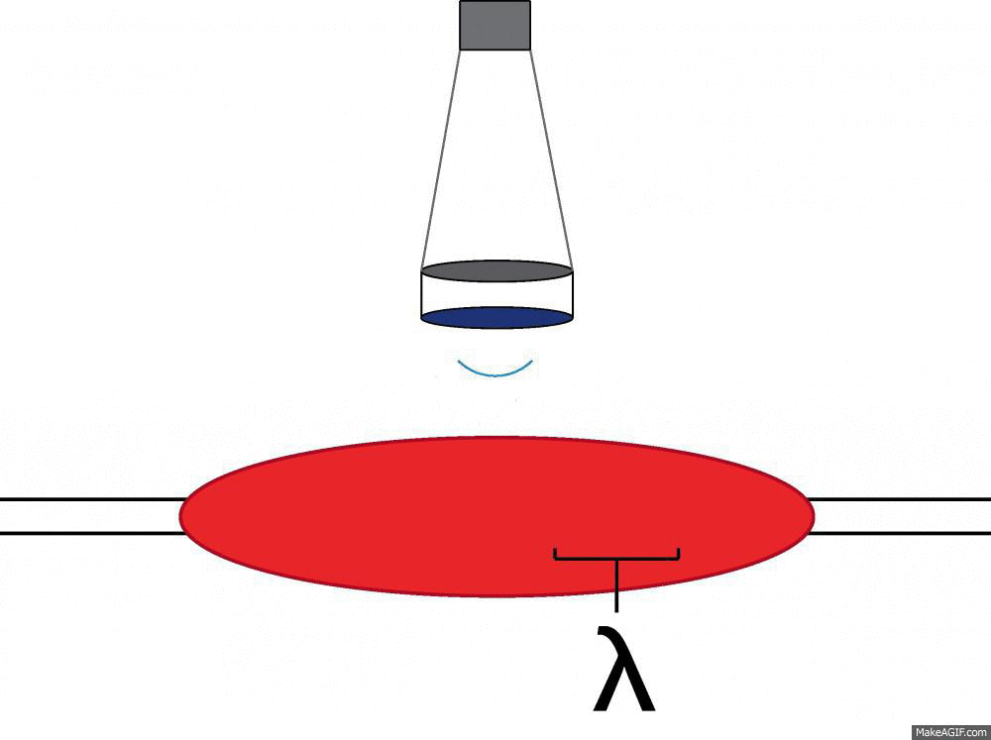
Ultrasound Elastography
Body

Slide 3
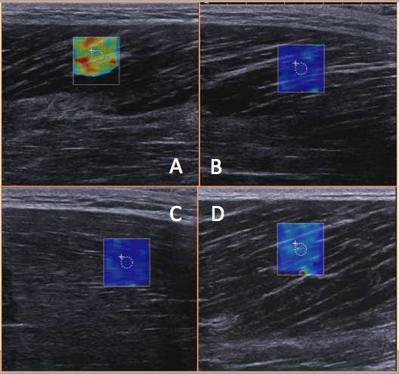
Applications to Prevent Injury
S009
SMM
(51.1 kPA))
S009
BFM
(17.9 kPA))
Body
S009
STM
(12.6 kPa)
S007
SMM
(21.5 kPa)

Slide 4
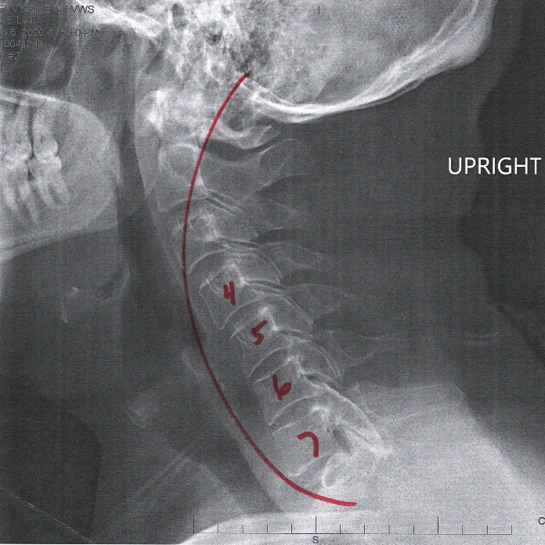
Currently Funded ONR Project
Most studies have utilized EMG to study neck muscle activation as it relates to helmet design
Load does not directly equate with pathology or pain
General Hypothesis: Neck pathology is coming from high loads associated with the complex interaction of helmet load and posture.

Slide 5
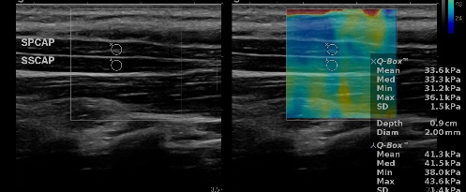
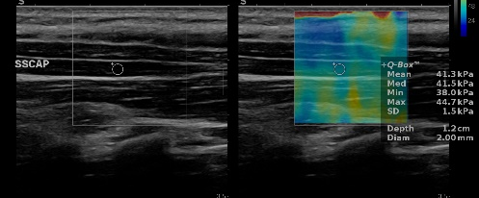
Preliminary Results
Achieved good wave propagation in relaxed and contracted states. Wave speed is scaling as expected with contraction intensity.

Slide 6
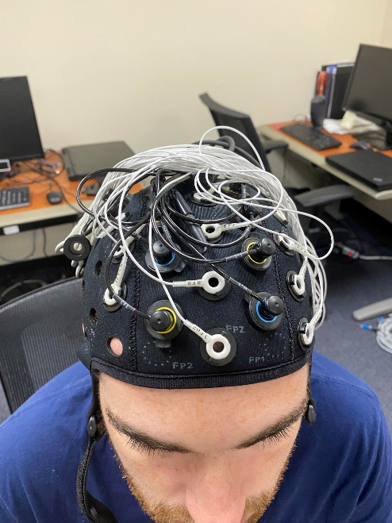
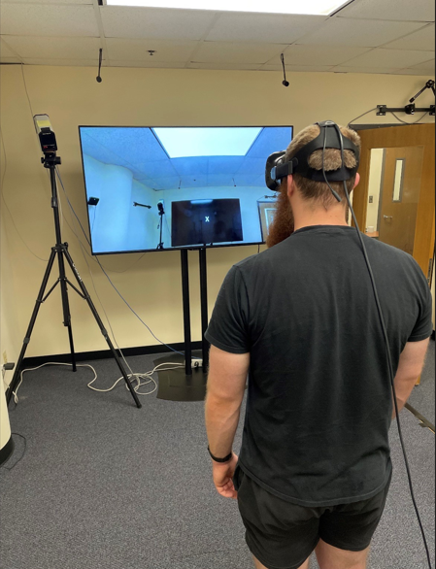
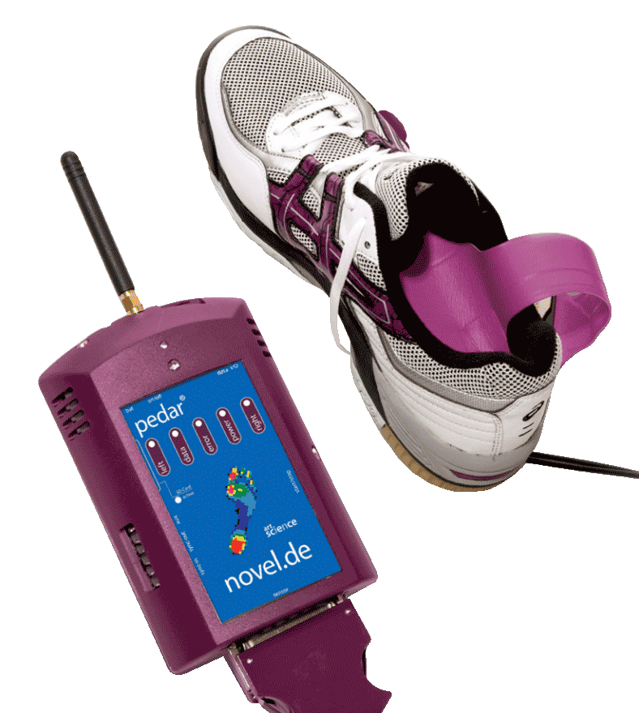
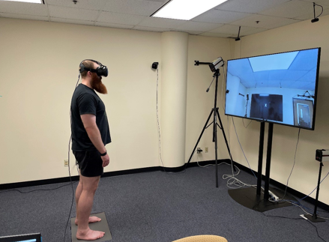
Mobile Balance Testing System
By combining VR, Brain Imaging, and in shoe pressure measurement we can detect mTBI related balance changes

Slide 7
Application
Repetitive loading even at relatively low loads has the potential to cause significant neurological disfunction.
Aim:
Development of improved blast exposure guidelines for training activities
Provide a mechanism to test effectiveness of interventions designed to reduce the effects of blast exposure.
Short-term neurological impairments from blast exposure may increase musculoskeletal injury risk and impair mission performance. This study could provide a timeline of this impairment.

