Slide 1
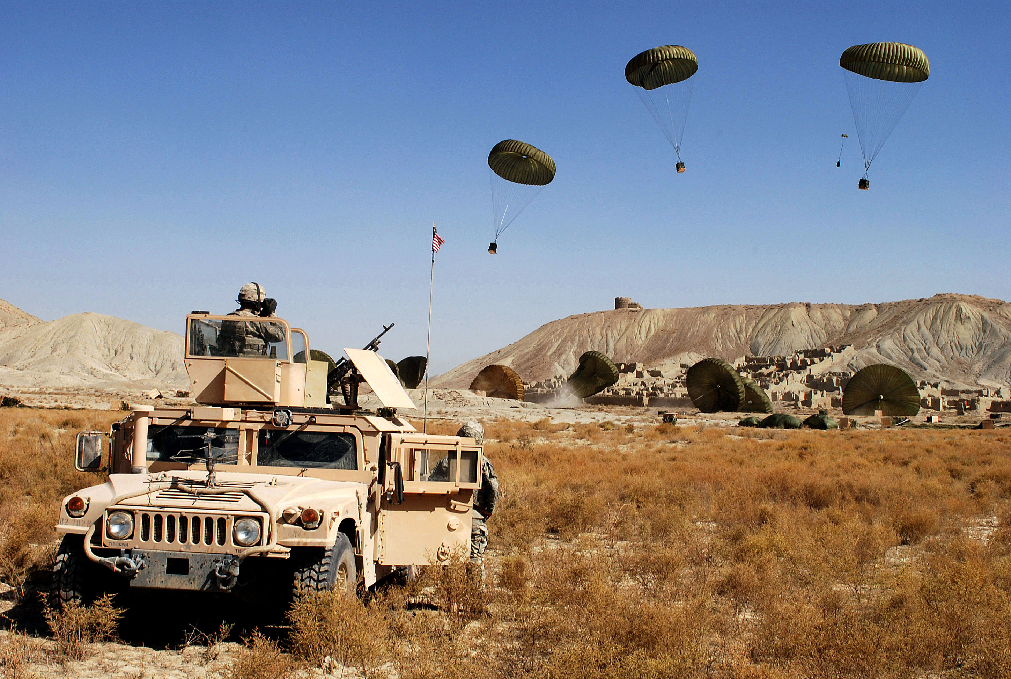
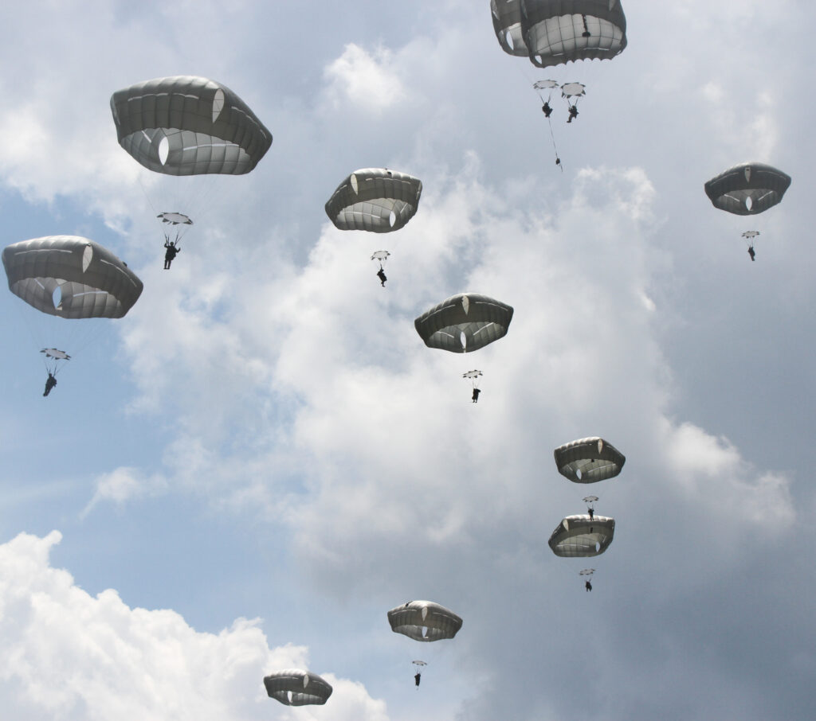
82nd Airborne’s Airdrop Database Optimization
Erol Ozan, Ph.D.
Associate Professor
Department of Technology Systems

Slide 2
Introduction
Erol Ozan, Ph.D., Associate Professor
Dept. of Technology Systems, College of Engineering and Technology
DoD research topic(s): DoD Software Asset Modernization Process Optimization, Machine Learning + IoT
Current DoD research sponsor: Civil Military Innovation Institute, U.S. Army 82nd Airborne (June 2022 – September 2022). $285,543
Years 2006 – 2012: DoD/NSA Capacity Building & Scholarship Grants
6 Grants, total amount: $329,150
Cumulative Total of DoD Grants (2006 – 2022): 7 Grants, total amount: $614,693
Cumulative Total of All External Grants: 14 Grants; Total Amount: $1,254,237
(Non-DoD Granting Agencies include NASA, NSF, NCDOT

Slide 3
82nd Airborne Airdrop Database Optimization (SEED) Project
Project PI: Erol Ozan
Project Co-PI: Biwu Yang
Data collection on the legacy system use cases
Analysis of the Deployment Environment
Interviews with soldiers and stakeholders
System Requirements
System requirement analysis (from initial problem definition to formalized system requirements)
Unit provided the initial problem definition
Research team formalized the problem definition in collaboration with the legacy system user and key stakeholders

Slide 4
Software Modernization for Airdrop Database
Legacy System
Modernized System
End users
(soldiers, military and civilian personnel)
82nd Airborne HQs
IT infrastructure context
DOD Software Modernization Priorities
Stakeholders of the System

Slide 5
Software Modernization in Two Phases
Collect all data and information regarding the existing database and its use
1
Identify customer’s needs and wants
2
Understand the IT context
3
Talk with key stakeholders to identify an optimal vision and solution specification
4
Phase 1
Phase 2
Build the specified optimal solution
Test the solution in a realistic user settings with actual end-users
Modify, improve, and get customer’s approval for the production system
Operationalize the solution by providing training, guidance for integration into workflow, and road map for future iterations of the system

Slide 6
Delivering a Fast and Highly Performant System Solution (Key Approaches)
Involve end-users and stakeholders at every stage
Better problem definition
Understand the users’ needs and wants
Fast customer-centric system development with capable and experienced team
High quality software solution
Efficient project management
Comprehensive system testing with end-users replicating real use cases
Reduce time to operationalize
Maximize the quality and reliability of the end-product

Slide 7
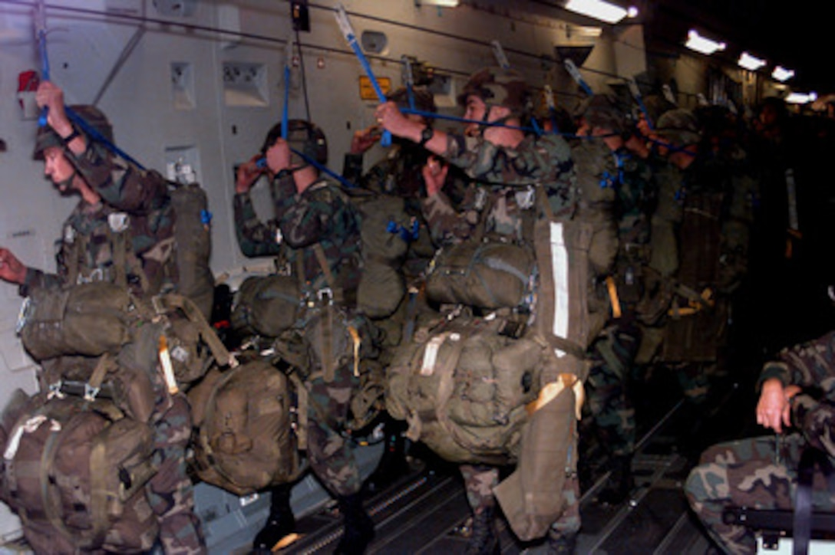
Integrating Soldiers’ Perspectives
Soldiers and Military Personnel as System
End-users at the Center of R&D Efforts
End users’ needs and wants shape the R&D project
Pilot project places significant emphasis on the extensive testing with the end-users

Slide 8
Conclusion
My ideal industry research partner in the future: Lockheed Martin Center of Innovation (“The Lighthouse”) because of their “unique infrastructure, optimized for collaborative experimentation and analysis.”
My ideal DoD/Federal research sponsors in the future: DARPA and Army Research Lab because of their effective “ecosystem of innovation.”
My next big research focus areas:
Rapid AI System Development (ML + Edge Computing + IoT)

