Slide 1

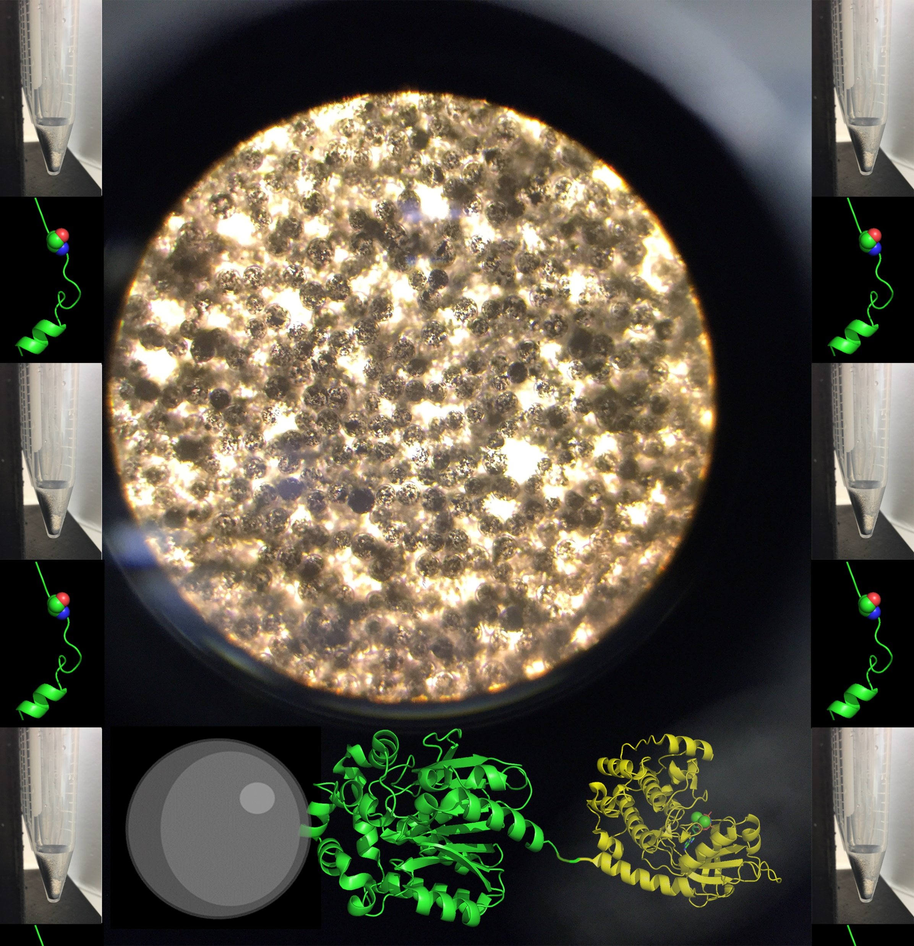
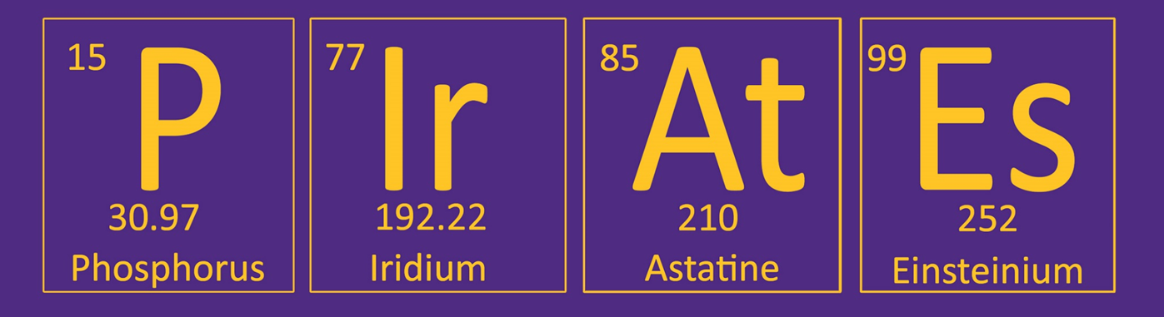
Hughes Lab: Enzyme Immobilization
GOAL:
Customizable, Reusable, Robust
Enzyme Formulations
Design
Analyze
Make
Test
Department of Chemistry

Slide 2
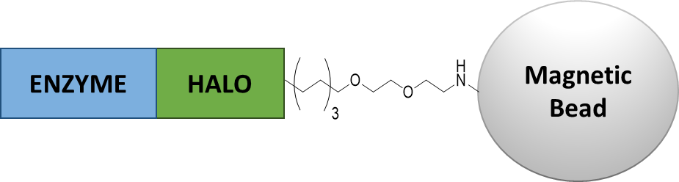
Enzyme Immobilization
How?
Why?
Encapsulation
Cross-linking
Non-specific binding
Generic functional group capture
Protein-ligand interaction
HaloTag covalent capture
Improved Stability
Extreme Condition Functionality
Reusability
Multi-surface Coating
Applications
Detection/Biosensing
Threat Remediation
Bioenergy
Waste Stream Management
Human Health

Slide 3



Recent DOD Funded Examples
Immobilized enzymes for non-surgical burn wound debridement methods and materials for scenarios involving pre-hospital environments and prolonged field care. Immobilized enzymes for specific detection of tributyl phosphate solvent used in nuclear fuel processing. Immobilized enzymes that are directly relevant to detecting chemical signatures of weapons of mass destruction. Immobilized enzymes on a wide variety of surfaces and substrates for potential applications in sensing, catalysis, and biocompatible materials. Immobilized enzymes with high potential for biotransformation and inactivation of explosive molecules was successfully demonstrated. In the study trinitrotoluene (TNT) and nitroglycerin (NG) were successfully transform into a safe intermediates with less toxicity and explosiveness. Immobilized enzymes in enzymatic biofuel cells are a type of fuel cell that utilizes enzymes as the electrocatalysts to catalyze the oxidation of fuel and/or the reduction of oxygen or peroxide to convert chemical energy into electricity.

Slide 4
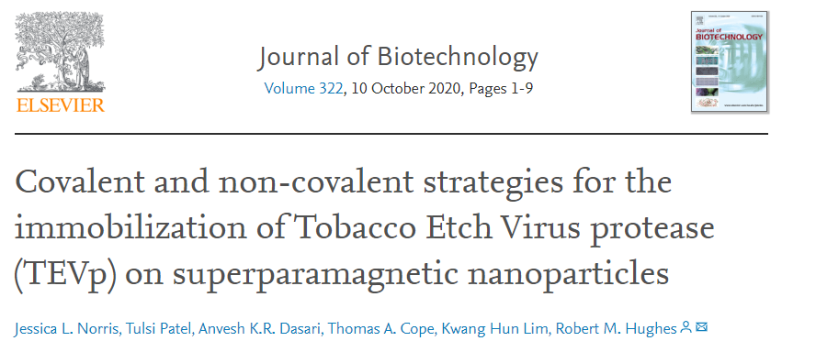
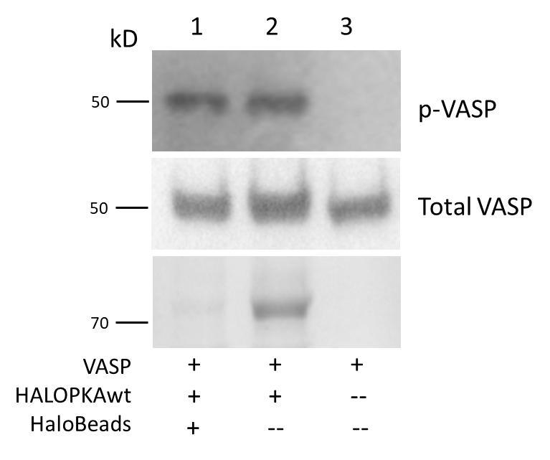
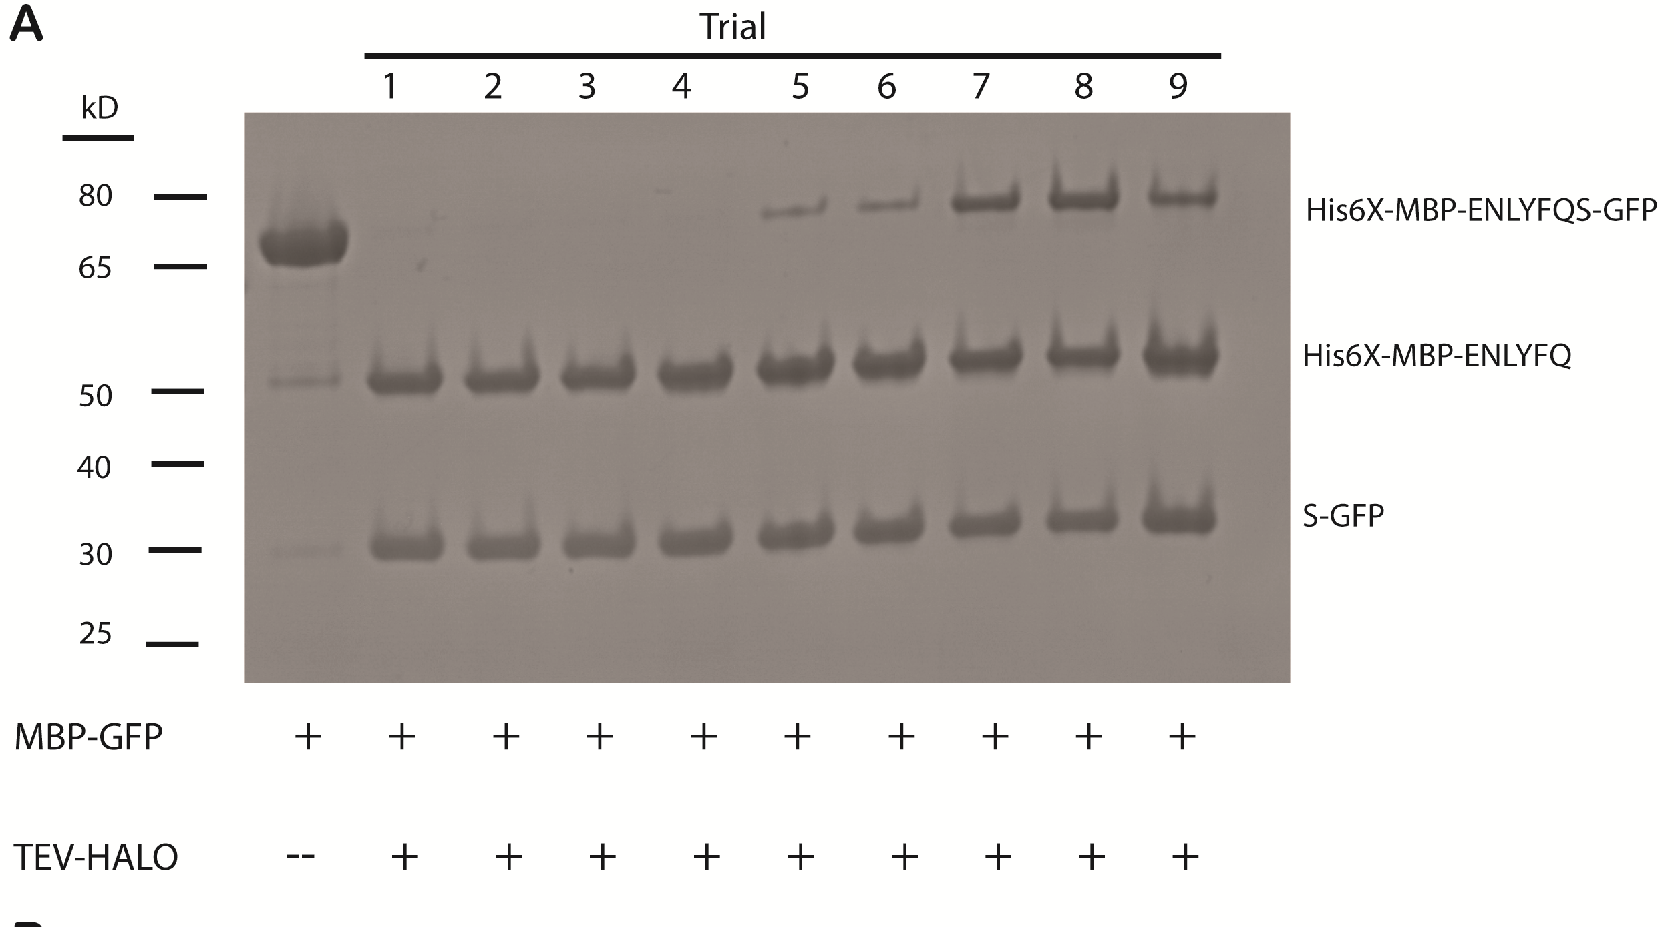
Hughes Lab: Current Capabilities
Immobilized Protein Kinase
Immobilized TEV Protease
Fusion Linker Optimization

Slide 5
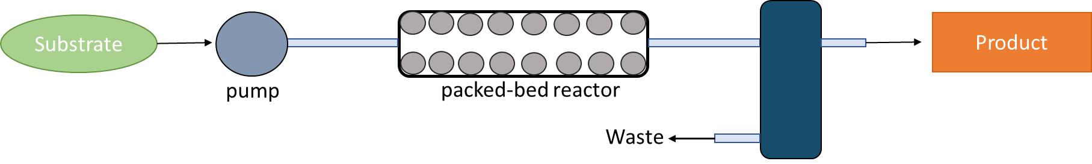
Hughes Lab: Future Work
Bioprocessing pipeline for production of Anti-Fungal Peptides (Dental Medicine)
Other Interests
Potential Funding Partners
Bioenergy
Threat detection/remediation

