Slide 1
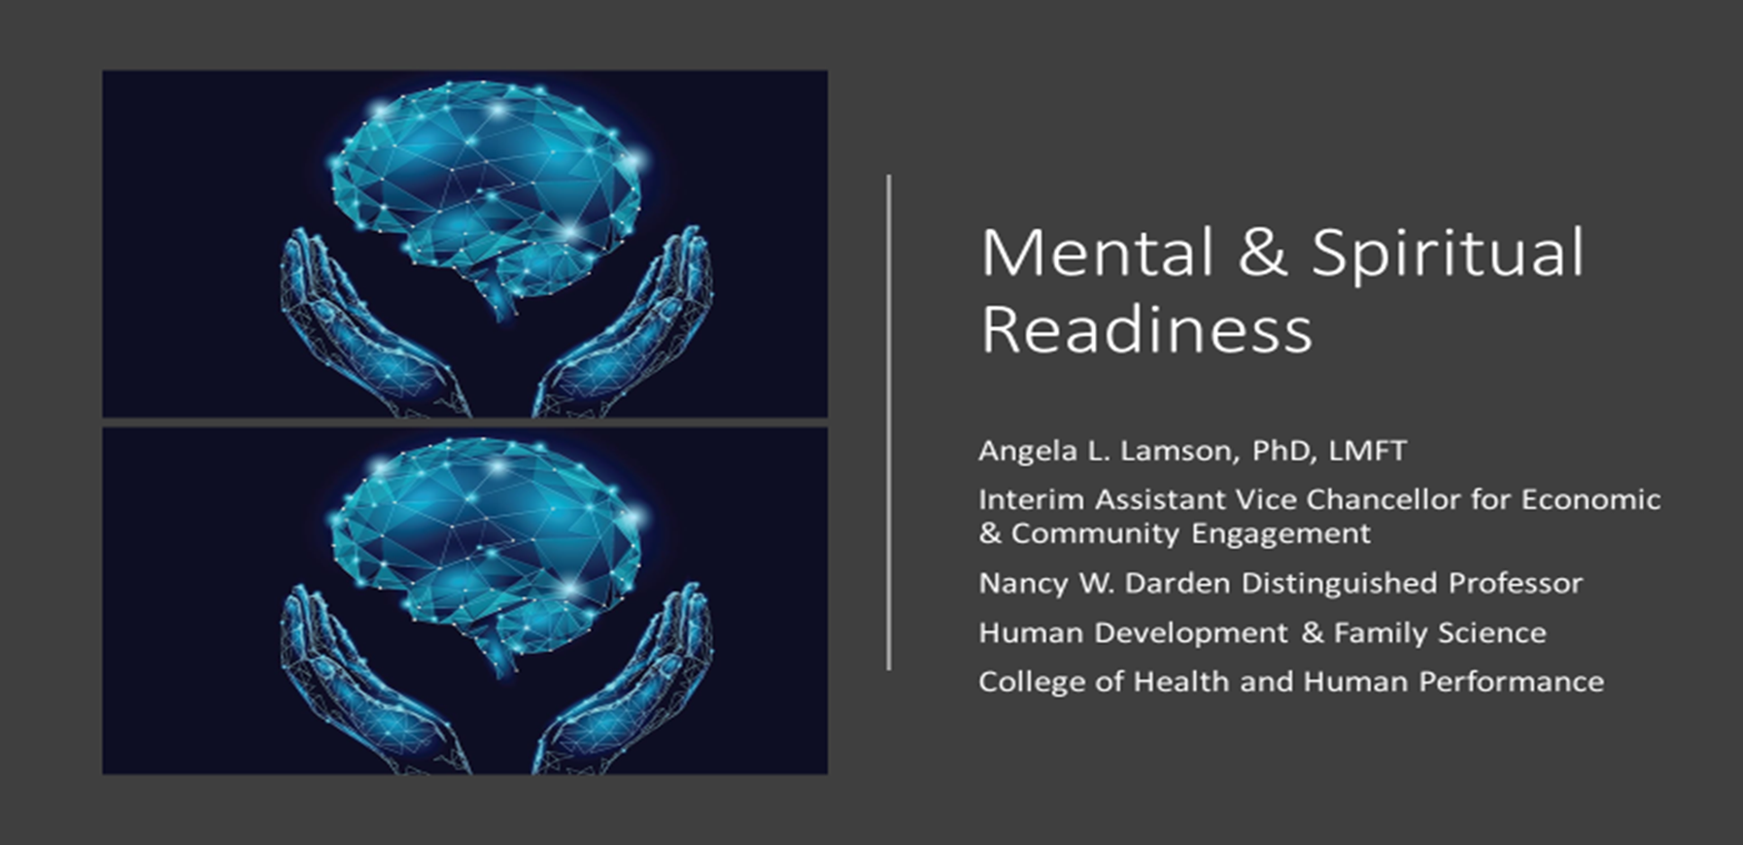

Slide 2
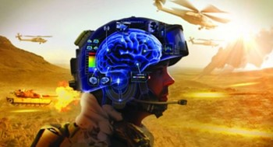
Moral Injury-Injuries of the Soul
PTSD
Exposure to trauma
Intrusion
Avoidance
Negative changes in cognition/mood
Changes in behaviors/emotions
TBI
Sudden injury/blow/jolt to head
disrupts brain function
MI
Guilt
Shame
Existential/spiritual Distress
Betrayal
Richardson, N. M., & Lamson, A. L. (2022). Understanding moral injury: Military-related injuries of the mind, body, and soul. Spirituality in Clinical Practice, 9(3), 145–158. https://doi.org/10.1037/scp0000270
Notes:
Table 1. U.S. Active-Duty Military Deaths, 2006-2021, by Category
Category Total Deaths
The role of suicide with active duty service-members. There are factors including and beyond PTSD and TBI---we were concerned about Moral Injury
Deaths as % of Total Accident 6,198 32.0% Self-inflicted 4,930 25.4% Illness/Injury 3,470 17.9% Killed in Action 2,740 14.1% Died of Wounds 891 4.6% Homicide 619 3.2% Undetermined 329 1.7% Pending 176 0.9% Terrorist 21 0.1% While Captured 4 0.0% Total 19,378 100%
Over the course of their military service, service members are often required to make difficult decisions or be exposed to actions in war or other missions that violate their deeply held personal values and core ethics distinct from those that commonly present themselves in civilian contexts. And if left unresolved, these violations may result in significant inner conflict.
To date, the most widely used definition for moral injury among researchers and mental health providers was developed by Litz and colleagues (2009) to capture the shame and guilt-based disturbances that many veterans experience after engaging in wartime acts. They defined morally injurious experiences as, “events in which an individual perpetrates, fails to prevent, bears witness to, or learns about acts that transgress deeply held moral beliefs and expectations” (p. 700).
However, after completing my own systemic review of commonly used definitions of moral injury, I learned that there continues to be Contradictions for the origin of moral injury and that their
Lack of empirical support for this construct.
Taking a look at some of the other common responses to traumatic stress experiences by service members, We realized that while some overlap in symptomology may exist between PTSD and TBI (e.g., changes in mood, irritability, nightmares, sleep disturbances, memory loss) less is known about the symptoms of moral injury and how those symptoms are unique from or interface with PTSD and TBI
THE LITERATURE REALLY HELPED TO paint a picture of what we know about other trauma disorders common to military populations and how that informs JUST what we DON’T KNOW but also what steps we need to take to “legitimize” moral injury --> with the thoughts of, “could moral injury be what we are missing in our understanding of military experiences”?
.

Slide 3
Betrayal
Moral Ambivalence
Soul Wounds
Reconciliation
Richardson, N. M.*, Lamson, A. L., & Hutto, O.* (2022). “My whole moral base and moral understanding was shattered”: A phenomenological understanding of key definitional constructs of moral injury. Traumatology. Advance online publication. https://doi.org/10.1037/trm0000364
Richardson, N.*, Lamson, A., Smith, M., Eagan, S., Zvonkovic, A., & Jensen, J. (2020). Defining moral injury among military populations: A systematic review. Journal of Traumatic Stress. 33, 575-586. https://doi.org/10.1002/jts.22553
This Photo by Unknown Author is licensed under CC BY-SA-NC
Notes:
SI among our sample
Betrayal (self, other, system); Moral ambivalence (questioning of purpose, shift in world view, shades of gray); Soul wounds (guilt, demoralization, isolation); lack of reconciliation (duty first; penitence)**
Betrayal
Self-betrayal - a betrayal of what’s right vs wrong or who I thought I was
Betrayal from or unto others
Most prevalent was Systemic betrayal - Misuse of power across the greater hierarchical system as a whole, often resulting in lack of trust due to continuous moral violations
Veterans also acknowledged an ongoing struggle with holding onto multiple realities or identities which seemed to contradict with the roles, values, or expectations they ascribed to as service members, often igniting internal feelings of moral ambivalence.
Questioning of Purpose - The misalignment in personal values and the decisions or outcomes of war often resulting in questioning the purpose of one’s involvement within higher-level systemic affairs
Shift in world view - The fracturing in one's moral foundation, once influenced by spiritual, family, and/or military values caused by ongoing threats and infringements to an individual's worldview and the ethical expectations of self and others.
Moral shades of gray - Viewing ethical decisions and moral values on an ambiguous spectrum that much consider context rather than "black and white"
To quote one veteran participant, he stated: “my whole moral base and moral understanding was shattered.” Deeper rooted injuries of the soul were also found to be flooded with experiences of guilt, which often lead to a demoralized cultural climate and outlook for many, and increased feelings of isolation.
4. Veterans described the ability – and often necessity - to avoid thinking about the morally injurious experiences endured during service by focusing on the mission at hand. Both during and after service, many struggled with reconciliation for the atrocities witnessed or experienced. They described that the “duty “ or mission had to come first and that they no choice but to come to terms with the reality that ethical boundary lines often become blurred.

Slide 4
MI Presence Across Boots on the Ground
Notes:
Within medicine, the deeply held moral belief that grounds our work – in addition to the ones we all grew up with – is the oath each person in medicine took when embarking on their path as providers – to put the patients needs first. To do no harm.
This Hippocratic Oath is based one's moral code for ethical conduct and practice in medicine – therefore, it is not surprising that we are learning more and more about the moral injuries impacted our medical systems.
Every time a health care provider is forced to make a decision that contradicts the patients' best interest, there is a sting of moral injustice. Moral injury describes the challenges of simultaneously knowing what care patients need but being unable to provide it due to constraints beyond their control. Often times providers and administrators in heatlh care are faced with the ethical double binds – how do we take care of the patient while also taking care of the hospital, the EHR, the health care system, ANDDD meet our productivity metrics? And what comes first?
Drs. Wendy Dean and Simon Talbot, a psychiatrist and a surgeon, were the first to apply the term to health care. Both wrestled with symptoms of burnout themselves. They concluded that "moral injury" better described the root cause of their anguish: They knew how best to care for their patients but were blocked from doing so by systemic barriers related to the business side of health care.
-My ideal industry research partner in the future would be ____ because ____
-My ideal DoD/Federal research sponsor in the future would be ___ because ___
-I think my next big research focus area will be ___

Slide 5
Next Steps for Research
Current team focuses on MI quantitative analyses in tandem with qualitative findings
Assess MI in other contexts (e.g., health care)
Analyses of Interventions focused on MI
Dynamic Diffusion Network (Smigelsky et al, 2020)
Notes:
Dynamic Diffusion Network (Smigelsky et al, 2020)
This is a pilot program “Mental Health and Chaplaincy DDN was developed to advance suicide prevention efforts and moral injury care practices being conducted by 13 chaplain-mental health professional teams across the Veterans Health Administration”
This has emerged as a integrated and adaptive intervention set of programs to specifically attend to suicide prevention and moral injury

Slide 6
Angela Lamson, PhD, LMFT
lamsona@ecu.edu
252-737-2042
Notes:
Dynamic Diffusion Network (Smigelsky et al, 2020)
This is a pilot program “Mental Health and Chaplaincy DDN was developed to advance suicide prevention efforts and moral injury care practices being conducted by 13 chaplain-mental health professional teams across the Veterans Health Administration”
This has emerged as a integrated and adaptive intervention set of programs to specifically attend to suicide prevention and moral injury

