Slide 1

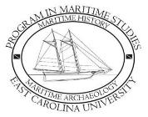
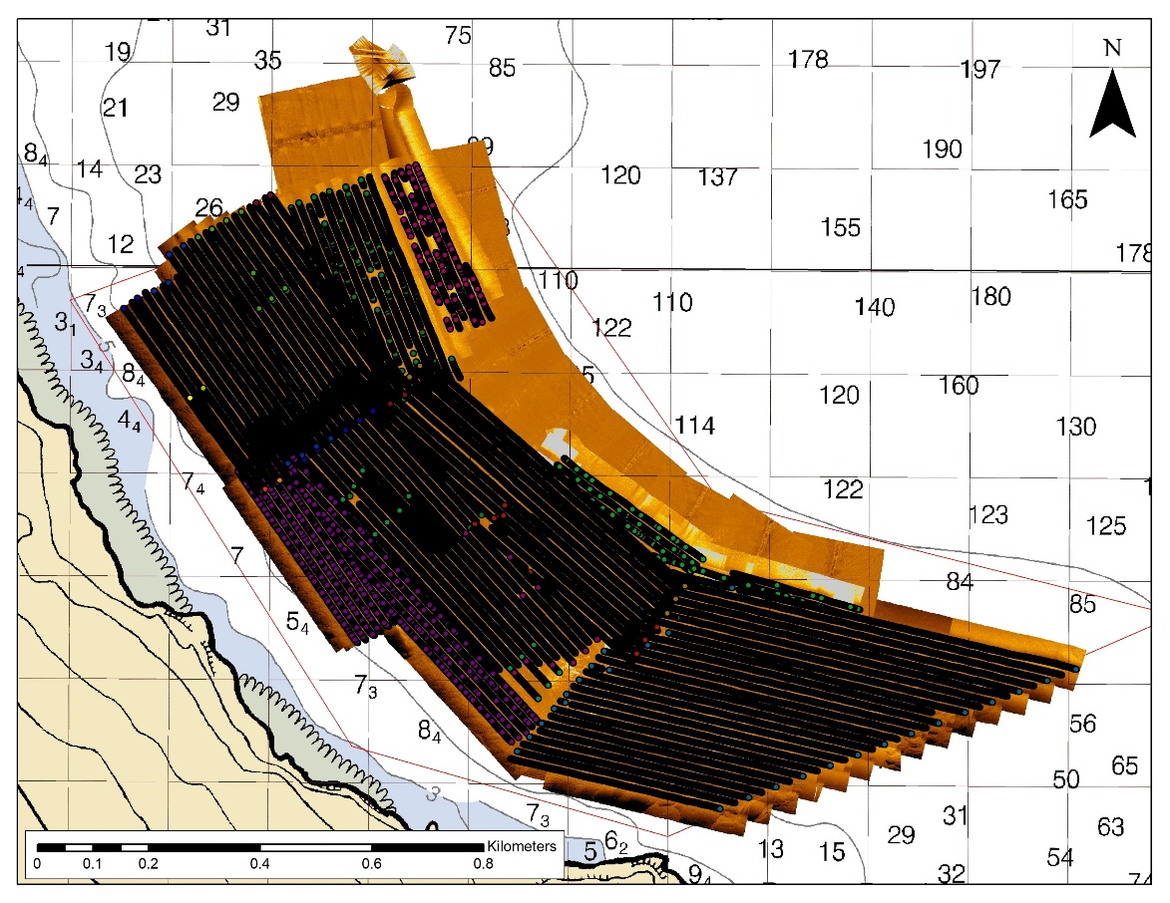
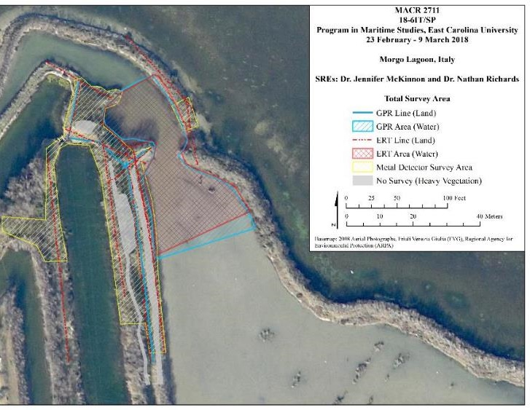
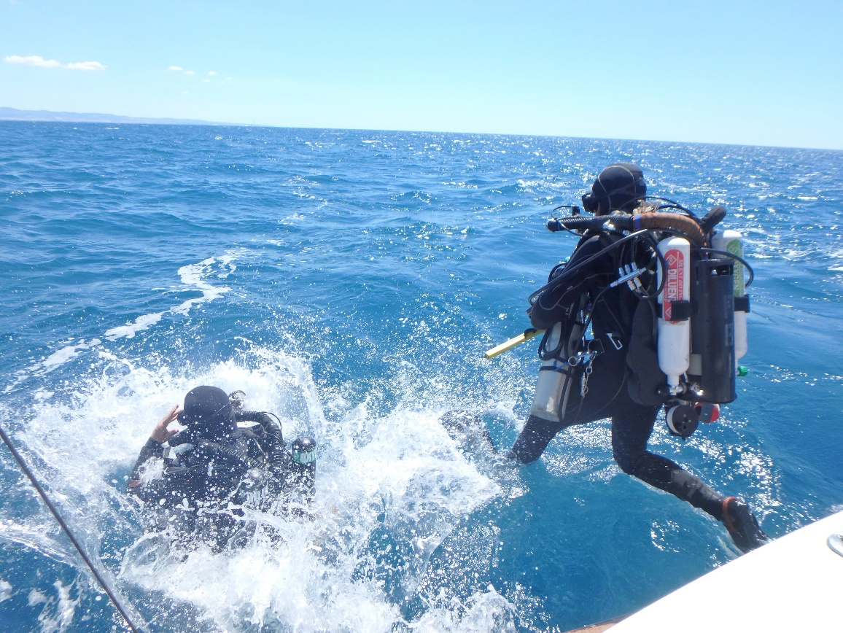
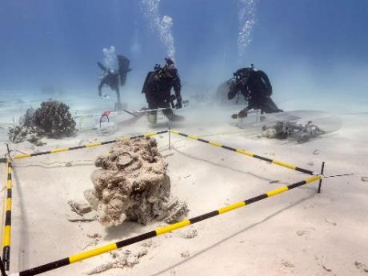
POW/MIA Survey and Recovery
Jennifer F. McKinnon
Professor
Program in Maritime Studies
Department of History
Thomas Harriot College of Arts & Sciences
Research Topics
Search, survey, excavation, and recovery of underwater cultural heritage
LIDAR, Magnetometry, Sonar (Sector, Side Scan,
Sub-bottom,), AUV, ROV, Photogrammetry,
Ground Penetrating Radar, Resistivity, AI
Special Forces veteran rehabilitative therapy events and engagement
Funding
DOD/DPAA Research Fellow 2017-present 413,484.00
DOD/DPAA Projects 2017- present 929,296.00
DOD/DPAA Innovation Project 442,450.00
DOD/DPAA 2023 Planned Projects 520,449.00
Total 2,305,679.00 (2017-2023)

Slide 2

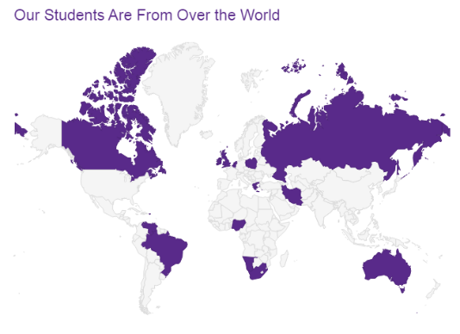
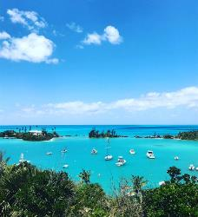
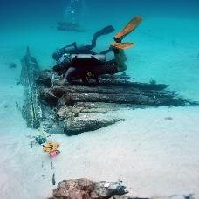
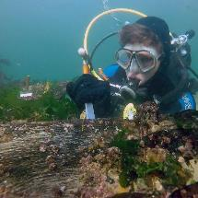
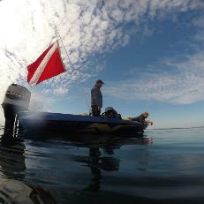
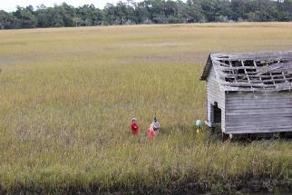
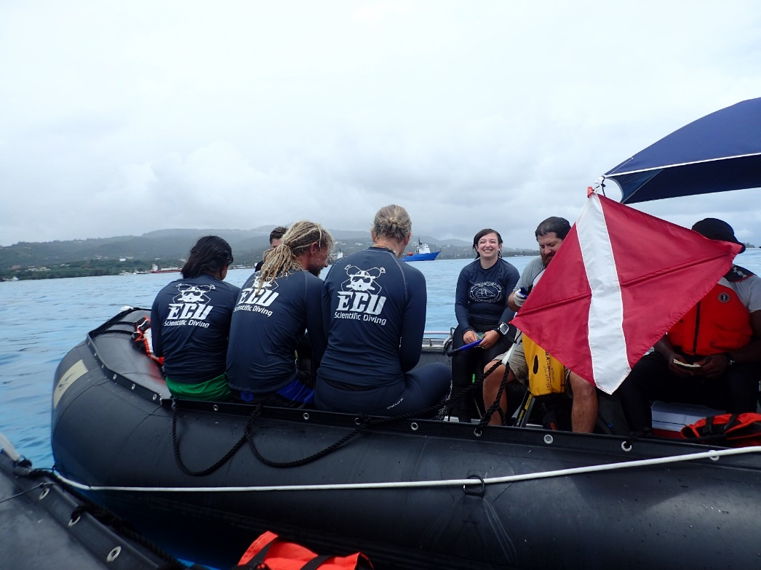
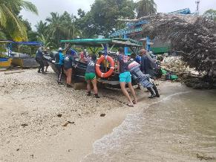
Bermuda
ECU PROGRAM IN MARITIME STUDIES
For the last several years ECU has produced the most applicants to the Register of Professional Archaeologists
Biscayne National Park, Miami
South Africa
The Great Lakes
Outer Banks, NC
Saipan, CNMI
Cahuita National Park, Costa Rica

Slide 3
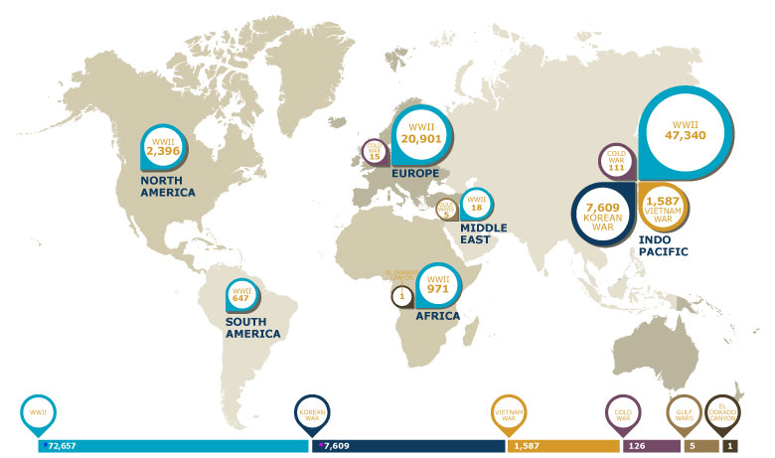
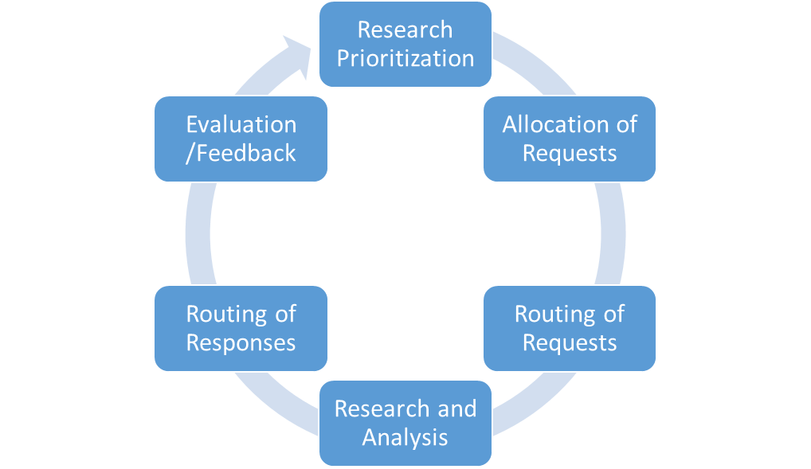

DOD/DPAA
DPAA HUB/SPOKE FELLOW NETWORK
PARTNERSHIPS
Notes:
DPAA mission is to provide the fullest possible accounting for our missing personnel from past conflicts to their families and the nation. Missing personnel from World War II (WWII), the Korean War, the Vietnam War, the Cold War, the Gulf Wars, and other recent conflicts
As this map shows it is a BIG job, at present, more than 81,900 Americans remain missing from WWII, the Korean War, the Vietnam War, the Cold War, and the Gulf Wars/other conflicts. Out of the more than 81,900 missing, 75% of the losses are located in the Indo-Pacific, and over 41,000 of the missing are presumed lost at sea (i.e. ship losses, known aircraft water losses, etc.).
* Reflects actual number still unaccounted-for. PMKOR database count is slightly higher due to several entries pending administrative review.
* As part of DPAA's data consolidation effort we have validated the number of missing from WWII. This new figure reflects the elimination of duplicative records, erroneous entries, and information that demonstrates the individual was properly accounted for by the appropriate authorities before our Agency inherited those responsibilities.

Slide 4
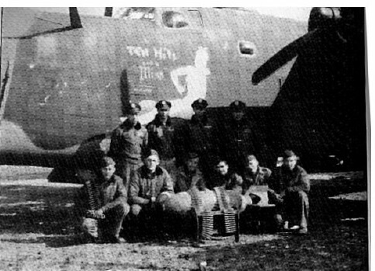
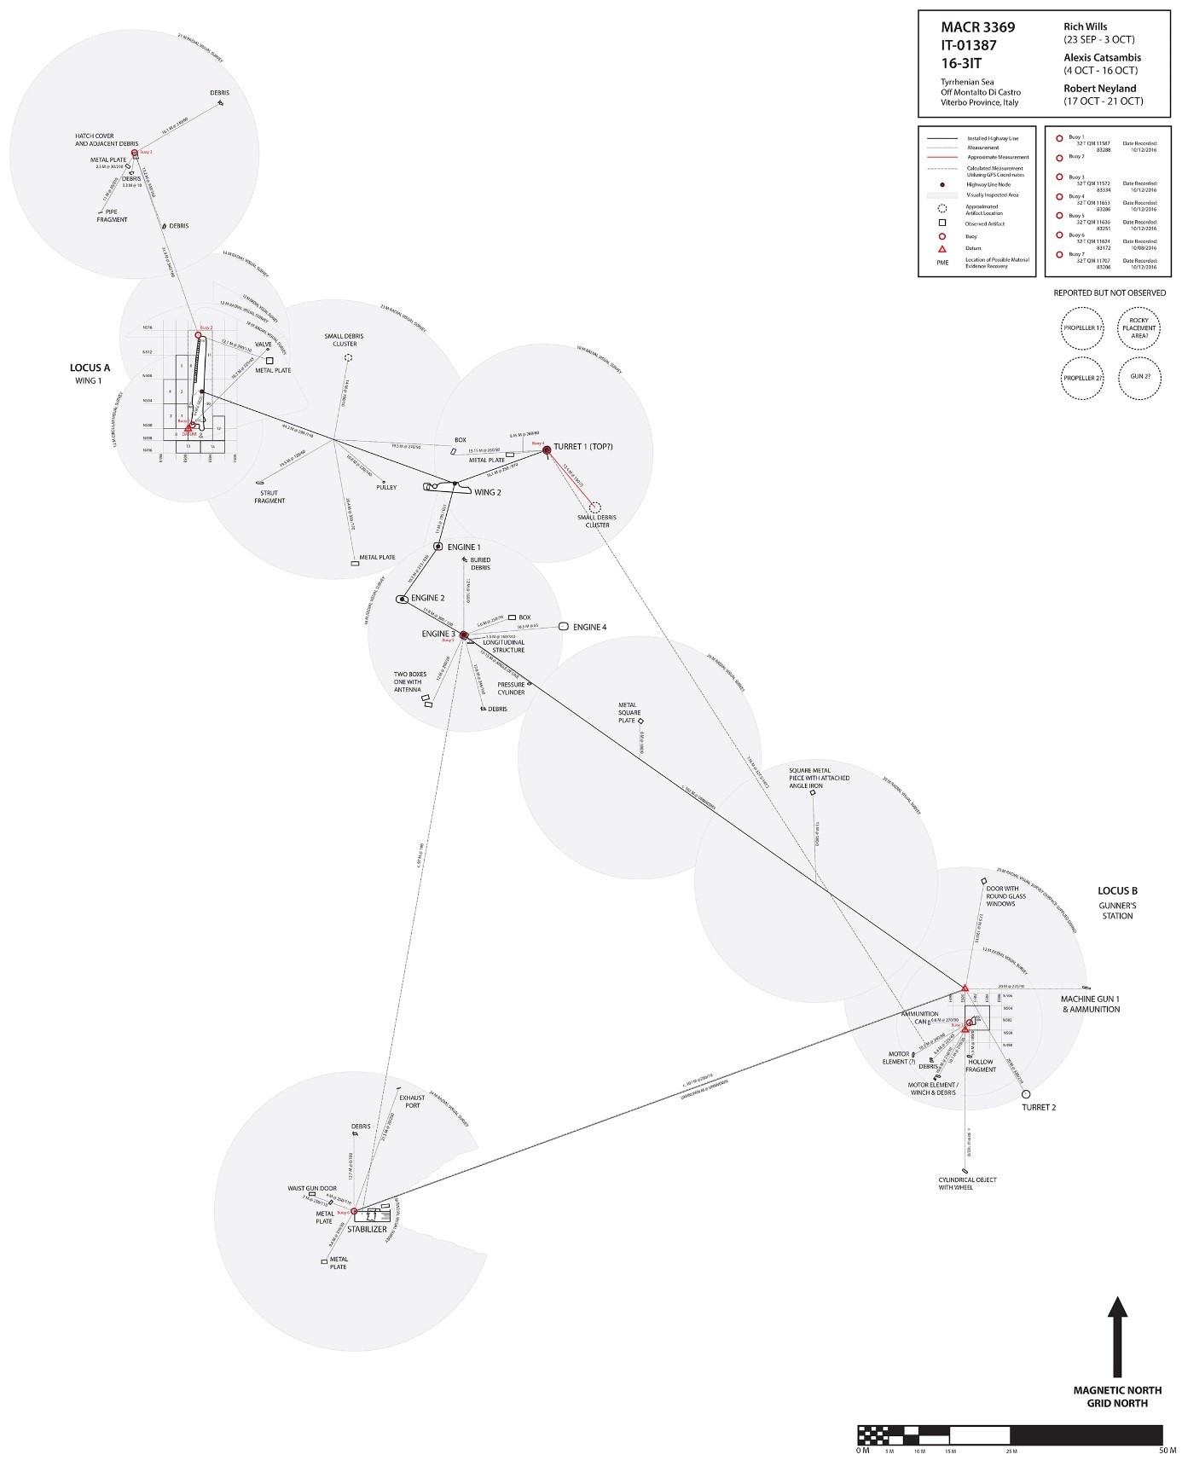
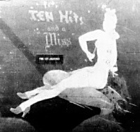
Montalto di Castro, Italy 2017

Slide 5
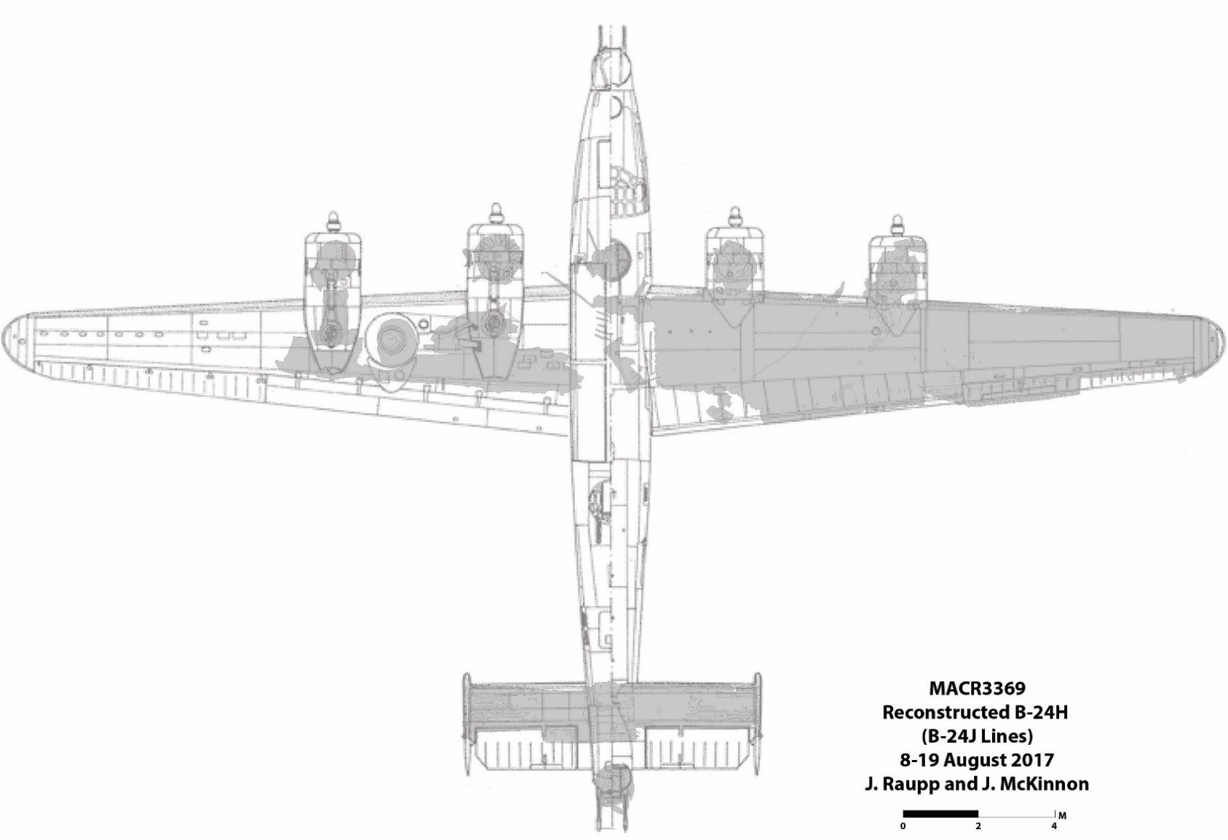
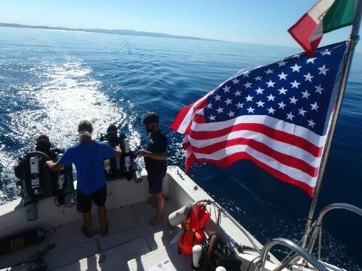
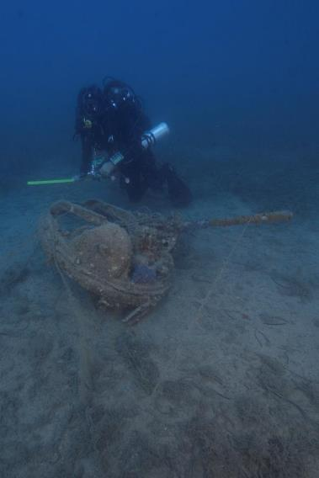
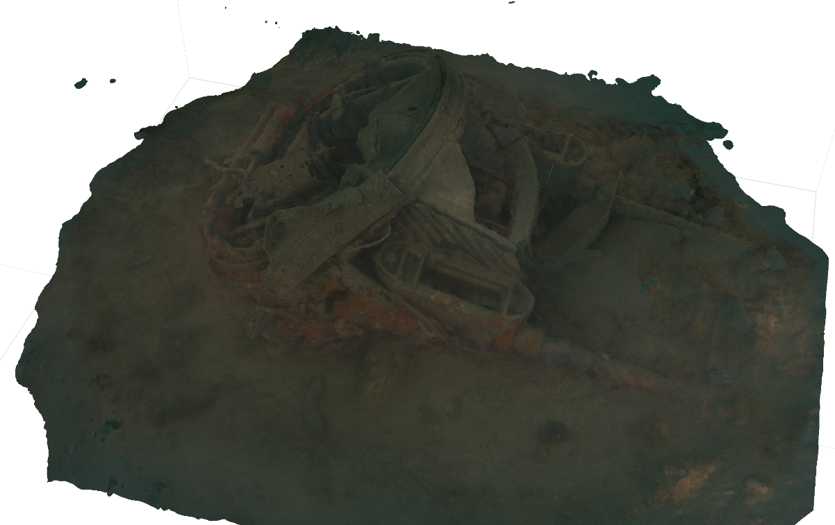
Montalto di Castro, Italy 2017

Slide 6
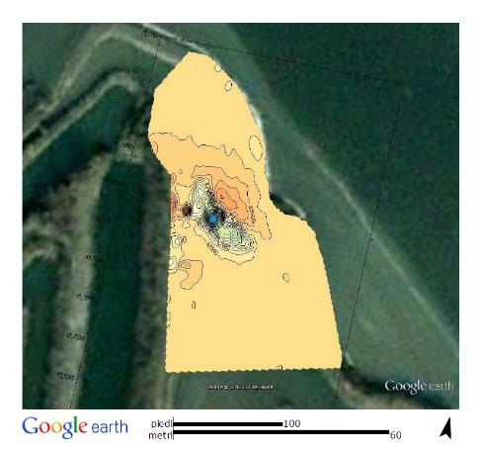
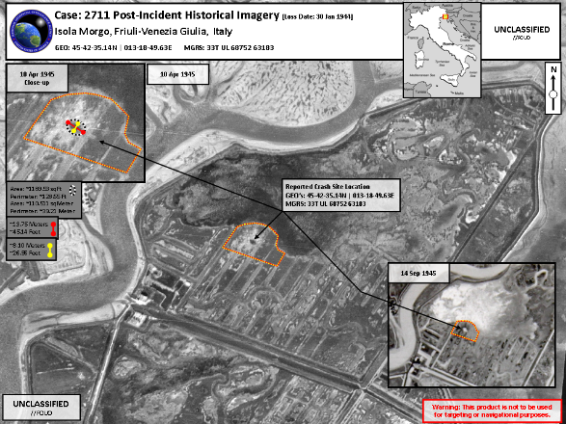
Morgo, Italy 2018

Slide 7
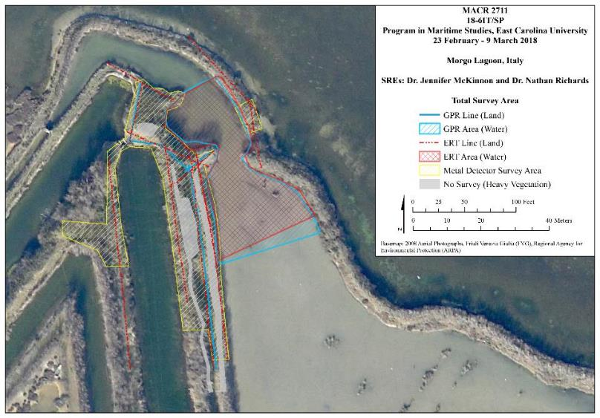
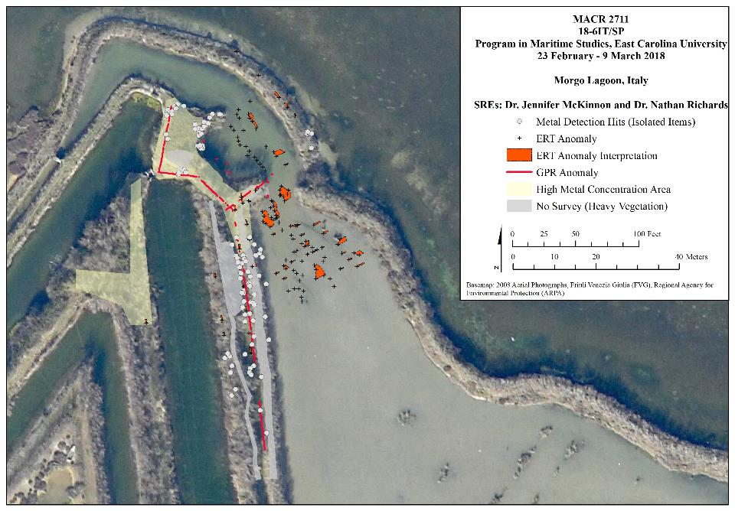
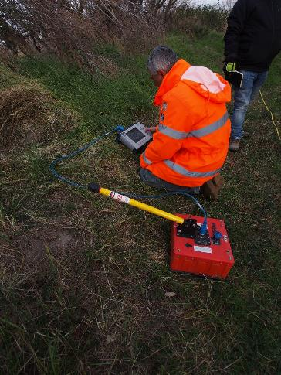
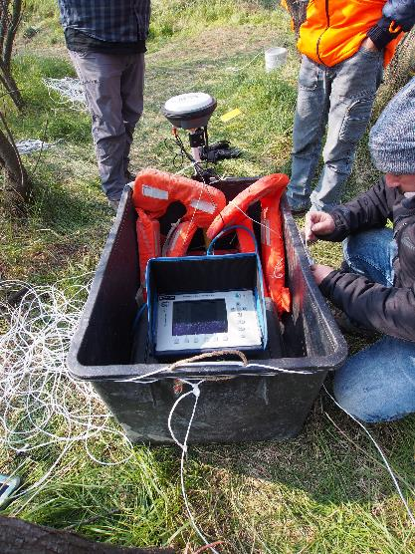
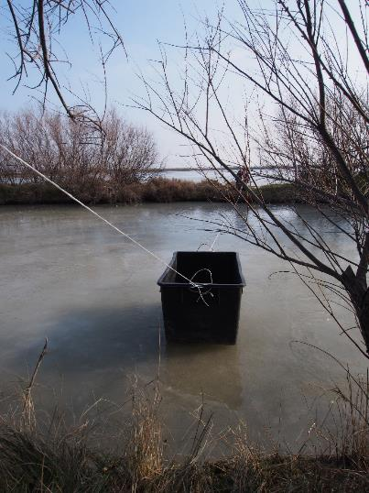
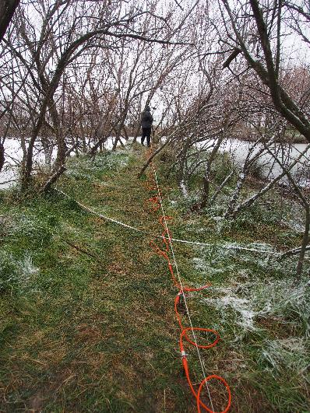
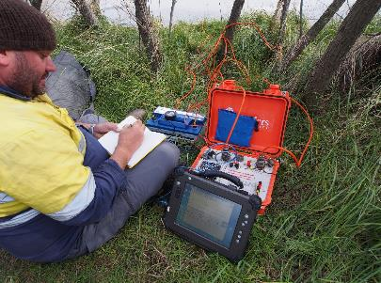
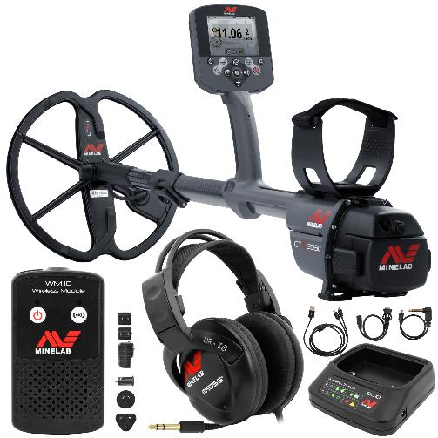
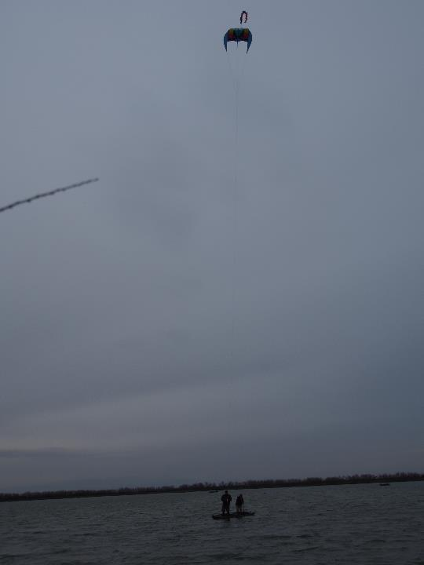
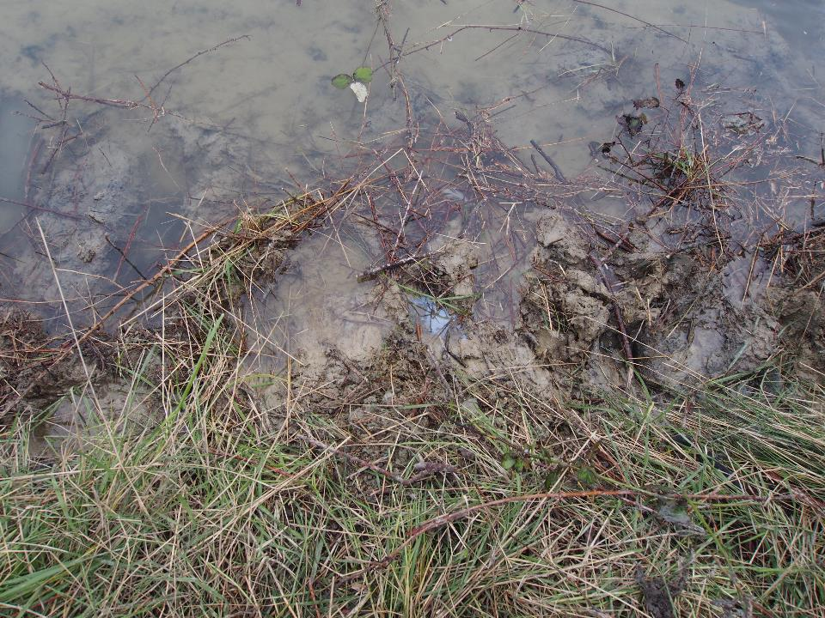
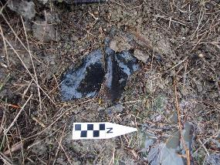
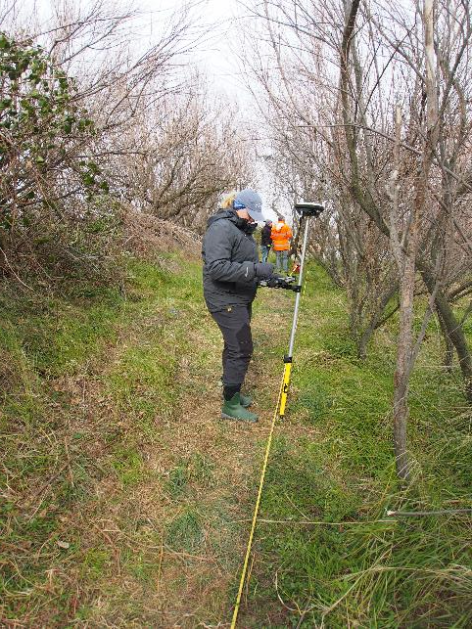
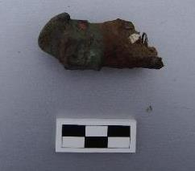
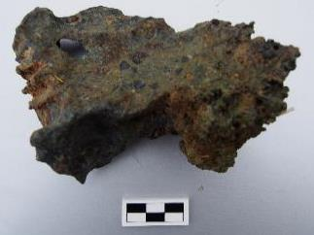
Morgo, Italy 2018

Slide 8
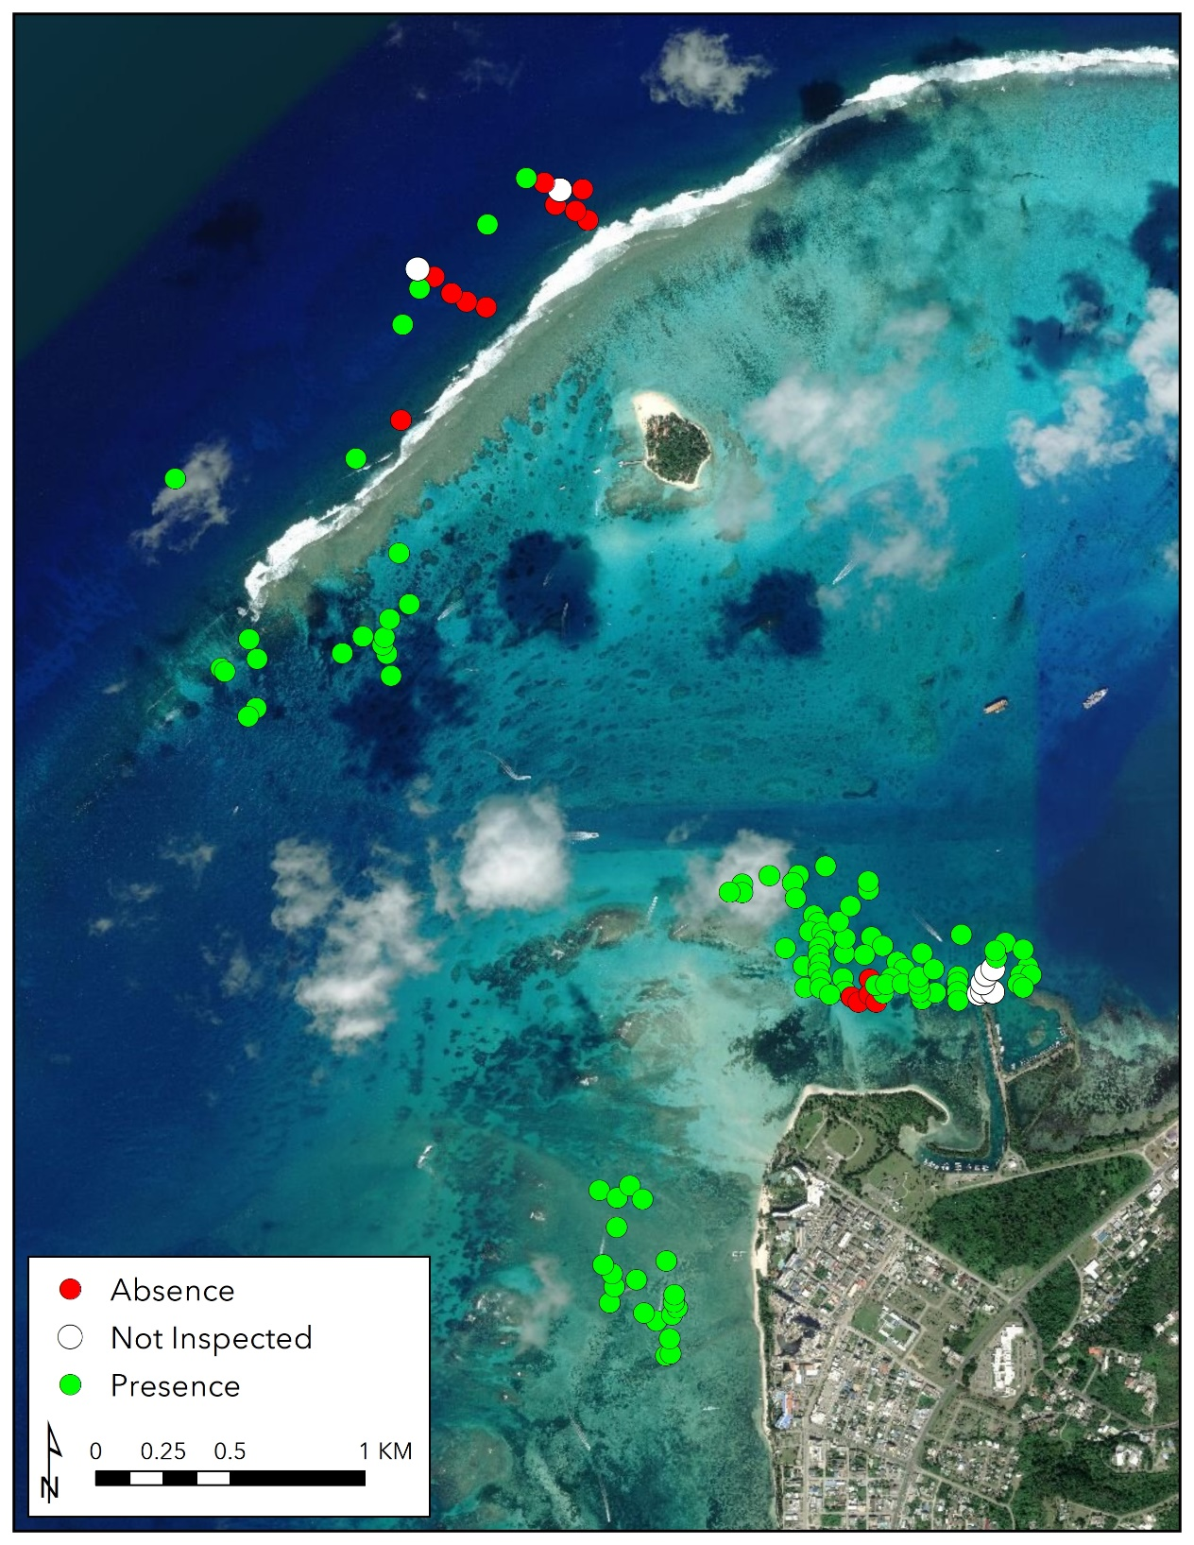
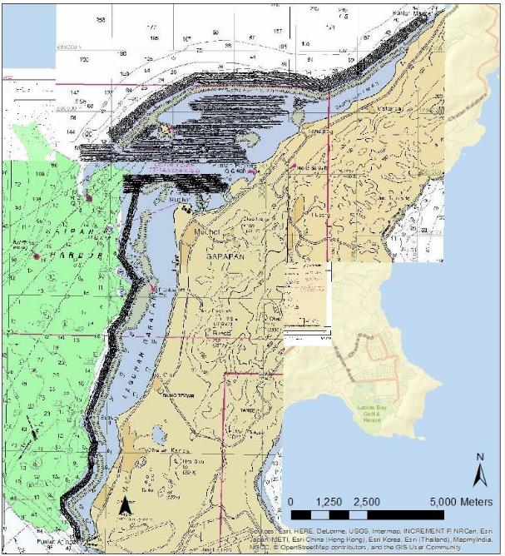
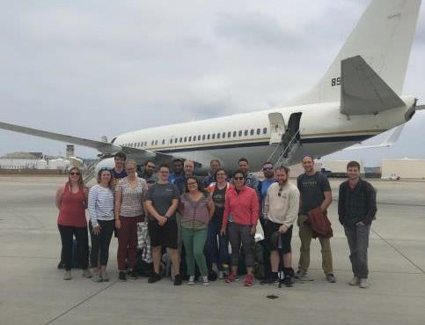
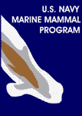
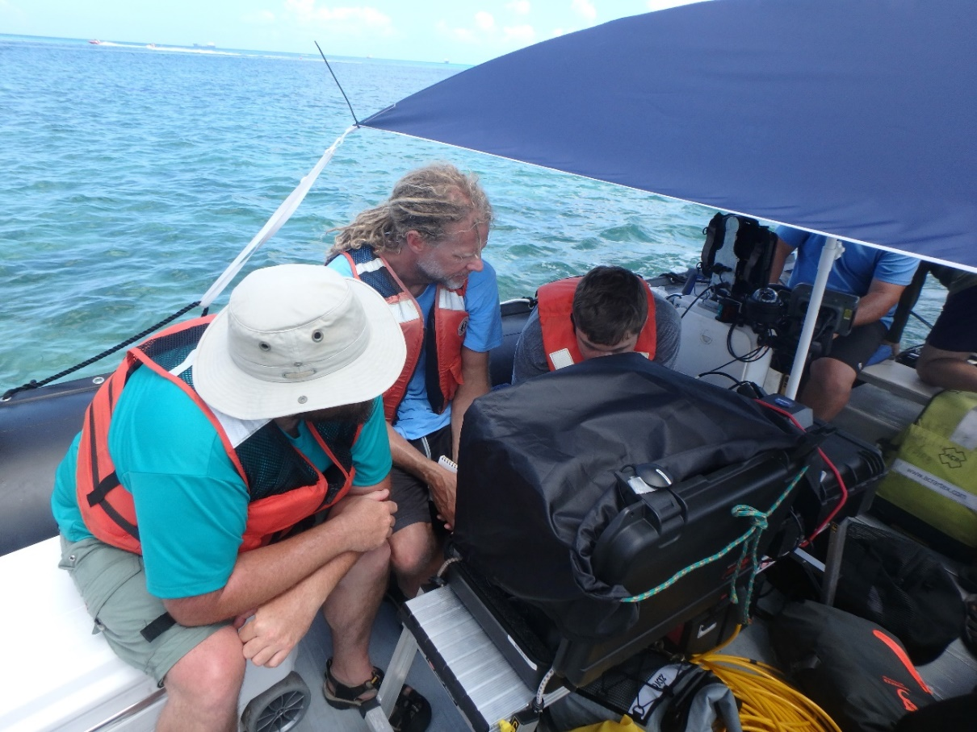
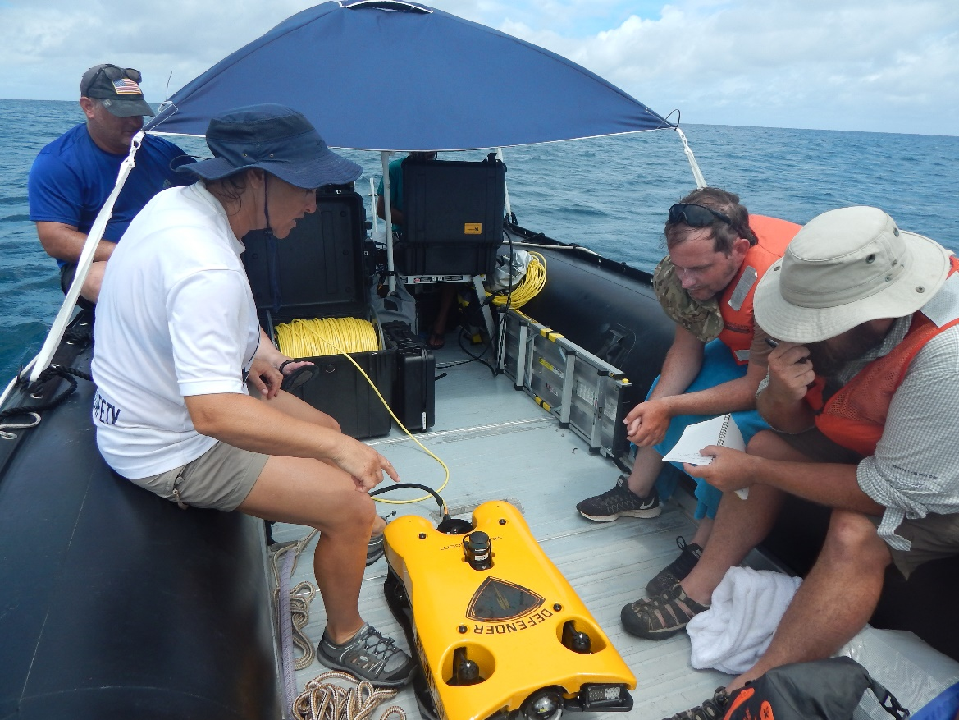
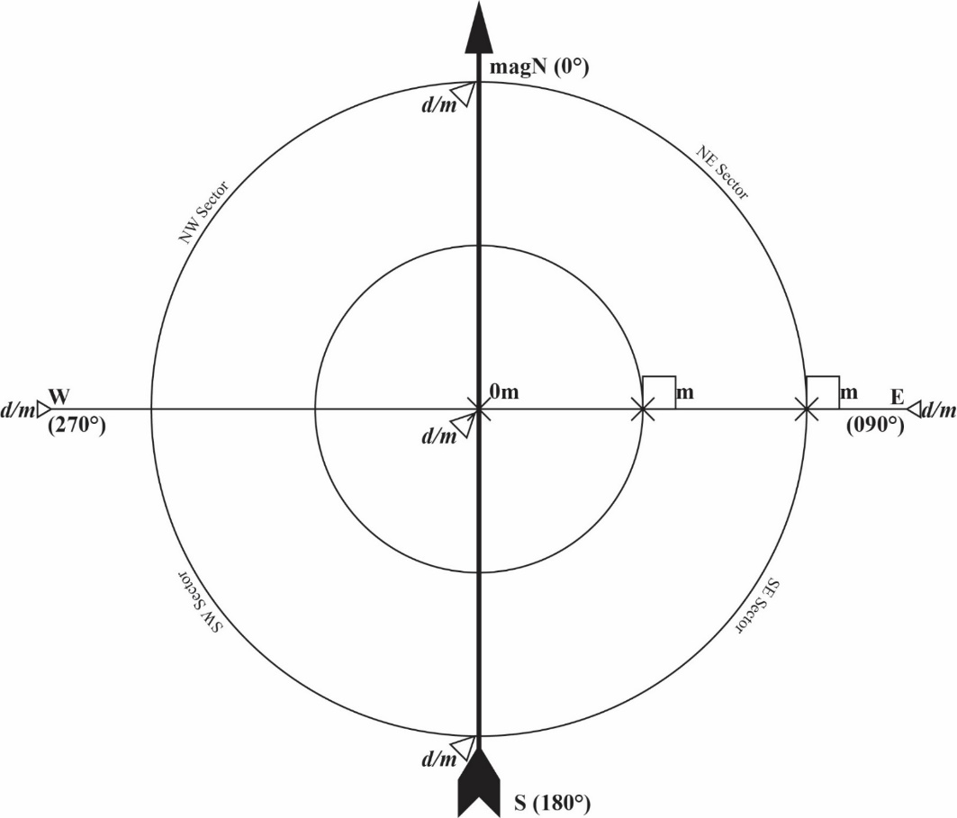
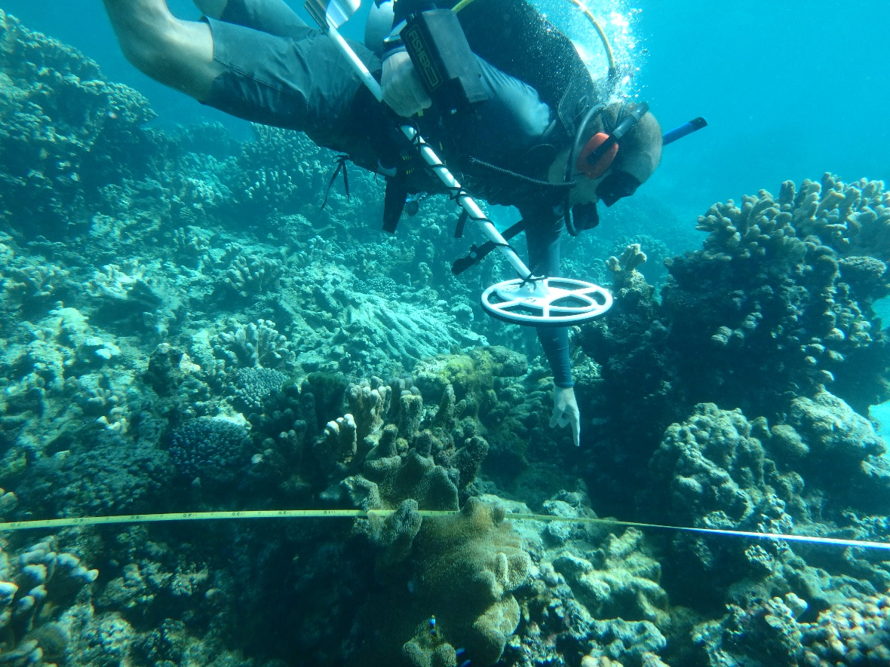
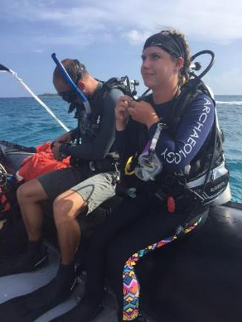
Saipan, CNMI 2018 Part I

Slide 9
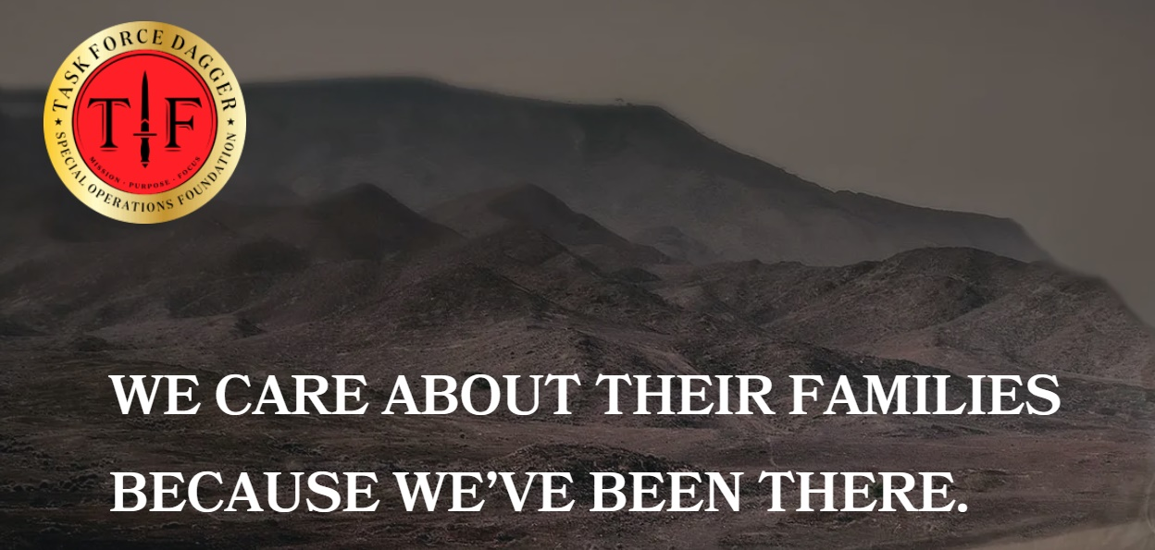
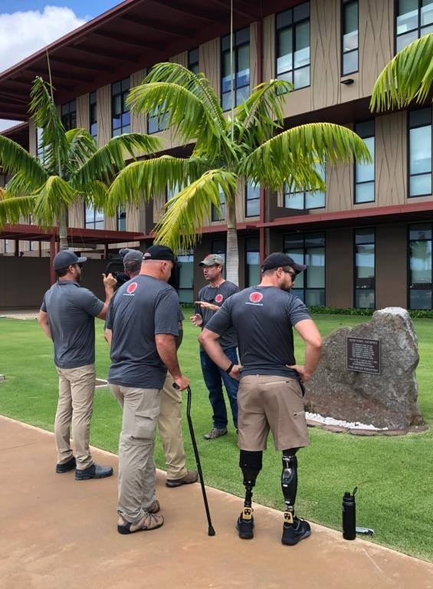
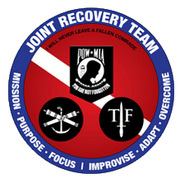

Saipan, CNMI 2018 Part II
TFD assists Special Operations personnel and their families with needs that are not covered by the Military, DoD, VA, or their insurance.
SOF Health Initiatives: The SOF Health Initiatives Program is a Mind, Body, Spirit and Purpose driven program focused on finding the root causes of illness and treating them with Functional Medicine. The SOF Health Initiatives Program offers a full systems, patient-centric approach to medicine and creates an environment conducive to healing and recovery.
Rehabilitative Therapy Events: TF Dagger sponsors activities that foster a sense of well-being, offer encouragement, and assist the service member's rehabilitation and recovery from wounds/injuries sustained while serving our country.

Slide 10




Saipan, CNMI 2018 Part II
7 days of searches
220 dives conducted
130 dive hours
82 targets ground-truthed
6,714 sq. meters searched
Located a potential aircraft that warranted future investigation

Slide 11


Saipan, CNMI 2019

Slide 12






Saipan, CNMI 2019

Slide 13
Kwajalein Lagoon, Marshalls 2019

Slide 14








Saipan, CNMI 2022 eDNA Innovations

Slide 15


Saipan, CNMI 2022

Slide 16





Veteran Program Assessment

Slide 17


2023 & Beyond
DPAA Saipan, CNMI
-complete recovery excavation
NOAA Saipan, CNMI
-Lidar & Machine Learning
-eDNA (Blue Economy/Tourism)
-Corrosion/Photogrammetry
-Veteran families
DPAA Queensland, AUS
-remote sensing
-target testing

Slide 18
Thank You!
My ideal industry research partners are:
Partners who can see a vision for and support an interdisciplinary (archaeology, history, engineering, biology, geography, geology) military research institute devoted to discovery, identification, research, and protection of underwater military-related sites. Why? Because we have the best underwater archaeology program in the US supporting the largest number of UG, Masters, and PhD students, we have the expertise, and we have the basic toolkit to conduct this research. We do need access to additional emerging technologies to do large-scale survey (ROV and AUV with remote sensing capabilities), AI and machine learning equipment and expertise to process existing remote sensing data (NOAA, BOEM, NASA), and more personnel to support the demand we currently have for partnership projects.
Partners who could see a vision for veteran engagement in citizen science initiatives to include rehabilitative therapy events for diving and its benefits to combat veterans reintegrating. Partners in the medical field for research on the benefits of citizen science and diving on the mental and physical (underwater sensors, biofeedback, peer to peer support).
Partners who have an idea to pitch to DPAA Innovations…
My ideal government partner in the future would be continuing to work with DOD DPAA, but also expand to work with SOCOM to develop and deliver trainings on base about encountering underwater cultural heritage on deployment (Graphic Training Aids) and further develop veteran rehabilitative therapy events.
My next big research focus area will be…let’s partner in 2024! mckinnonje@ecu.edu

