Slide 1
Renewable Ocean Energy Developments:
From Theory to Throwing it Overboard
Dr. Mike Muglia
Assistant Director of Science and Research NC Renewable Ocean Energy Program

Slide 2
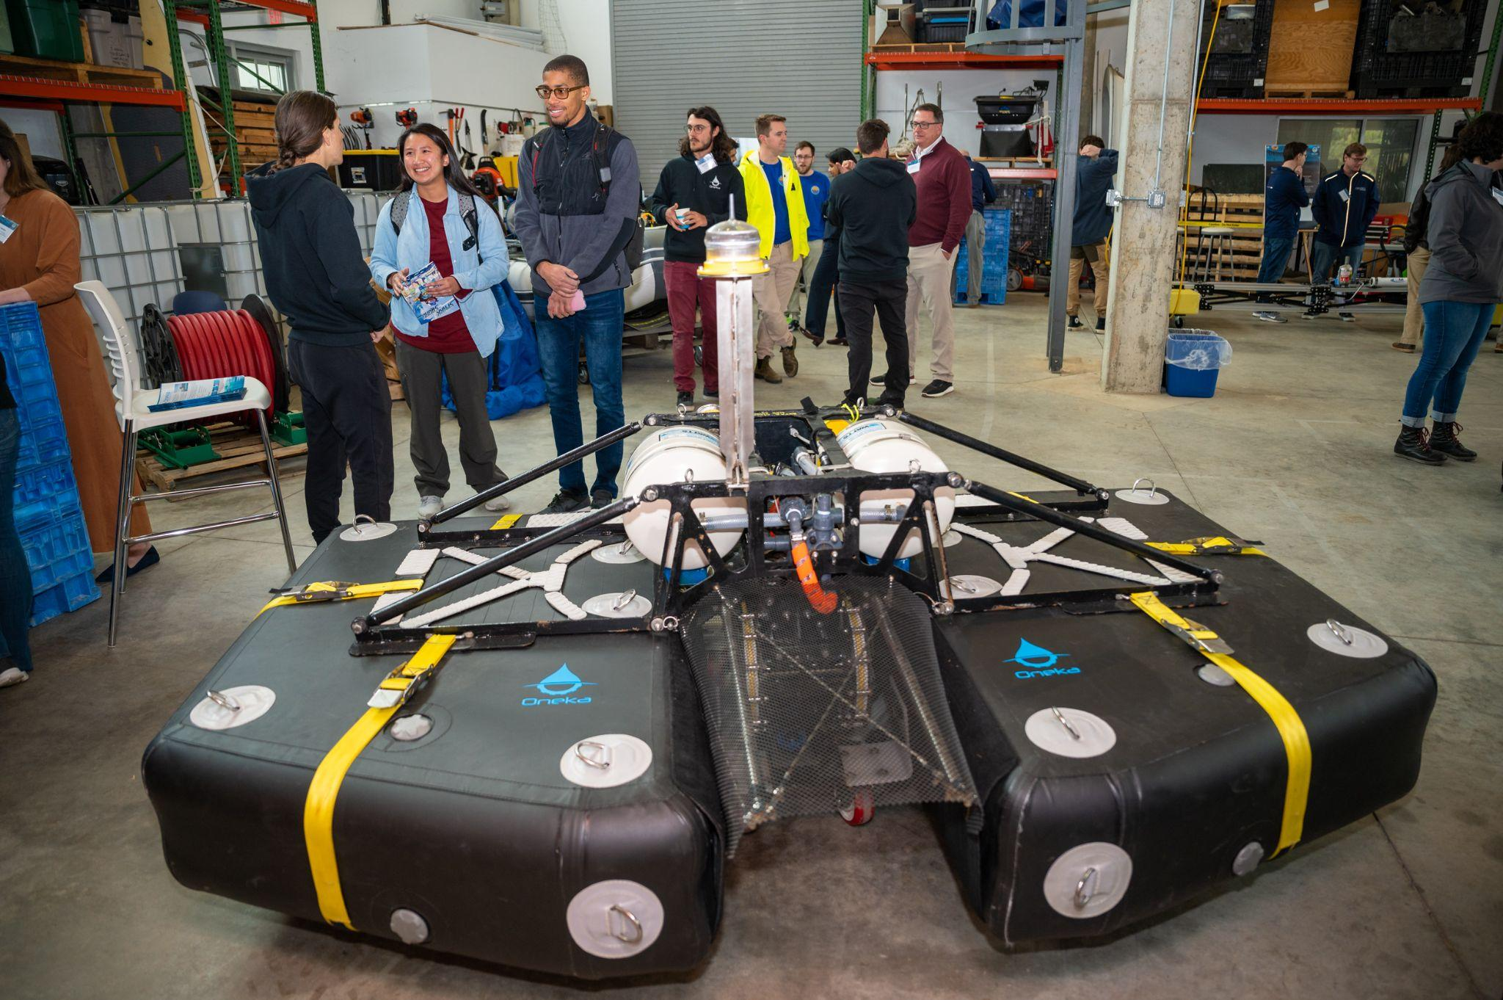
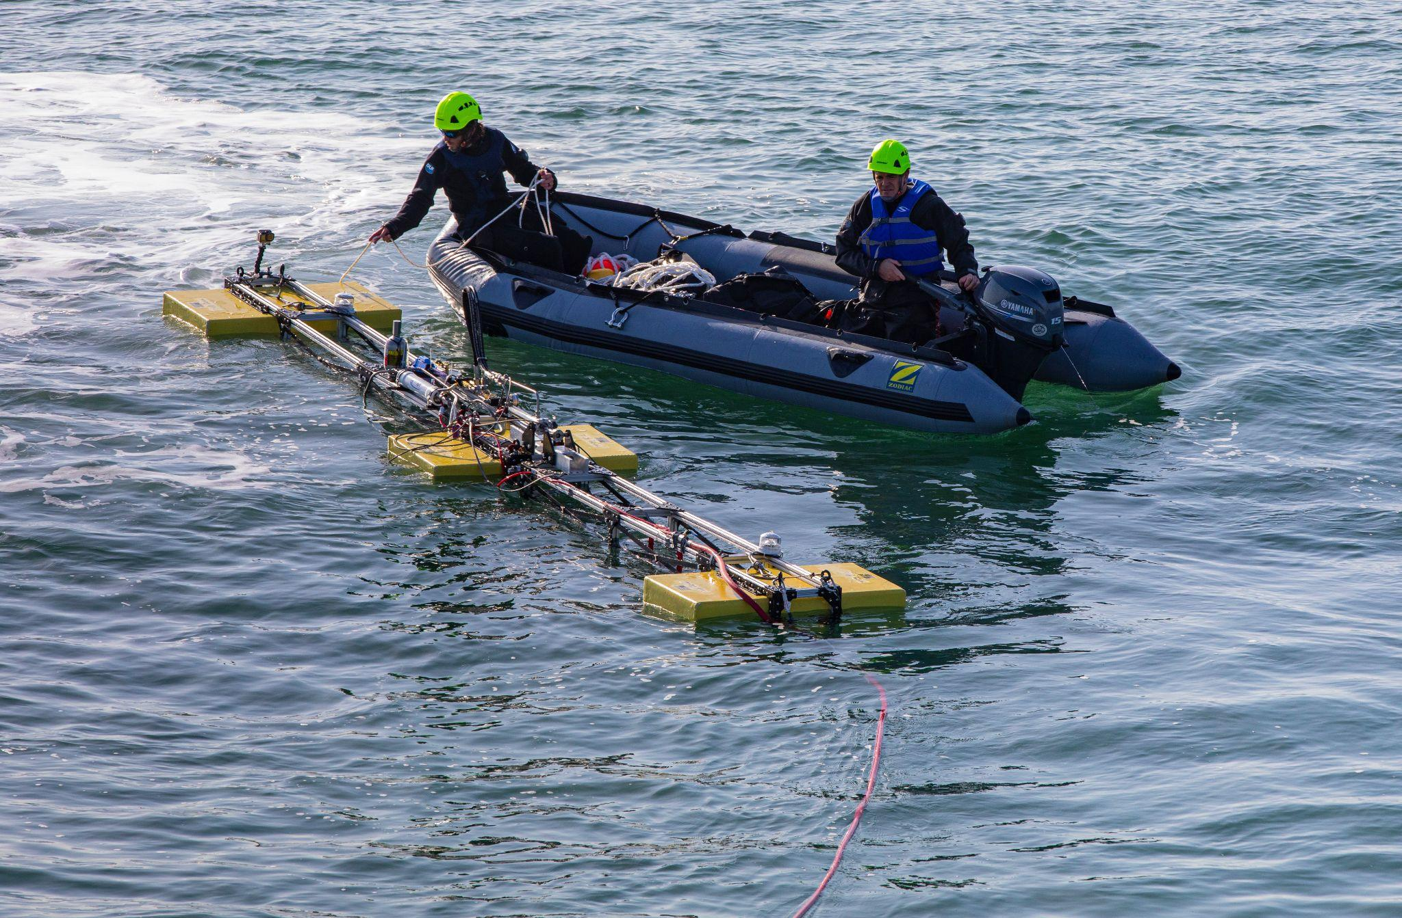
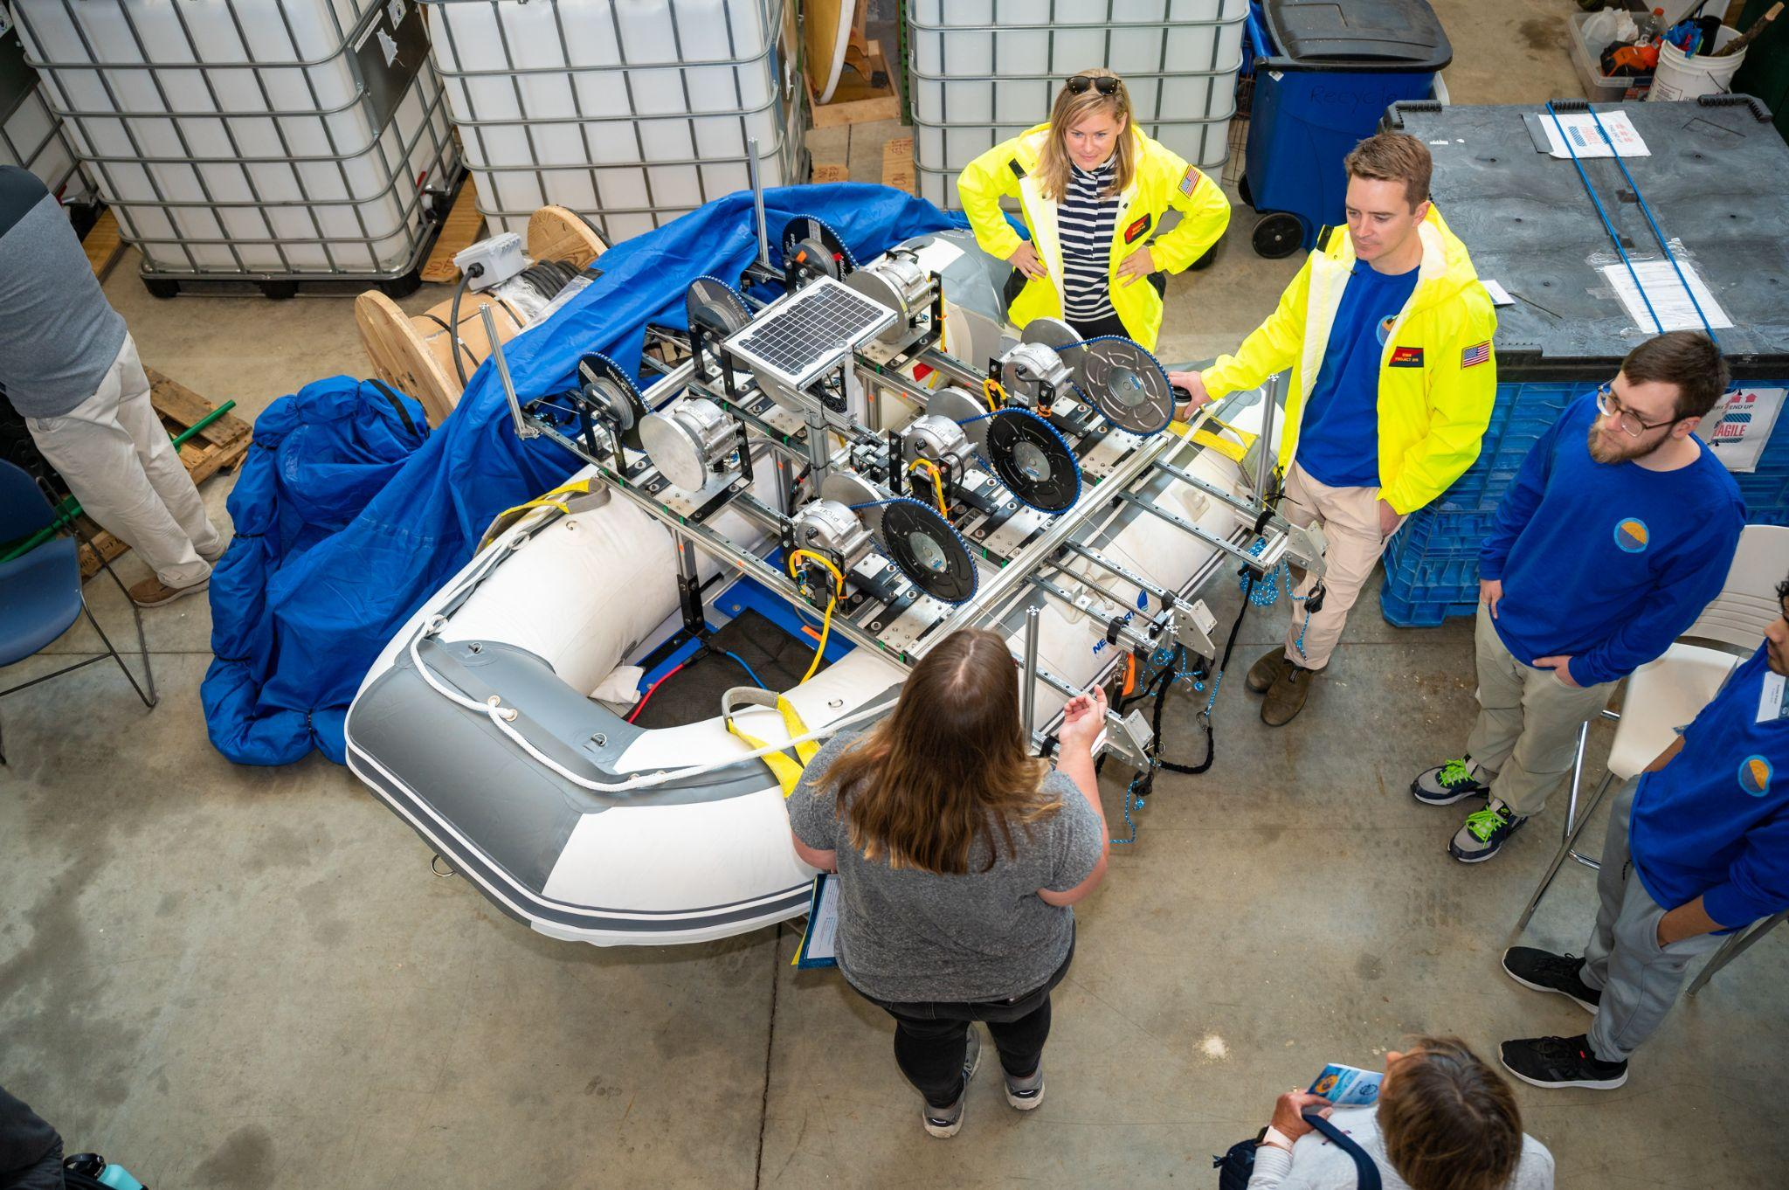
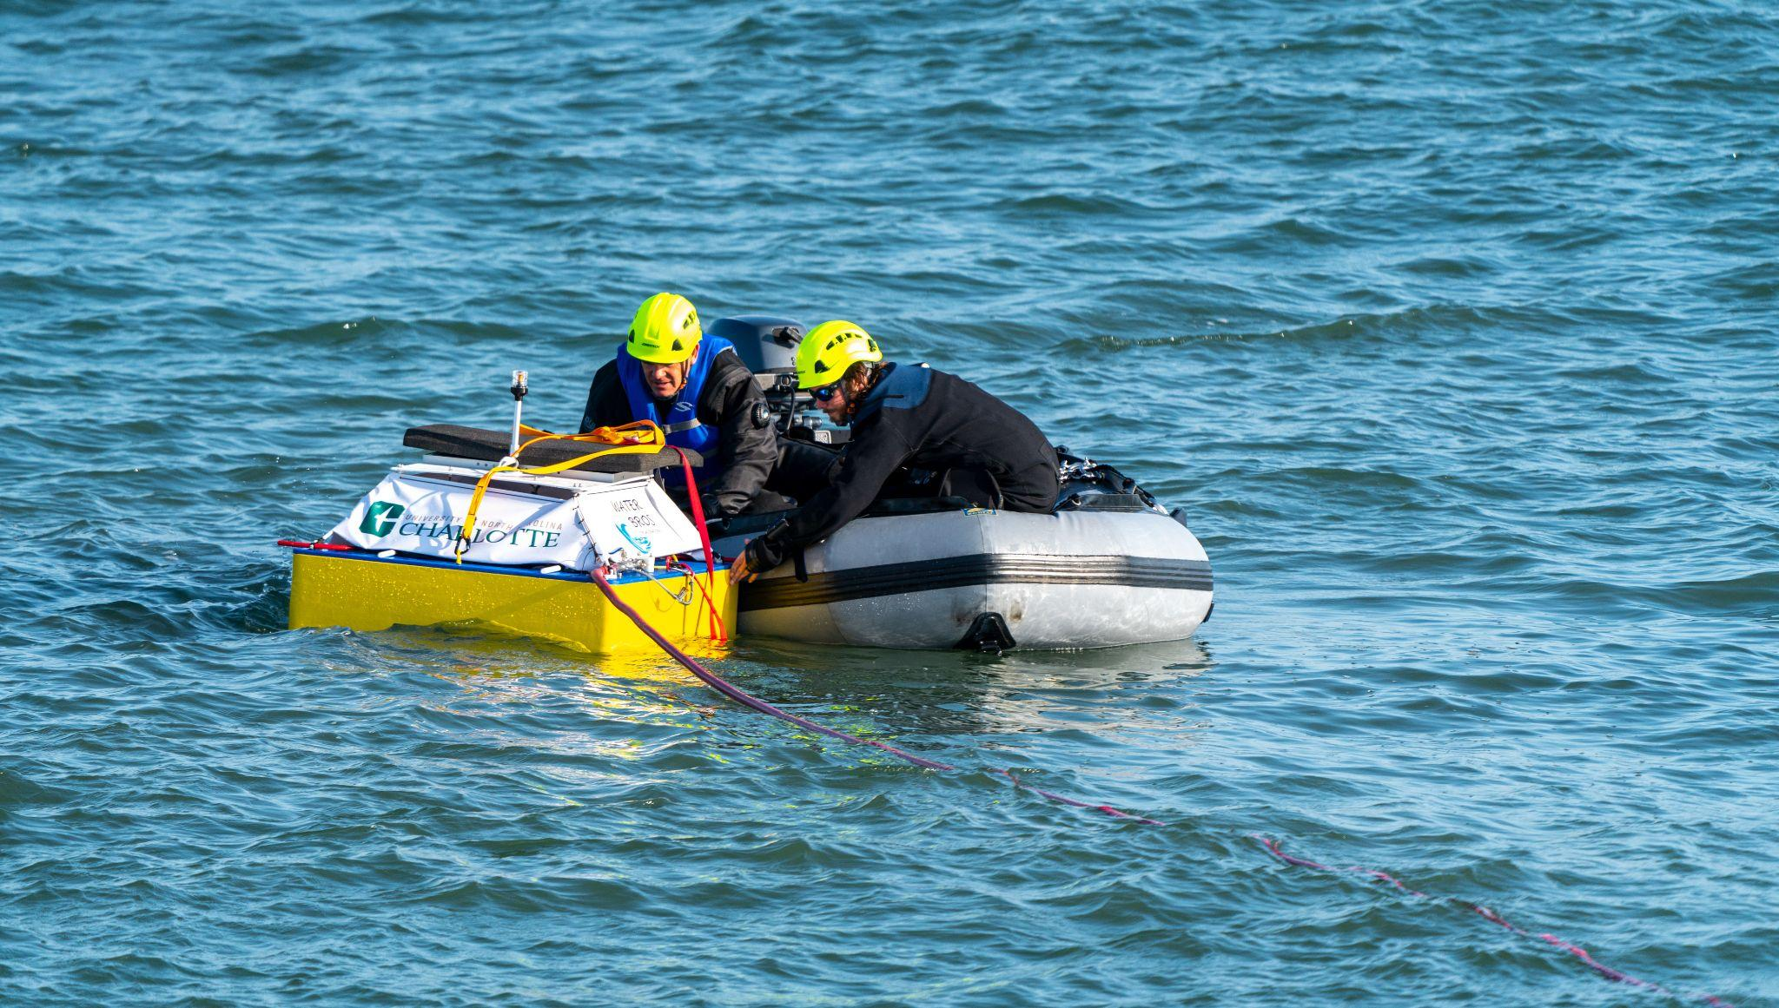
Wave Energy Converters

Slide 3
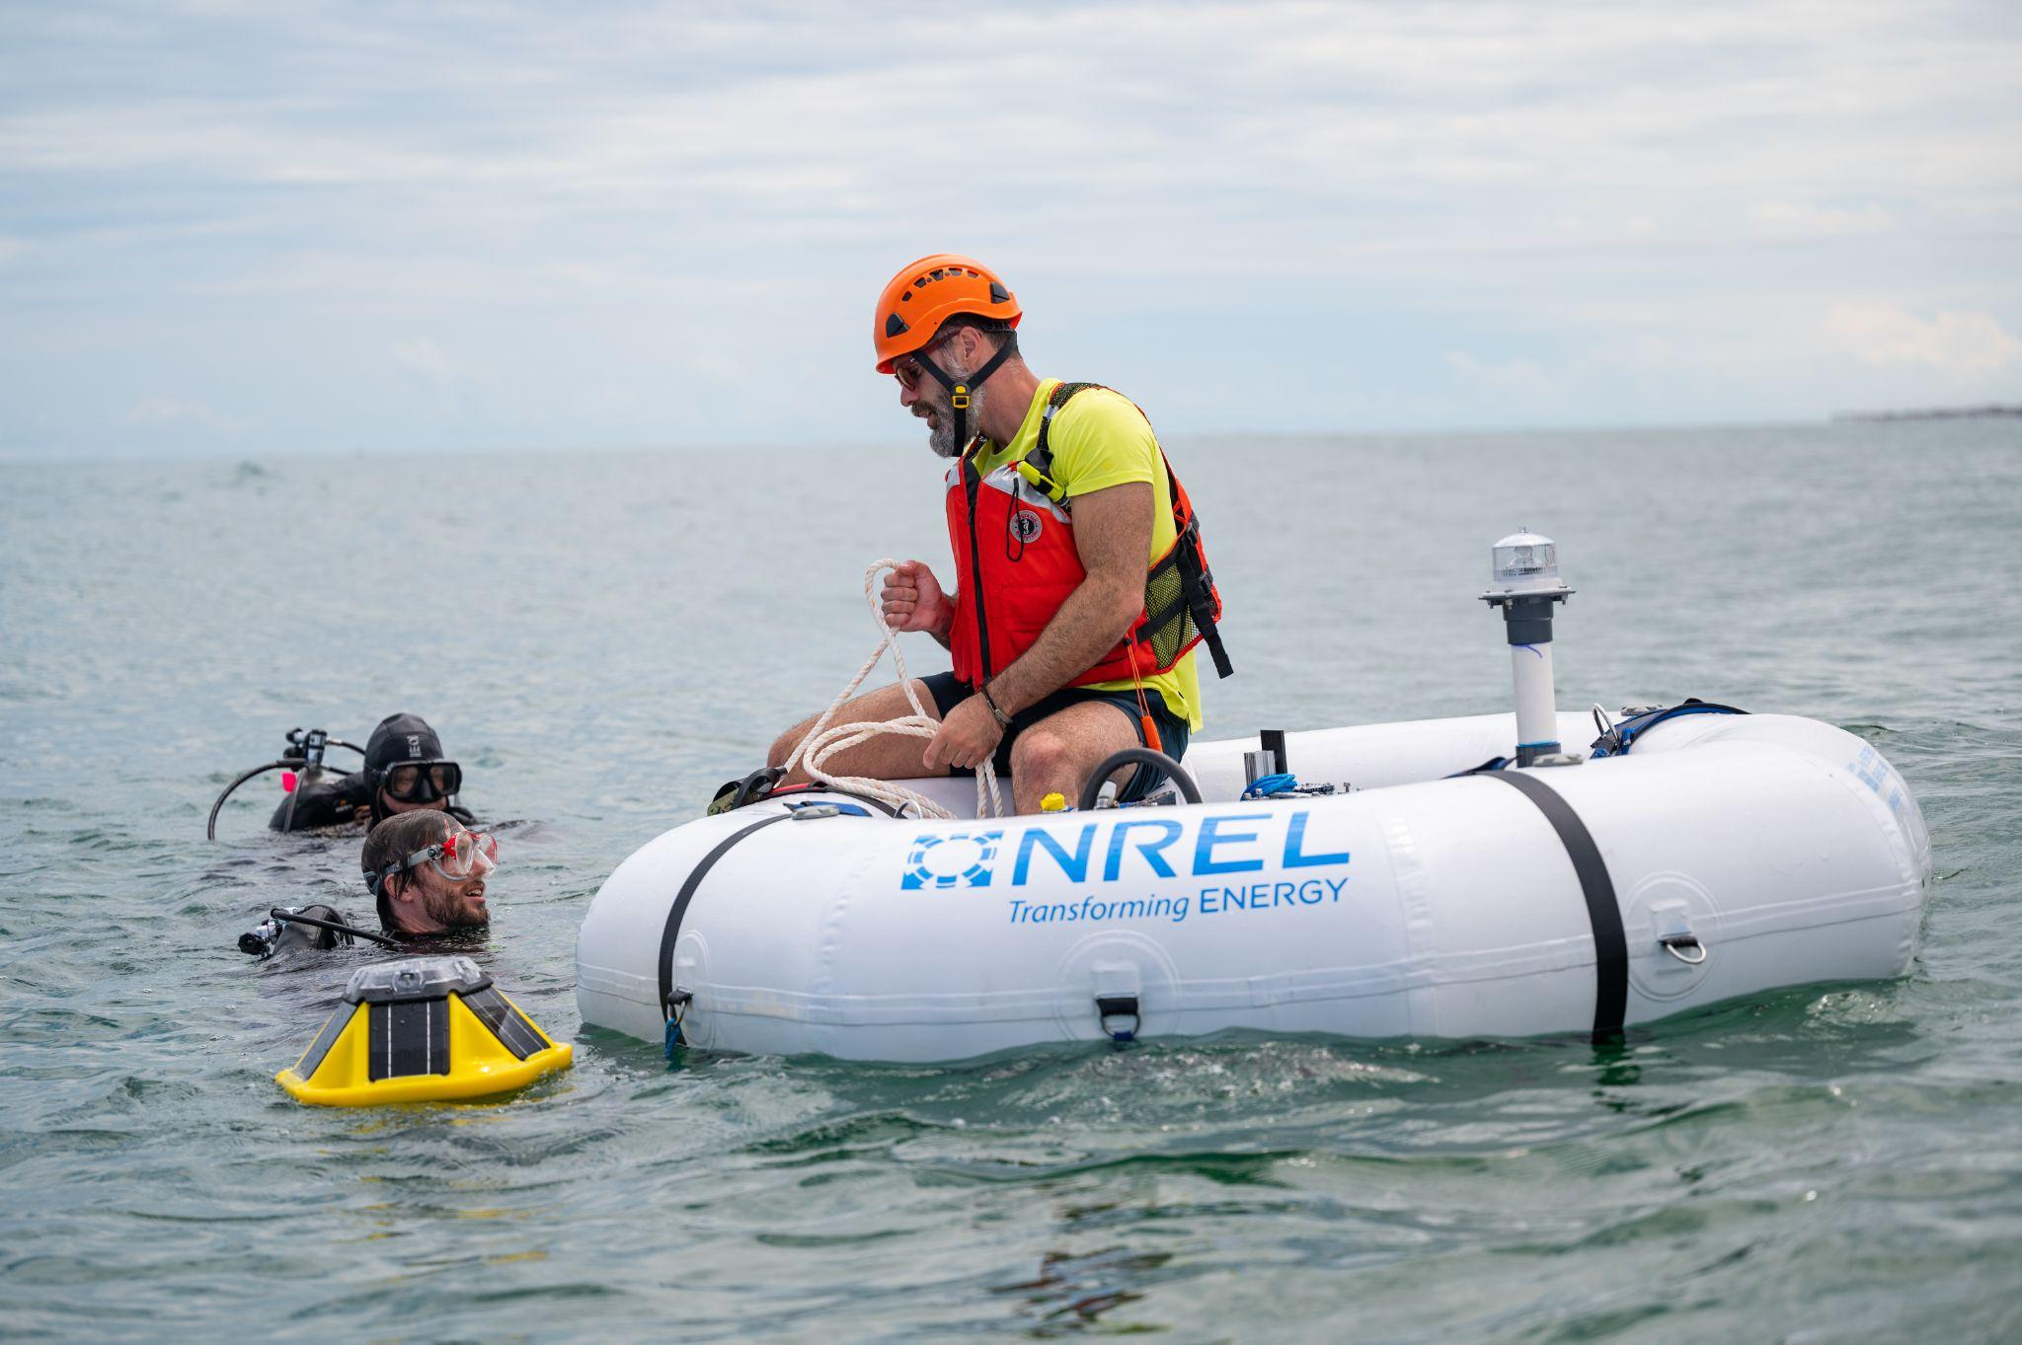
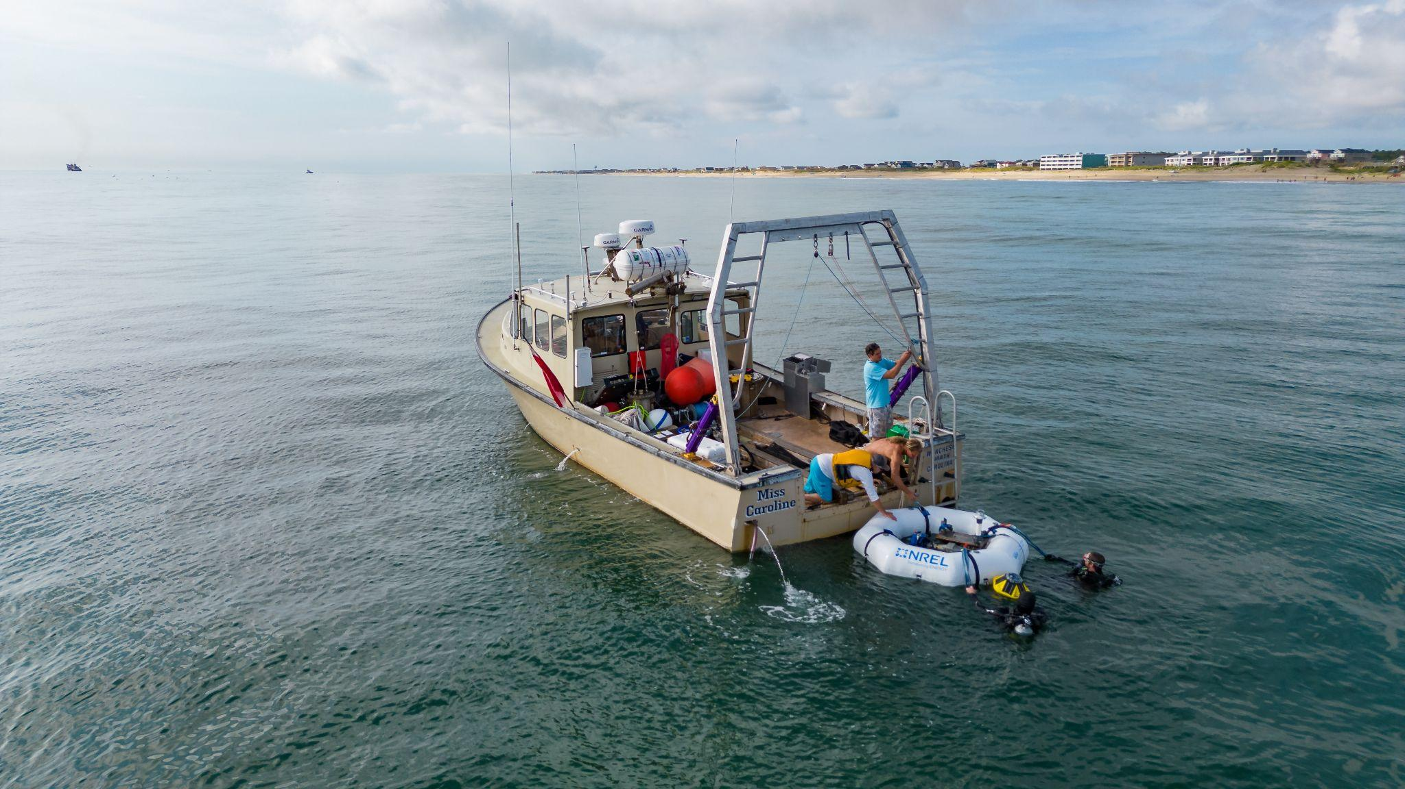
Wave Energy Converters

Slide 4
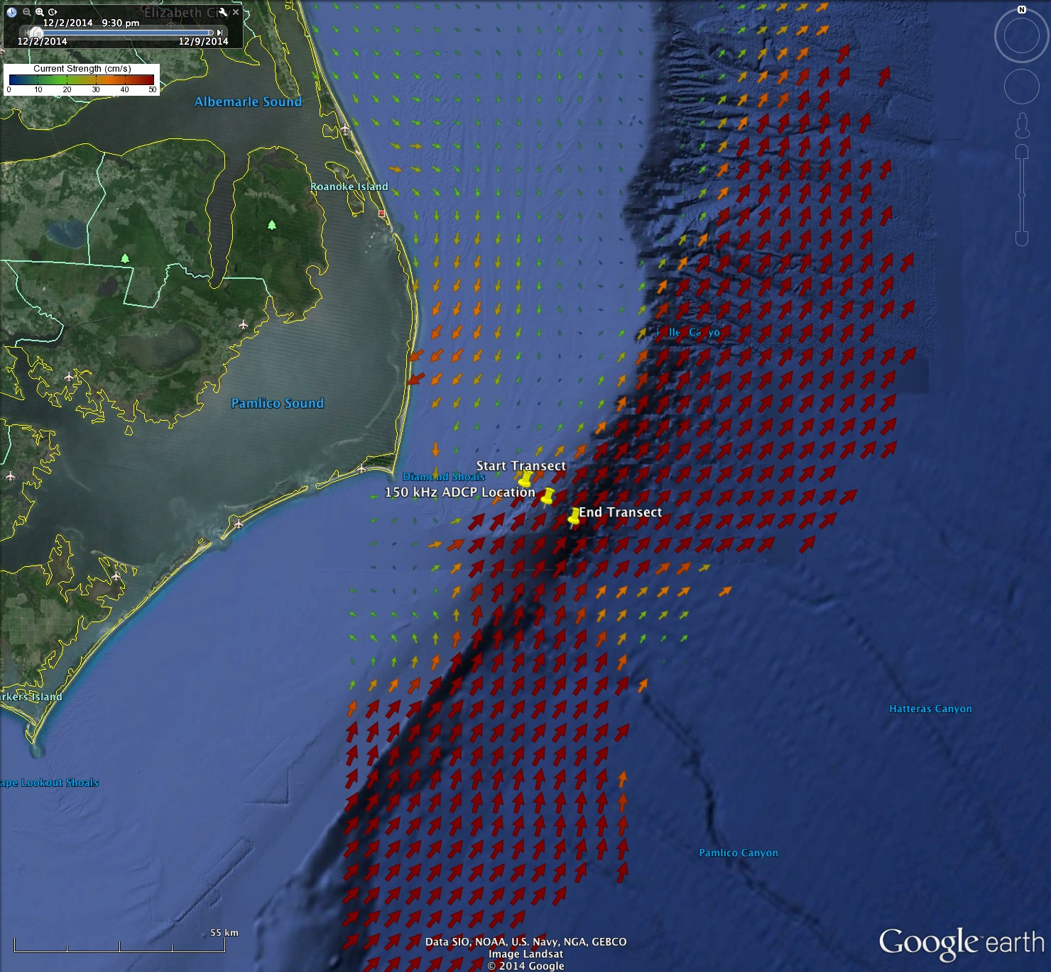
Wave Energy Converters: Coming Soon!
1. WEC to power the National Science Foundations Ocean Observing Initiative Pioneer Array with Sandia National Labs
2. Oscilla Power/Codar Ocean Sensors WEC powering an offshore transmitter for Coastal Ocean Radar

Slide 5
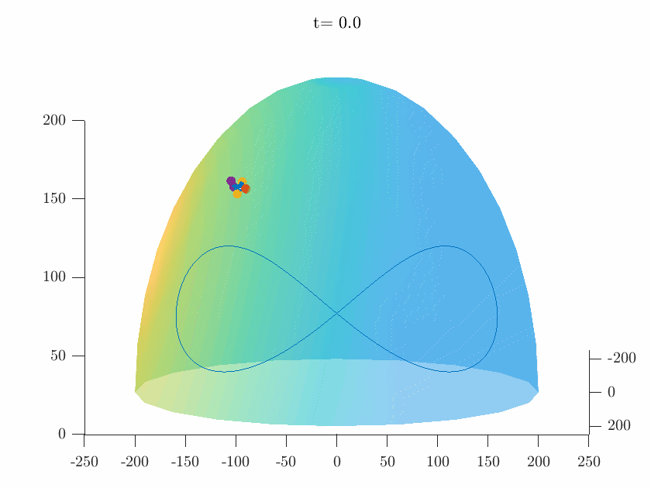
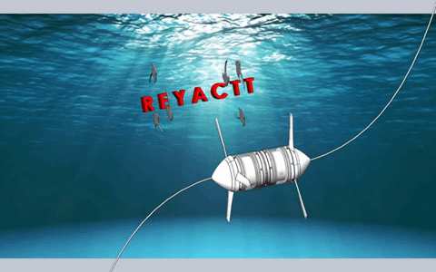
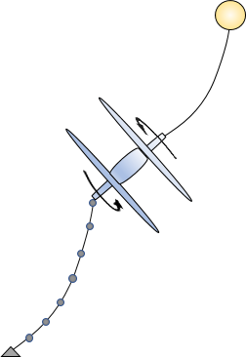
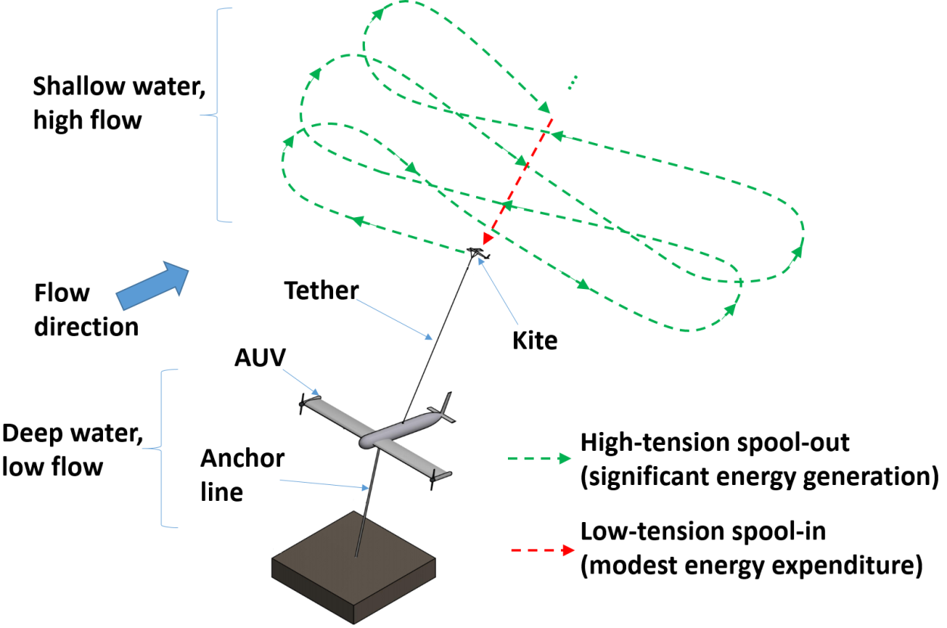
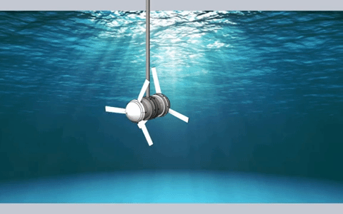
+v
Mike Muglia
mugliam@ecu.edu
-u
+u
Thank you for
your attention!
Mike Muglia
mugliam@ecu.edu
-v
s⁻¹
s⁻¹x10⁻⁴
Underwater Biaxial Turbines and Kites
Tethered Coaxial Turbine
Ocean Kite

Slide 6
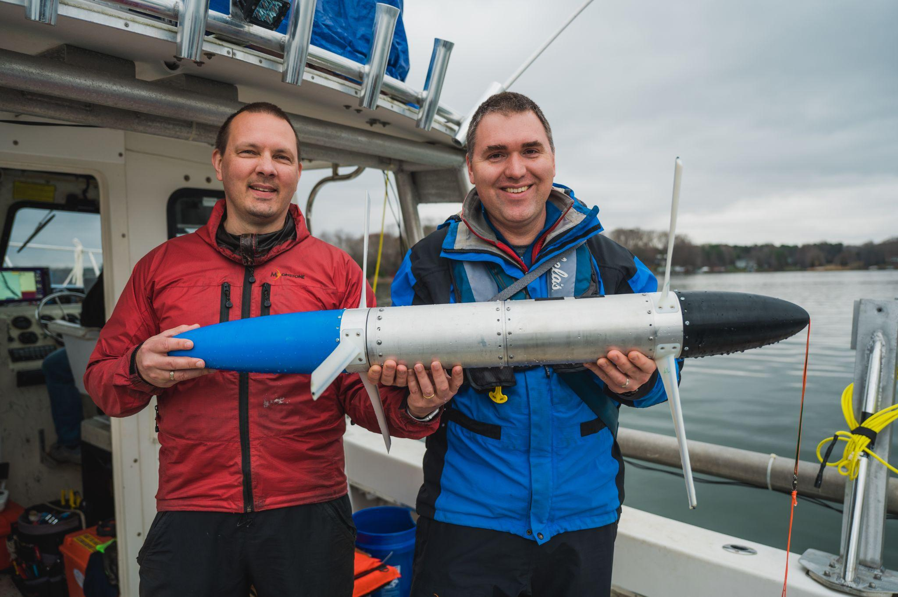
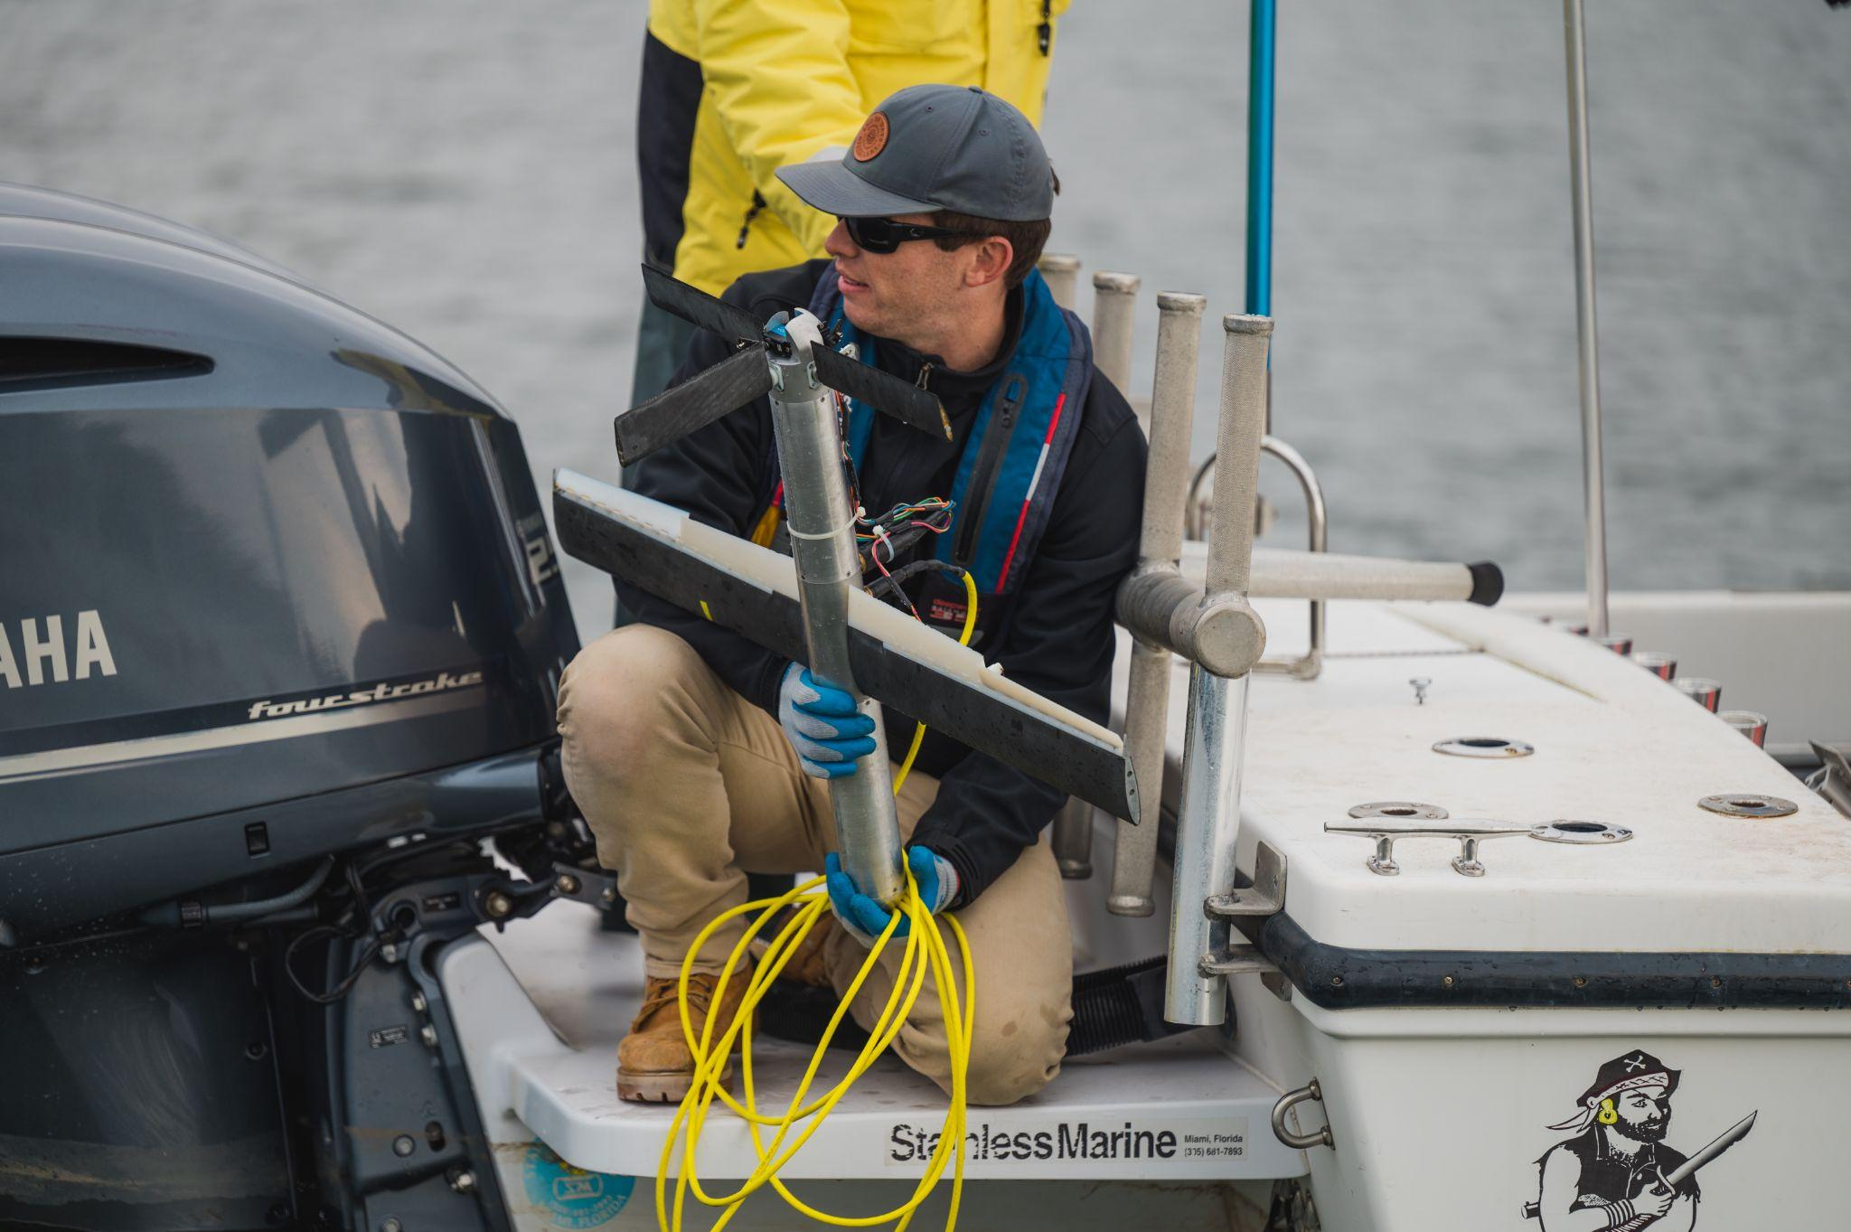
+v
Mike Muglia
mugliam@ecu.edu
-u
+u
Thank you for
your attention!
Mike Muglia
mugliam@ecu.edu
-v
s⁻¹
s⁻¹x10⁻⁴
Underwater Biaxial Turbines and Kites
Tow Testing

Slide 7
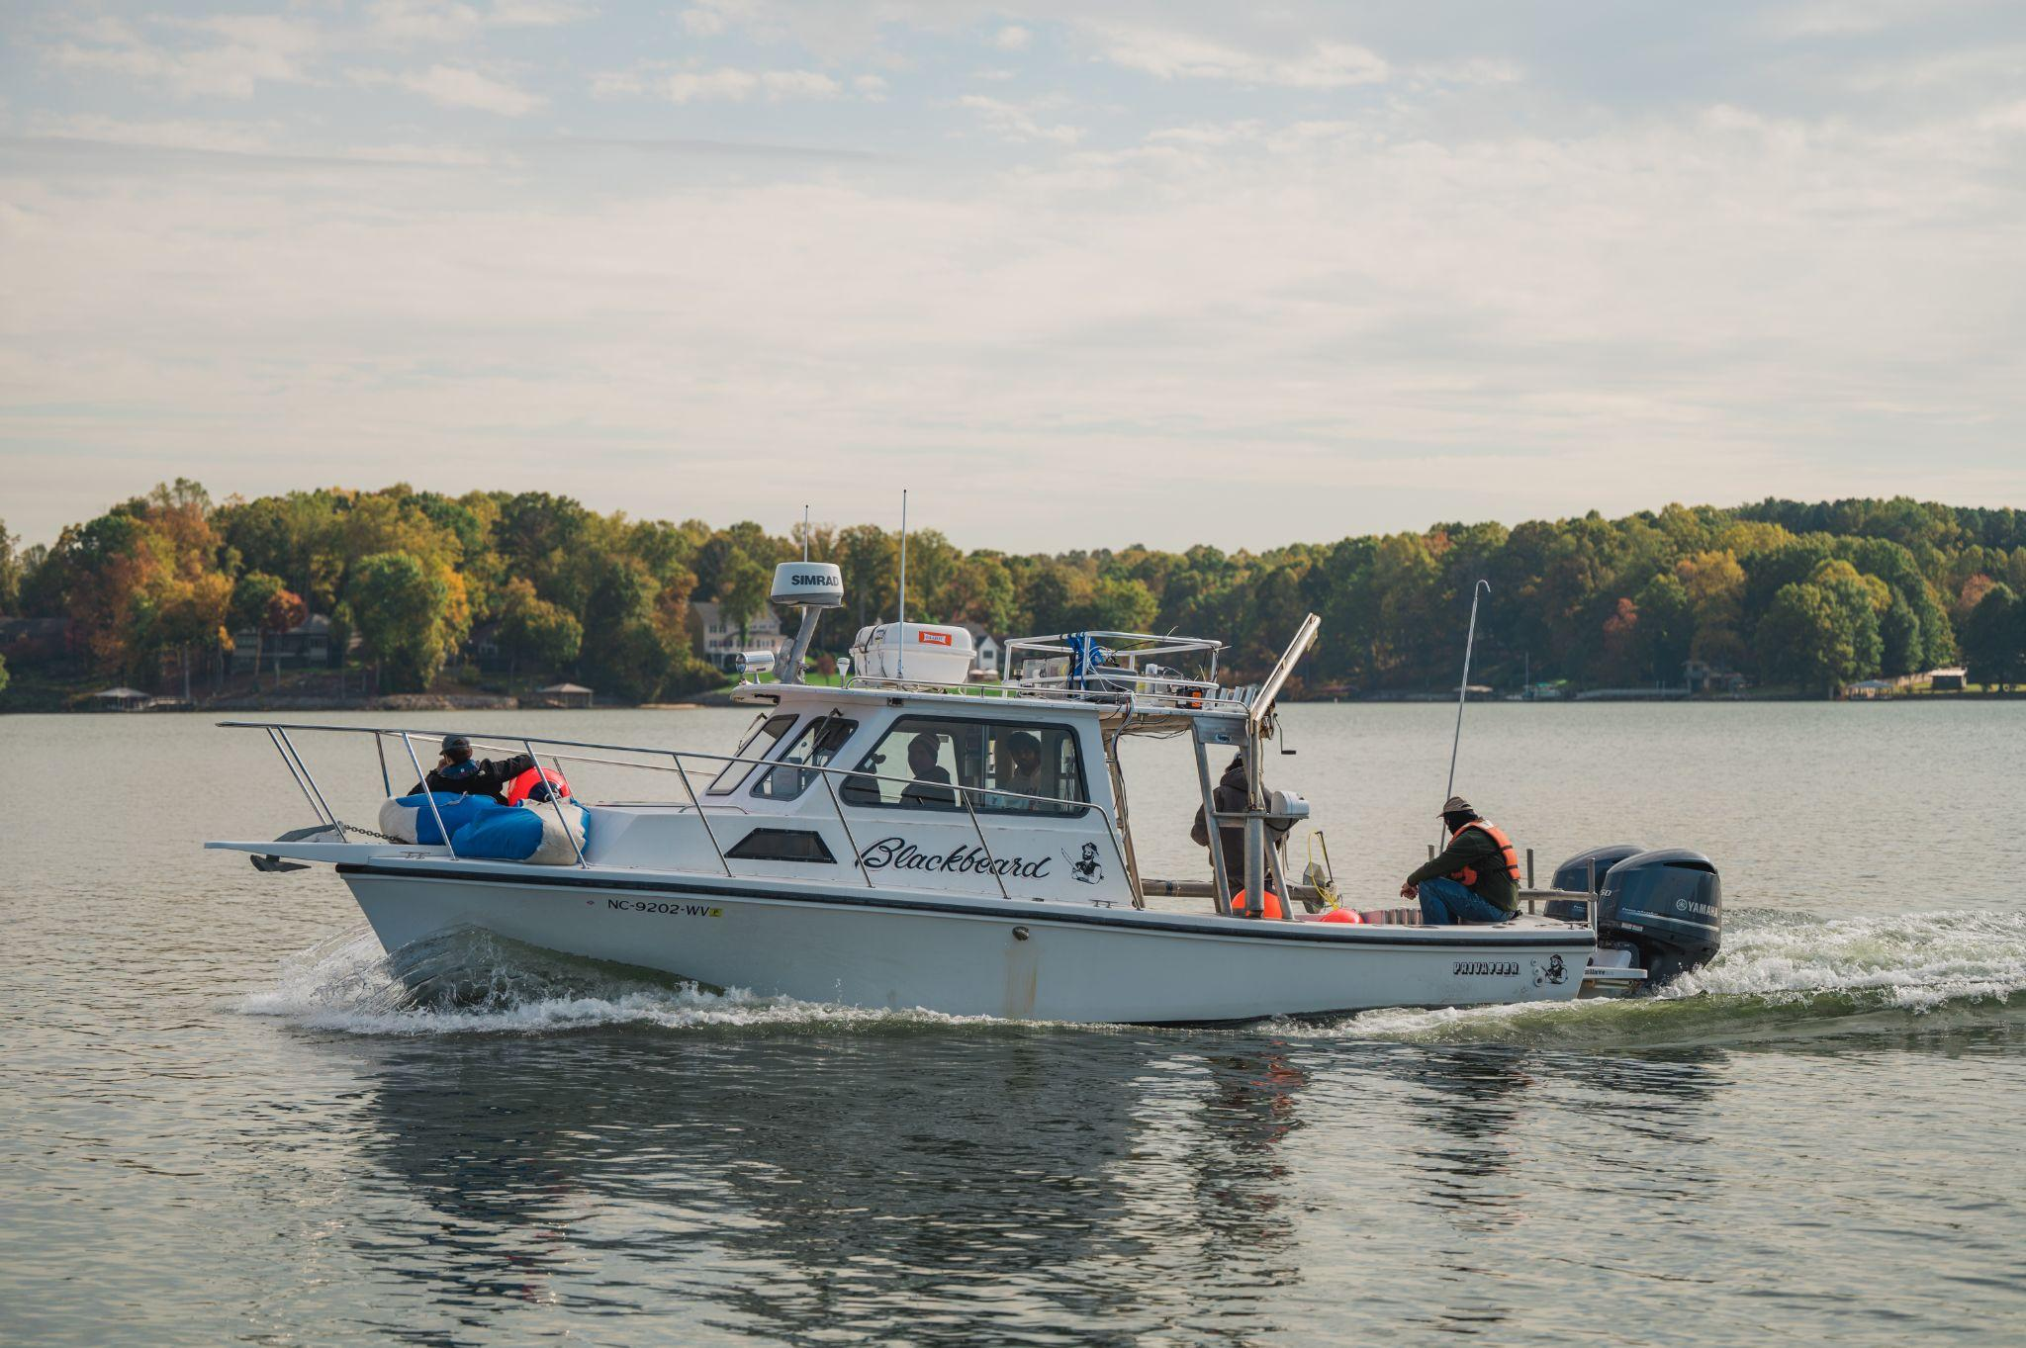
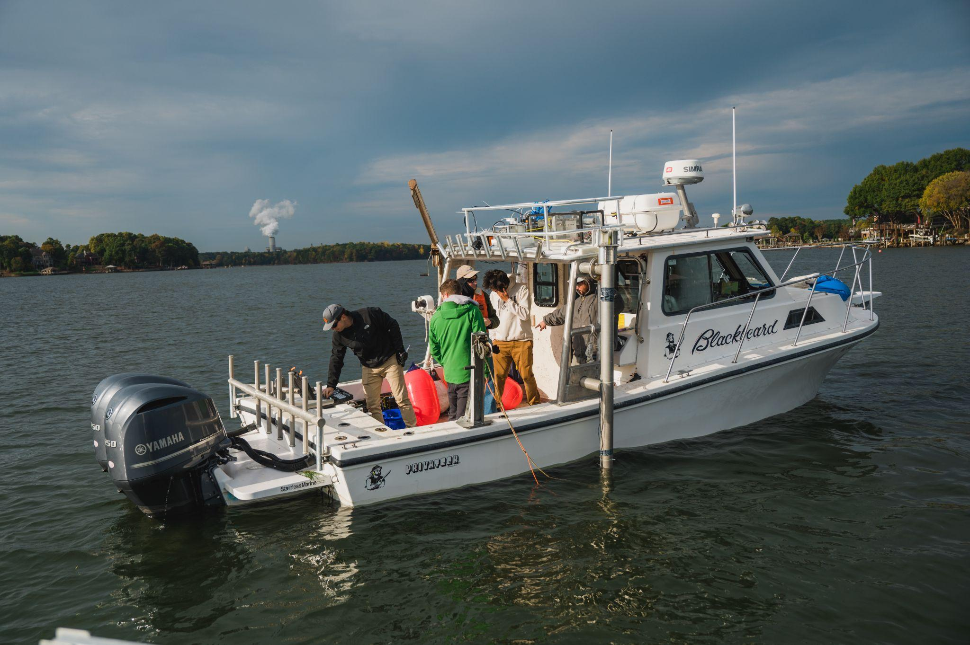
+v
Mike Muglia
mugliam@ecu.edu
-u
+u
Thank you for
your attention!
Mike Muglia
mugliam@ecu.edu
-v
s⁻¹
s⁻¹x10⁻⁴
Underwater Biaxial Turbines and Kites
Tow Testing

