Slide 1
E.R.S. Effort Reporting SYSTEM Reviewed June 2024
PRE-REVIEW
COST SHARE

Slide 2
LOG IN: https://ers.ecu.edu/GenericERS/custom/index.jsp
SAME USER ID AND PASSWORD AS PIRATE PORT
OFF CAMPUS- MUST HAVE VPN TO LOGIN

Slide 3
HOME PAGE
CLICK ON NUMBER IN CURRENT PENDING NON-CRITICAL BOX

Slide 4
FORMS PENDING PRE-REVIEW
Click edit icon

Slide 5
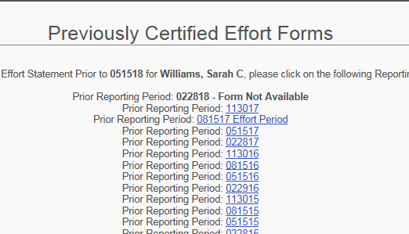
PRE-REVIEW SCREEN

Slide 6
PRE-REVIEW SCREEN
DON’T SEE SPONSORED GRANT FUND NUMBER?
ADD ACCOUNT

Slide 7
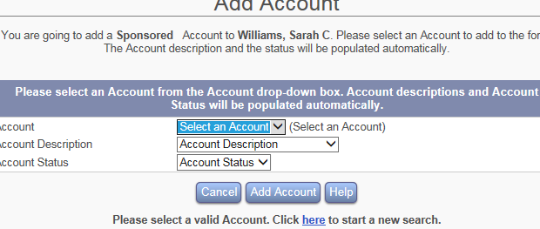
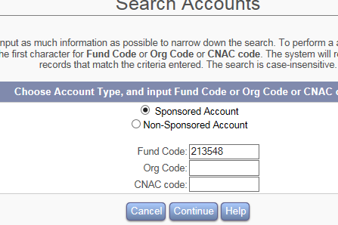
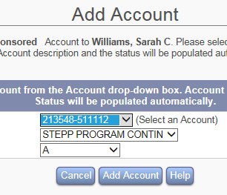
HOW TO ADD AN ACCOUNT
1.SELECT SPONSORED ACCOUNT
2.KEY IN FUND GRANT NUMBER
3.CLICK CONTINUE
4.CLICK DROP DOWN BOX “SELECT AN ACCOUNT”
5.CLICK ON CORRECT GRANT FUND NUMBER
6.CLICK ADD ACCOUNT

Slide 8
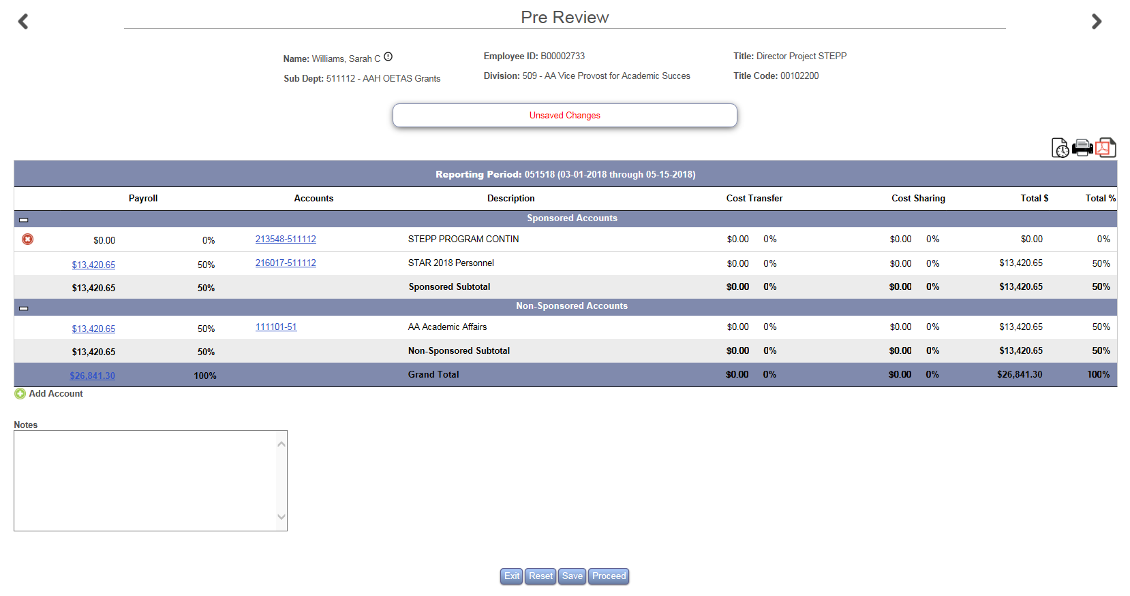
HOW TO ADD AN ACCOUNT
ACCOUNT IS ADDED TO FORM
CLICK SAVE

Slide 9
HOW TO KEY COST SHARE
CLICK EITHER $0.00 OR 0%
A TEXT BOX WILL OPEN

Slide 10
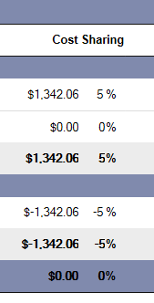
HOW TO KEY COST SHARE
IN THE TEXT BOX UNDER THE COST SHARE COLUMN : KEY THE CORRECT $ OR % IN THE SPONSORED AND NONSPONSORED ROWS
THE SPONSORED AND NONSPONSORED ROWS MUST BALANCE
THE TOTAL% (BOTTOM RIGHT) MUST BE 100%
CLICK PROCEED

Slide 11
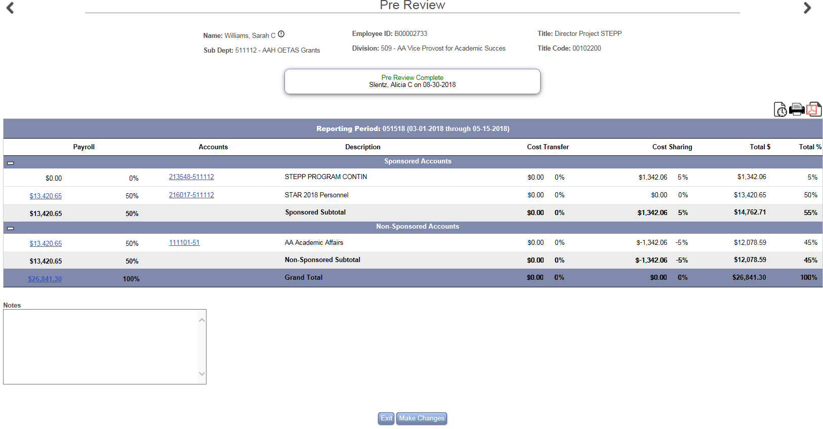

Slide 12
HOME PAGE

Slide 13
CONGRATULATIONS PRE-REVIEW COMPLETE!
LOG IN OFTEN TO CONFIRM CERTIFICATION
REMINDERS WILL BE SENT AT 3, 2 AND 1 WEEK PRIOR TO PERIOD END
NOTIFY YOUR DEPARTMENTAL EFFORT CORRDINATOR IF YOU HAVE QUESTIONS ABOUT THE EFFORT PROCESS
EMAIL ERS HELP DESK WITH ANY UPDATES, CHANGES OR QUESTIONS YOU MAY HAVE WITH THE EFFORT SYSTEM
ERSHELPDESK@ECU.EDU

