Slide 1
E.R.S. Effort Reporting SYSTEM Revised June 2024
PRE-REVIEW
COST TRANSFER

Slide 2
LOG IN: https://ers.ecu.edu/GenericERS/custom/index.jsp
SAME USER ID AND PASSWORD AS PIRATE PORT
OFF CAMPUS- MUST HAVE VPN TO LOGIN

Slide 3
HOME PAGE
CLICK ON NUMBER IN CURRENT PENDING NON-CRITICAL BOX

Slide 4
FORMS PENDING PRE-REVIEW
Click edit icon

Slide 5
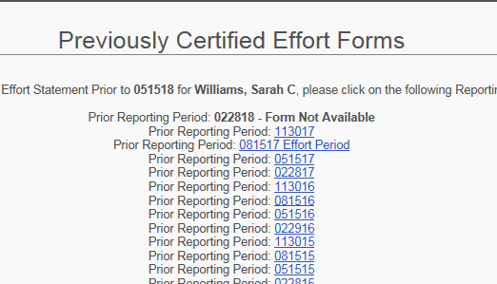
PRE-REVIEW SCREEN

Slide 6
PRE-REVIEW SCREEN
DON’T SEE SPONSORED GRANT FUND NUMBER?
ADD ACCOUNT

Slide 7
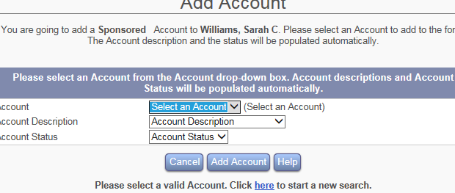
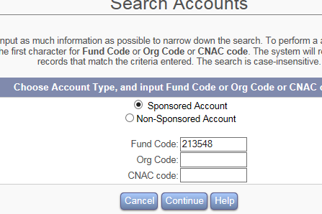
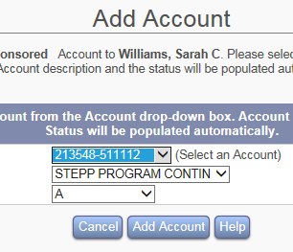
HOW TO ADD AN ACCOUNT
1.SELECT SPONSORED ACCOUNT
2.KEY IN FUND GRANT NUMBER
3.CLICK CONTINUE
4.CLICK DROP DOWN BOX “SELECT AN ACCOUNT”
5.CLICK ON CORRECT GRANT FUND NUMBER
6.CLICK ADD ACCOUNT

Slide 8
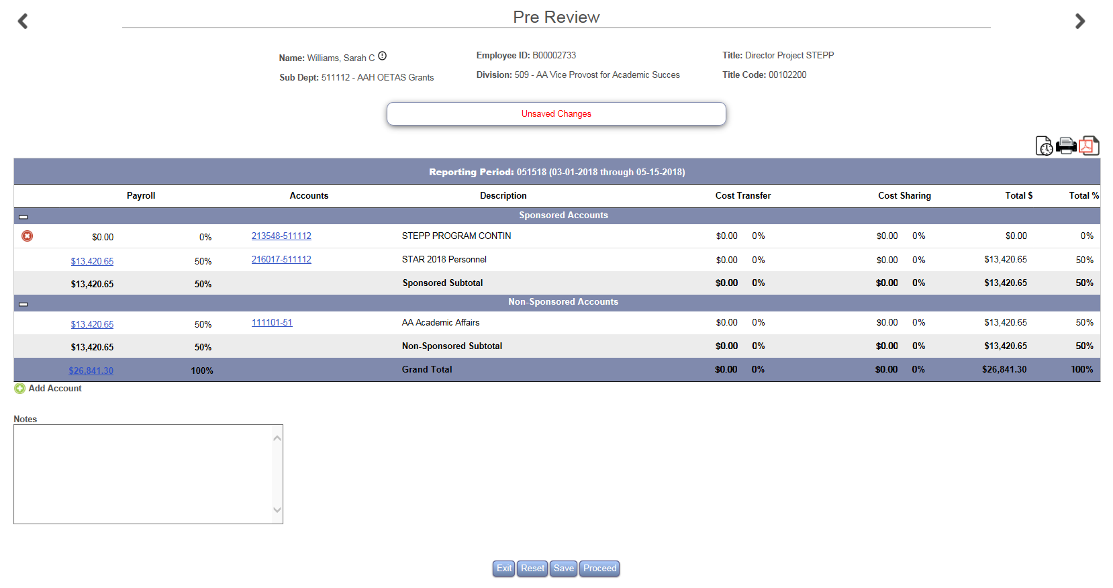
HOW TO ADD AN ACCOUNT
ACCOUNT IS ADDED TO FORM
CLICK SAVE

Slide 9
HOW TO KEY A COST TRANSFER
CLICK EITHER $0.00 OR 0%
A TEXT BOX WILL OPEN

Slide 10
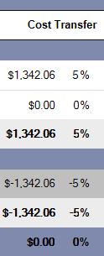
HOW TO KEY A COST TRANSFER
IN THE TEXT BOX UNDER THE COST TRANSFER COLUMN : KEY THE CORRECT $ OR % IN THE SPONSORED AND NONSPONSORED ROWS
THE SPONSORED AND NONSPONSORED ROWS MUST BALANCE
THE TOTAL% (BOTTOM RIGHT) MUST BE 100%
CLICK PROCEED

Slide 11
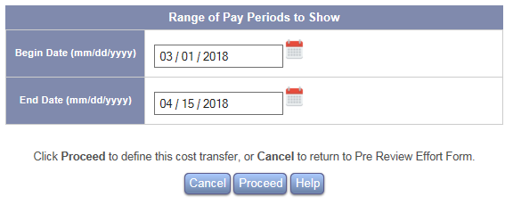
HOW TO KEY A COST TRANSFER
DEFINE COST TRANSFER
ON THIS SCREEN YOU WILL CHOOSE THE PAYROLL DATE RANGE TO ASSIGN THE DOLLAR TRANSFER
THESE DATES CAN RANGE FROM ONE TO SIX PAY PERIODS

Slide 12
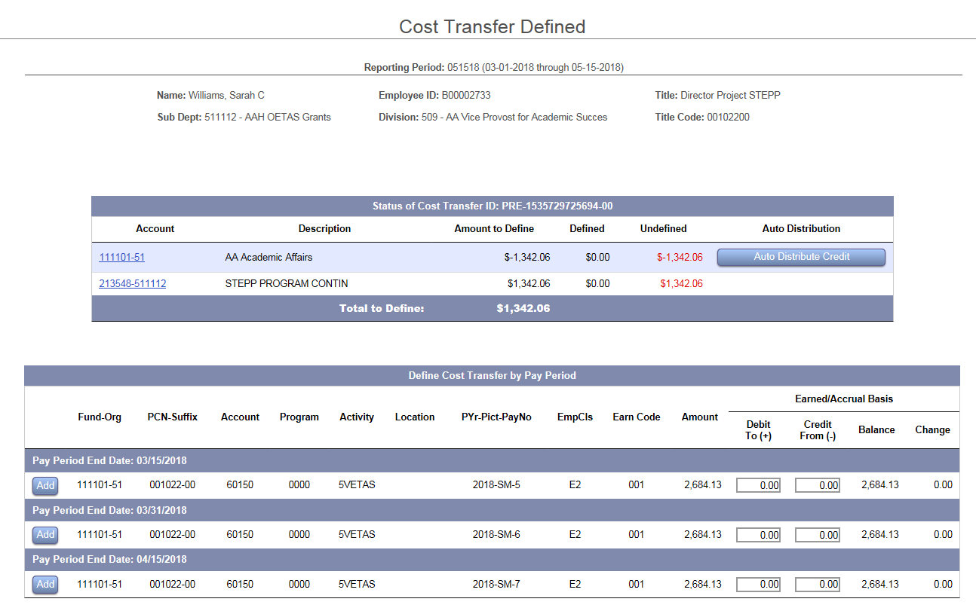
HOW TO KEY A COST TRANSFER
NOTICE YOUR NEW GRANT FUND IS NOT VISIBLE
THESE MUST BE ADDED TO EACH PAY PERIOD

Slide 13
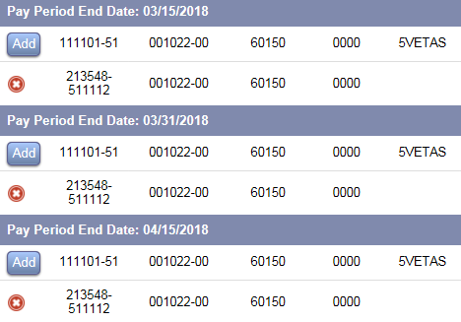
HOW TO KEY A COST TRANSFER
CLICK ADD
USE THE DROPDOWN ARROW TO CHOOSE THE CORRECT FUND-ORG & PCN-SUFFIX
THEN KEY THE CORRECT ACCOUNT, PROGRAM AND ACTIVITY CODE
CLICK THE GREEN CHECKMARK TO COMMIT
REPEAT FOR EACH PAY PERIOD

Slide 14
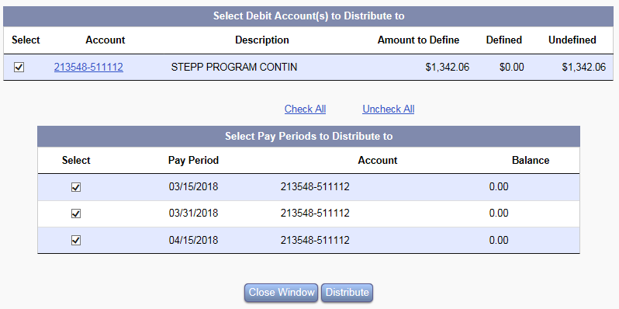
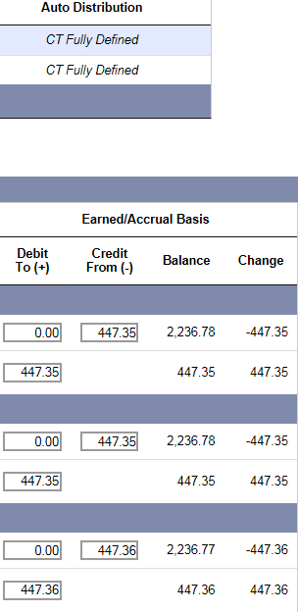
HOW TO KEY A COST TRANSFER
IF THE COST TRANSFER IS TO BE EVENLY DISTRIBUTED THROUGHOUT ALL PAYROLLS, THE AUTO DISTRIBUTE CREDIT BUTTON CAN BE USED
THIS WILL EVENLY DISTRIBUTE THE FUNDS
WRITE JUSTIFICATION (NOTE)
CLICK PROCEED

Slide 15
HOW TO KEY A COST TRANSFER
IF THE COST TRANSFER NEEDS TO BE DISPERSED WITH A DIFFERENT AMOUNT EACH PAYPERIOD THEN YOU MUST KEY THEM INDIVIDUALLY
ONCE THE COST TRANSFER IS FULLY DEFINED
KEY THE JUSTIFICATION (NOTE)
CLICK PROCEED
CLICK PROCEED AGAIN

Slide 16
HOW TO KEY A COST TRANSFER
Timeliness of Cost Transfers
Cost transfers must be processed in a timely manner, properly documented, and approved.
Cost transfers should be prepared and submitted as soon as the need for a transfer is identified, but no later than 90 calendar days from the month-end for which the costs were originally incurred; or within 30 days of the expiration date, whichever comes first
Cost transfers exceeding the 90 calendar-day period, regardless of the amount, require completion of a Cost Transfer Justification Memo and Financial Analyst approval.
Cost transfers exceeding 180 calendar-days following the date for which the costs were originally incurred must be approved by AVC for Research Administration and Compliance.

Slide 17
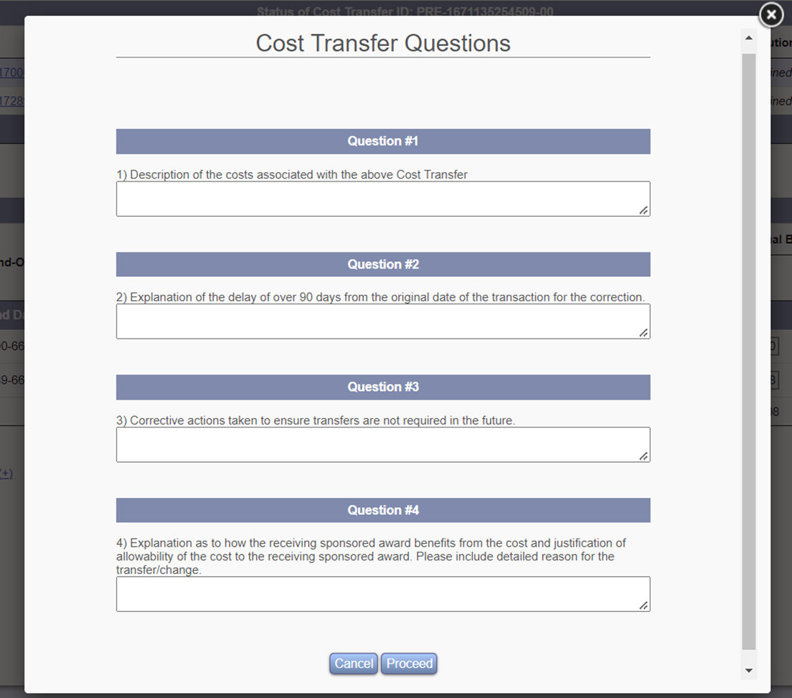
HOW TO KEY A COST TRANSFER
Cost Transfer Justification Memo

Slide 18
ERS Cost Transfers Best Practice
Due to the need for FA Approval of Cost Transfers >90 Days, all effort forms will not move on to the certification step until Cost Transfers are approved.
This creates an extra step and minor lag time in moving effort forms through the pre review and certification process.
To minimize the effect of this extra step, please complete your payroll redistributions before the effort reporting period is initiated.

Slide 19
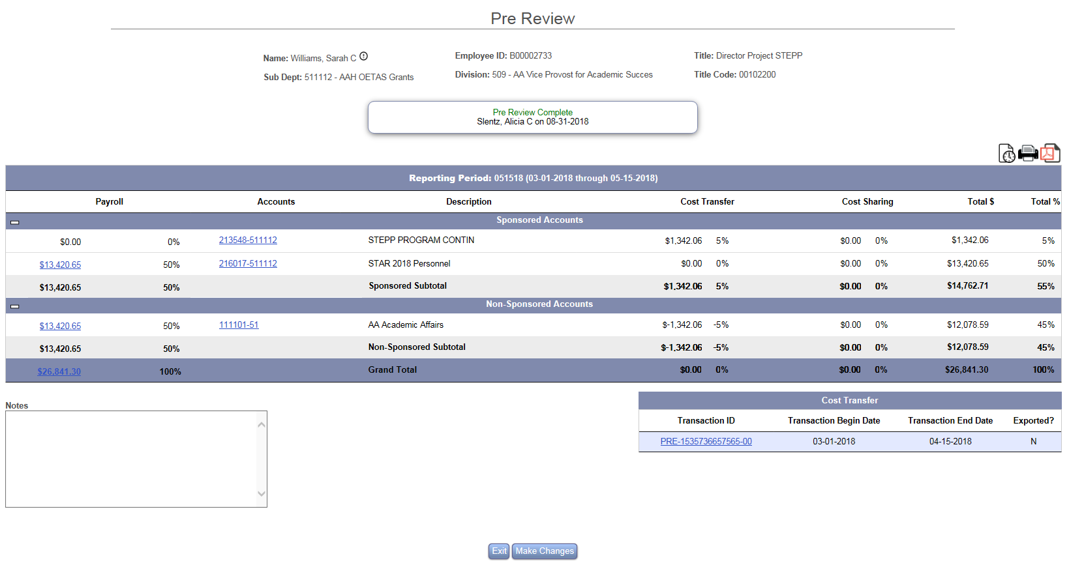
NOTICE THE COST TRANSFER IS NOW ON THE FORM

Slide 20
HOME PAGE

Slide 21
CONGRATULATIONS PRE-REVIEW COMPLETE!
LOG IN OFTEN TO CONFIRM CERTIFICATION
REMINDERS WILL BE SENT AT 3, 2 AND 1 WEEK PRIOR TO PERIOD END
NOTIFY YOUR DEPARTMENTAL EFFORT CORRDINATOR IF YOU HAVE QUESTIONS ABOUT THE EFFORT PROCESS
EMAIL ERS HELP DESK WITH ANY UPDATES, CHANGES OR QUESTIONS YOU MAY HAVE WITH THE EFFORT SYSTEM
ERSHELPDESK@ECU.EDU

