Slide 1
ERS – Effort reporting system Revised June 2024
FA Approvals of Cost Transfers >90 Days

Slide 2
The creation and implementation of ORA Policies 511 and 511.01 necessitated a change in the ERS Cost Transfer approval flow.
The policy outlines that all cost transfers and payroll redistributions >90 days from the date of the charge require the approval of the Financial Analyst managing that sponsored fund.
Because of the requirements of this policy, the Cost Transfer process in ERS has been changed to include this extra step of approval.
The newly updated process in ERS is outlined in this presentation.

Slide 3
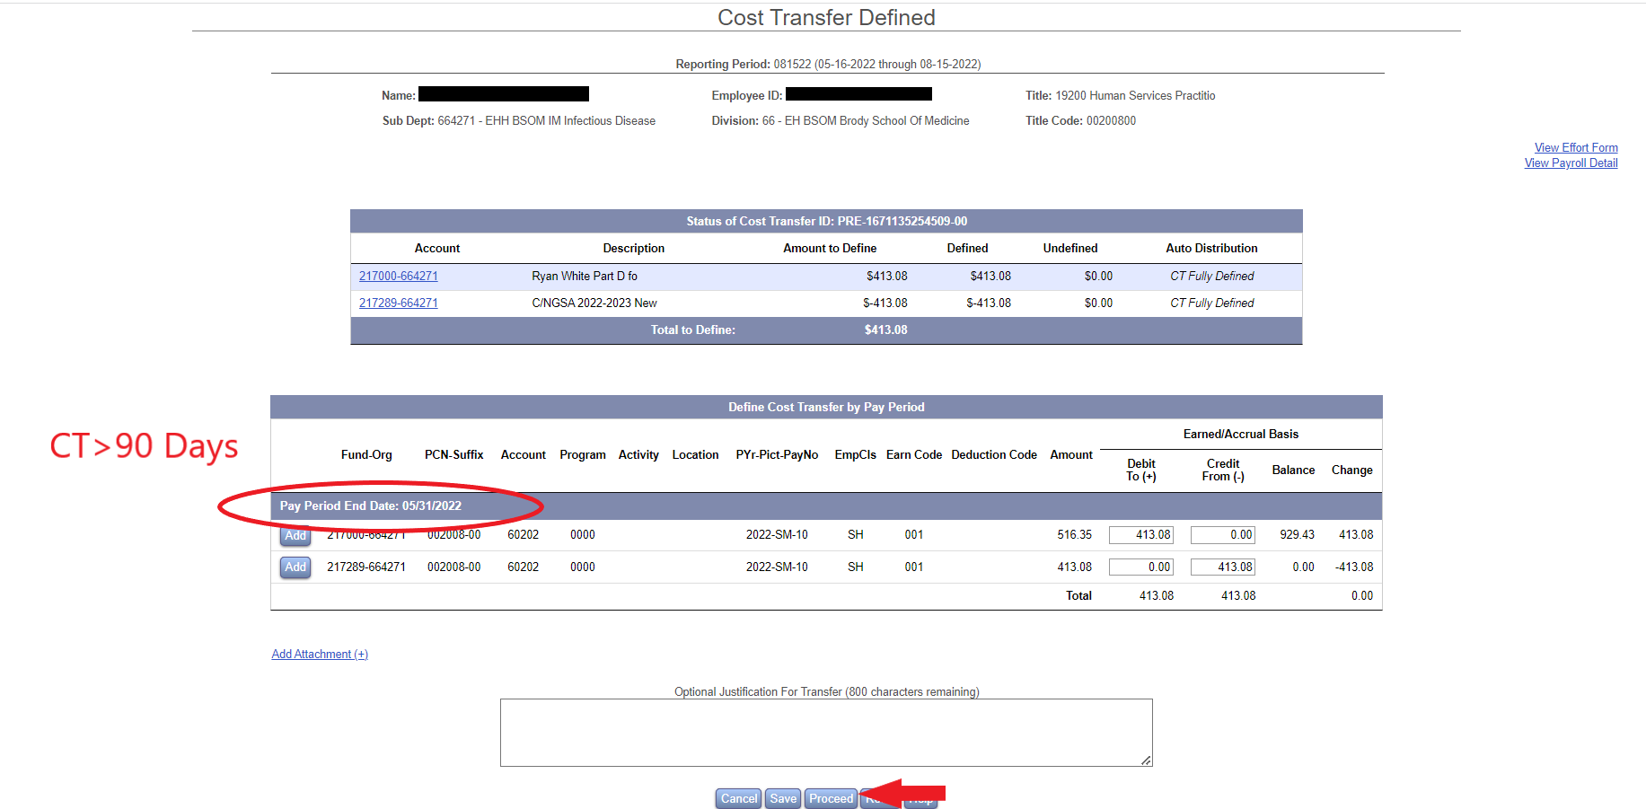
Pre-Review
Pre-Review process will remain unchanged unless Cost Transfer >90 Days is processed.

Slide 4
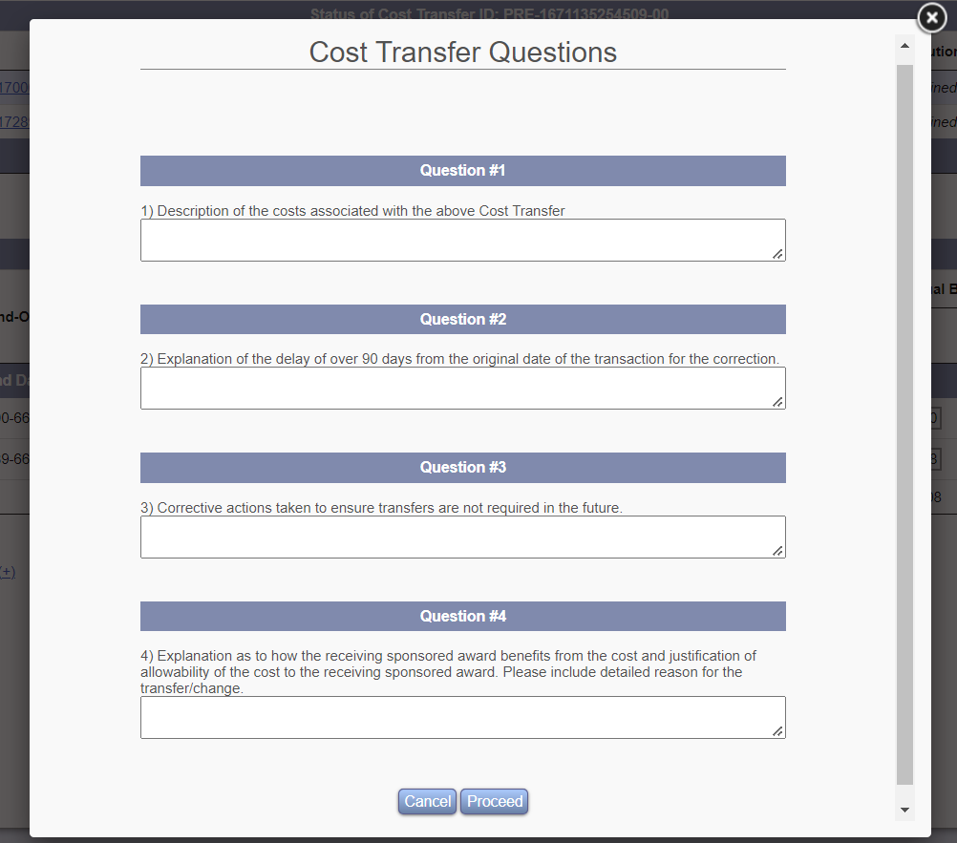
Pre-Review
If a Cost Transfer is processed in ERS that is >90 days from the charge, a Pop-Up window will open, requiring the pre-reviewer to answer 4 questions. These questions mirror the Cost Transfer Justification Memo (Policy 511.01)
The answers to these questions are required in order to proceed to the next step.

Slide 5
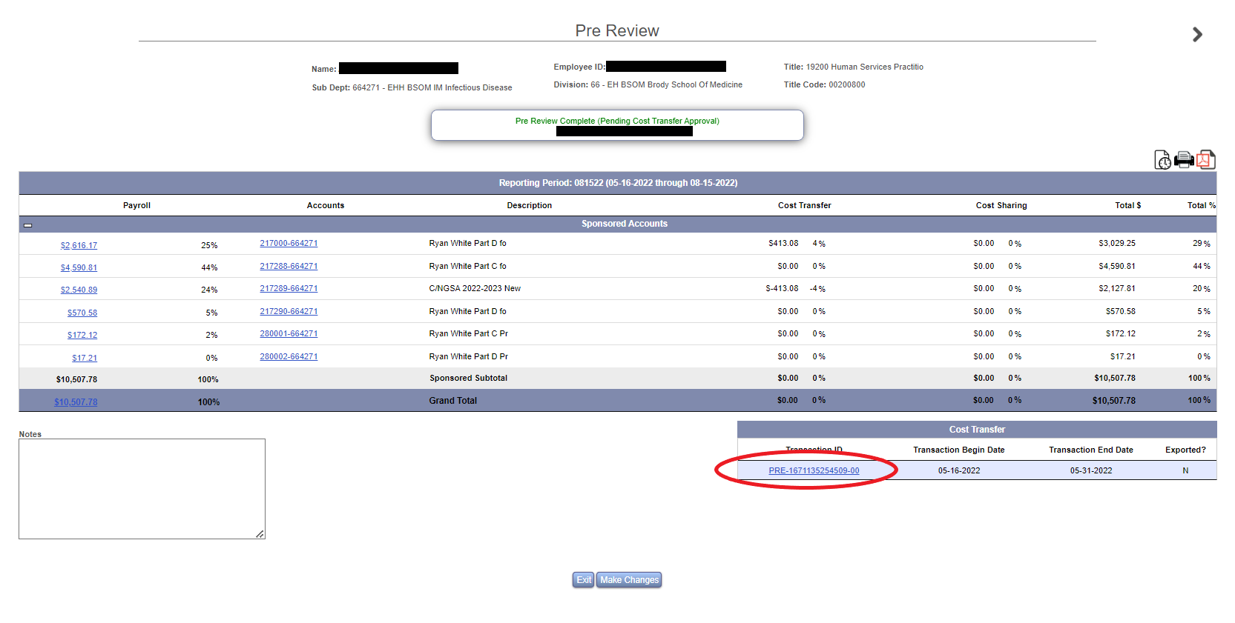
Pre-Review
Cost Transfer Justification Memo answers and optional attachments will be saved in the Cost Transfer Detail record.

Slide 6
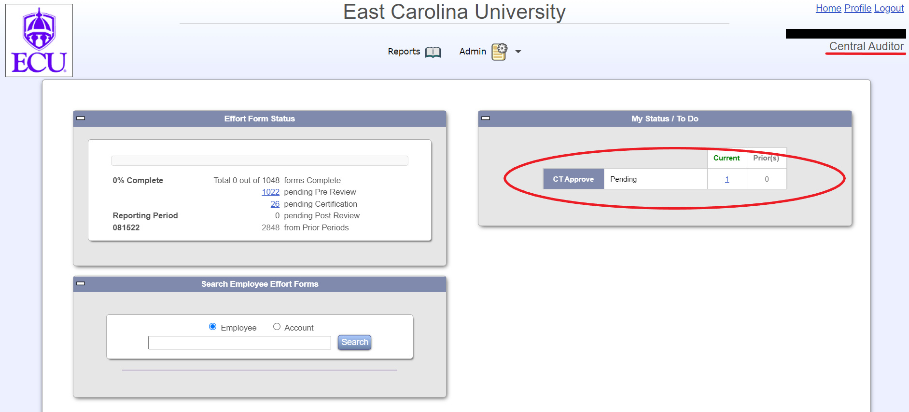
FA Approval
If a CT >90 Days is processed, the FA managing that sponsored project will receive an automated email from ERS.

Slide 7
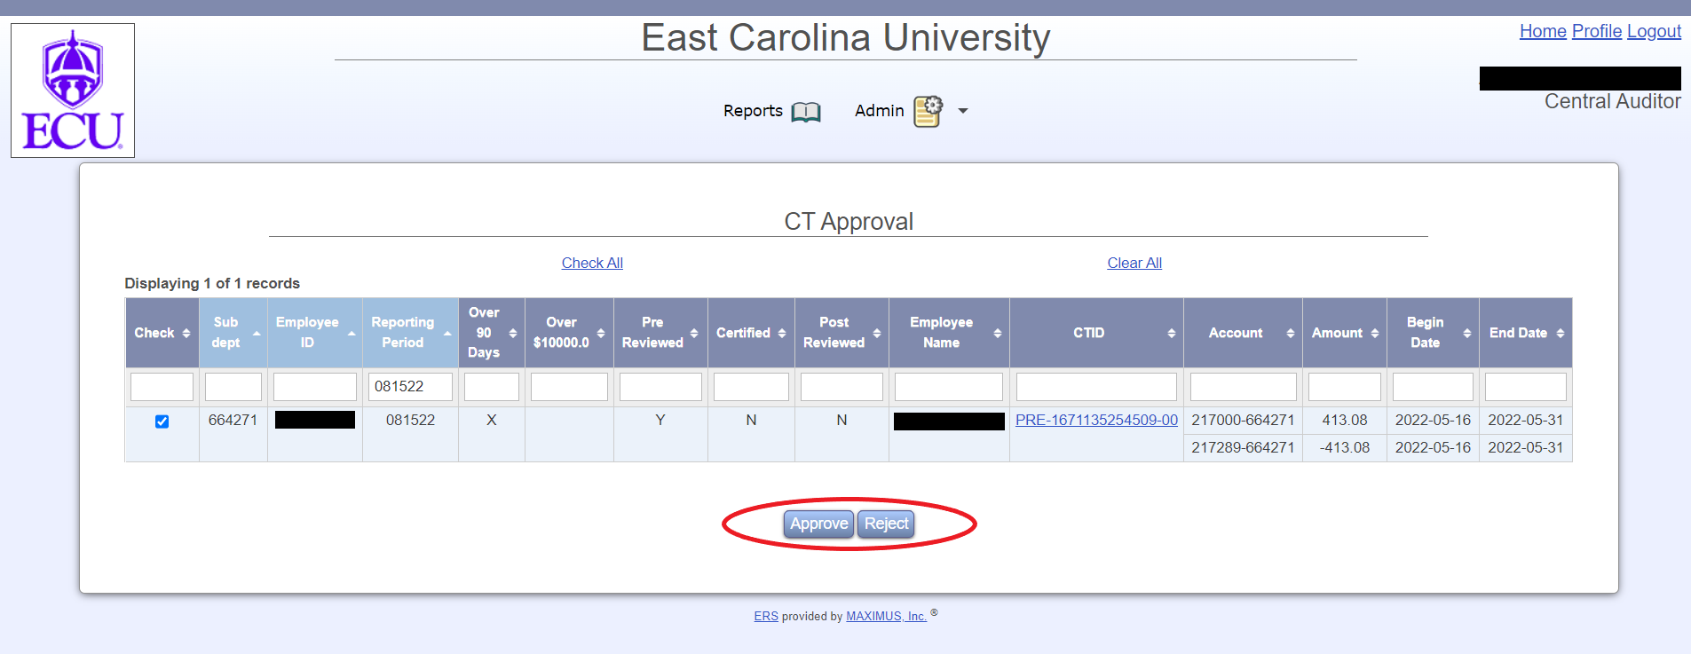
FA Approval
At this point, FAs can approve or reject Cost Transfers.
If CTs are approved by the FA, the effort form moves to the ERS Certifier approval step.
If CTs are rejected, the effort form will be moved back into the Pre-Reviewer’s queue.

Slide 8
FA Approval
Formerly, Certifiers were able to complete the certification process in ERS as soon as the pre-review was completed, even occasionally while Cost Transfers were awaiting approval from the ERS Administrator.
Due to the need for FA Approval of Cost Transfers >90 Days, all effort forms will not move on to the certification step until Cost Transfers are approved. Only CTs >90 Days will need approval by an FA. All other effort forms will only need approval by the ERS Administrator. The ERS Administrator will typically process Cost Transfers daily.
This creates an extra step and minor lag time in moving effort forms through the pre review and certification process
To minimize the effect of this extra step, please complete your payroll redistributions before the effort reporting period is initiated. Your ERS Coordinator will contact you with effort initiation dates, as well as Banner-HR Payroll Redistribution deadlines.

