Slide 1
E.R.S. Effort Reporting SYSTEM REVIEWED JUNE 2024
HOW TO CERTIFY YOUR EFFORT FORM

Slide 2
LOG IN: https://ers.ecu.edu/GenericERS/custom/index.jsp
SAME USER ID AND PASSWORD AS PIRATE PORT
OFF CAMPUS- MUST HAVE VPN TO LOGIN

Slide 3
HOME PAGE
CLICK ON NUMBER IN CERTIFICATION PENDING NON-CRITICAL BOX

Slide 4
FORMS PENDING CERTIFICATION
Click edit icon

Slide 5
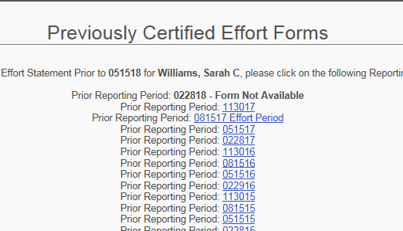
CERTIFY SCREEN

Slide 6
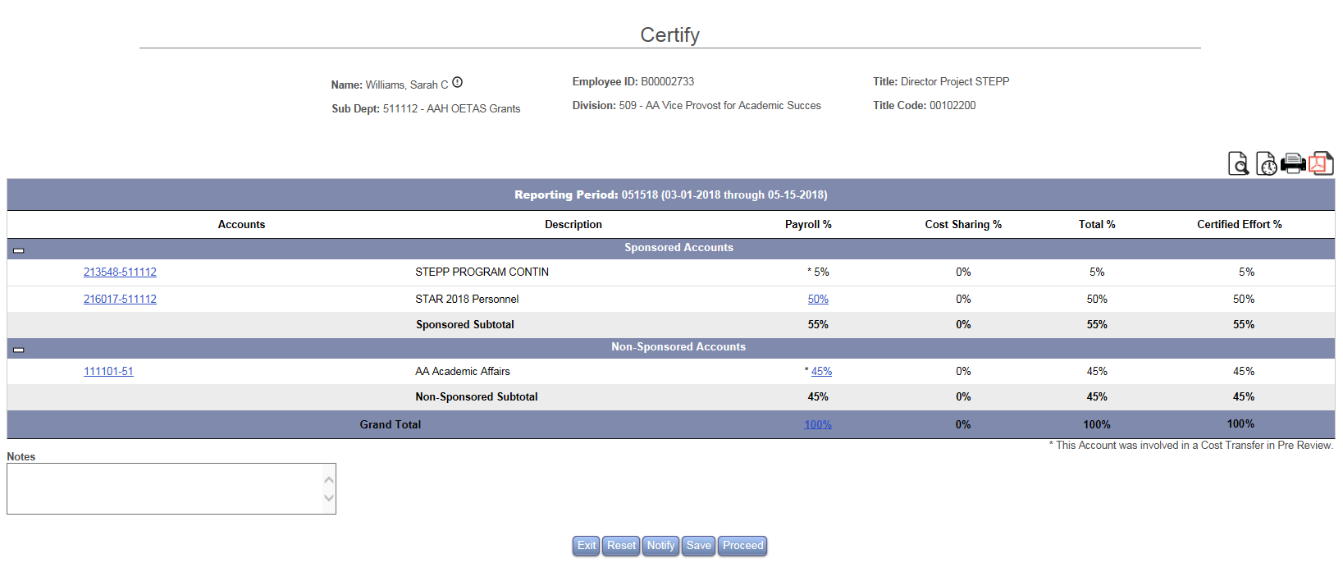
CERTIFY SCREEN
*NO CHANGES TO FORM?*
CLICK PROCEED

Slide 7
CERTIFY SCREEN
CLICK CERTIFY

Slide 8
CONGRATULATIONS CERTIFICATION COMPLETE!
LOG IN OFTEN TO CONFIRM CERTIFICATION
NOTIFY YOUR DEPARTMENTAL EFFORT CORRDINATOR IF YOU HAVE QUESTIONS ABOUT THE EFFORT PROCESS
EMAIL ERS HELP DESK WITH ANY UPDATES, CHANGES OR QUESTIONS YOU MAY HAVE WITH THE EFFORT SYSTEM
ERSHELPDESK@ECU.EDU

