Slide 1
E.R.S. Effort Reporting SYSTEM
PRE-REVIEW
COST TRANSFER

Slide 2
LOG IN: https://ers.ecu.edu/GenericERS/custom/index.jsp
SAME USER ID AND PASSWORD AS PIRATE PORT
OFF CAMPUS- MUST HAVE VPN TO LOGIN

Slide 3
HOME PAGE
CLICK ON NUMBER IN CURRENT PENDING NON-CRITICAL BOX

Slide 4
FORMS PENDING PRE-REVIEW
Click edit icon

Slide 5
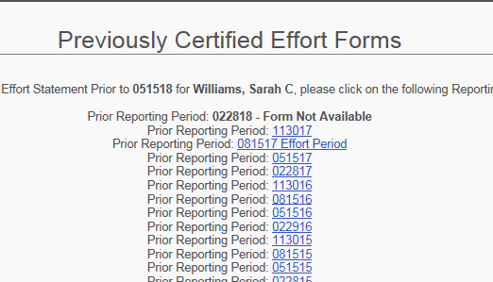
PRE-REVIEW SCREEN

Slide 6
PRE-REVIEW SCREEN
DON’T SEE SPONSORED GRANT FUND NUMBER?
ADD ACCOUNT

Slide 7
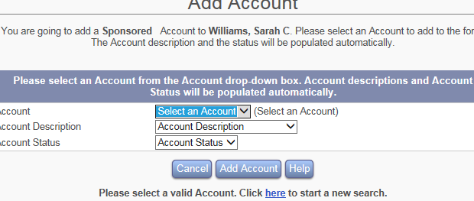
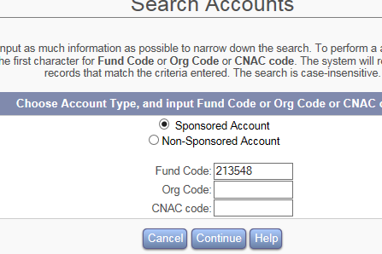
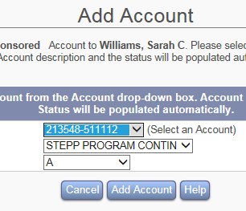
HOW TO ADD AN ACCOUNT
1.SELECT SPONSORED ACCOUNT
2.KEY IN FUND GRANT NUMBER
3.CLICK CONTINUE
4.CLICK DROP DOWN BOX “SELECT AN ACCOUNT”
5.CLICK ON CORRECT GRANT FUND NUMBER
6.CLICK ADD ACCOUNT

Slide 8
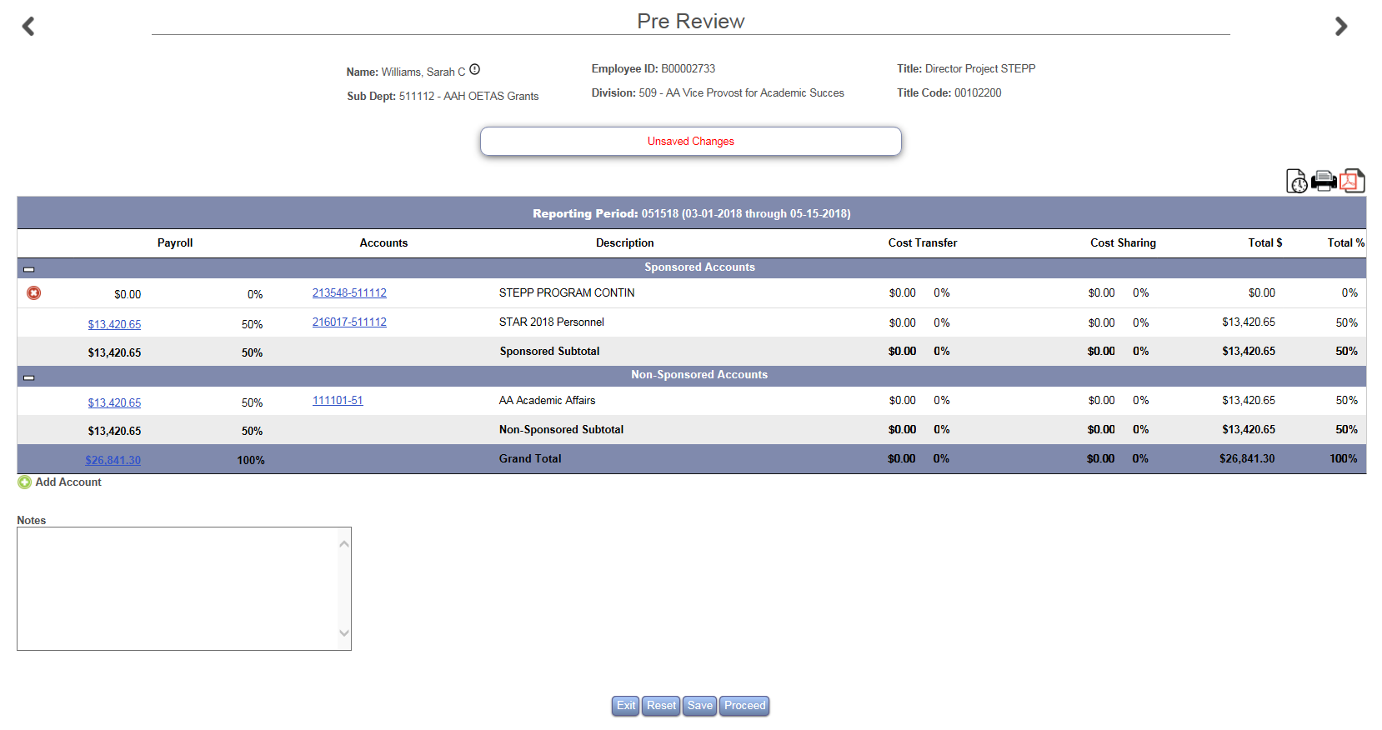
HOW TO ADD AN ACCOUNT
ACCOUNT IS ADDED TO FORM
CLICK SAVE

Slide 9
HOW TO KEY A COST TRANSFER
CLICK EITHER $0.00 OR 0%
A TEXT BOX WILL OPEN

Slide 10
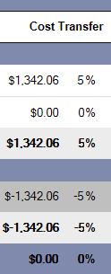
HOW TO KEY A COST TRANSFER
IN THE TEXT BOX UNDER THE COST TRANSFER COLUMN : KEY THE CORRECT $ OR % IN THE SPONSORED AND NONSPONSORED ROWS
THE SPONSORED AND NONSPONSORED ROWS MUST BALANCE
THE TOTAL% (BOTTOM RIGHT) MUST BE 100%
CLICK PROCEED

Slide 11
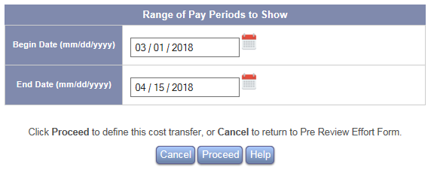
HOW TO KEY A COST TRANSFER
DEFINE COST TRANSFER
ON THIS SCREEN YOU WILL CHOOSE THE PAYROLL DATE RANGE TO ASSIGN THE DOLLAR TRANSFER
THESE DATES CAN RANGE FROM ONE TO SIX PAY PERIODS

Slide 12
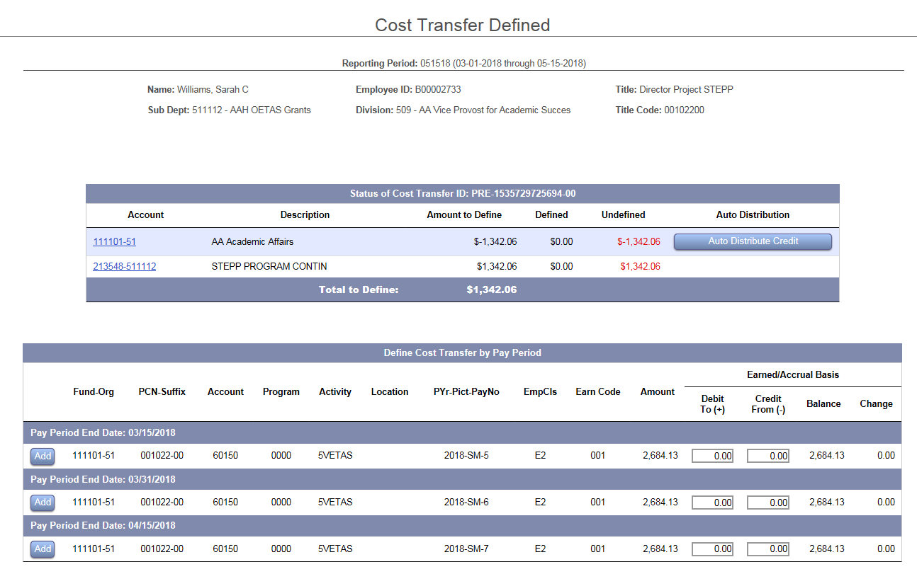
HOW TO KEY A COST TRANSFER
NOTICE YOUR NEW GRANT FUND IS NOT VISIBLE
THESE MUST BE ADDED TO EACH PAY PERIOD

Slide 13
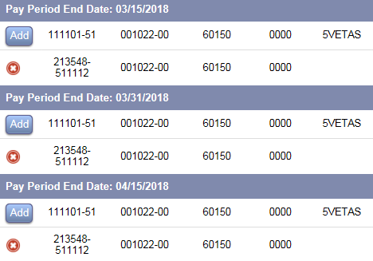
HOW TO KEY A COST TRANSFER
CLICK ADD
USE THE DROPDOWN ARROW TO CHOOSE THE CORRECT FUND-ORG & PCN-SUFFIX
THEN KEY THE CORRECT ACCOUNT, PROGRAM AND ACTIVITY CODE
CLICK THE GREEN CHECKMARK TO COMMIT
REPEAT FOR EACH PAY PERIOD

Slide 14
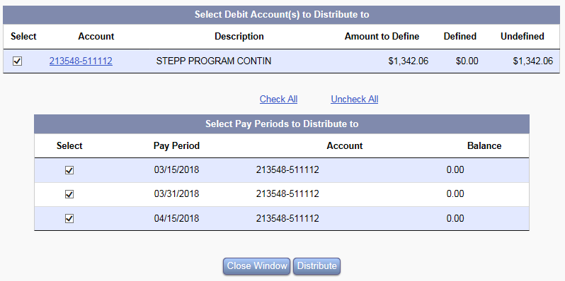
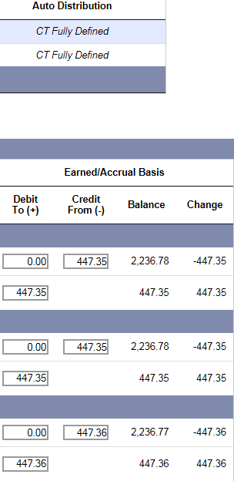
HOW TO KEY A COST TRANSFER
IF THE COST TRANSFER IS TO BE EVENLY DISTRIBUTED THROUGHOUT ALL PAYROLLS, THE AUTO DISTRIBUTE CREDIT BUTTON CAN BE USED
THIS WILL EVENLY DISTRIBUTE THE FUNDS
WRITE JUSTIFICATION (NOTE)
CLICK PROCEED

Slide 15
HOW TO KEY A COST TRANSFER
IF THE COST TRANSFER NEEDS TO BE DISPERSED WITH A DIFFERENT AMOUNT EACH PAYPERIOD THEN YOU MUST KEY THEM INDIVIDUALLY
ONCE THE COST TRANSFER IS FULLY DEFINED
KEY THE JUSTIFICATION (NOTE)
CLICK PROCEED
CLICK PROCEED AGAIN

Slide 16
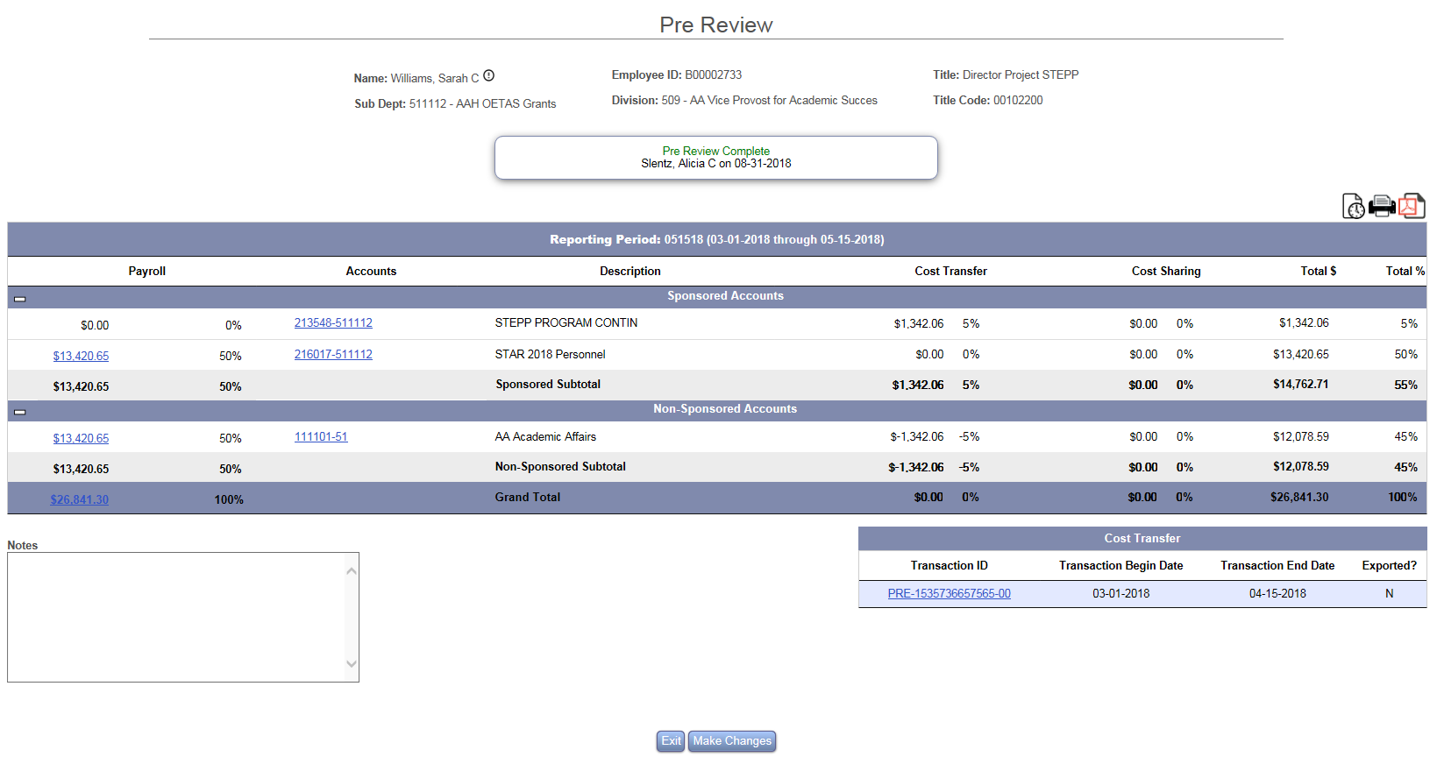
NOTICE THE COST TRANSFER IS NOW ON THE FORM

Slide 17
HOME PAGE

Slide 18
CONGRATULATIONS PRE-REVIEW COMPLETE!
LOG IN OFTEN TO CONFIRM CERTIFICATION
REMINDERS WILL BE SENT AT 3, 2 AND 1 WEEK PRIOR TO PERIOD END
NOTIFY YOUR DEPARTMENTAL EFFORT CORRDINATOR IF YOU HAVE QUESTIONS ABOUT THE EFFORT PROCESS
EMAIL ERS HELP DESK WITH ANY UPDATES, CHANGES OR QUESTIONS YOU MAY HAVE WITH THE EFFORT SYSTEM
ERSHELPDESK@ECU.EDU

