Slide 1
E.R.S. Effort Reporting SYSTEM
PRE-REVIEW
NO CHANGES

Slide 2
LOG IN: https://ers.ecu.edu/GenericERS/custom/index.jsp
SAME USER ID AND PASSWORD AS PIRATE PORT
OFF CAMPUS- MUST HAVE VPN TO LOGIN

Slide 3
HOME PAGE
CLICK ON NUMBER IN CURRENT PENDING NON-CRITICAL BOX

Slide 4
FORMS PENDING PRE-REVIEW
Click edit icon

Slide 5
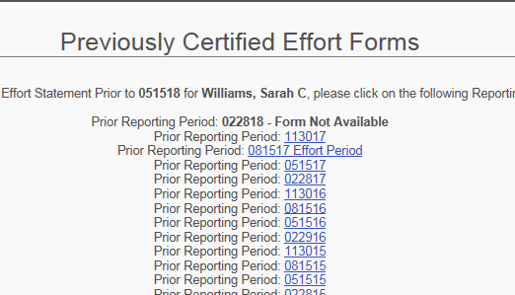
PRE-REVIEW SCREEN

Slide 6
PRE-REVIEW SCREEN
*NO CHANGES TO FORM?*
CLICK PROCEED
AN EMAIL IS AUTOMATICALLY SENT TO CERTIFIER

Slide 7
HOME PAGE

Slide 8
CONGRATULATIONS PRE-REVIEW COMPLETE!
LOG IN OFTEN TO CONFIRM CERTIFICATION
REMINDERS WILL BE SENT AT 3, 2 AND 1 WEEK PRIOR TO PERIOD END
NOTIFY YOUR DEPARTMENTAL EFFORT CORRDINATOR IF YOU HAVE QUESTIONS ABOUT THE EFFORT PROCESS
EMAIL ERS HELP DESK WITH ANY UPDATES, CHANGES OR QUESTIONS YOU MAY HAVE WITH THE EFFORT SYSTEM
ERSHELPDESK@ECU.EDU

