Slide 1
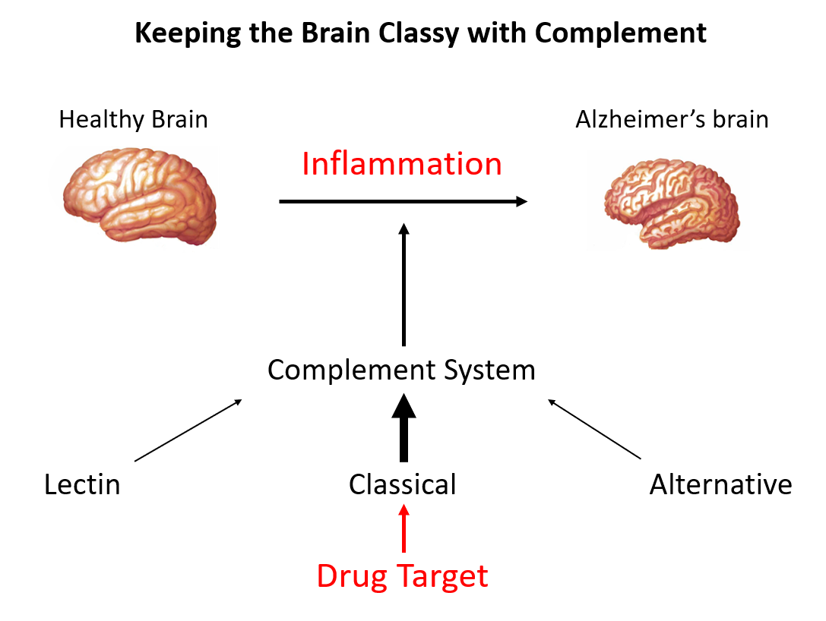
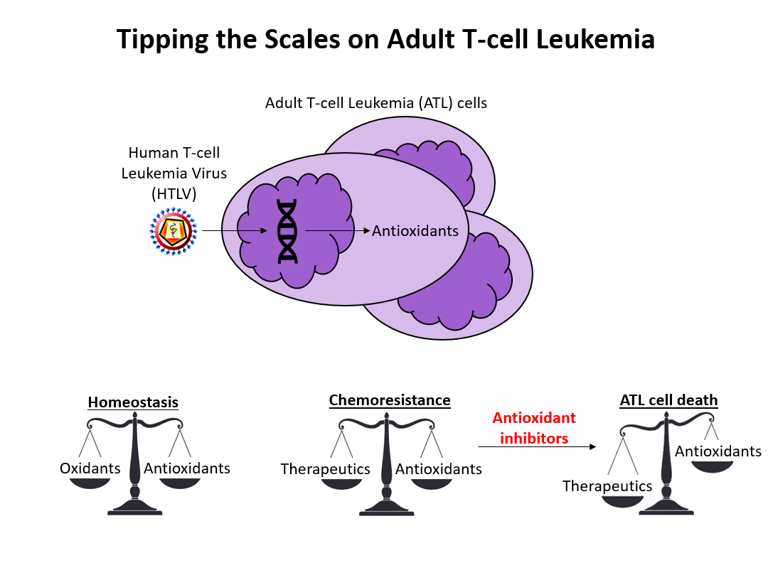
Dr. Jay Golden Meet-and-Greet and 3-Minute Research Presentations

