Slide 1
Fueling Research at East Carolina University
With ForagerOne
@ForagerOne
Notes:
Introduce ForagerOne members & ForagerOne

Slide 2
ForagerOne’s Goals
Break down barriers to experiential learning and research opportunities
Provide tools to build your research team
Improve faculty to faculty collaboration
Notes:
Break down barriers to experiential learning and research opportunities
Increase accessibility and promote research for all students
Provide a network to build your research team
Improve faculty to faculty collaboration

Slide 3
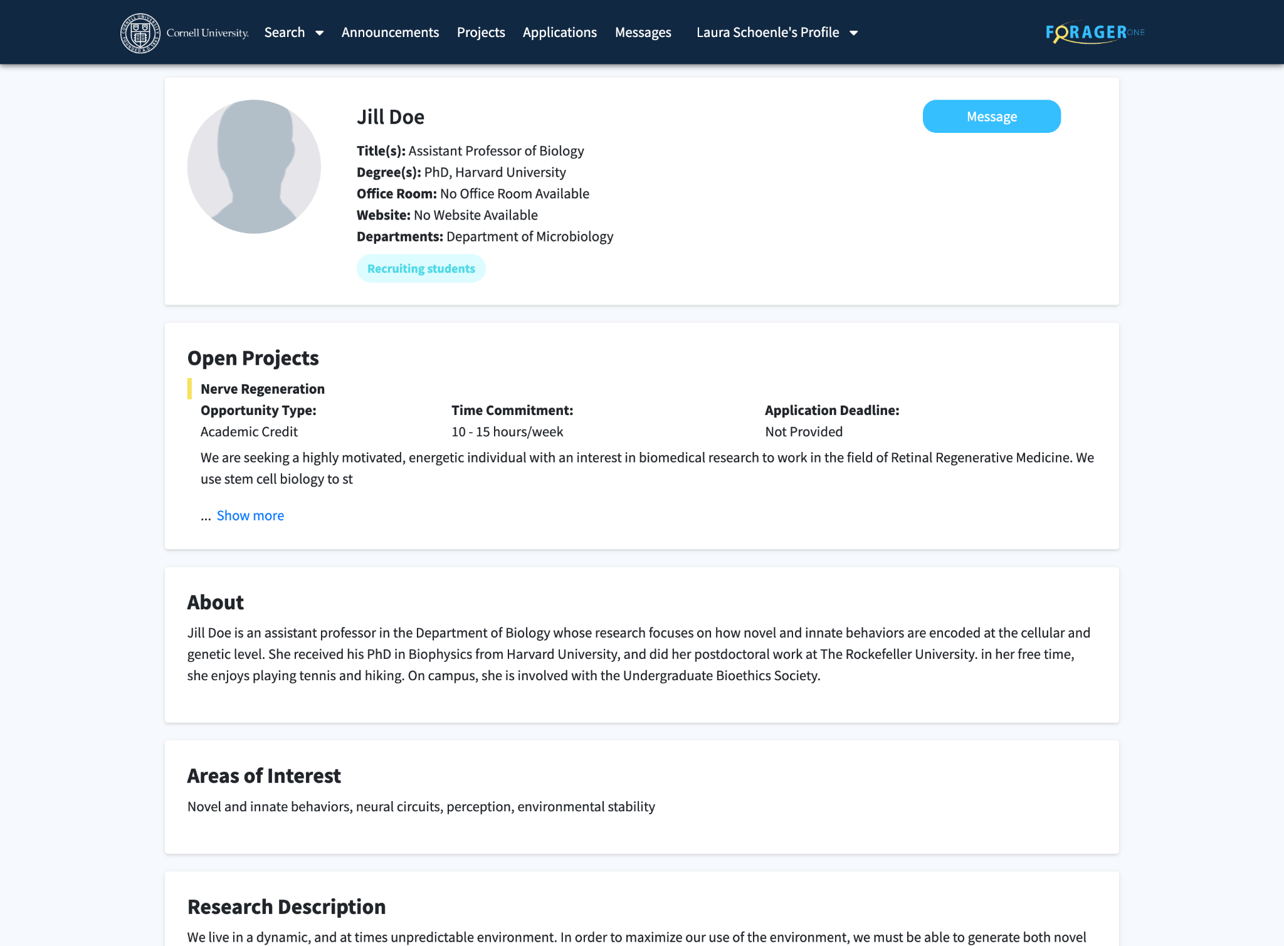
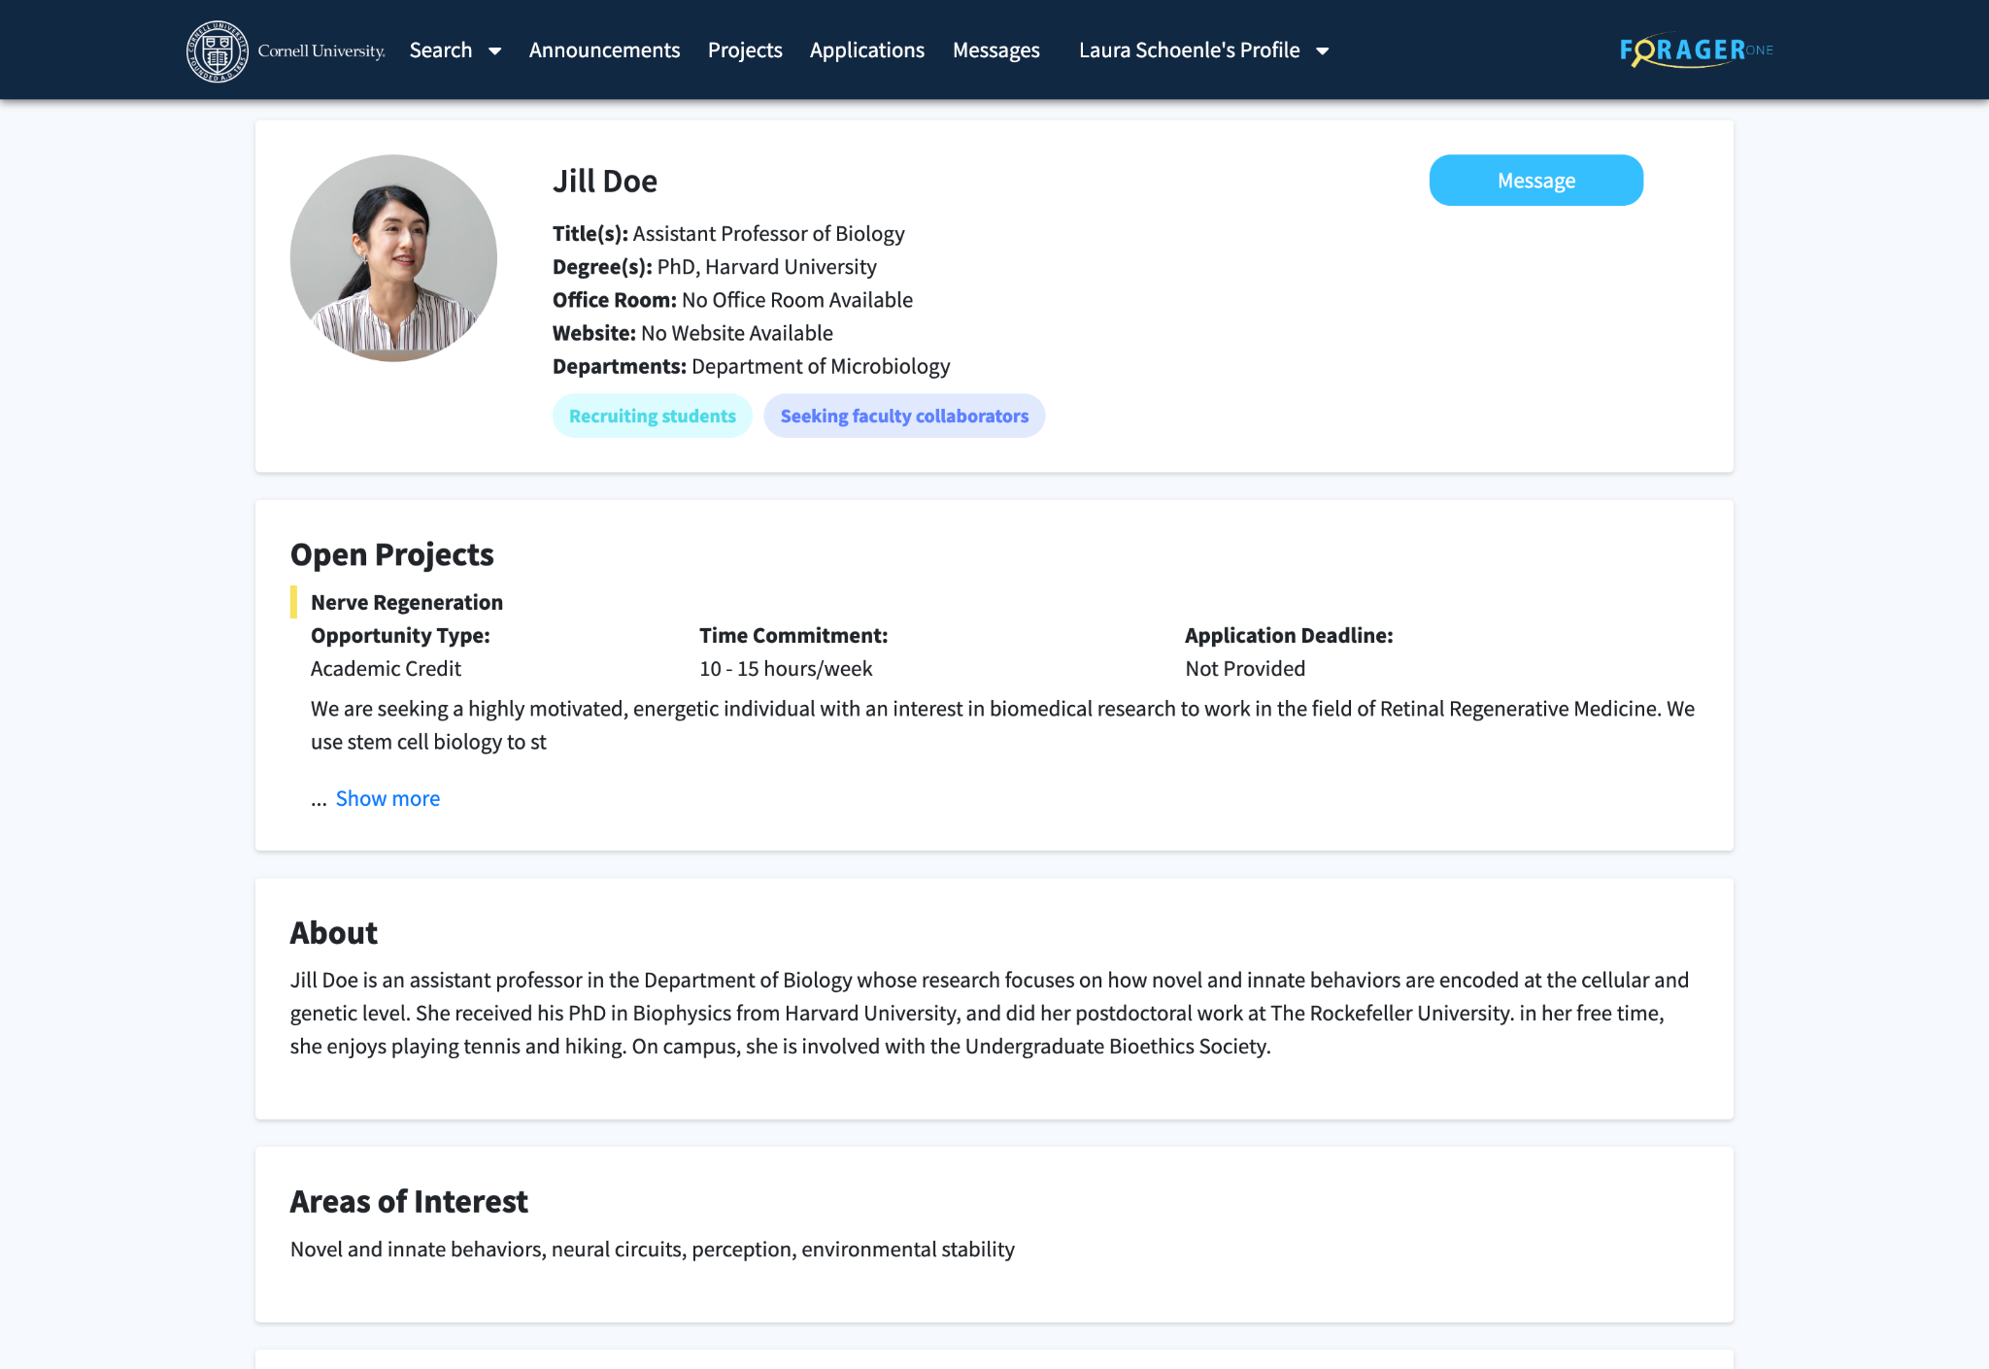
Faculty Profile
01 General Information
02 Open Projects
03 About
04 Areas of Interest

Slide 4
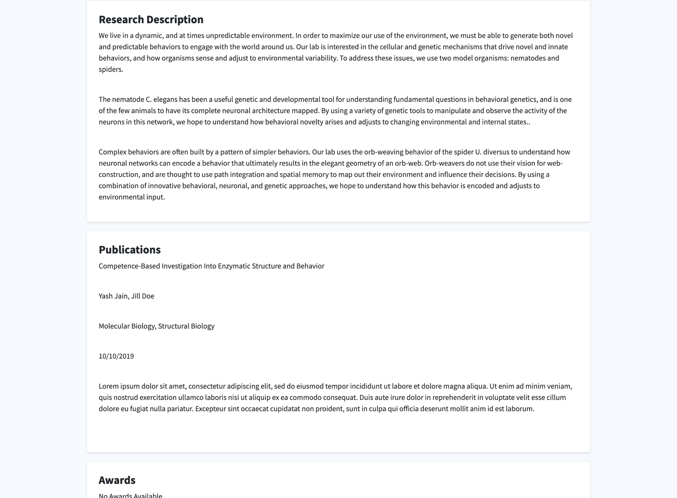
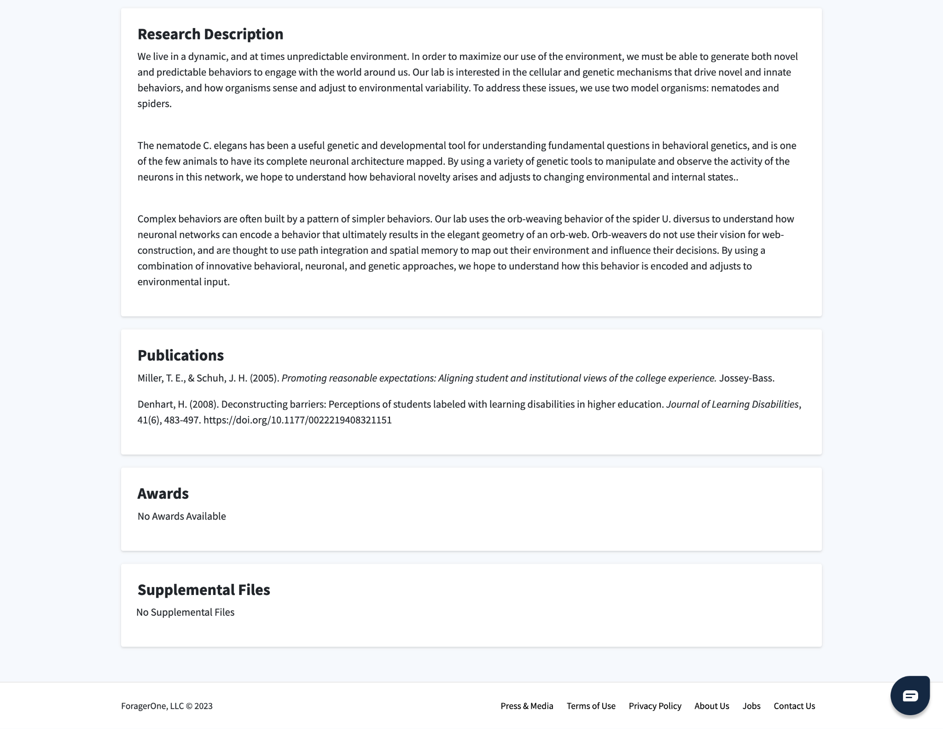
Faculty Profile
05 Research Description
06 Publications
07 Awards
08 Supplemental Files
Notes:
UPDATE

Slide 5
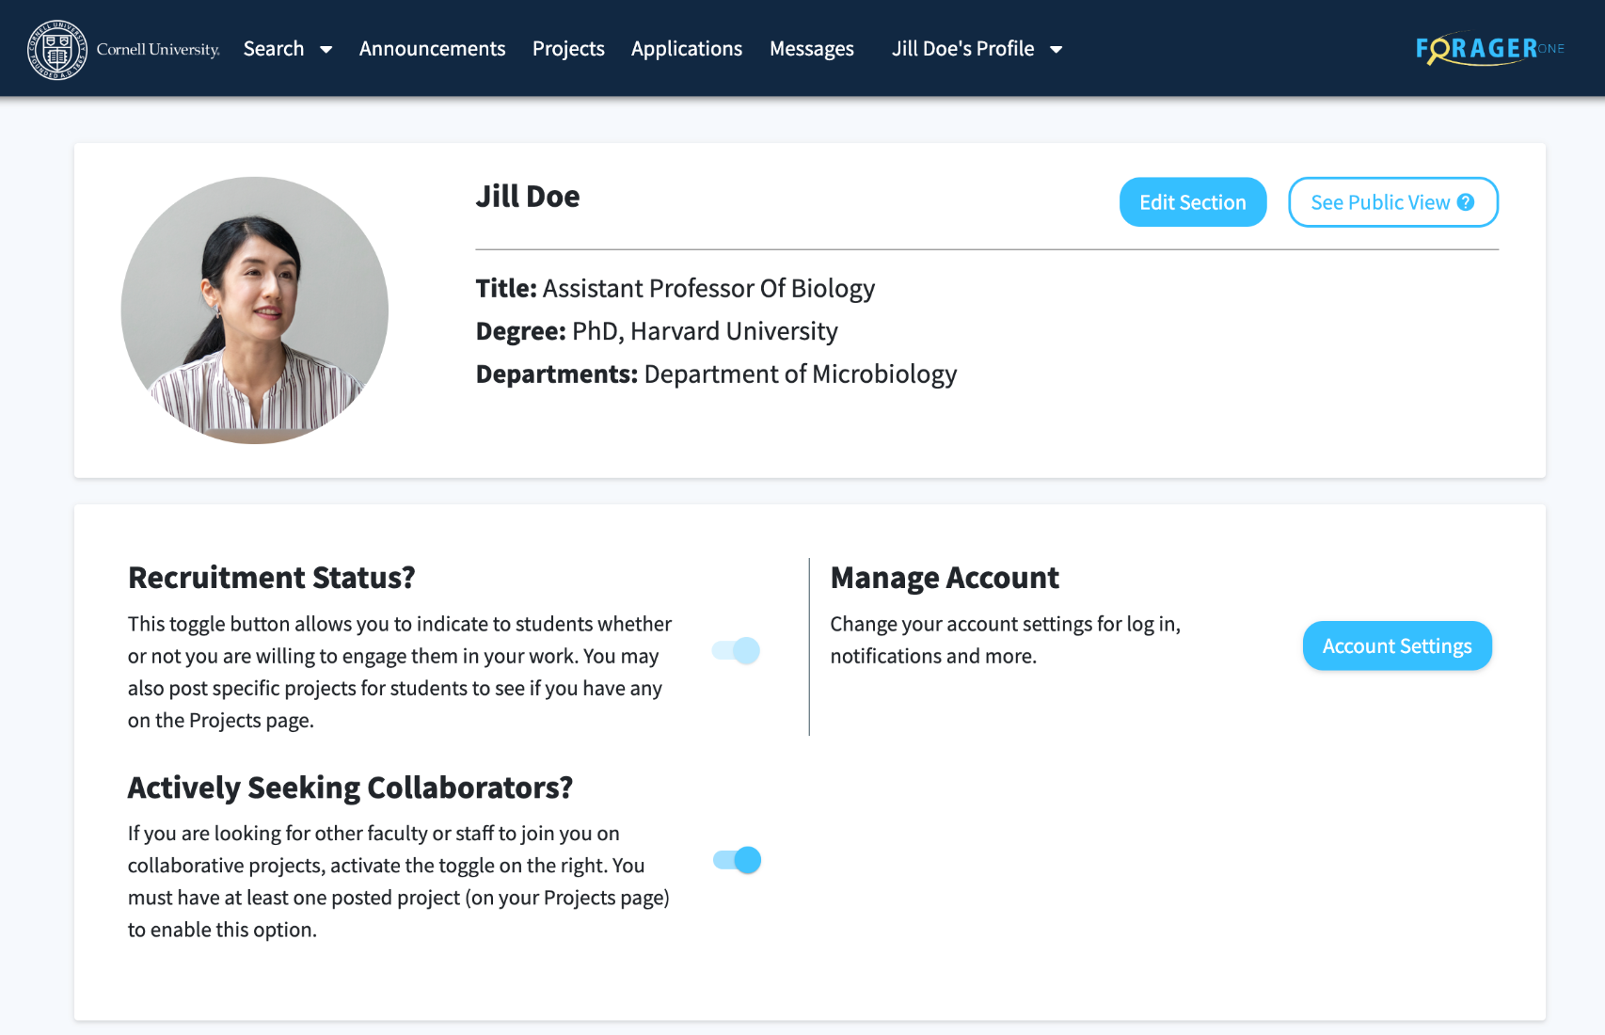
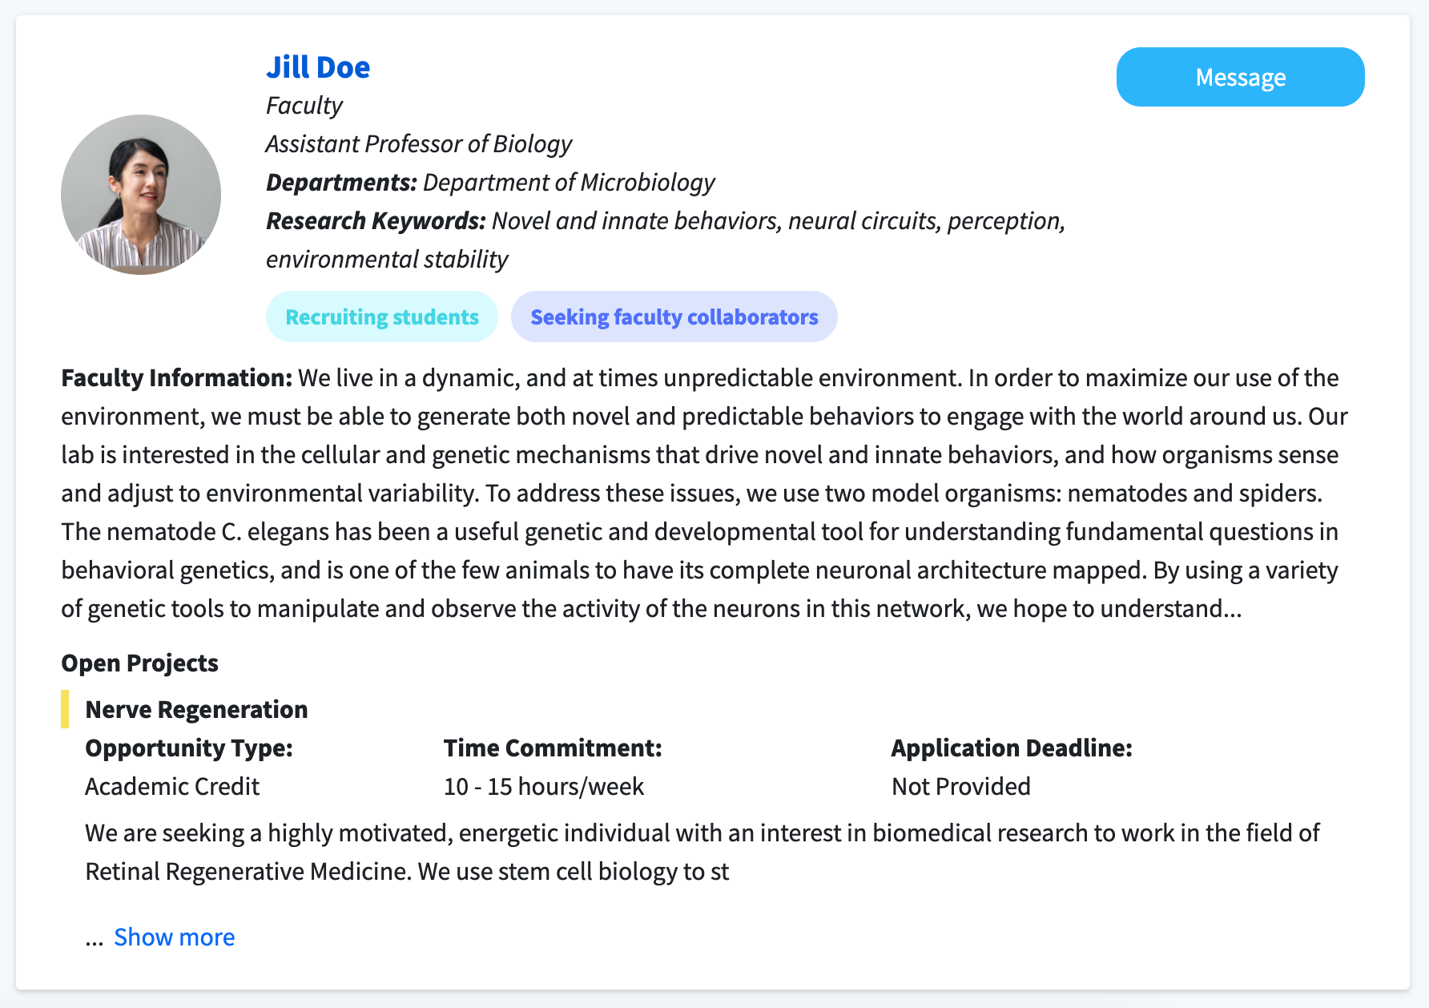
Faculty Profile - Toggles

Slide 6
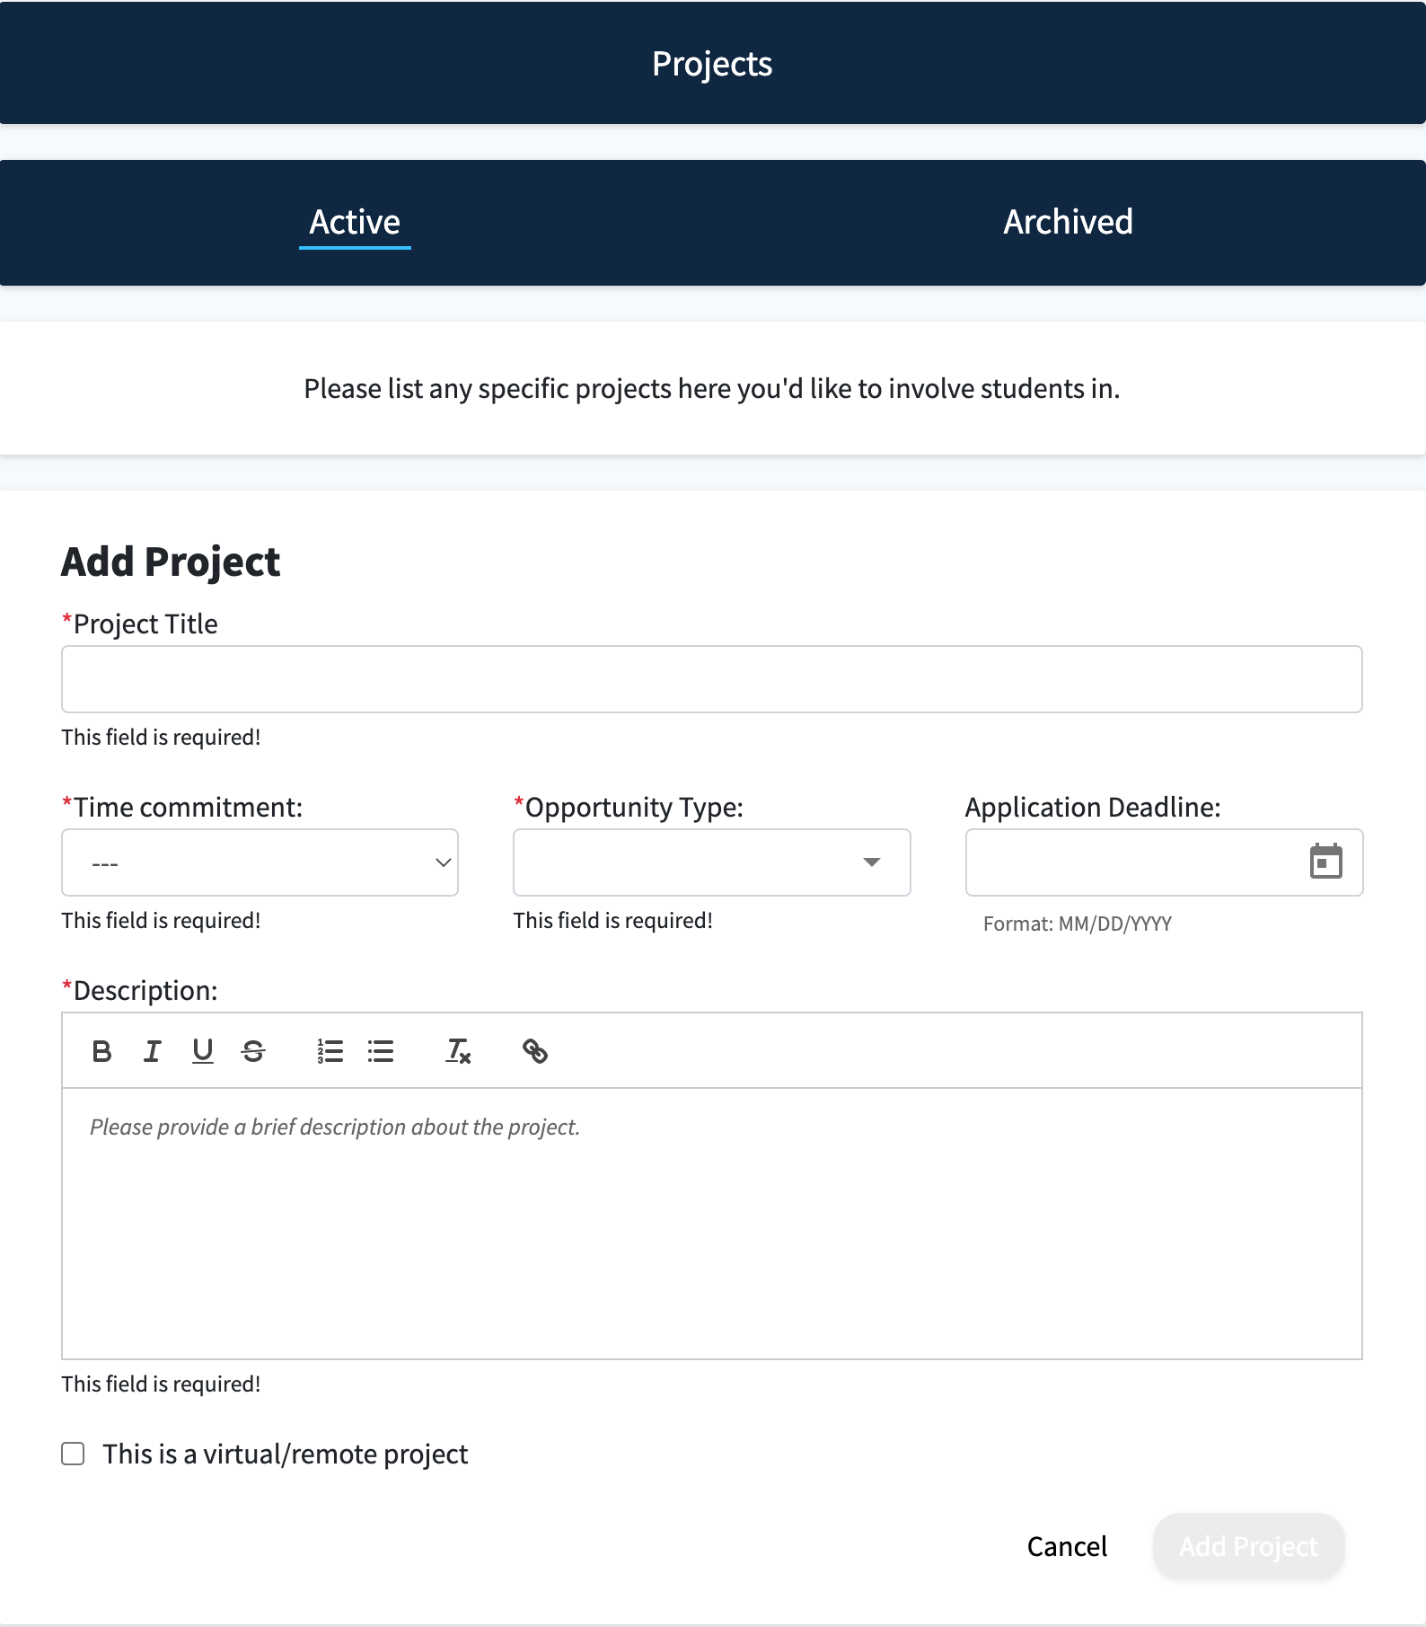
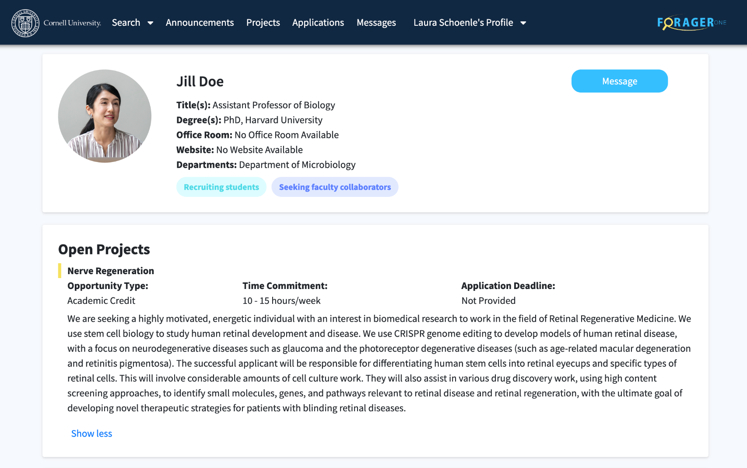
Projects

Slide 7
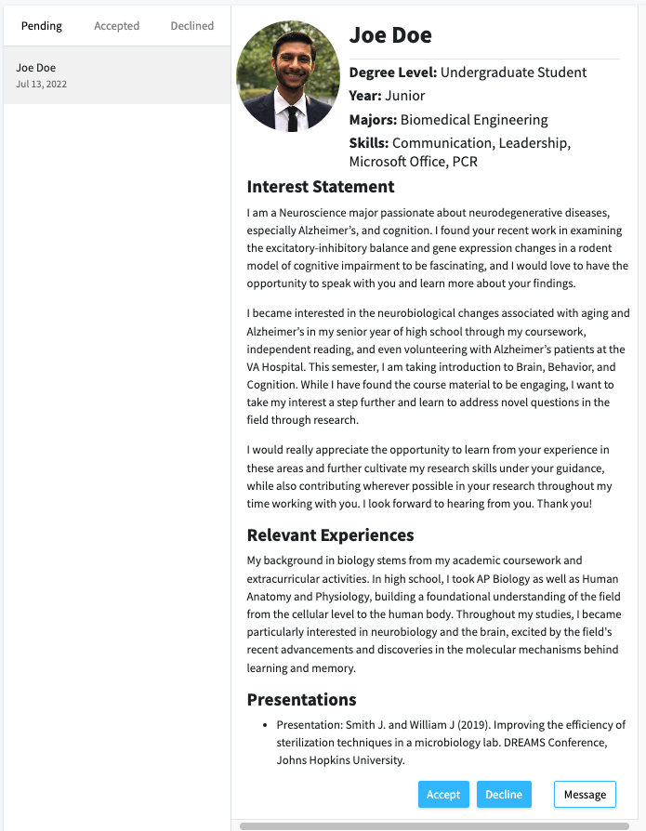
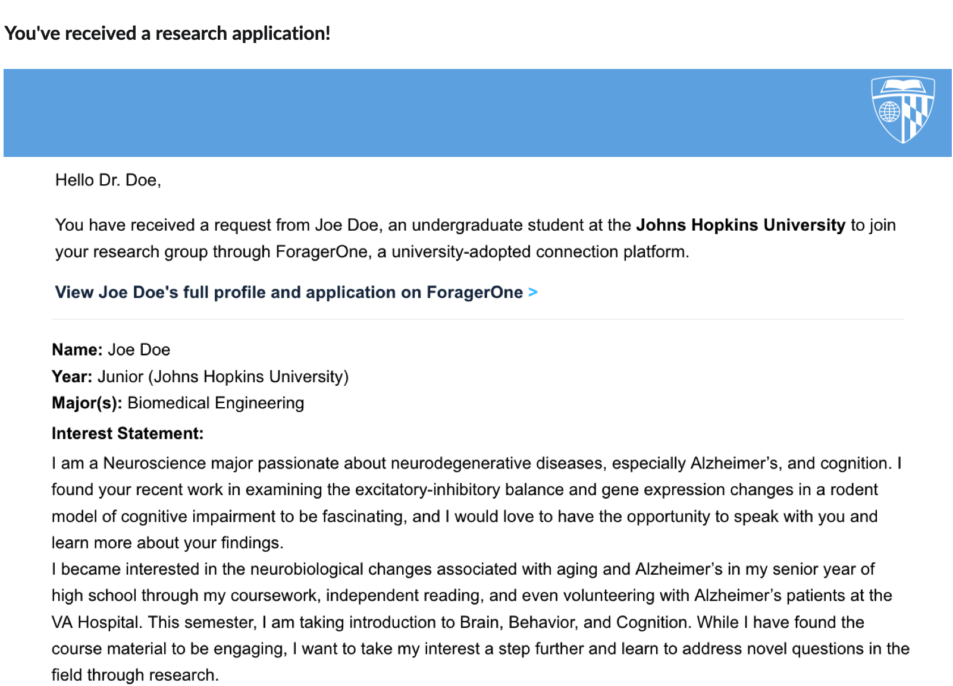
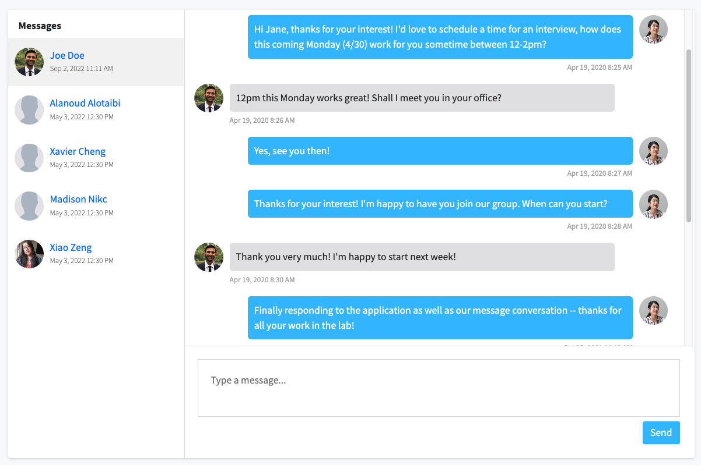
Application Connection Workflow
01 Receive application
03 Accept or decline student
02 Message student

Slide 8
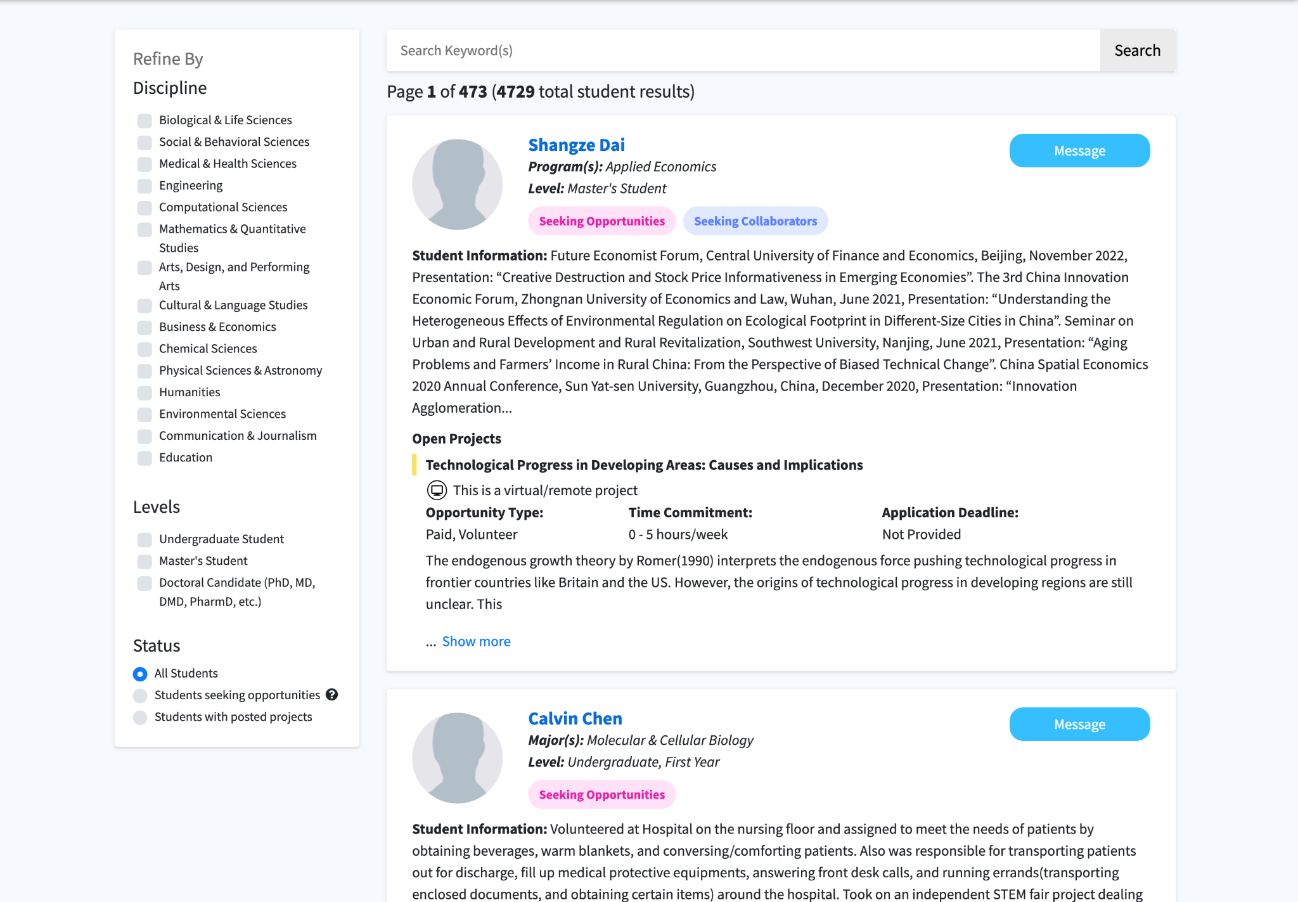
Student
Searchable
Database
01 Search bar
02 Filters
03 Message

Slide 9
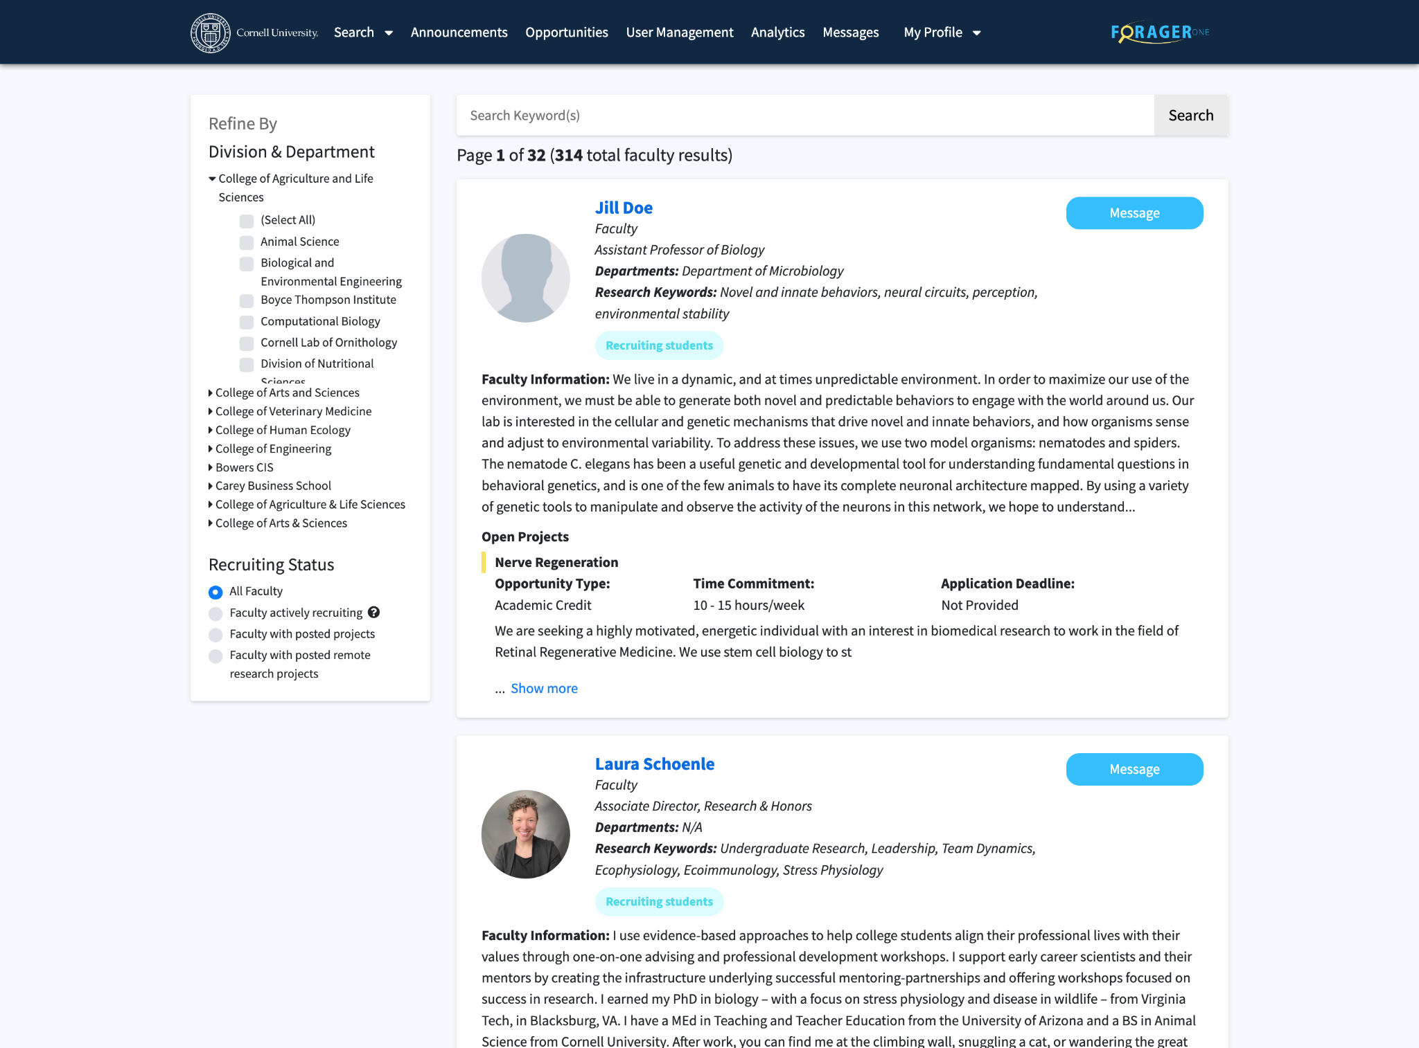
Faculty
Searchable
Database
01 Search bar
02 Filters
03 Message

Slide 10
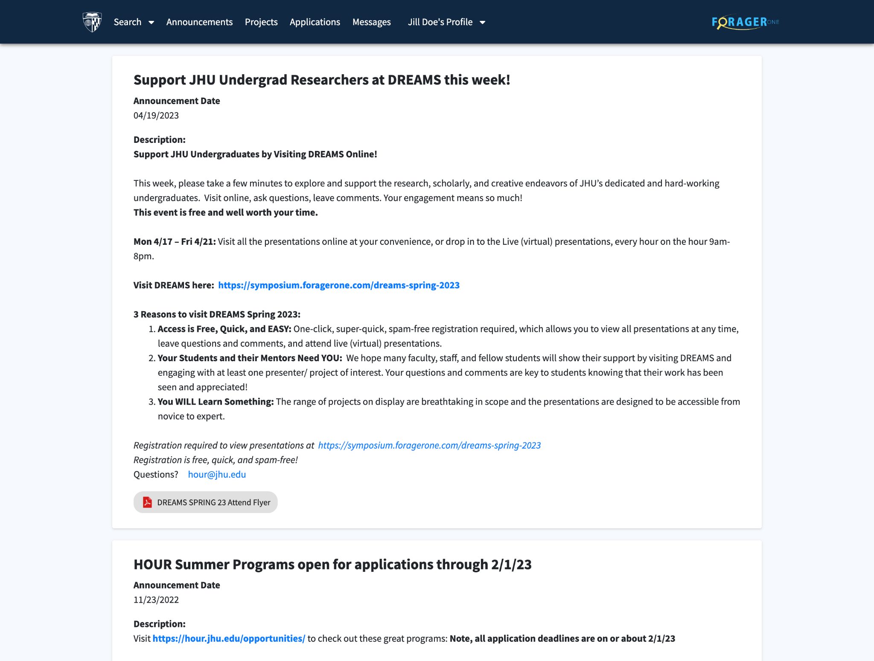
Announcements

Slide 11
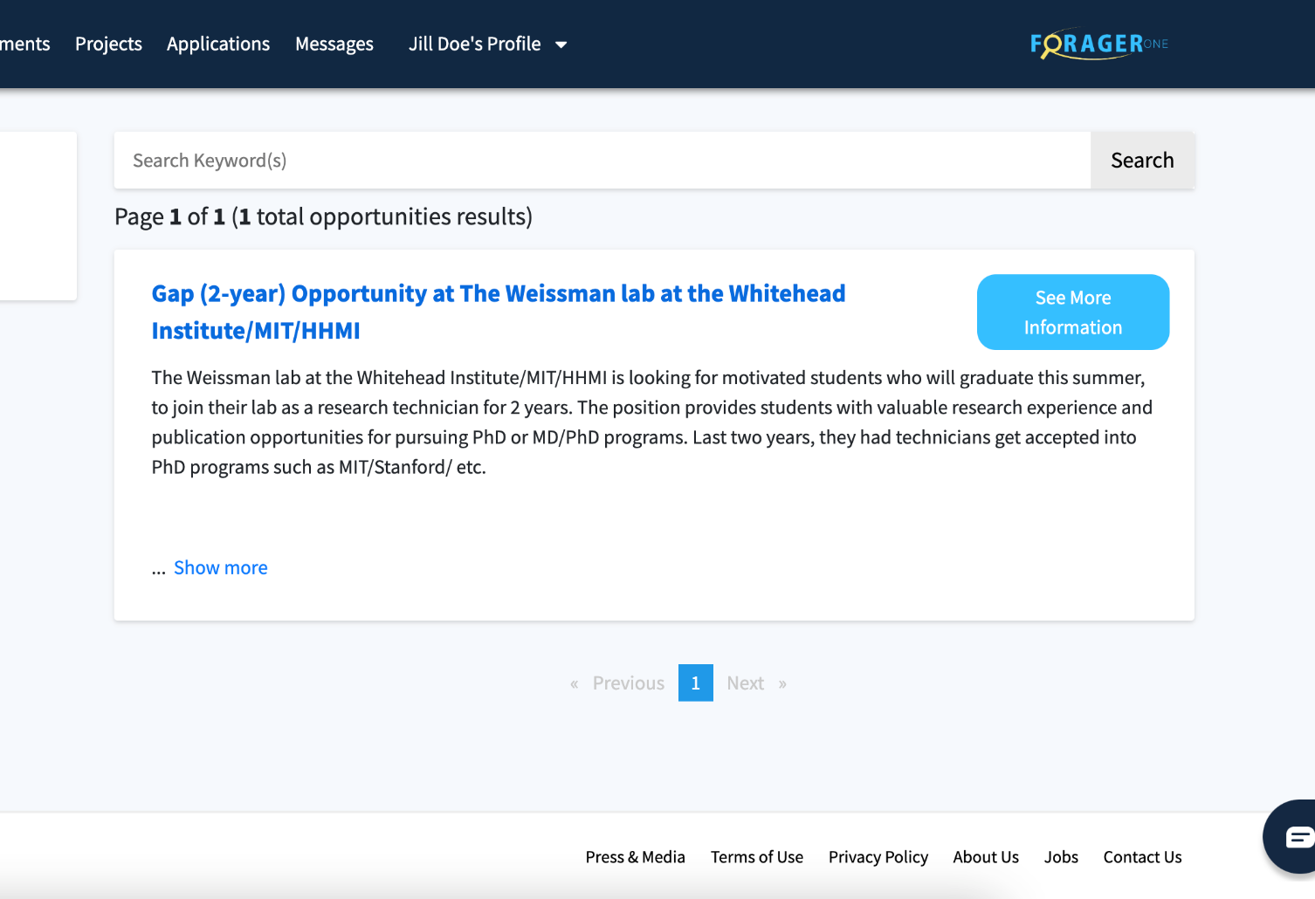
Funding,
Programs, &
External
Opportunities

Slide 12
How to Engage?
01 Claim/make your profile
02 Indicate your availability with toggles
03 Post project(s)
04 Respond to student requests
05 Connect with other faculty and staff members
Notes:
Break down barriers to experiential learning and research opportunities
Increase accessibility and promote research for all students
Provide a network to build your research team
Improve faculty to faculty collaboration

Slide 13
Questions
Visit foragerone.com to claim or make your account
Email: support@foragerone.com
@ForagerOne

Slide 14
Visit foragerone.com
@ForagerOne

