Slide 1
Topics
Flow cytometry core:
New Core Director
New Cytek Aurora 5-Laser Spectral Flow Cytometer
New BSL3 Laboratory in Department of Comparative Medicine
New X-Irradiator in the Department of Comparative Medicine
Brief overview of the MannieLab COVID-19 research program

Slide 2
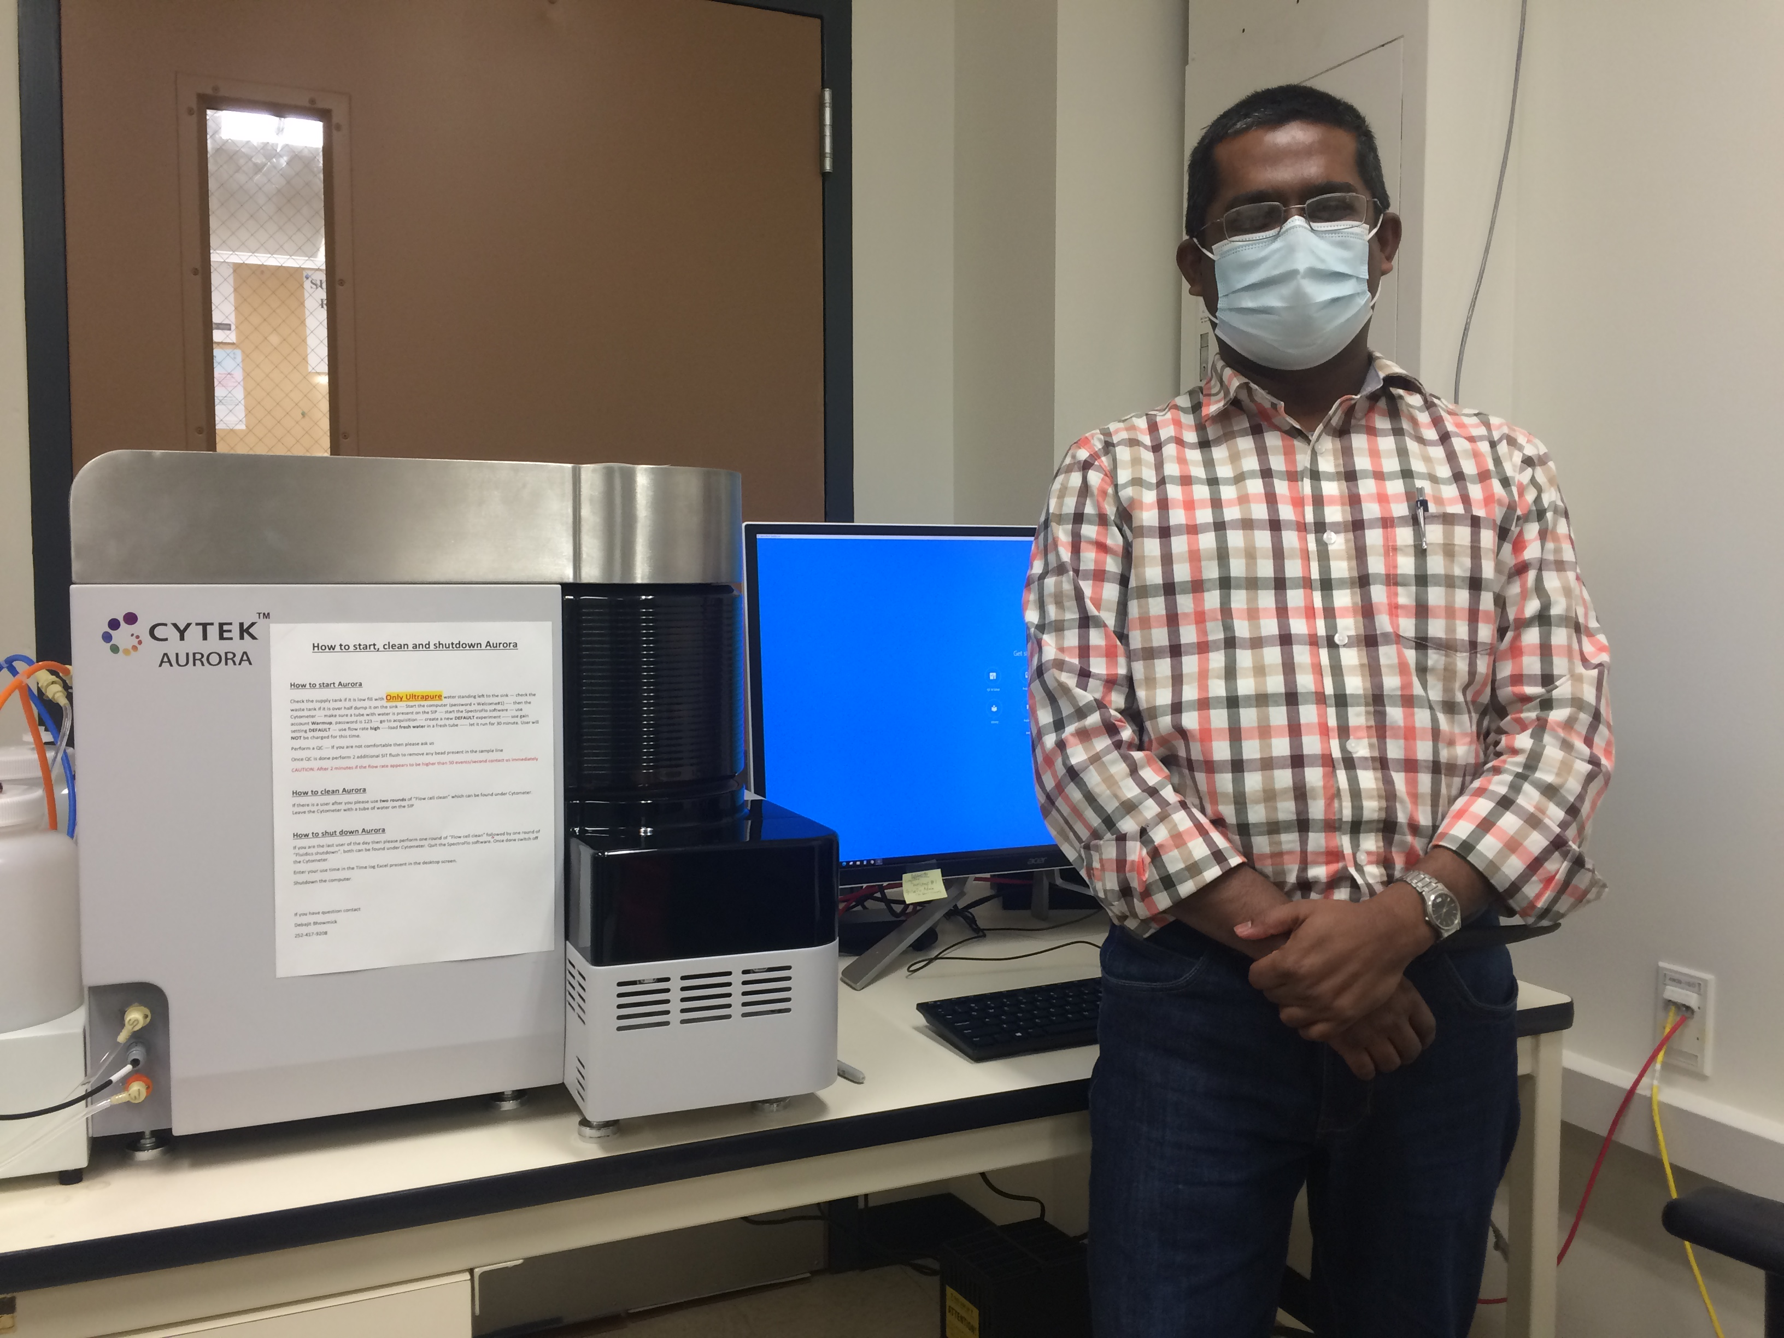
Debajit Bhowmick, PhD
Flow Core Facility Director
bhowmickd20@ecu.edu
Phone: 252-744-3245
Room: 4W-46A
Joined the ECU Faculty in December of 2020

Slide 3
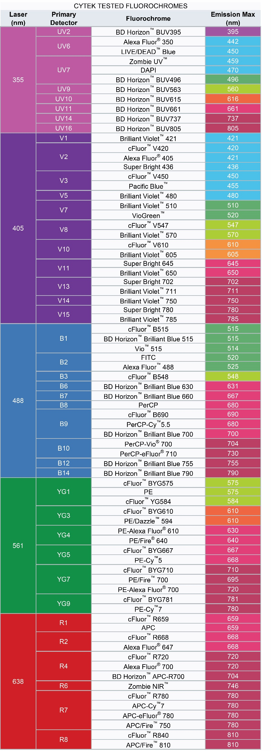
Cytek Aurora Spectral Flow Cytometry
Captures fluorescence emissions over a broad spectrum
No optical filters
Five-laser configuration:
355 nm: 20 mW, (16 channels from 365-829 nm)
405 nm: 100 mW, (16 channels from 420-829 nm)
488 nm: 50 mW, (14 channels from 498-829 nm)
561 nm: 50 mW (10 channels from 567-829 nm)
640 nm: 80 mW (8 channels from 652-829 nm)
Overall, 67 detection channels with FSC, 405 nm SSC, 488 nm SSC)
405 nm SSC: Can resolve 0.2 µm beads from noise
Major advantages
Resolution of fluorochrome combinations with high spectral overlap
Full spectrum cytometry enables efficient autofluorescence extraction
Exceptional small particle detection
Automatic Micro-Sampling System (AMS) 96 well plate acquisition.

Slide 5
High Dimensional Flow Cytometry

Slide 6
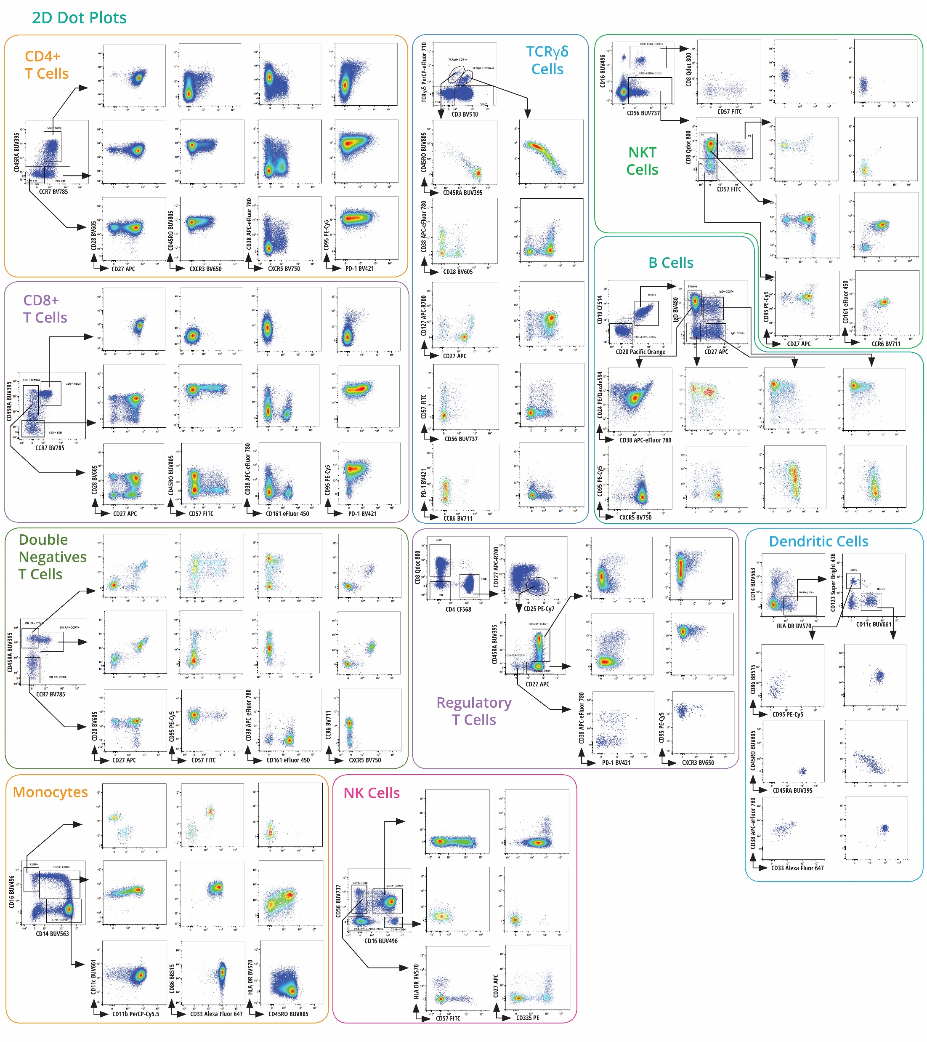
High Dimensional Flow Cytometry

Slide 7
High Dimensional Flow Cytometry

Slide 8
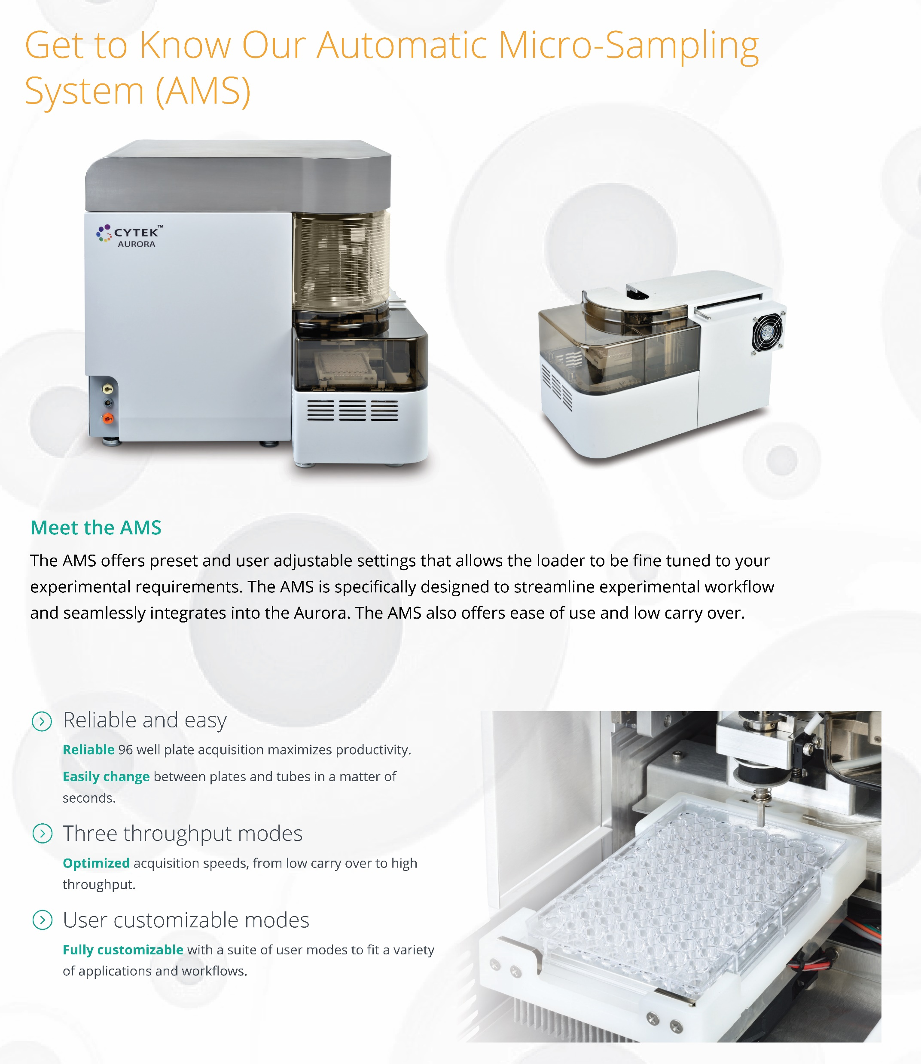

Slide 9
Dr. Debajit Bhowmick offers the following services
Consultation
Protocol development
Panel design
Data collection
Data analysis & interpretation
Cell Sorting under BSL2
Training (all aspects)

Slide 10
Beyond Immunophenotyping !!!!
Enzyme activity
Single cell genomics/ index sorting
pH probes
Small molecule detection
Apoptosis
Autophagy
mRNA detection
Protein-protein interaction
Chromosome sorting
Multiplexing/ barcoding
High throughput screening
Cell line generation
Tracking cell proliferation
Drug efflux assays
Oceanography
Water quality management
Soluble protein quantification
Phosphoprotein detection
Membrane potential probe
Extracellular vesicle
Nanoparticle analysis
Analysis of bacteria/parasites
Cell cycle analysis
Reporter assay
Population analyses of individual cells or particles

Slide 11
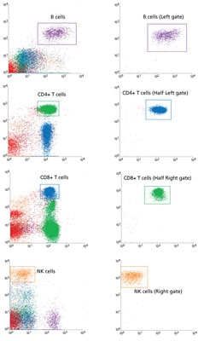
The BD FACSAria Fusion Cell Sorter (Kym Gowdy)
Debajit has 10 years of sorting experience using BD machines
4-laser (405, 488, 561, 637 nm), 12-color sorter from BD Bioscience
Can analyze 25,000 cells/ second and sort up to 10,000 cells/ second
Can sort 4 populations simultaneously
Can sort single cells into/onto 384- or 96-well plates or glass slides
Bulk sorting into any type of tube or 6, 12, or 24 well plates
Due to high power lasers, sorter can identify particles down to 200 nm
Cuvette-based detection provides excellent sensitivity
Index sorting

Slide 12
For specific information on BSL3 capability and access, please contact:
Dr. Dorcas O’Rourke
Professor and Chair, Department of Comparative Medicine
Brody School of Medicine
orourked@ecu.edu
(252) 744-2420

Slide 13
BSL3 Core for SARS-CoV-2 Research
DCM manages a BSL3 core at the Brody School of Medicine
Core has 2 suites, each with animal holding cubicles and an associated shared research lab
Biocontainment housing units (individually ventilated cages) for small animals (mice, rats, hamsters, etc) are in cubicles
BSL3 lab is available to both animal users and non-animal users

Slide 14
BSL3 Core for SARS-CoV-2 Research
Each shared lab space is equipped with:
minus 80 freezer
refrigerator
two CO₂ incubators
refrigerated centrifuge
inverted light microscope
microplate reader
thermal cycler
two biosafety cabinets (one hard-ducted)

Slide 15
Comparative Medicine website has details on BSL3 access requirements:
https://comparativemedicine.ecu.edu/intranet/about-us/

Slide 16
MultiRad 350 X-Ray Irradiator (Precision X-Ray Irradiation) (www.pxinc.com)
Utility
Irradiate cell cultures to prepare specialized cell culture systems
Sublethally irradiate recipient rodents (Humanized rodent models/ Irradiation bone marrow chimeras)
Features
Motorized Variable Collimator (enables accurate uniform irradiation of rodents)
Fully Integrated Cabinet X-ray Irradiator capable of up to 350 kilovoltage peak at 4 kilowatts
Integrated dosimeter with advanced Automatic Dose Control (ADC) for setting exact dose
Fully integrated system with closed-loop cooling system
Easy-to-use intuitive touch screen

Slide 17
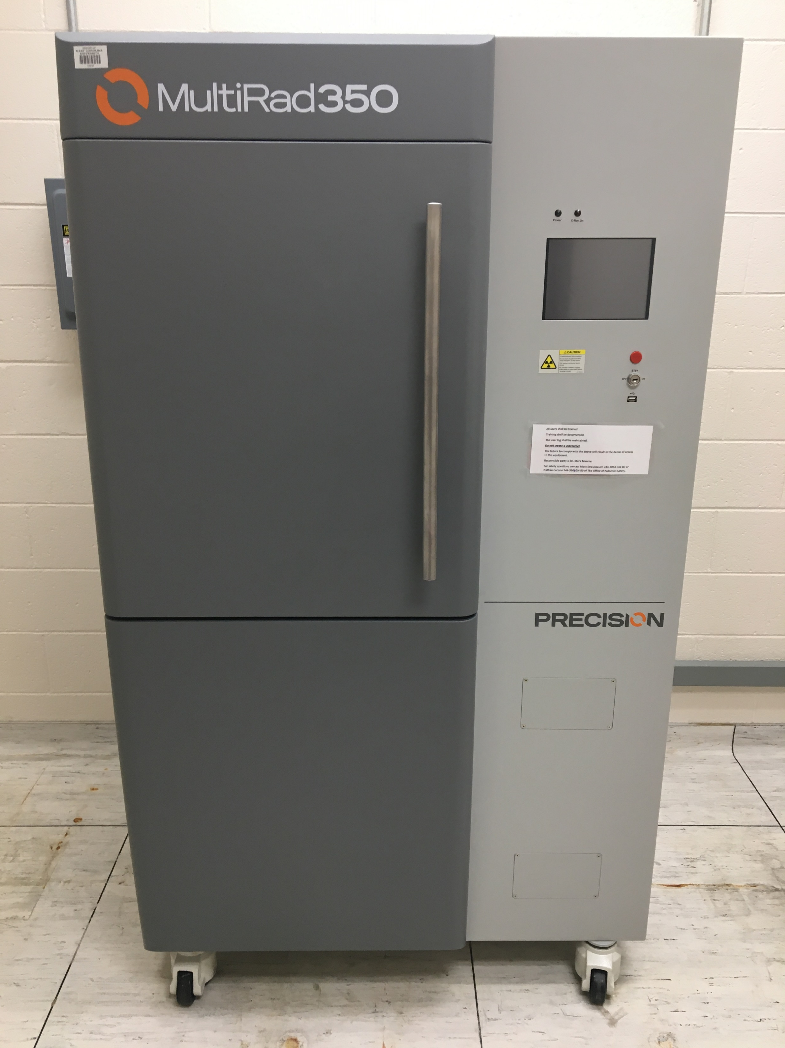
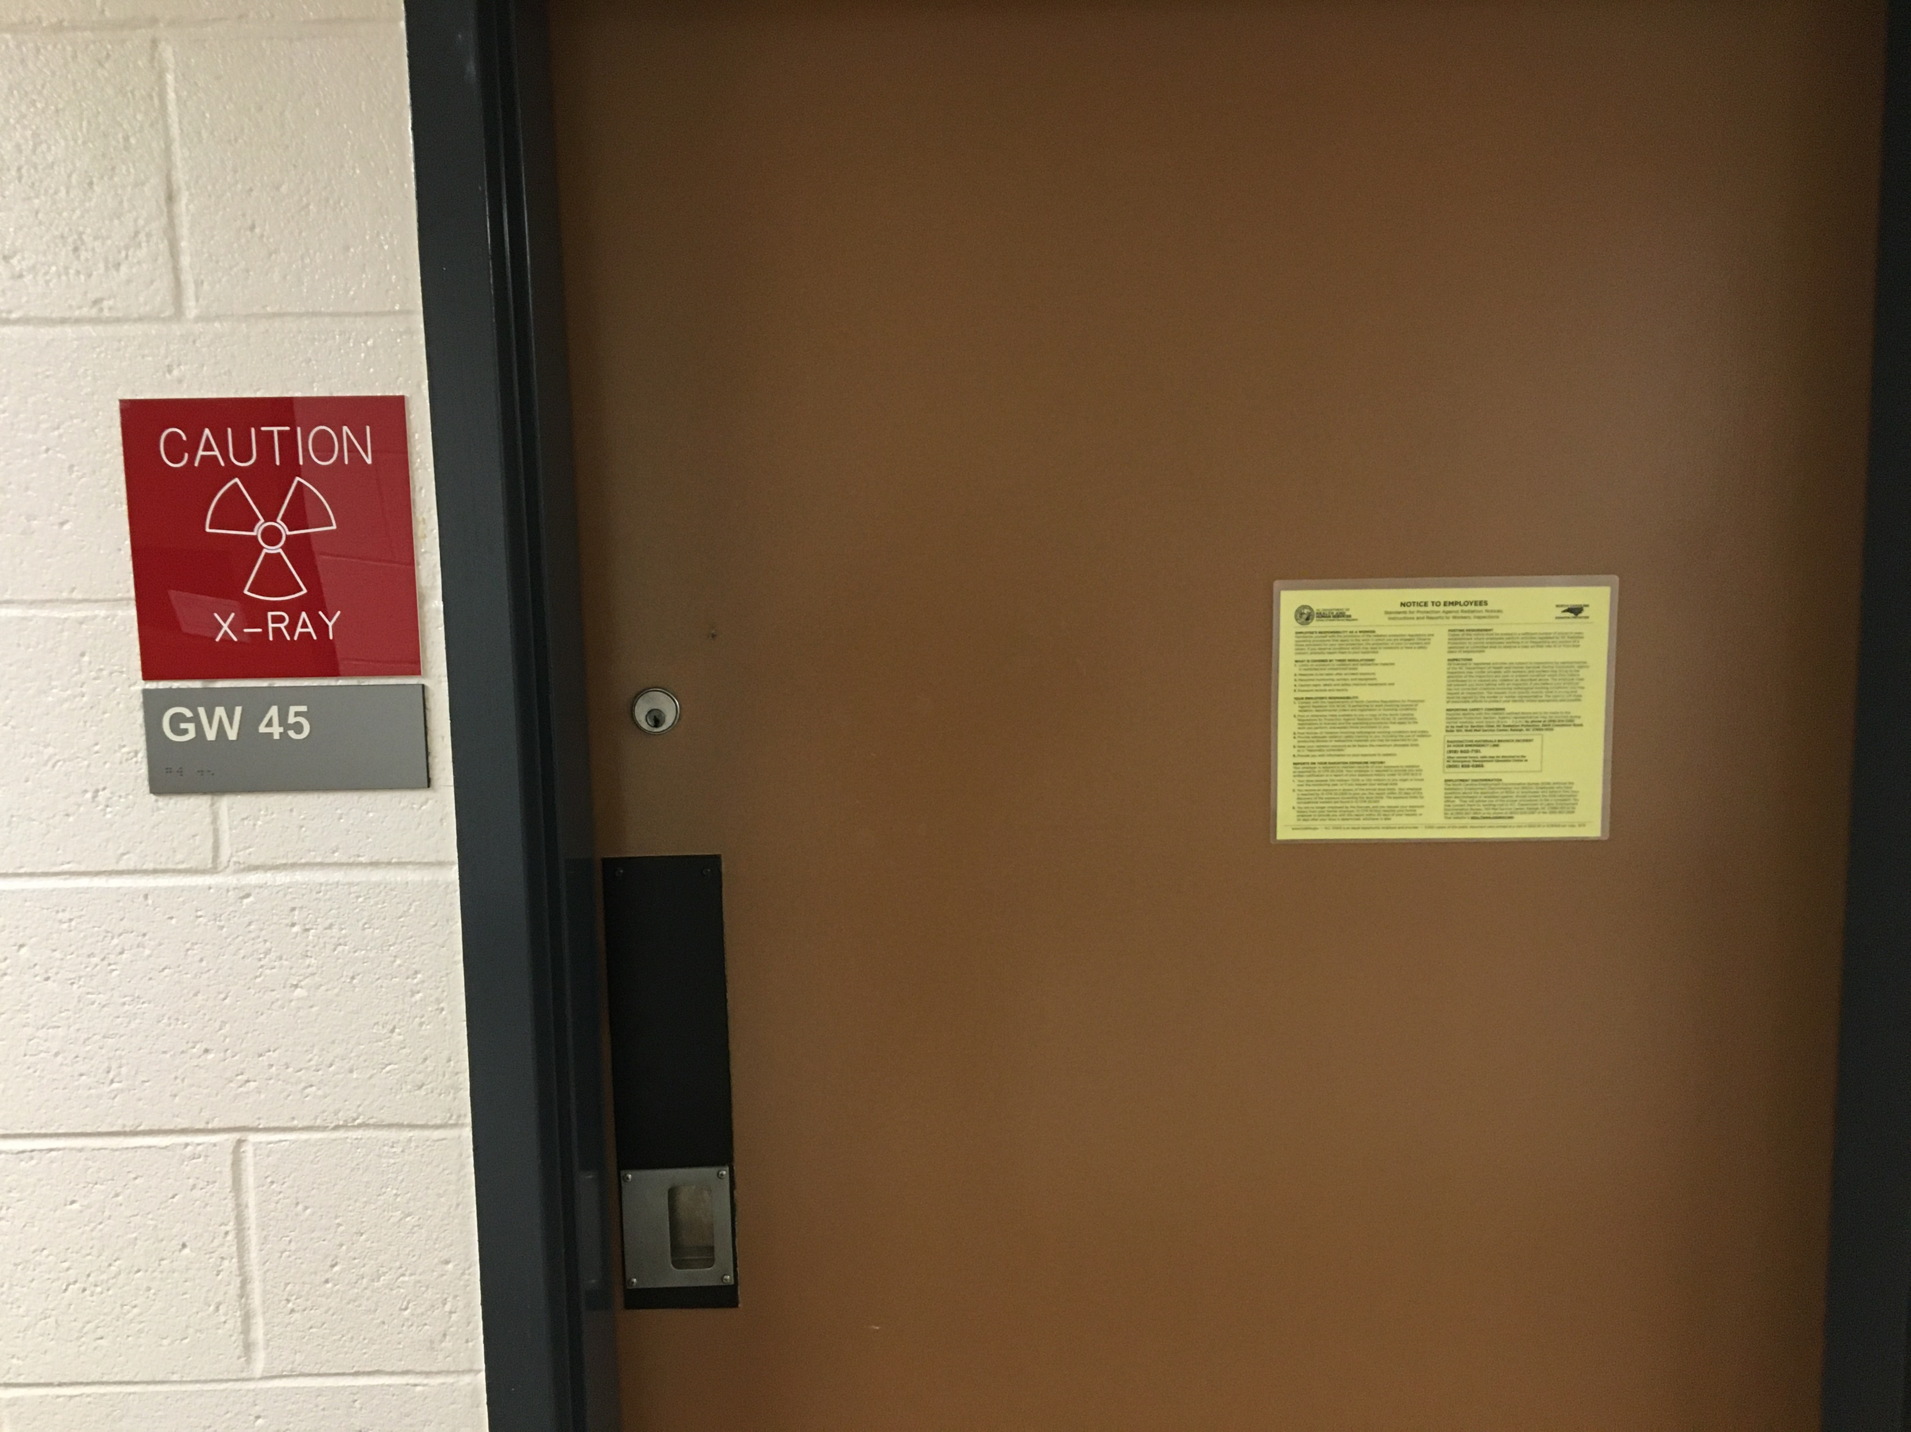
Location: The Ground Floor of the Brody Medical Sciences Building in the Department of Comparative Medicine
Routine training by Mannie Lab or DCM personnel
Mark Strausbauch, Radiation Safety Practitioner, Prospective Health (252-744-3094)

