Slide 1
Growing A BioPharma Ecosystem
Burroughs Wellcome opens $10M, 600 employee pharmaceutical plant in Greenville
150 families relocate from Tuckahoe, NY
ECU enrollment exceeds 10,000
School of Industry and Technology is organized
Pitt County approves a $9M bond for new 350-bed hospital
Pitt Tech (602 students) is 10th largest in NC community college system
ECU is 3rd largest in UNC system (2000 graduates)
Students admitted to 1-year medical program
1967
1971
1974
1970
1972
East Carolina College becomes East Carolina University
100 new faculty
NC General Assembly appropriates $1.8M for
1-year medical program at ECU
Land acquisition completed
Construction on hospital begins

Slide 2
Growing A BioPharma Ecosystem
Pitt Technical Institute becomes Pitt Community College (PCC)
Per capita income in Pitt County rises 166% since 1970 to $7,622 ($51,667 today)
PCMH opens on 100-acre site
Charter class of ECU medical students begin classes
1975
1979
1981
1977
1980
NC General Assembly authorizes a four-year medical school at ECU
Pitt County Memorial Hospital and ECU sign an affiliation agreement to make PCMH the primary teaching hospital
Construction of Brody Medical Sciences Building at ECU begins
First M.D. degrees awarded by ECU School of Medicine

Slide 3
Growing A BioPharma Ecosystem
First PhD awarded by ECU
EastCare begins emergency air transport service at PCMH
1982
1984
1986
1983
1985
75th anniversary for ECU
Growth to 11,725 students
425 acres, 77 buildings
Brody Medical Sciences Building opens
Open heart surgery begins at PCMH
Carolina Medical Products moves from Chapel Hill to Farmville

Slide 4
Growing A BioPharma Ecosystem
Burroughs Wellcome adds $8.2M expansion
ECU opens Biotechnology Center
Pitt County designated as a Metropolitan Statistical Area
1987
1990
1994
1988
1993
Burroughs Wellcome introduces Retrovir, an AIDS fighting drug and begins construction on $150M sterile products facility
Pitt County
  Population is 108,480
  Per capita personal income increases to $16,303 ($52,038 today)
PCMH begins 10th expansion
Facility now has 560 beds and employs 2,300 people
First heart transplant performed at PCMH
Metrics, Inc. establishes pharmaceutical testing and manufacturing facility

Slide 5
Growing A BioPharma Ecosystem
Pitt County agrees to transfer PCMH from a county-owned hospital to a private not-for-profit
ECU commemorates 91st anniversary, completes major library expansion, and is named one of America’s “most wired” campuses
Pitt County acquires a closed textile plant to convert into a technology-based business incubator
1995
1997
1999
1996
1998
Encelle (now Pioneer Surgical Technology) – maker of biotechnological medical products – is established
Glaxo acquires Burroughs Wellcome
Metrics breaks ground on new facility in Indigreen
University Health Systems of Eastern Carolina becomes a legal entity and PCMH parent company
Catalytica Pharmaceuticals purchases former Glaxo Wellcome facility

Slide 6
Growing A BioPharma Ecosystem
PCMH celebrates 50th anniversary
ECU enrolls 30 students in new engineering program
2000
2003
2006
2001
2004
DSM acquires Catalytica Pharmaceuticals
PCMH begins construction on 4-story emergency department with roof helipad
Pitt County
  Population is 133,719
  Per capita income is $25,181 ($50,673 today)
PCC leases space in the Technology Enterprise Center to teach biotechnology courses
Inception of the NC Biotechnology Center’s Eastern Region Office, located on the ECU campus

Slide 7
Growing A BioPharma Ecosystem
$60M East Carolina Heart Institute at ECU opens with outpatient treatment, research labs, offices, and educational facilities
Groundbreaking for new ECU School of Dental Medicine
PCC celebrates 50th anniversary
$7.9M expansion at Pitt Greenville Airport opens
ECU School of Dental Medicine enrolls first class of 52 students
2007
2009
2012
2008
2011
ECU celebrates 100th anniversary
Enrollment is 25,990
Pioneer Surgical Technology expands
ECU SoDM opens clinical and teaching facility at Ross Hall
University Health Systems of
Eastern NC is renamed Vidant Health
PCMH is now Vidant Medical Center
The East Carolina Heart Institute, a
six-story, $150M tower at PCMH opens

Slide 8
Growing A BioPharma Ecosystem
ECU opens new research & training facility on Health Sciences Campus
Metrics expands with fast-track product development lab
DSM Pharmaceuticals & Patheon merge to become DPx Holdings
ECU College of Technology & Computer Sciences becomes College of Engineering & Technology
Patheon expands with $159M capital investment & 488 jobs
Innovation Design Lab open at ECU
2013
2015
2017
2014
2016
PCC expands services at Sciences and Technology Training Center
Greenville: 9th Micro American City of the Future, MSA in top 20% of all US metros
ECU
  Innovation and Economic Prosperity University campus
  Creation of Miller School of Entrepreneurship
  Millennial Campus designation
Mayne Pharma expands oral dose manufacturing, $80M investment, 110 jobs
ECU and PCC develop NC Pharmaceutical Services Network (NCPSN) with $1.1M Golden LEAF grant
NCPSN education and training center opens
Patheon becomes a subsidiary of Thermo Fisher Scientific
PCC opens $17M, 79,000 sq.ft. Science and Technology Building
James and Connie Maynard Children’s Hospital opens on Vidant Medical Campus

Slide 9
Growing A BioPharma Ecosystem
ECU begins construction on new Life Sciences and Biotechnology Building
PCC breaks ground on Eddie and Jo Allison Smith Center for Student Advancement
Miller School launches new bachelor of science in entrepreneurship
Golden LEAF awards ECU $1.9M for Eastern Carolina Pharma Center
ECU Life Sciences and Biotechnology Building set to open in fall 2021
2018
2020
2019
2021
PCC and Pitt County Schools open Early College High school at PCC campus
Vidant opens Eddie and Jo Allison Smith Cancer Center
Thermo Fisher Scientific announces $500M expansion and creation of 500 new jobs in Greenville
Metrics announces $10M expansion
PCC serves 20,000 students
Intersect East announced by ECU and Elliot Sidewalk Communities

Slide 10









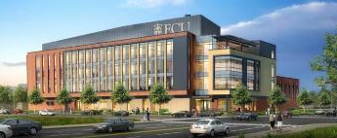

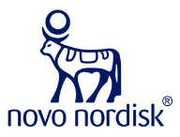





Life Science & Biotechnology – Golden LEAF
Eastern Region Pharma Center

Slide 11
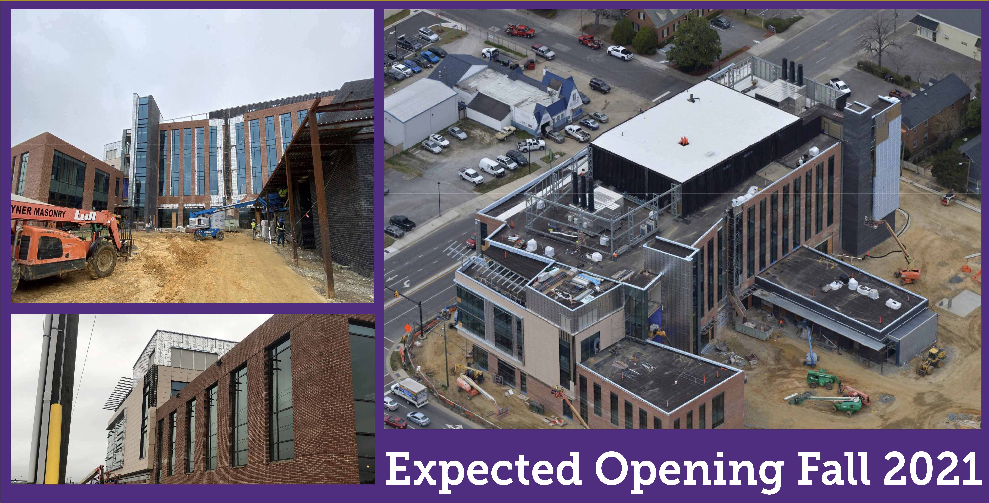
Life Science & Biotechnology – Status Update

Slide 12
Thermo Fisher Scientific

Slide 13
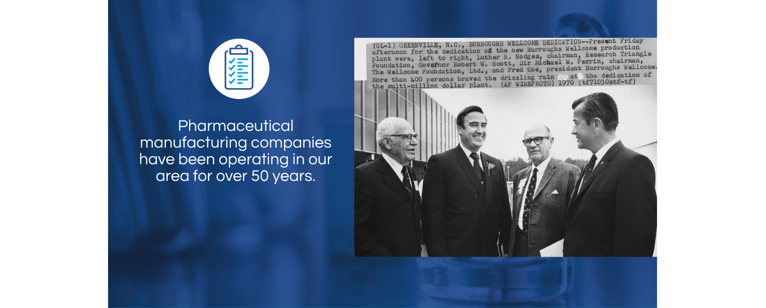
Our History
1970 – 1995
1995 – 1997
1997 – 2000
2000 – 2014
2014 – 2017
Current
Burroughs Wellcome
Glaxo Wellcome
Catalytica
DSM
Patheon
Thermo Fisher Scientific

Slide 14
Our Future
Roughly $500M investment into expansion of capacity and new technologies at the Greenville Facility
Over 500 jobs to be created over the coming years to support expansion across all experience levels

