Slide 1
Outstanding Paper
ECU Postdoctoral Scholar Research Award
2020

Slide 2
Description & Criteria
Funded by the Office of Postdoctoral Affairs and focuses on a research publication accepted for publication or published by an ECU postdoctoral scholar within the past 3 years.
Must be based on work conducted at ECU and may include brief reports, full length research articles, methods papers and review articles.
Only one submission will be considered from each postdoctoral scholar.
Papers from former postdoctoral scholars who have left ECU within the past 2 years will be considered, provided the work was completed at ECU when they were a scholar.
First or shared first author submissions will be held in higher consideration.

Slide 3
Outstanding Postdoctoral Scholar Paper
Two submissions
Factors considered:
Innovation
Methods/Approach
Analysis/Interpretation of Findings
Postdoc Level of Contribution
Impact/Significance
Three faculty reviewers:
Harriot College of Arts and Sciences
Department of Biology
Department of Chemistry
Brody School of Medicine
Department of Microbiology & Immunology

Slide 4
Morgan Milton, PhD
Mentor: John Cavanagh, PhD
Department: Biochemistry
Publication:
“The Solution Structures and Interaction of SinR and SinI: Elucidating the Mechanism of Action of the Master Regulator Switch for Biofilm Formation in Bacillus subtilis”
Milton ME, Draughn GL, Bobay BG, Stowe, SD, Olson AL, Feldmann EA, Thomspon RJ, Myers KH, Santoro MT, Kearns DB, Cavanagh J.
J Molecular Biology (2020) 432:343 (available online 05 September 2019)

Slide 5
Highlights of Reviewer Comments:
“The multifaceted, integrative approach towards solving an important problem in structural biology with both biophysical and computational methodology was compelling.”
“The study…describes a very targeted, mechanistic approach. Its innovativeness lies in application of targeted biochemical and structural approaches, thereby directly addressing proposed interaction models and filling in several knowledge gaps.”
“The paper and significance statement drive home the importance of biofilms to bacterial/pathogen propagation/resistance. The DNA-binding experiments showing the SinR DNA-bending model and revealing potential therapeutic targets will likely lead to direct applications soon.”

Slide 6
Benjamin Hale, PhD
Mentor: Chris Geyer, PhD
Department: Anatomy & Cell Biology, ECDOI
Publication:
“Acyl-CoA synthetase 6 enriches seminiferous tubules with the ω-3 fatty acid docosahexaenoic acid and is required for male fertility in the mouse”
Hale BJ, Fernandez, RF, Kim SQ, Diaz VD, Jackson SN, Liu L, Brenna JT, Hermann BP, Geyer CG, and Ellis JM.
J Biological Chemistry (2019) 294: 14394 (published online August 9, 2019)

Slide 7
Highlights of Reviewer Comments:
“The Hale manuscript used a diverse set of approaches including cell biology, biochemistry, and genetics.
“The well-established immunostaining and smFISH methods were well carried out with clear tissue differences in development and localization. Similarly, the lipidomics experiments gave clear compositional shifts with the MS imaging supporting different spatial distributions.”
“This paper is significant by further establishing a critical developmental role of Acsl6 in making functional sperm.”
“The overall presentation, contextualization, and striking figures present in the Hale paper were a winning combination for this judge.”
“Fully based on work conducted at ECU”

Slide 8
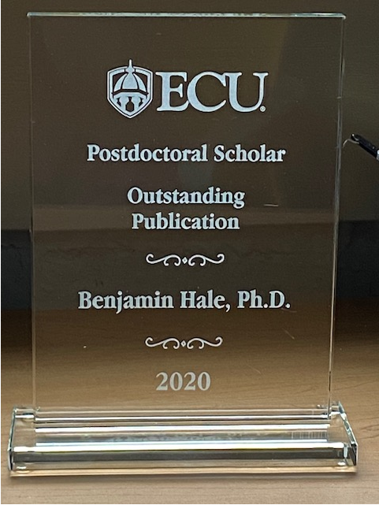
Outstanding Paper
Postdoctoral Scholar Research Award Winner
Benjamin Hale, PhD
“Acyl-CoA synthetase 6 enriches seminiferous tubules with the ω-3 fatty acid docosahexaenoic acid and is required for male fertility in the mouse”
J Biological Chemistry (2019) 294: 14394

