Slide 1
Genomics Core Lab Department of Pathology Brody School of Medicine East Carolina University

Slide 2
Our Goals:
Education
Research
Service
To serve the ECU community with the cutting-edge NGS technologies, genomics and bioinformatics.
Genomics

Slide 3
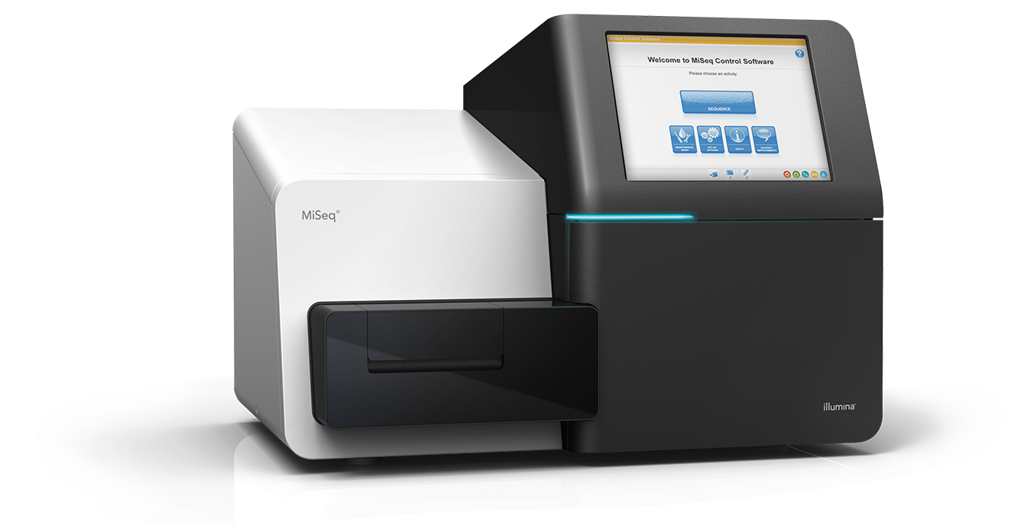
Our Sequencers:
MiSeq (Illumina)
15 - 25 M short-reads
per sequencing run

Slide 4
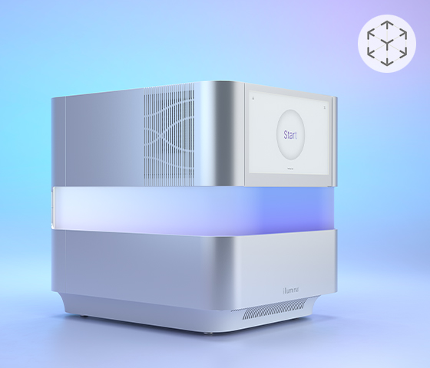
Our Sequencers:
MiSeq (Illumina)
NextSeq 2000 (Illumina)
400 - 1000 M short-reads
per sequencing run

Slide 5
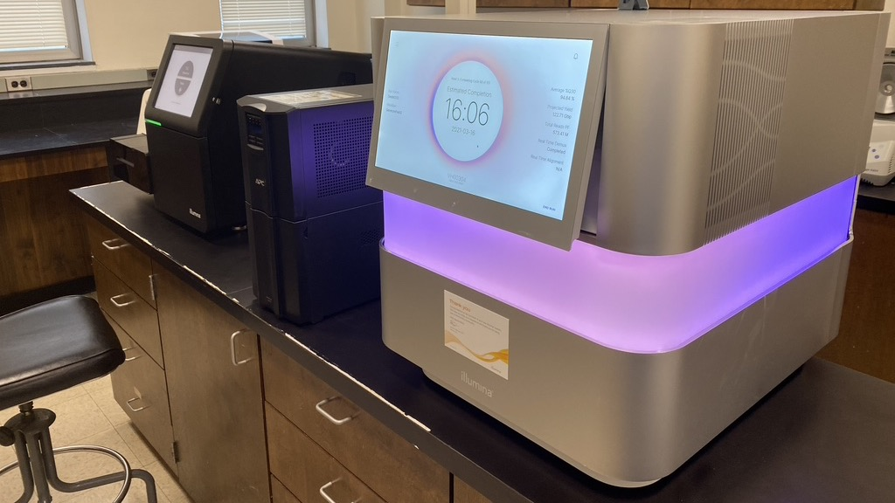

Slide 6
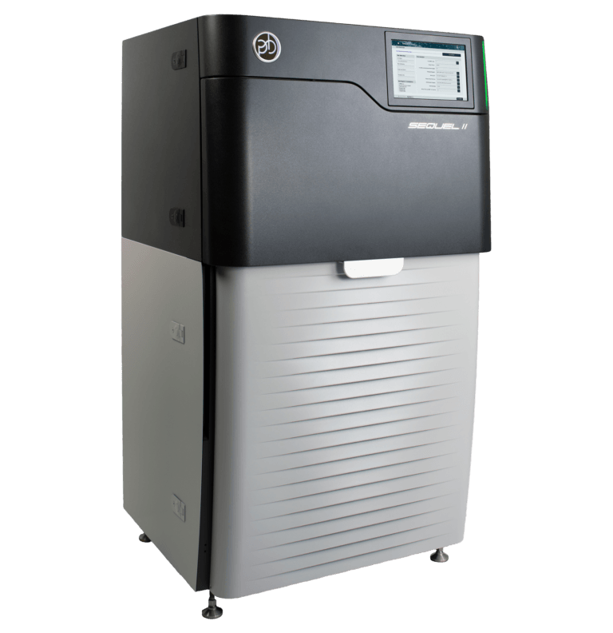
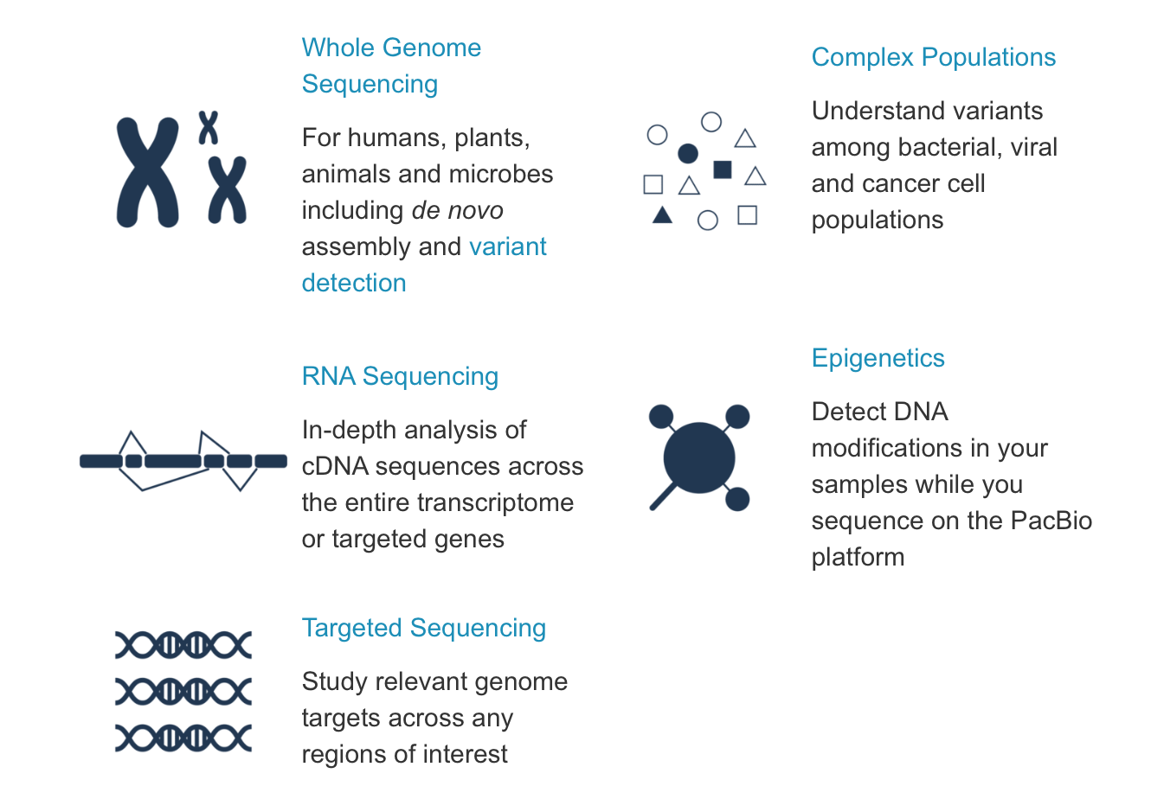
Our Sequencers:
MiSeq (Illumina)
NextSeq 2000 (Illumina)
Sequel IIe (Pacific Biosciences)

Slide 7
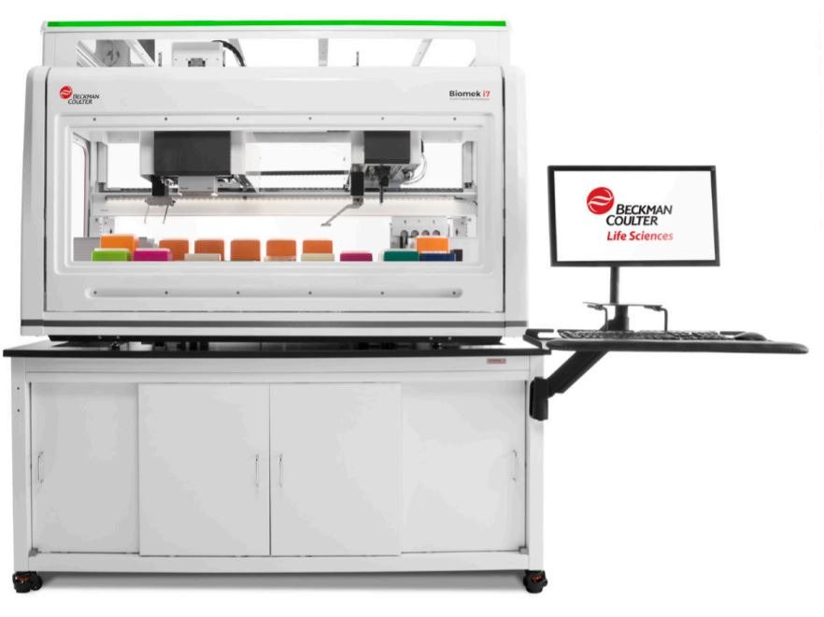
Our Liquid Handling Automations:
Biomek i7
(Beckman Coulter)
high-throughput with 96-channel head and span-8

Slide 8
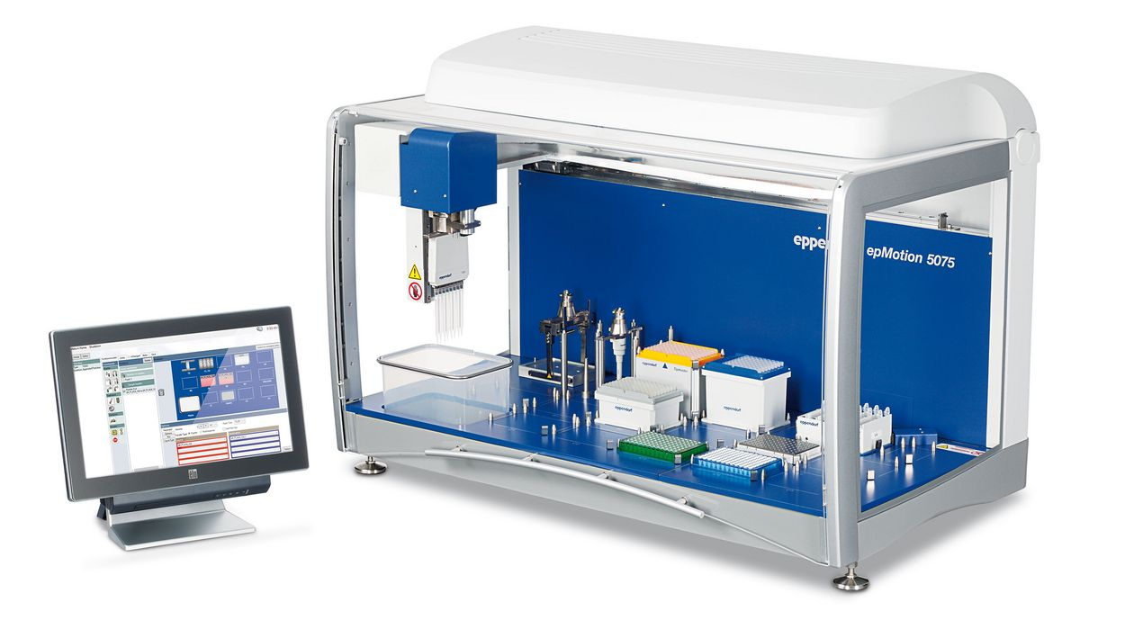
Our Liquid Handling Automations:
Biomek i7
(Beckman Coulter)
epMotion 5075
(Eppendorf)
flexible & integrated

Slide 9
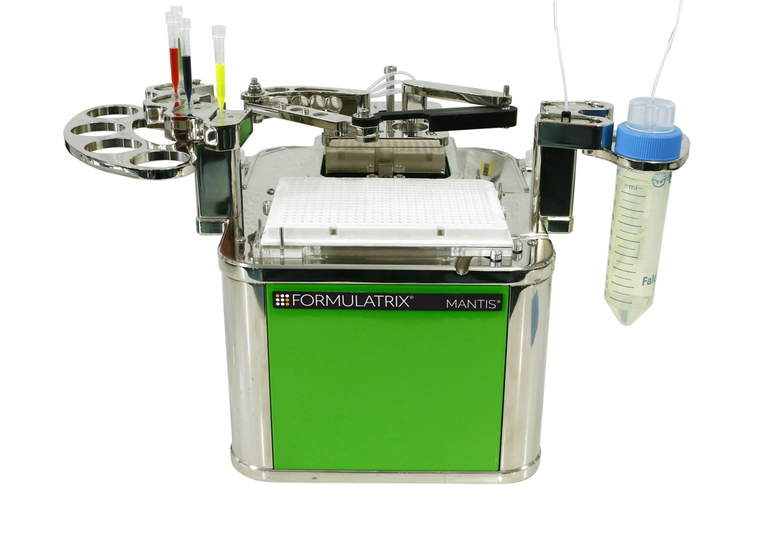
Our Liquid Handling Automations:
Biomek i7
(Beckmen Coulter)
epMotion 5075
(Eppendorf)
Mantis (Formulatrix) microfluidic liquid dispenser

Slide 10
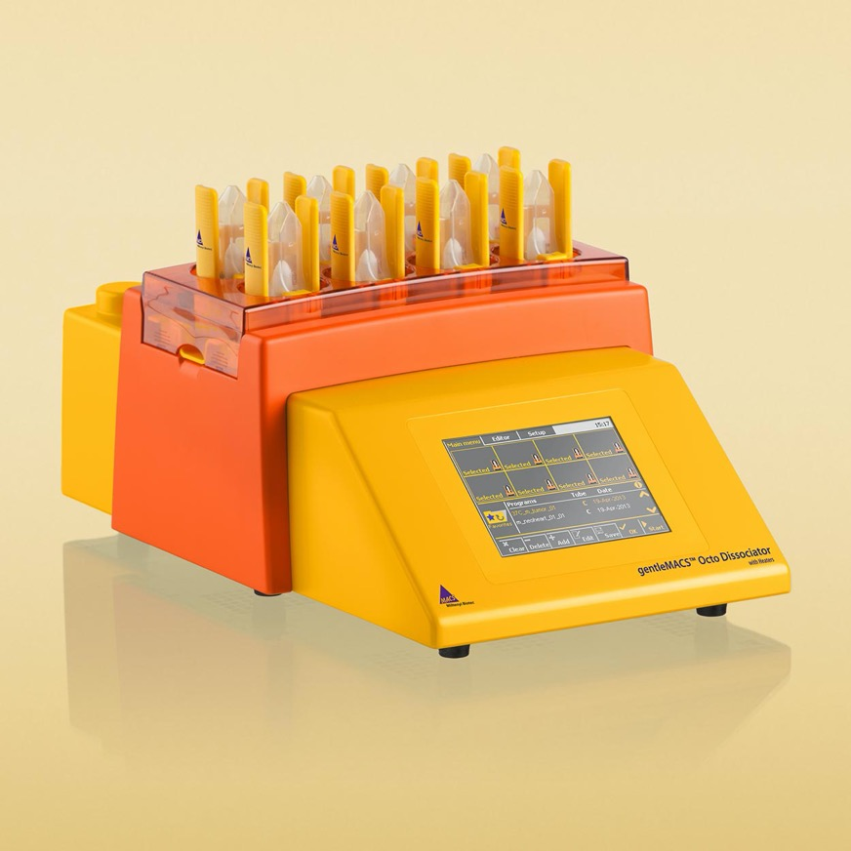
Our Single-Cell Analysis:
gentleMACS Octo Dissociator with heaters (Miltenyi Biotec)
semi-automated and standardized tissue dissociation and single-cell separation

Slide 11
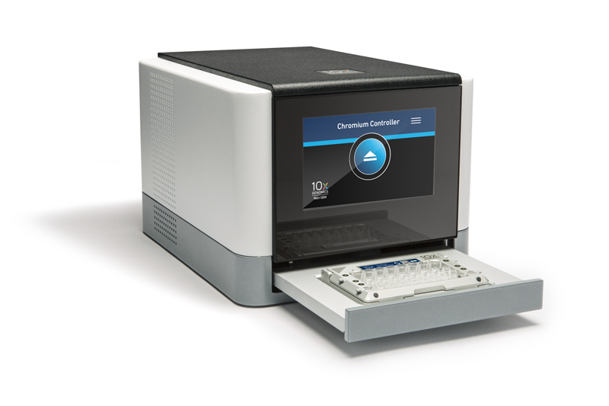
Our Single-Cell Analysis:
gentleMACS Octo Dissociator with heaters (Miltenyi Biotec)
Chromium Controller (10x Genomics)
single-cell RNA sequencing (scRNAseq)
single-cell epigenomic profiling (ATAC-seq)
single-cell immune profiling – V(D)J sequencing

Slide 12
Core Services including Bioinformatics:
Whole Genome Sequencing (WGS)
Whole Exome Sequencing (WES)
Whole Transcriptome Sequencing (RNAseq)
Gene Panel Target Sequencing
Small RNA (microRNA) Sequencing
Metagenomic Sequencing (16S or shotgun, DNA or RNA)
Single-Cell RNA Sequencing (scRNAseq)
Single-Cell Multi-omics Sequencing (ATAC-seq & scRNAseq)

Slide 13
Our Current COVID-19 Surveillance testing:
Waster water surveillance: > 10 ECU dorms; 3 times/week
Saliva surveillance testing: > 500 ECU students/week
Surveillance on SARS-CoV-2 variants: ~100 genomes (mainly, clinical swab specimens)

Slide 14
Waster water SARS-CoV-2 copies/sample
Dorm
Date

Slide 15
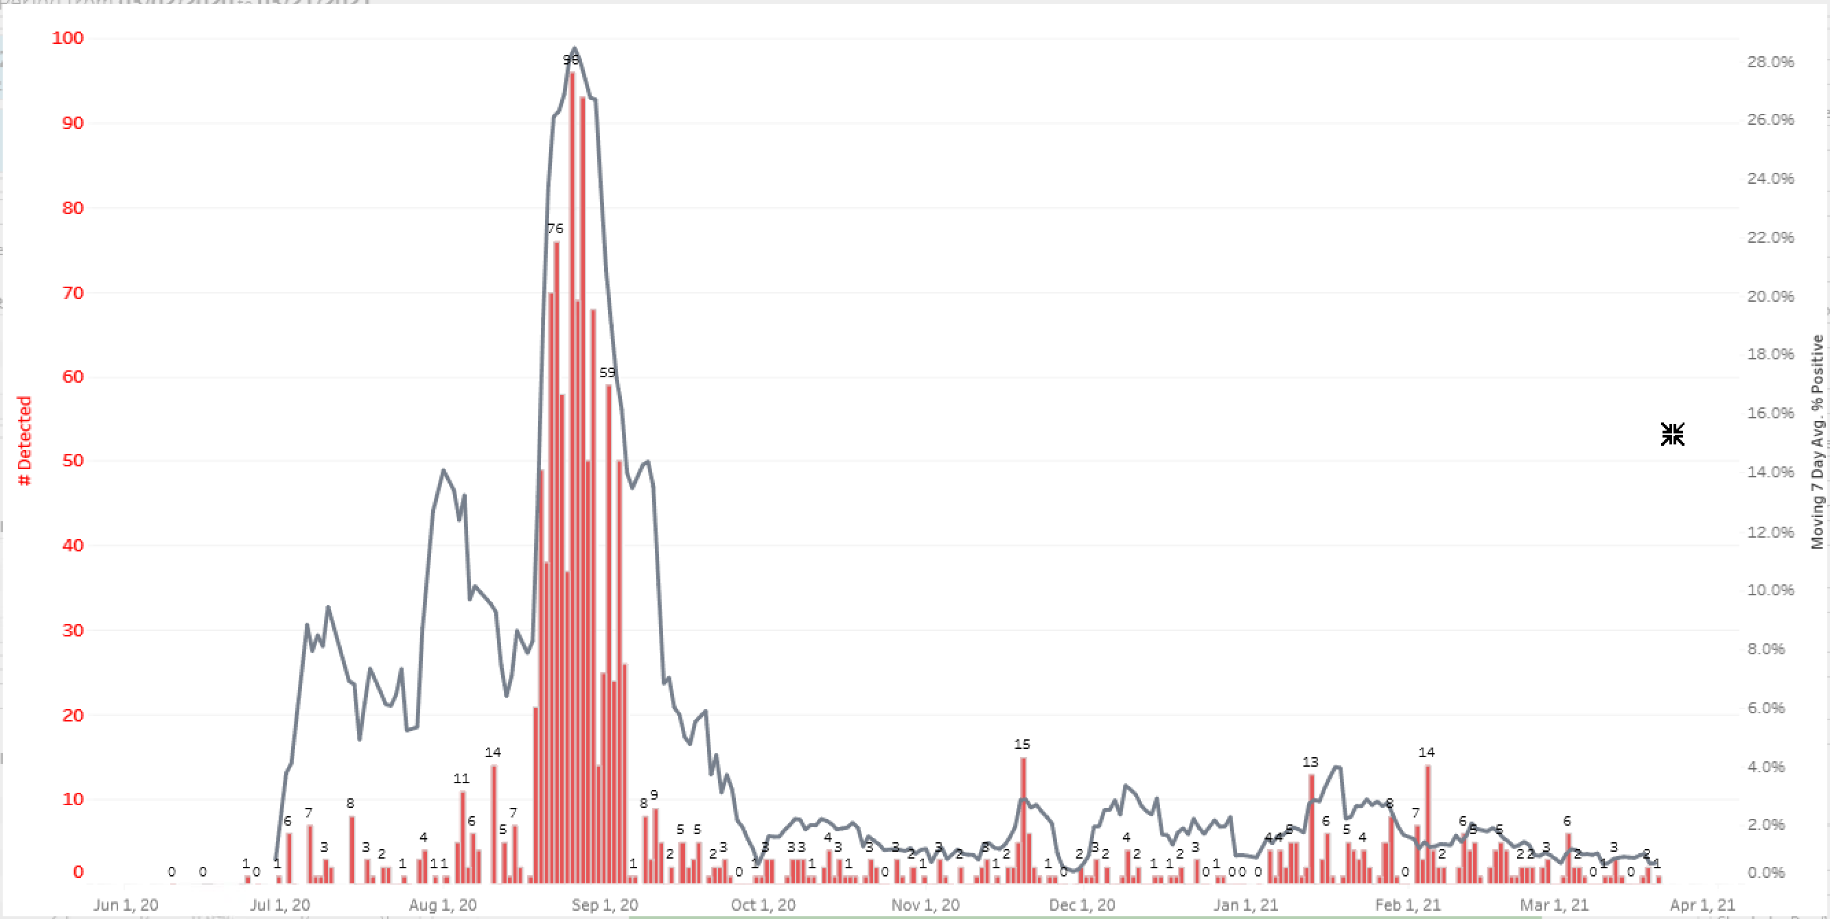
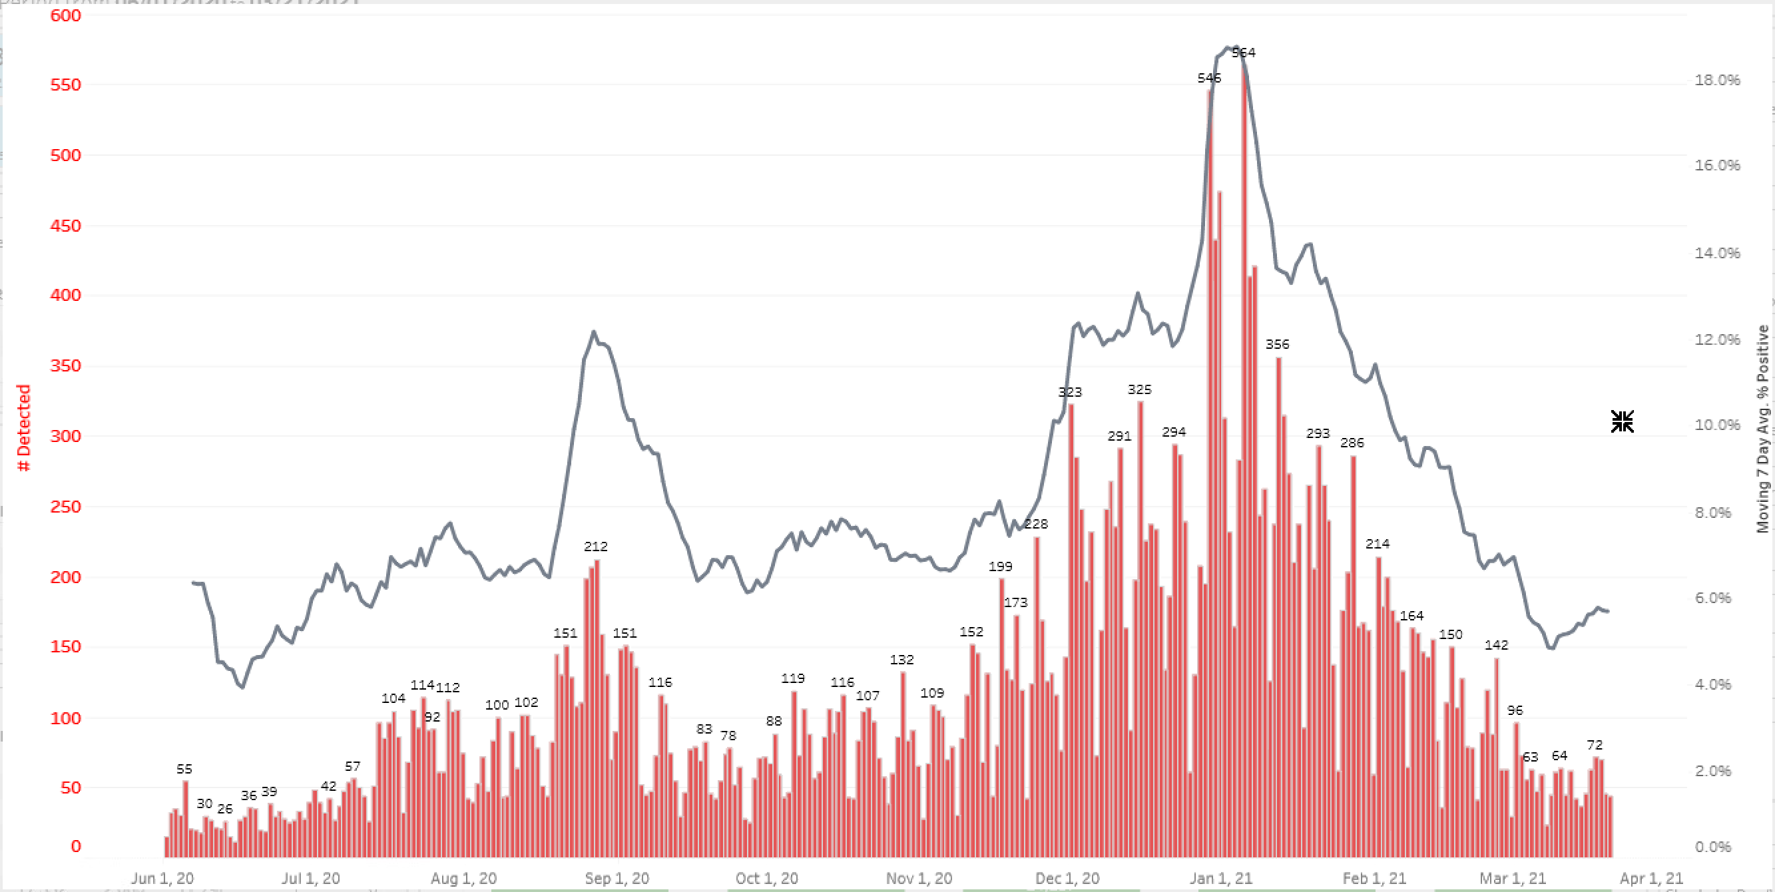
#PCR Positive SARS-CoV-2 NP swabs per day
ENC 371K
ECU SHS 26K
Black line is 7day percent positive rate

Slide 16
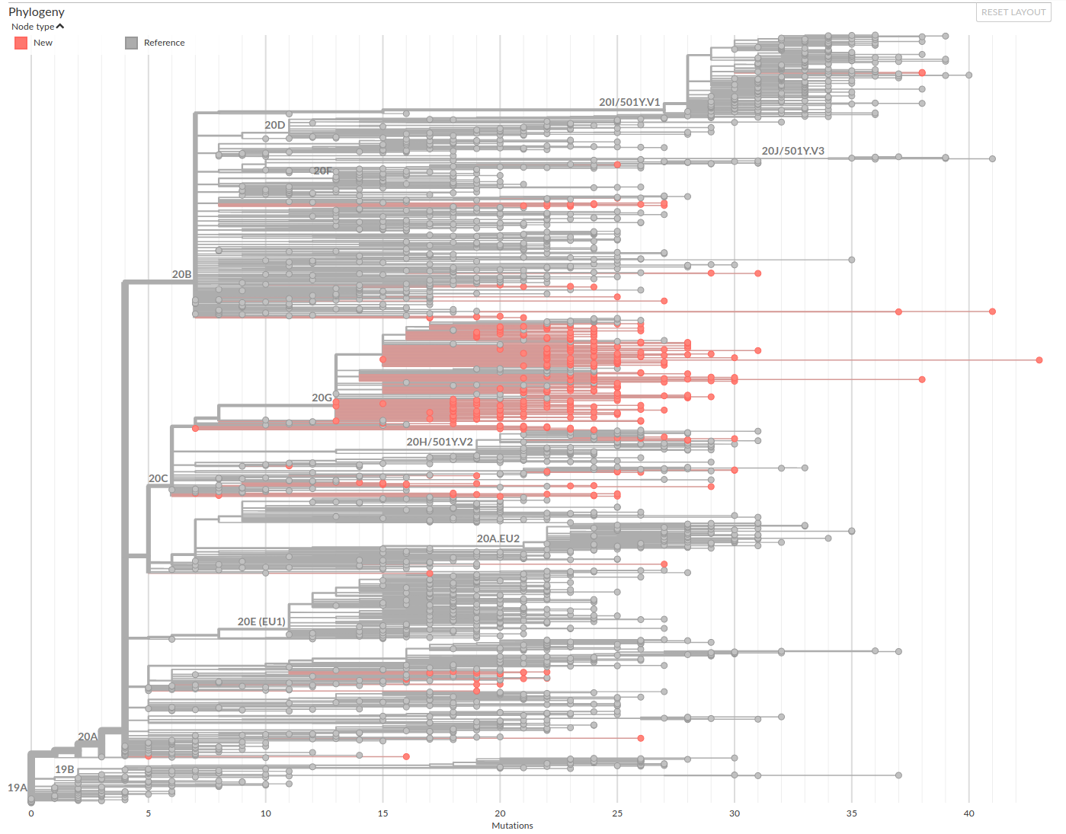
ENC SARS-CoV-2 Sequencing N=12/388 (3%) 422/3314 (13%)
UK
B.1.1.7
n=3
Brazil
B.1.1.28
N=0
South Africa B.1.351
n=9
Feb 2021

Slide 17
We will provide the best Genomic service possible to all of ECU.
Due to high complexity of NGS technologies, methodologies, and bioinformatics analyses, consultation is highly recommended before starting your projects.
For methodology incorporation and protocol optimization to meet your research requirements and demands, collaboration is highly encouraged.

Slide 18
Genomics Core Lab Department of Pathology Brody 7S Brody School of Medicine East Carolina University
Contact Info:
John T. Fallon, MD, PhD fallonj19@ecu.edu
Weihua Huang, PhD huangw20@ecu.edu
Changhong Yin, MD, PhD yinc20@ecu.edu
Kim Briley, MS brileyki@ecu.edu

