Slide 1
Health Behavior Research Cluster
End-of-Year Meeting
May 8, 2019

Slide 2
Cluster Research Priority Areas
Year 1
Pregnancy and infant health
Adolescent risk reduction
Year 2
Opioid epidemic
Year 3
Cardiovascular risk reduction and disease management
Rural occupational health and well being

Slide 3
Pan-Cluster Opioid Initiative
REDE
Opioid Epidemic Initiative
Natural Resources & Environment
Precision Health
Health Behavior Research

Slide 4
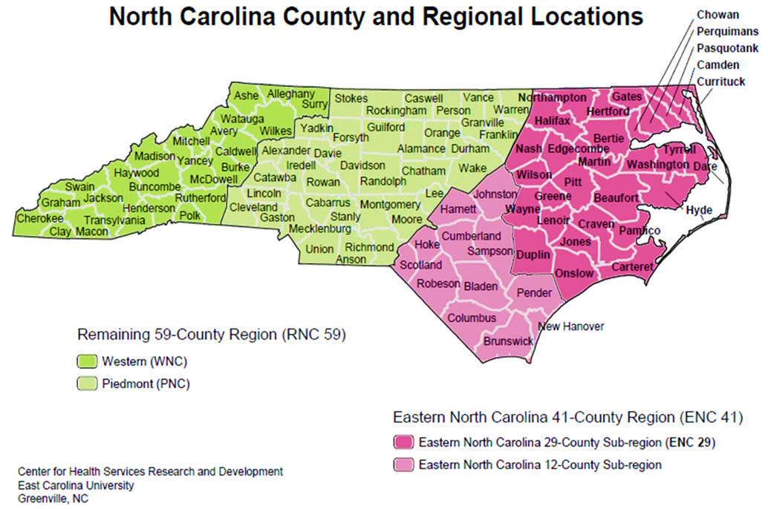




North Carolina Opioid Crisis
Notes:
Beaufort - Bonnie
Bertie – Silas
Brunswick - Tajanae
Carteret
Craven
Dare - KJ
Duplin - Ciandra
Gates
Greene - Lauren
Camden
Chowan
Craven
Cumberland - Kiera
Currituck -
Edgecomb
Halifax -Kianda
Hertford - Taylor
Hyde - Zach
Jones – Christopher/Brian
Lenoir
Martin - Alexis
Nash
New Hanover - Brittany
Northhampton
Onslow
Pamlico - Eriona
Pasquotank
Perquimans
Pitt
Tyrrell - LC
Washington - Abigail
Wayne - Jeremiah

Slide 5
Project Lazarus Intervention Model
https://www.projectlazarus.org/
Notes:
Established in 2007 in Wilkes County
A response to extremely high overdose mortality rates in Wilkes County, NC
Project Lazarus successfully and dramatically decreased Wilkes’ overdose mortality rate by devising and implementing what is now known as the Project Lazarus Model.
The Project Lazarus Model is a public health model based on the twin premises that overdose deaths are preventable and that all communities are responsible for their own health.
Reported a 50% decrease in opioid overdose deaths between 2009-2014
Provider education & ER visits combined reduced deaths by 12%.

Slide 6
Cluster Participation
HB Interest Group
Comprised of all individuals on the HB cluster email list who have expressed an interest in the cluster mission through attending general meetings or responding to surveys.
Working Groups
Comprised of faculty from various disciplines who have organized themselves into smaller groups to explore ways to combine complementary expertise to address one of the cluster research foci.
Action Teams
Comprised of cluster members who have formed a research team with a clearly articulated program of research that is linked to federal and foundation funding priorities.
This group will receive targeted communication and invitations to meetings convened to discuss research directions.
Faculty who join a working group will be considered HB cluster members, if they choose to identify as such.
Action teams may request seed funding as part of a competitive process based on research productivity and potential.

Slide 7
Health Behavior Research Survey Results
157 Respondents
50+ disciplines represented
Survey identified:
  Research Areas
  Age Groups
  Special Populations
  ENC 29 Counties and other ENC & RNC counties
Dashboard Tool will go live in late April

Slide 8
Next Steps
HBR Dashboard – Late May
Opioid Research Capacity Assessment – June
RFP Announcement – July 1

