Slide 1
Pregnancy and Infant Research Collaborative (PIRC)
Co-Directors: Devon Kuehn and Linda May
May 08, 2019
Notes:
DK

Slide 2
Outline
Mission
Individual Projects
Upcoming Manuscripts
Mission Alignment
Questions

Slide 3
Mission
To develop, promote, facilitate, and support interdisciplinary, basic, and clinical research conducted on pregnant women and infants in a standardized approach in order to promote wellness, transform health care, and improve the quality of life of women and future generations.
Notes:
Established June 2017
DK

Slide 4
Team: June 2017
Chemists
Public Health
Microbiologist
Engineering
Students: Grad, Dental, UG
External collaborators
Clinicians
Exercise Physiologists
Nutritionists
Physical therapists
Psychologists
Dentists
Notes:
Group of ~20 faculty
Clinicians: Peds, Neonatology Peds Cardio, Peds Radiology, OB/Gyn, Dentists
Students: dental, medical, doctoral, masters, undergraduate (Exer Science, Public Health, have had PT students help previously, engineering)
DK

Slide 5
Projects
Enhanced Neonatal Health And Neonatal Cardiac Effect (ENHANCED by Mom)
Child Health After Maternal Physical activity (CHAMP)
Pregnancy Exposure and Infant Outcomes
Illicit drugs
Pregnancy-Offspring-Dentistry (POD)
Prenatal Oral Health Program (pOHP)
Postpartum Depression
Offspring Cognition
Mindfulness
Notes:
Standardized measures for pregnant women: nutrition, exercise habits
Standardized measures: Placenta, blood collection, questionnaires (PA, nutrition), HR/HRV, body composition, neuromotor, cognition,
LM does POD, pOHP, ENHANCED, CHAMP
DK- depression & nutrients
LM- cognition

Slide 6
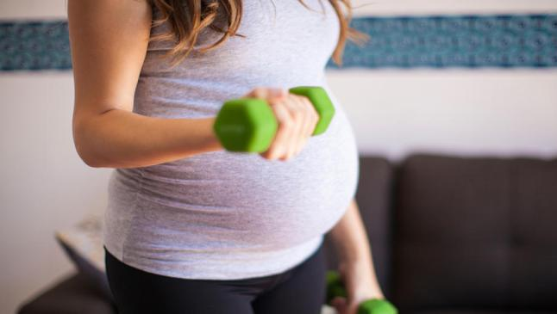
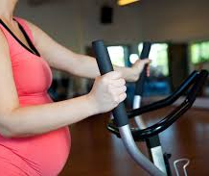
ENHANCED by Mom
Goal: Determine the influence of different types of exercise on offspring health outcomes
Publications:
2018-2019: 3 accepted (so far);
Upcoming manuscript submissions list (coming soon)
Conference Presentations: 3 ACSM, 1 Physical Therapy, 2 MFM, 1 Bioengineering, 1 Peds, 1 Anal.Chem
Current Grant Funding:
AHA Innovative Program Award (AHA- IPA)
AAUW Fellowship grant
Grants Under Review:
NIH F31 – Resubmission (high score 1st submission)
NIH – LRP-PR
Upcoming Grants Applications:
NIH F32- Resubmitting - April 8, 2019
American Diabetes Association Postdoctoral Fellowship – July 15th, 2019
American Heart Association Postdoctoral Fellowship – August 15th, 2019
NIH - R01 – October 8, 2019
Notes:
Grants Submitted:
Funded: 1 external (AHA-GIA)
Unfunded: 4 external (ADA, AHA Collaborative, AHA Transformational, R15), 1 internal (Vidant)

Slide 7
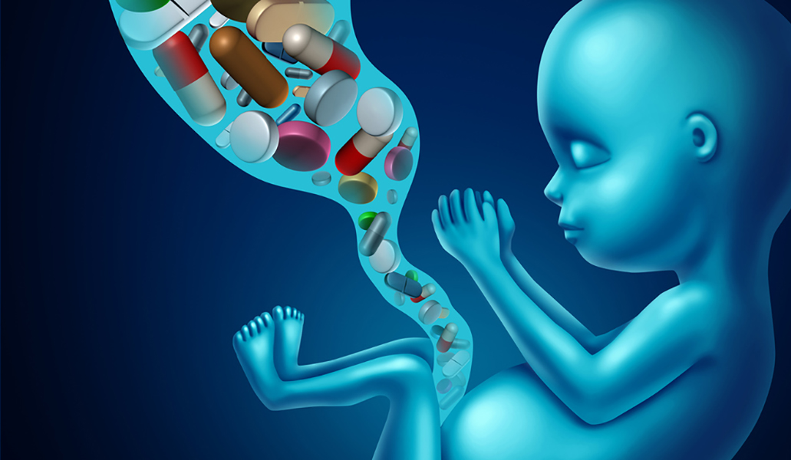
Pregnancy Exposures and Infant Outcomes
Goal: Determine the influence of opioid exposure on offspring health outcomes
Publications:
2018-2019: 1 revising
Current Grant Funding:
Vidant CMN
Grants Under Review:
Gerber Foundation-resubmission
Grants Submitted:
Funded: 1 internal
Unfunded: 2 external
Notes:
Vidant – Children’s Miracle Network grant
Current Grant Funding:
N/A
Grants Under Review:
Gerber Foundation- Resubmitting in Feb
Grants Submitted:
Funded: N/A
Unfunded: 1 external (Gerber, APA), 2 internal (Vidant, Brody Brothers)

Slide 8
Pregnancy, Offspring, & Dentistry (POD)
Goal: determine relationship to maternal behaviors (activity, nutrition) during pregnancy and offspring oral/dental health
Publications:
2018-2019: 1 under review
Current Grant Funding:
ECU-UNC collaboration with pOHP
Grants Under Review: NA
Grants Submitted:
NCAPD- unfunded

Slide 9
Postpartum Depression and Nutrients
Goal: to determine the association between key nutrients (B-vitamins and omega-3 fatty acids) on level of postpartum depression and infant health
IRB Approved Feb 2019
Publications: NA
Current Grant Funding:
ECU Faculty Senate Grant:
Grants Under Review:
Allen Grant
Grants Submitted:
NA

Slide 10
Offspring Cognition
Goal: determine relationship to maternal behaviors (activity, reading) during or after pregnancy and offspring cognition
Publications:
2018-2019: upcoming (Summer 2019)
Current Grant Funding:
NA
Grants Under Review:
NA
Grants Submitted:
NA

Slide 11
Mindfulness during Pregnancy
Goal: determine the influence of mindfulness training during pregnancy on maternal stress & health outcomes
Publications:
2018-2019: IRB approved May 2019
Current Grant Funding:
NA
Grants Under Review:
NA
Grants Submitted:
NIH- NIMH- R21- January 2020

Slide 12
Upcoming Manuscripts-Summer 2019
Effects of Prenatal Exercise on Fetal Morphometrics (lead PI: May)
submit to Early Human Development by May 25
Method development and validation for drugs of abuse in umbilical cords- (lead PI: Kuehn)
submit to Analytical Chemistry by May 25
Influence of Physical Activity During Pregnancy and Child Oral Health (lead PI: Kordis)
submit to American Journal of Public health by May 25
Effects of Prenatal Aerobic Exercise on Fetal Right and Left-side Cardiac Function and Flow – (lead PI: May)
submit to AJOG by June 1
Influence of Exercise types on Primary Cesarean Section Rates (Mouro)
submit to PLoS One by June 1
Effects of Prenatal Aerobic Exercise on One-Month Neonatal Body Composition (May)
submit to JAMA Pediatrics by June 15
Effects of Prenatal Aerobic Exercise on Maternal Metabolic Health in Late Pregnancy (McDonald)
submit to MSSE by June 15
Effects of Prenatal Aerobic Exercise on One-Month Neonatal Heart Function– (May)
submit to Sports Medicine by July 1
Exercise during pregnancy and preschooler cognition (Curtindale)
submit to AJOG by July 15
Risk Factors for Prenatal and Postpartum Depression (Dolbier)
submit to Archives of Women’s Mental Health by July 15
Metabolomics analysis of the impact of aerobic exercise during pregnancy on maternal and Umbilical cord nutrients (May/Kew)
submit to Exercise and Sports Science Reviews by July 31

Slide 13
Upcoming Manuscripts-Fall 2019
The Effects of Prenatal Exercise on the Racial/Ethnic Disparities in Pregnancy Outcomes (Raper)
submit to Obstet Gynecol by August 1
Method development for metabolomics analysis of serum and plasma- from Denise's SBRP work (Kew/Strom)
Submit to Scientific Reports by August 1
Metabolomic Profiling of Downstream Nutritional Effects from Methadone Exposure in Utero Using Umbilical Cords​ (Kuehn/Kew)
submit to Journal of American Academy of Pediatrics by August 14
Influence of Aerobic Exercise During Pregnancy on Infant Neuromotor Skills at 6 Months of Age: Follow-up Study (Gross McMillan)
submit to Pediatrics By August 15
Metabolomics analysis of the impact of aerobic exercise during pregnancy on infant nutrients (Kew/May)
submit to BMC Pregnancy and Childbirth by August 31
Method development and validation for DHA and EPA in blood vs. plasma - for quantifying DHA and EPA (Strom)
submit to The American Journal of Clinical Nutrition by: September 15
Maternal vitamin B12, folate, and choline pathway analysis and exercise impacts on infant heart rate variability (Pawlak)
submit to The American Journal of Clinical Nutrition by: September 28
The Association Between Maternal Physical Activity Throughout Pregnancy on Maternal Glucose Tolerance (McDonald/May/Zhang)
submit to Diabetes Care by: October 6
The Association Between Maternal Aerobic Exercise and maternal DHA levels on Offspring Body Composition (Stout-Davies)
submit to International Journal of Obesity by: October 15
Maternal Aerobic Exercise Influence on Maternal Blood Pressure and Pregnancy Outcomes (Murphy)
submit to PLoS Medicine by: October 30
Determining the Influence of Maternal Exercise Before and During Pregnancy on Infant Heart Rate Variability (Roldan/Morales)
submit to Early Human Development by: October 30

Slide 14
Mission Alignment
Discovers new knowledge and innovations to support a thriving future for eastern North Carolina and beyond;
Improved detection of opioid exposed infants
Application of metabolomics to optimize infant outcomes based on maternal exposures (+,-)
Transforms health care, promotes wellness, and reduces health disparities;
working towards changes to impact clinical guidelines during pregnancy (dentistry, PA, nutrition, mental well being)
Directly promoting wellness (Collectively, we have interacted with 659 women and their children)

Slide 15
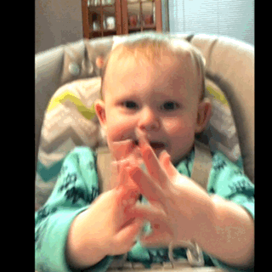
Questions? Thank you!

